Slide 1
Chapter 2
Measurements and Calculations

Slide 2
Section 1
The Scientific Method

Slide 3
The Scientific Method
What is it?? A logical approach to solving problems.
5 Major Parts:
Observing and Collecting Data
Formulating a Hypothesis
Testing the Hypothesis
Formulating Theories Supported by Data
Publish Results
Scientific Method Song

Slide 4
Observing and Collecting Data
Observing—using the sense to obtain information. Sight, Smell, Touch, Taste, Hear.
Collecting Data—Two different ways
Quantitatively—numerical. Example: Mass (30 grams)
Qualitatively—descriptive, non-numerical. Example: A reaction mixture changes from red to blue.
Experimentation—carrying out a procedure under controlled conditions to collect data and make observations.

Slide 5
Formulating a Hypothesis
Examine and compare data from experiments.
Find patterns and relationships in the data.
Use generalizations about the data to form a hypothesis, an educated guess.
Hypothesis is used as a prediction for further experiments.

Slide 6
Testing the Hypothesis
Further experimentation
Controls—experimental conditions that remain constant
Variable—experimental conditions that change, or vary.
Independent Variable - The variable you change to see how it will affect the dependent variable.
Dependent variable – The variable that changes according to the changes in the other variable.
Data from experiments either supports or refutes hypothesis
Support—Hypothesis and data is combined to formulate a theory.
Refute—Hypothesis is modified or discarded.

Slide 7
Formulating a Theory
Form an explanation for the question WHY?
Scientists use models—an explanation of how phenomena occur and how data and events are related.
Enough data to support the WHY claim can upgrade a model to a theory.
Theory—a broad generalization that explains a body of facts.
Considered successful if it can predict results of many new experiments.

Slide 8
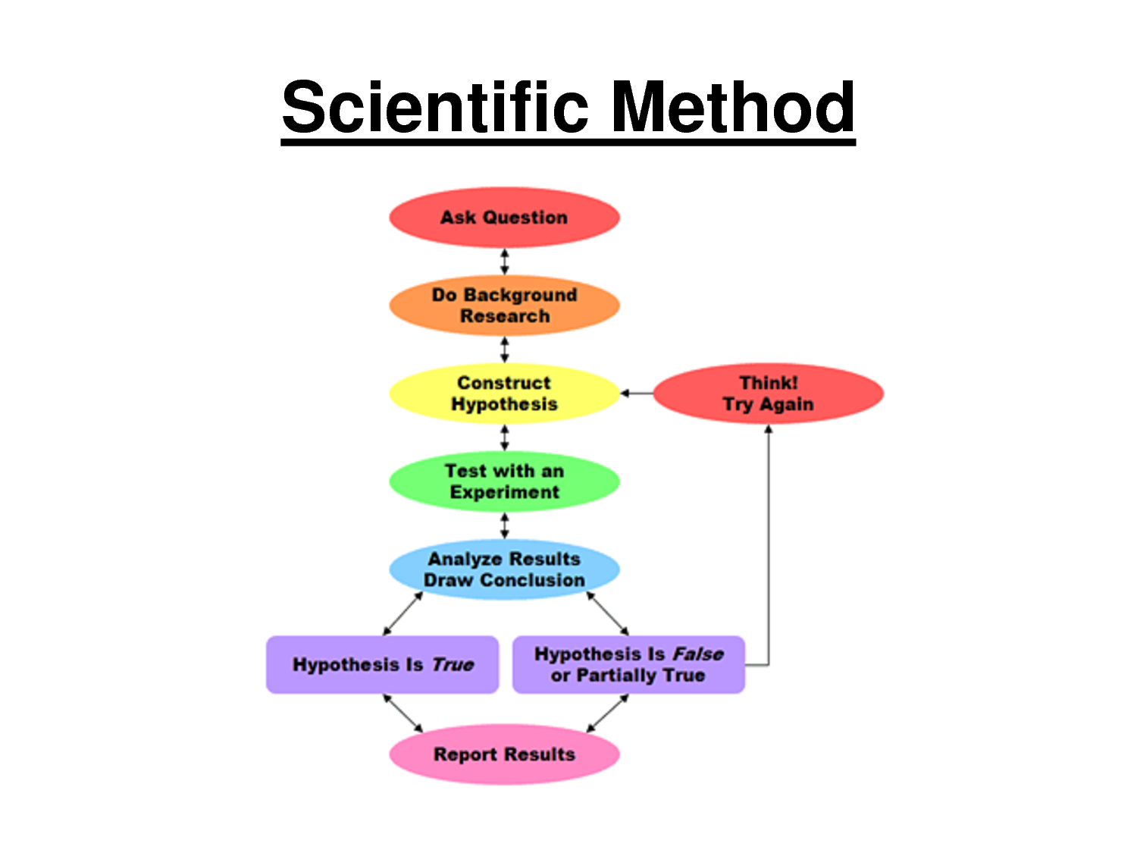

Slide 9
Activity
Step 1 – For your experiment, read the problem and state your hypothesis
Step 2 –design an experiment
Step 3 –based on the designed experiment, identify:
Constants
Independent Variable
Dependent Variable
Control

Slide 10
Section 2
SI Measurements

Slide 11
Scientific notation
Scientific notation is a way to write very large or very small numbers
Only one nonzero number can appear to the left of the decimal
If you move the decimal to the left, the exponent is positive
If you move the decimal to the right, the exponent is negative.
Negative exponents represent the inverse of a number.
Ex—10⁻³ = 1/1000 = 0.001

Slide 12
Scientific notation practice
Write the following numbers in scientific notation
560,000 ____________________
33,400 ____________________
0.0004120 ____________________
101.210 ____________________
0.301 ____________________
6,967,000 ____________________
32.1 ____________________
0.000000432 ____________________

Slide 13
Multiplying and Dividing
When multiplying numbers in scientific notation, multiply the numbers and add the exponents.
(2.15 × 10¹⁵)(5.134× 10³⁴) = ___________________
(1.234 × 10⁻⁴)(5.134× 10²) = ___________________
Dividing—Divide numbers first, then subtract exponents
3.12 × 10⁹ / 4.355 × 10³ = ___________________
9.10 × 10⁻⁷ / 5.014 × 10² = ___________________

Slide 14
Addition and Subtraction
To add or subtract, move decimal places to that exponents are the same and then carry out the operation.
7.142 × 10⁵ + 4.12× 10³ = ___________________
1.024 × 10⁻¹ – 3.12× 10⁻³ = ___________________

Slide 15
SI measurement
A measurement must include a value and a unit.
Example: 54.3 grams (g)
Benefits:
Everything goes by 10’s.
Standard naming
Calculations and conversions are easier to perform.

Slide 16
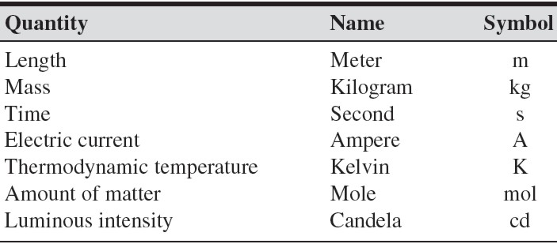
SI Base Units

Slide 17
Significant Figures (Sig Figs)
What are they?
The minimum number of digits required to report a value without loss of accuracy.
Why are they useful?
They tell us how good the data are that we are using.
For example: If a scientist reports the mass of a compound, which is more accurate?
100 g
100.3 g
100.3574 g?

Slide 18
Significant Figures (Sig Figs)
Rule | Example
1.) Zeros appearing between non-zero digits are significant. | 40.7 has three sig figs. 56,007 has five sig figs.
2.) Zeros appearing in front of all nonzero digits are not significant. | 0.023154 has five sig figs. 0.00002 has one sig fig.
3.) Zeros at the end of a number and to the right of the decimal place are significant. | 85.00 has four sig figs
4.) Zeros used as placeholders are not significant. | 2000 has one sig fig 34,000 has two sig figs
5.) A decimal point placed after zeros indicates that they are significant. | 2000. has four sig figs 35,000. has five sig figs
Notes:
Do examples on the board and then hand out a worksheet.

Slide 19
Significant figures examples
How many significant figures are in each of the following measurements?
28.6 g _________
3440. cm _________
910 m _________
0.04604 L _________
0.0067000 kg _________
Suppose the value “seven thousand centimeters” is reported, how would you express the number to . . .
1 significant figures _______________
4 significant figures _______________
6 significant figures _______________

Slide 20
Significant figures cntd.
Addition and subtraction – the answer must have the same number of digits to the right of the decimal as the number having the fewest number of digits to the right of the decimal
Look to the right of the decimal
Fewest number of decimal places wins.
Multiplication and division – the answer must have the same number of digits as the number having the fewest number of digits
Look at the entire number
Least number of digits wins

Slide 21
Examples
Carry out the following calculations. Express each answer to the correct number of significant figures.
5.44 mL – 2.6103 mL =
2.4 m x 15.82 m =
2.099 g + 0.05681 g =
87.3 cm – 1.655 cm =
Calculate the volume of a rectangular prism that measures 1.34 mm by 0.7488 mm by 16.894 mm.

Slide 22
Prefixes
Prefixes are used to identify quantities that are much higher or much lower than the base units
PREFIX | SYMBOL | MULTIPLYING FACTOR
Kilo- | K | 1,000
Hecto- | h | 100
Deca- | da | 10
BASE UNIT | BASE UNIT | BASE UNIT
Deci- | d | 0.1
Centi- | c | 0.01
Milli- | m | 0.001
Micro | µ | 0.000001
Nano | n | 0.000000001
Pico | p | 0.000000000001

Slide 23
Converting
We can use conversion factors in order to convert from one unit to another.
Conversion factor is defined as a ratio derived from the equality between two different units.
Example:
$\frac{4 quarters}{1 dollar}$ = 1 $\frac{1 dollar}{4 quarters}$ = 1
Use conversion factors to cancel units and arrive at the unit you want.
Ex. 5000 mg to g

Slide 24
Converting
Start with the GIVEN
Set your “conversion line up”
Write your units, so the units will cancel
Put a “1” with the largest unit
Put the equivalent conversion factor with the smaller unit
ALWAYS stop at the base unit!!!!!!
Multiply across the top and multiply the bottom

Slide 25
Practice
Complete the following conversions:
10.5 g = ______________ kg
1.57 pm = ______________ m
1.2 L = ______________dL
78.3 cJ = _______________ kJ
323 mJ = _______________ nJ

Slide 26
White board practice
Complete the following conversions:
890 L = ______________ mL
5.234 km = _______________ cm
48.9 hg = _______________ kg
0.0658 kg = _______________ mg

Slide 27
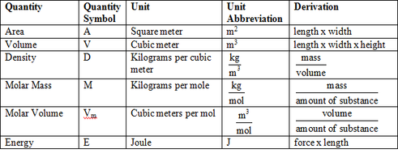
Derived SI Units

Slide 28
Volume (V) – amount of space occupied by an object
Two ways to measure the volume of solids:
1.) Regularly-shaped
Measure length, width, and height then multiply.
2.) Irregularly-shaped
Must measure using displacement of water.
Units of measurement for volume: m³, cm³, mL
1 mL = 1 cm³

Slide 29
Volume problems
50 mL of water was added to a 100 mL beaker. A rock was added and the water level rose to 55.5 mL. What is the volume of the rock?
Calculate the volume of a dresser having a length of 1.2 m, a height of 1.98 m, and a depth of 0.60 m.

Slide 30
Density
The measurement of the ratio of mass to volume of a substance.
$D=\frac{m}{V}$
For solids, g/cm³
For liquids, g/mL

Slide 31
Density problems
1. What is the density of an 84.7 g sample of an unknown substance if the sample occupies 49.6 cm³?
2. What volume would be occupied by 7.75 kg of this same substance?

Slide 32
Density white boarding
What is the density of a block of marble that occupies 310 cm³ and has a mass of 853 g?
Diamond has a density of 3.26 g/cm³. What is the mass of a diamond that has a volume of 0.351 cm³?
What is the volume of a sample of liquid mercury that has a mass of 76.2 g, given that the density of mercury is 13.6 g/mL?

Slide 33
Temperature
Temperature – the quantity of the energy of motion of the particles that make it up
Three scales °C, °F, K (no degrees sign for Kelvin)
Melting point for water: 0 °C, 32 °F, 273.15 K
Boiling point for water: 100 °C, 212 °F, 373.15 K
K = °C + 273.15

Slide 34
Dimensional Analysis
What is it?
A way to use units to solve mathematical problems involving measurements.
Quantity sought = quantity given × conversion factor
How many quarters are in 12 dollars?

Slide 35
Dimensional Analysis Problems
1.) How many nickels are in 56.32 dollars?
2.) How many seconds are in 3.23 years?
3.) How many centimeters are in 2.5 miles (1 mile = 1.61 km)?

Slide 36
More practice conversions
1 hr = 60 min | 1 min = 60 sec | 1 ton = 2000 lbs | 7 days = 1 week
24 hrs = 1 day | 1 kg = 2.2 lbs | 1 gal = 3.79 L | 264.2 gal = 1 cubic meter
1 mi = 5,280 ft | 1 kg = 1000 g | 1 lb = 16 oz | 20 drops = 1 mL
365 days = 1 yr | 52 weeks = 1 yr | 2.54 cm = 1 in | 1 L = 1000 mL
0.621 mi = 1.00 km | 1 yd = 36 inches | 1 cc is 1 cm³ | 1 mL = 1 cm³
Convert 5.93 cm³ to m³
How fast is 50 mph in km/sec?
Traveling at 65 miles/hour, how many feet can you travel in 22 minutes?

Slide 37
White boarding Practice
1 hr = 60 min | 1 min = 60 sec | 1 ton = 2000 lbs | 7 days = 1 week
24 hrs = 1 day | 1 kg = 2.2 lbs | 1 gal = 3.79 L | 264.2 gal = 1 cubic meter
1 mi = 5,280 ft | 1 kg = 1000 g | 1 lb = 16 oz | 20 drops = 1 mL
365 days = 1 yr | 52 weeks = 1 yr | 2.54 cm = 1 in | 1 L = 1000 mL
0.621 mi = 1.00 km | 1 yd = 36 inches | 1 cc is 1 cm³ | 1 mL = 1 cm³
1 mL of ink can print 50 pages of text. If you had 100 gallons of ink then how many pages could you print?
The moon is 384,403 km from the earth. Estimate how many quarters laid end to end it would take to reach the moon if a quarter has a diameter of 2.3 cm.
The distance from a Port Huron to the Indiana State line is approximately 271 miles (via I-94). Express this distance in kilometers.

Slide 38
Section 3
Using Scientific Measurements

Slide 39
Accuracy and Precision
Accuracy—how close a measurement is to the actual “accepted” value.
Precision—how close together a group of measurements are.

Slide 41
Percentage Error
Used to determine the accuracy of a measurement.
% error = $\frac{\text{Value}\text{experimental}\text{ – }\text{V}a\text{lue}\text{accepted}}{\text{V}a\text{lue}\text{accepted} }$ × 100
Example: A students measures the mass and volume of a substance and calculates its density to be 1.35 g/mL. The actual density of the substance is 1.30 g/mL. Calculate the percentage error of the student’s measurement.

Slide 42
Representing data
Direct Relationship – as one value increases, the other value increases; dividing one value by the other gives a constant value
Indirect relationship or inverse relationship – as one value increases, the other value decreases; the product of these two values is constant

Slide 43
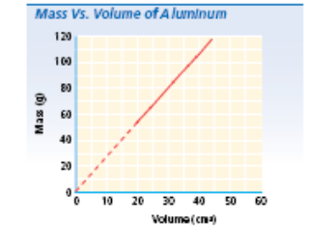
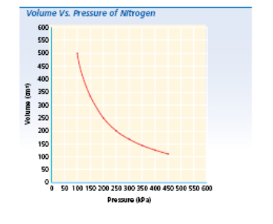
Direct Relationship
Indirect Relationship

