Slide 1
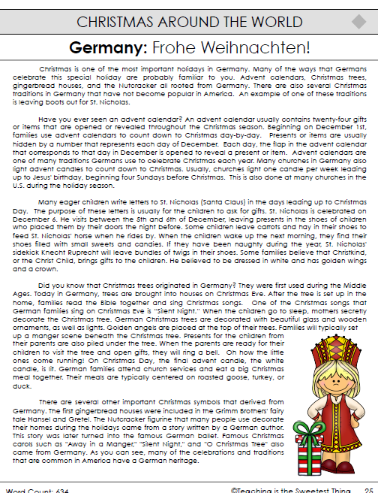
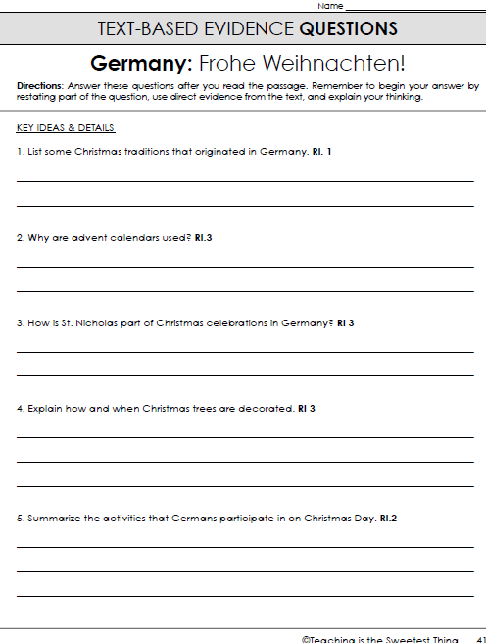
Wednesday, December 18, 2019
Wednesday: Classworks
M - Amiyah - 1
M – Elin - 2
M – Jearon – 3
M – Brena - 4
M – Jaylie – 5
M – Macon – 6
M – Paisleigh - 7
M – Erin - 8
PM (both) – Landon – 9
7:55 – 8:35

Slide 3

Christmas in
Germany

Slide 4
Guten tag! I’m Hans and I’ll be your guide as we travel through Germany today to learn about holiday celebrations! Let’s go!

Slide 5
In Germany, Christmas celebrations begin on December 6. This is the night when St. Nicholas comes to leave treats in the shoes of good children and coal in the shoes of naughty children. Sometimes Schwarz Peter or Belsnickel come with St. Nick. Schwarz Peter carries a whip to scare naughty children. Belsnickel dresses in furs and brings a switch, or branch, to scare naughty children with!

Slide 6
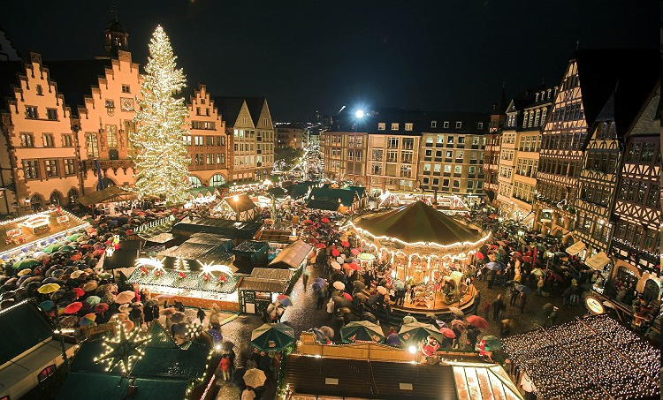
Many towns have Christmas Markets that are open in December where people sell arts and crafts and children can play games.

Slide 7

The Christmas Tree is a tradition that began in Germany. In German, it is called a tannenbaum. Before electric lights, Christmas trees were lit with candles. Today we use electric lights. An old tradition is that, the day the tree is decorated, the mother of the family sends the children to their rooms while she secretly decorates the tree. When the kids come out, they get to see their beautiful tree for the first time!

Slide 8
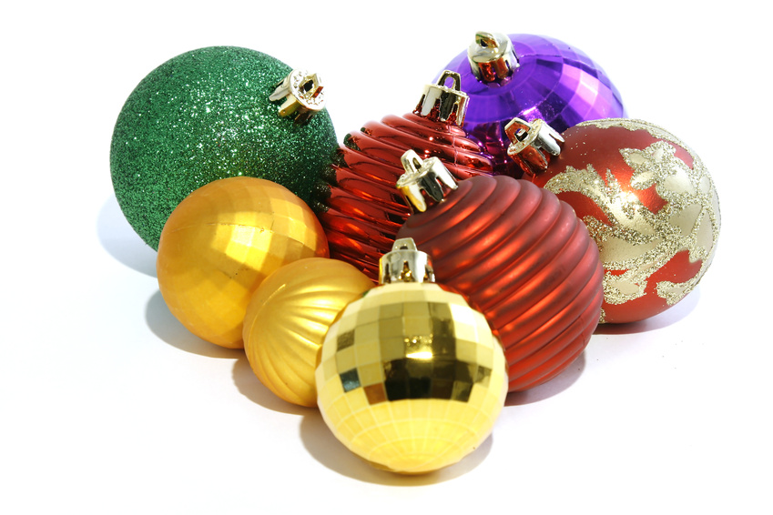
I’ll bet you put ornaments on your tree, right? The first ornaments came from Germany too. They were made of glass and blown by hand. Today ornaments come in all shapes, sizes, and kinds. But I’ll always love the traditional old glass ornaments on my tree the best.

Slide 9
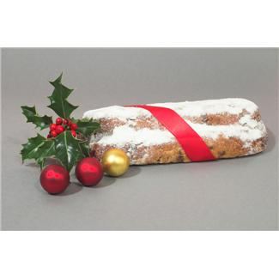
I’m getting hungry! Let’s sample a traditional German Christmas treat- stollen. Yum! I love this bread filled with nuts and fruit! We also eat roast goose for our meal. Both the stollen and goose are treats I always look forward to at Christmas!

Slide 10

Some other German traditions include making gingerbread houses and lighting candles on an advent wreath. For Advent, we light a candle each Sunday until Christmas, when we light them all. Look- my oma... that’s my grandma, is lighting the first one right now! I also have a special Advent calendar. It has little doors and each little door has a treat inside! I open one door each night to help count down to Christmas.

Slide 11
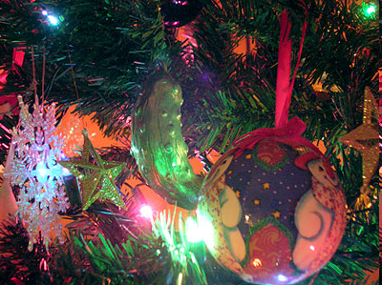
Do you like pickles? Well, in Germany we have a fun tradition of hiding a pickle ornament on our tree. The legend says that whoever spots the pickle will have a year of good luck! Can you find the pickle in my tree?

Slide 12

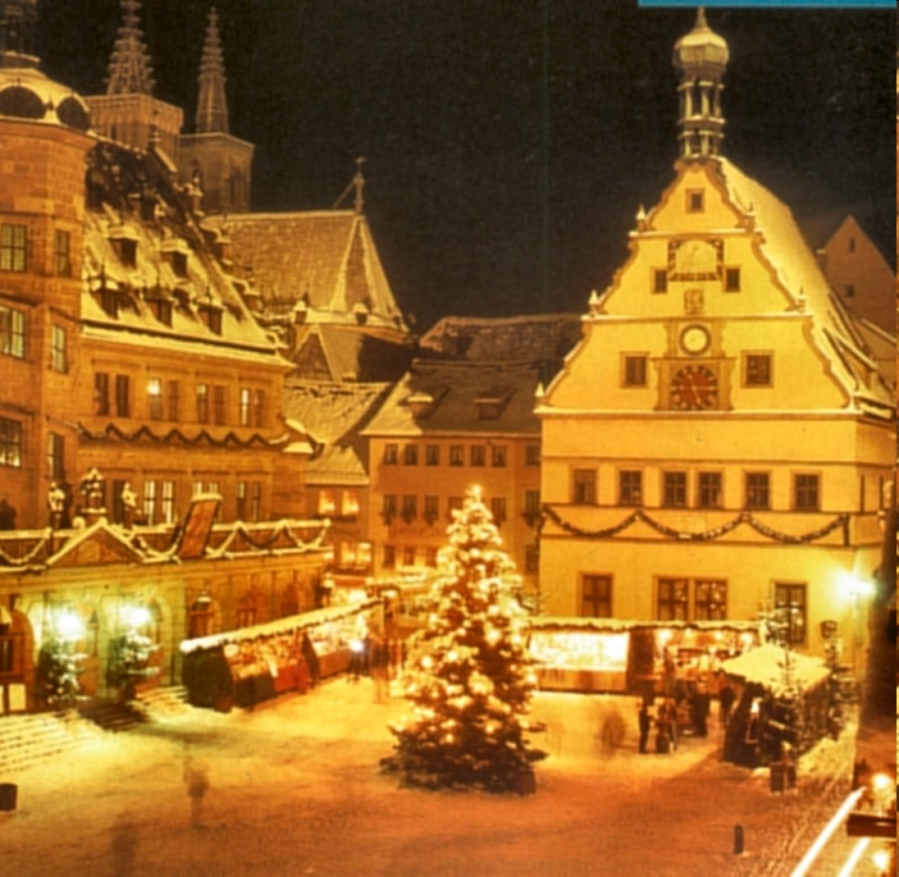

Finally it is Christmas Eve! Let’s travel with Santa Claus while he brings gifts to the good children of Germany!

Slide 13

Frolich Weihnachten!
Well, it’s time for me to go home and see what Santa left for me! I hope you enjoyed traveling through Germany with me! Frolich Weihnachten!

Slide 14

CHOMP TIME
F.A.S.T. Groups
Focused Academic Support Time

Slide 15
F.A.S.T. Designations
Computers – Classworks: R - Aiden - 1 M - Katelynn - 2 M - Jearon - 3 R - Kaylah - 4 M – Carleen – 5 R – Brena - 6 R – Emma - 7 M - Erin - 8 Free choice - Jaiden – 9 | Mrs. Roby: LLI Special Activity | Mrs. Thompson: LLI Jaylie Caydance Amiyah Cohen Paisleigh Kaylee | POETRY – Final selection on notebook paper, or final draft: All others
Landon – Phonics 1st with Mrs. Page
Macon – SIPPS with Mrs. Bess
8:40 – 9:10

Slide 16

Reading Time

Slide 17
Team Captains, please get your groups’ MM Response books.

Slide 18

Gather at the Carpet with your MM Response book and pencil.
Are we still the best?

Slide 19

Review: Contributing Ideas
How does contributing different ideas to your partner discussions help you and your partner learn more about the topic you are discussing?

Slide 20


Review Expository Nonfiction and Text Features
Earlier you heard the expository nonfiction books Morning Meals Around the World and Evening Meals Around the World, and you have read expository texts independently.
Expository text gives factual, or true, information about a particular topic.
Let’s review the Text Features chart.

Slide 21
Text Features
So far in this unit we have discussed the following text features:
  Summary on the back cover
  Table of Contents
  Index
  Extras – Fun Facts and/or To Learn More
  Glossary

Slide 22

New Read Aloud
Author:
Chris Oxlade
This expository book is about the many ways that science is at work in our homes.
Let’s look at the back cover.
Remember, the back cover of expository books often have summaries that let the readers know what the books are about.
Let’s read the first paragraph on the back cover.

Slide 23

What do you expect to learn from this book?
Remember, a table of contents lists the chapters in a book and the page number on which each chapter starts.
Now, let’s look at the table of contents on page 3.
I will read the from the first two chapters today

Slide 24
Homes
Let’s read page 4.
Look at the diagram on page 5.
Expository texts often include diagrams like this one to help readers make sense of the information in the text.
Turn to page 31 in your Student Response book.

Slide 25
Diagrams
A diagram is a special kind of picture that shows different parts of something.
Diagrams often include labels, or words that point to and identify the different parts, and a caption that describes what the diagram is about.
Follow along as I read the caption and labels in the diagram.

Slide 26
Labeled Diagrams and Captions
What did you learn from this diagram about the parts of a house that use science? Turn to your partner
Let’s add labeled diagrams and captions to the Text Features chart.

Slide 27
Photographs
The next part I will read describes the science that goes into building a home. Listen as I read page 6.
Look at the photograph on page 6. Expository texts often have photographs like this one with accompanying captions that tell what they are about.
Listen as I read the caption.
Expository texts often have photographs like this one with accompanying captions that tell what they are about.

Slide 28
Photographs
What kind of material do you think would be good for building a house? Why? Turn to your partner
Let’s add photographs to the Text Features chart.
Let’s look at pages 8 and 9 now, including the captions.

Slide 29
Classroom Discussion
What did you learn from the reading today?
What do you wonder?

Slide 30

Restroom Break
9:45 – 9:55

Slide 31

  Mrs. Roby
  LLI:
  Kaylah
  Emma
  Adalyn
  Kaylee
Independent Daily Reading & Teacher Conferences
Computers – Classworks:
  M - Amiyah - 1
  R – Caydance -2
  FC – Jearon - 3
  FC – Emma - 4
  M - Brena- 5
  M - Macon - 6
  M – Jaylie – 7
  M - Erin - 8
  M – Cohen – 9
  Mrs. Thompson:
  LLI
  Landon
  Macon
  Paisleigh
  Jaiden
Everyone else – Poetry Project or Independent Novel! ☺
9:55 – 10:25

Slide 32



Vocabulary & Grammar Time
10:25 – 10:40

Slide 33

intense – very great or strong
P28-29
Wilma was in Rome getting ready to compete in her first Olympic race, which no one expected her to win.
Intense means very great or strong. Because the Olympics would be on television, millions of people would be watching Wilma and the other athletes.
This put intense, or very great, pressure on them because they did not want to fail with so many people watching them.

Slide 34

intense
Imagine that it is summertime and the heat is intense.
What would you wear on a day when the heat was intense? What would you do? Why? Turn to your Partner
  If the heat were intense, I would…because…

Slide 35
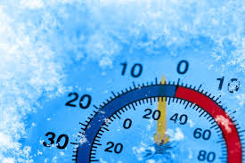
intense
Imagine that it is winter and the cold is intense.
What would you wear on a day when the cold was intense? What would you do? Why? Turn to your Partner
If the cold were intense, I would…because…

Slide 36
What’s the new word we are learning that means “very great or strong”?
intense

Slide 37
exhilarated – very happy and excited
P32-33
In this part of the story, Wilma had won her first gold medal in the 100-meter dash and was preparing to run her next race.
Exhilarated means about the same thing as happy, with this important difference: if you are exhilarated, you are not just a little happy, you are very happy and excited.

Slide 38
exhilarated
When people are exhilarated, they are more than simply happy; they are intensely happy – or very happy.
People feel exhilarated when something special or unexpected happens.
I was exhilarated when I found out our class average increased by almost 10 points!
When have you felt exhilarated? Turn to your Partner
  I felt exhilarated when…because…

Slide 39
What’s the new word we are learning that means “very happy and excited”?
exhilarated

Slide 40
astounding – amazing or very surprising
P36-37
During Wilma’s last Olympic race, the 400-meter relay, Wilma almost dropped the baton and her team fell into third place.
Astounding means about the same thing as surprising, but if something is astounding, it is not just a little surprising, it is very surprising or amazing.

Slide 41
astounding
Wilma’s performance at the Olympics was astounding, or amazing, because Wilma accomplished something that no one expected her to – she won three gold medals.
When have you seen something you thought was astounding? Turn to your Partner
I saw an astounding…

Slide 42
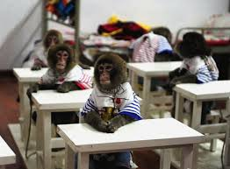
astounding
Astounding can also mean very surprising.
Would it be astounding if a monkey suddenly ran into our classroom? Why?

Slide 43
What’s the new word we are learning that means “amazing or very surprising”?
astounding

Slide 44
Out of Classroom!
Recess 10:40 – 11:05

Slide 45

Writing Time
11:05 – 12:00

Slide 46

Team captains pass out Writing Journals to your group

Slide 47
Review and Select Drafts
Today you will stay in your seat and look through all of your poems.
After you have reread all of your poems, you will select one to develop for publication.
As you’re looking through your poems, what might you want to look for to help you decide on one to develop?

Slide 48
Reread, Review, and Select
You have 5 minutes to reread each of your poems, review which one you could develop (add sensory details and sounds).

Slide 49
Look Closely at your Chosen Poem
Find one place in your poem where you describe, or could describe, something using sensory details. Put a self-stick note in the margin next to that place and write sensory details on it.
What do you hope your reader will imagine when reading that line?

Slide 50
Look Closely at your Chosen Poem
Do the sounds of the words in your poem help to communicate what the poem is about? Find a place where you might be able to add some interesting-sounding words. Put a self-stick note in the margin next to that place and write sounds on it.
What do you hope your reader will imagine when reading that line?

Slide 51
Look Closely at your Chosen Poem
What decisions have you made about how your poem looks on the page? Does the way it looks on the page help readers understand what it is about? If you think you can change the way your poem looks on the page to help the reader understand what it is about, put a self-stick note in the margin next to that place and write how it looks on the page on it.
What do you hope your reader will imagine when reading that line?

Slide 52

Writing Time
Writing Journal
Remember:
Write silently
Double-space, or skip every other line
Continue writing until time is up
Review the things you marked with self-stick notes.
Revise your poem.
Remove the self-stick notes when you finish revising.
If necessary, continue adding to your poem until it is finished.

Slide 53
Sharing and Reflecting
Each one of you choose one line in one of your poems that you think is an improvement over the original line.
How does the line you read improve your poem?
What lines did you hear your classmates read that got your imagination going?
What questions do you want to ask a classmate about his or her writing?

Slide 54
Math Fluency & Focus Lesson!
12:00 – 12:35
3.MD.5 I can recognize area as an attribute of plane figures and understand concepts of area measurement. (a) a square with side length 1 unit, called “a unit square” is said to have “one square unit” of area, and can be used to measure area.
3.MD.6 I can measure areas by counting unit squares.

Slide 55
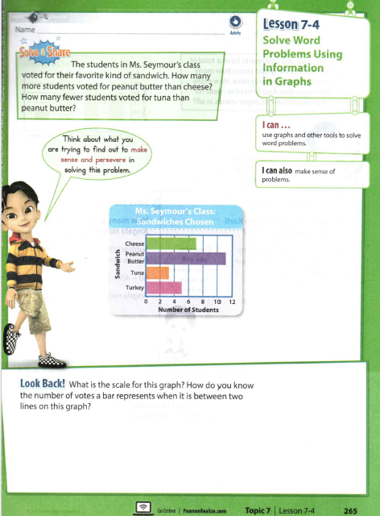

Slide 56
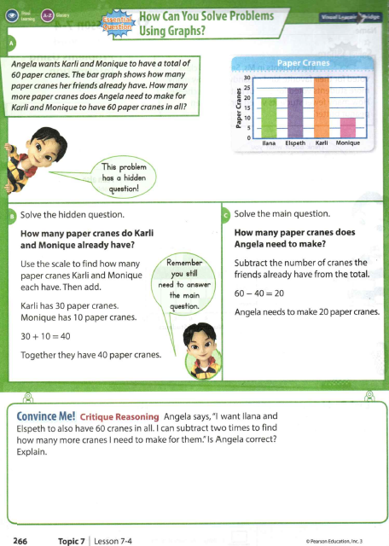
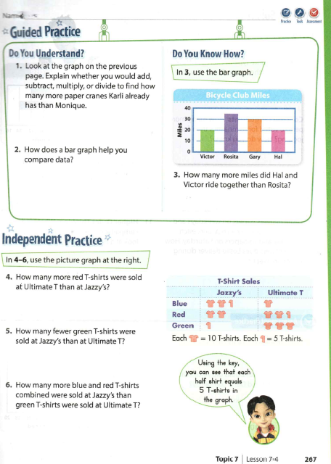

Slide 57
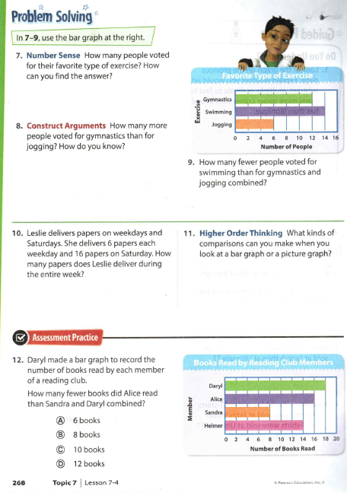

Slide 58

Out of Classroom!
Lunch 12:35 – 1:05

Slide 59
Restroom Break
1:05 – 1:10

Slide 60

Out of Classroom!
Activity 1:10 – 1:55

Slide 61

Chemical Change Cafe

Slide 62

Engage – Chemical Change Café Lesson!
(focus – Changes in Matter)
Changing Paper
What can I do to change a piece of paper?
Did you suggest
folding it,
rolling it up,
cutting it,
tearing it,
writing on it, or
crumpling it into a ball?
Is it still paper?
Notes:
Teacher shows students a piece of blank paper. Students many suggest folding it, rolling it up, cutting it, tearing it, writing on it, and crumpling it into a ball. Try all student suggestions, and after each one, ask: Is it still paper?

Slide 63
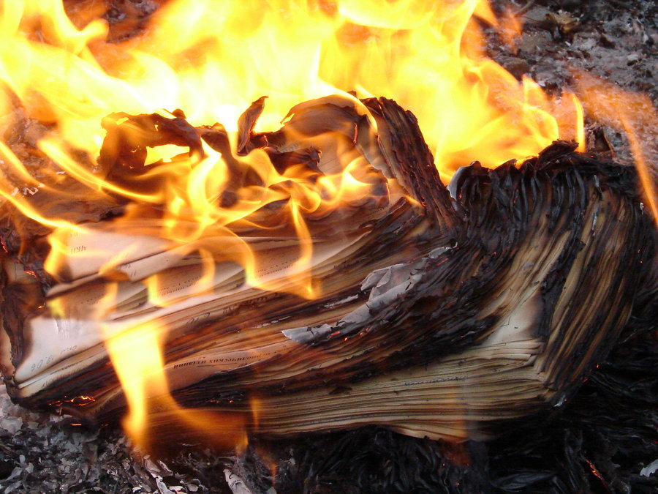
Engage – Chemical Change Café Lesson!
(focus – Changes in Matter)
What would happen to the paper if I burned it?
https://vimeo.com/30525547
Is it still paper?
How do you know?
Paper that has been burnt is a different substance with new properties.
Notes:
If school allows/fire safety imperative – roll up the piece of paper, and put it in a large glass jar. Strike a match and light the paper on fire. Let the students watch it burn. After the paper has finished burning, ask students question.

Slide 64

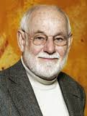

Explain – Chemical Change Café!
(focus – Changes in Matter)
Now, I’m going to share a book by
author-illustrator Eric Carle.
Eric Carle has illustrated more than seventy books, many best sellers, most of which he also wrote, and more than 132 million copies of his books have sold around the world.
As I read the story, you should listen for examples of chemical and physical changes that occur in the story. Raise your hand when you hear an example. Classify as physical or chemical change and justify your answer.

Slide 65
Elaborate – Chemical Change Café!
(focus – Changes in Matter)
Time for the Chemical Change Café
Today we will make “hotcakes” (pancakes) batter.
Yes, you will get to eat the newly chemically formed substance!
On a piece of paper, each of you should draw and describe the pancakes before and after they are cooked and explain why cooking pancakes is a chemical change.

Slide 66




3:10 – 3:15 Wrap Up!
Pair-Up back to back and share one thing you learned in class today with your partner
Pack-Up
Office will announce:
Car Riders – Leave around 3:20
Bus Riders – (listen to intercom for dismissal)
2:30 – 3:20
How much time has elapsed?

