Slide 1
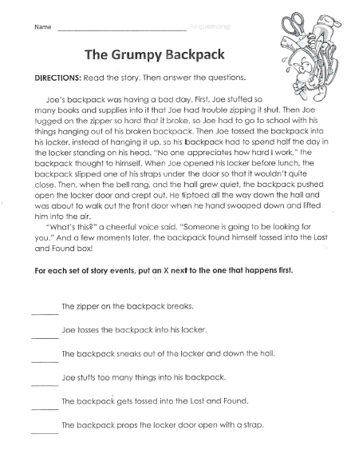
Friday, October 18, 2019
Friday: Classworks
M - Amiyah - 1
Free Choice – Erin - 2
Free Choice – Landon – 3
M – Jearon - 4
M – Jaylie – 5
M – Macon – 6
Free Choice – Jaiden - 7
M – Emma - 8
M - Brena - 9
We have pledge this week: At 8:20, the following will go to the office to represent our class and state the pledge:
Kaylee
Elin
Cohen
Paisleigh
Cayli
Noah
7:55 – 8:30

Slide 3
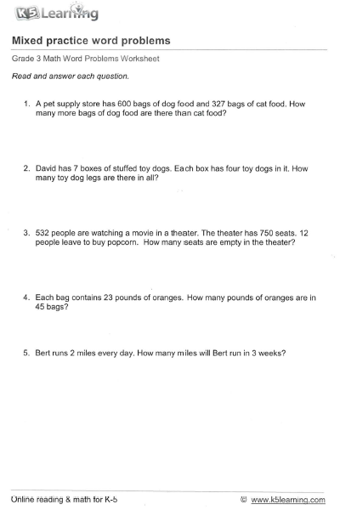
600 – 327 = 273
7 x 4 = 28
Step 1: 750 – 532 = 218
Step 2: 218 – 12 = 206
4. 45 x 23 = 1,035
5. Step 1: 2 x 7 = 14
Step 2: 14 x 3 = 42
Review Homework

Slide 4

CHOMP TIME
F.A.S.T. Groups
Focused Academic Support Time

Slide 5
F.A.S.T. Designations
Computers – Classworks: M - Amiyah- 1 M - Jearon - 2 M - Cayli - 3 M - Jaylie - 4 Free Choice - Katelynn – 5 Free Choice – Kaylah - 6 Free Choice - McKenzie - 7 Free Choice - Khamani – 8 Free Choice – Caydance – 9 | Mrs. Roby: LLI Kaylah Brena Emma Adalyn | Free Book Choice: Everyone else
Landon – Phonics first – Mrs. Page
Macon – SIPPS – Mrs. Bess
8:40 – 9:10

Slide 6

Restroom Break
9:10 – 9:20

Slide 7

Lake Cormorant High School Parade

Slide 8
Restroom Break
10:00 – 10:10

Slide 9



Vocabulary & Grammar Time
Snack Time
10:00 – 10:15

Slide 10

handy – useful or easy to use
P22,23
Nicky spends lots of time on the raft and he asks his grandma for drawing paper to keep on board.
Handy is a synonym for useful.

Slide 11

handy
P23 Grandma says the snorkel and mask might be handy, or useful, on the raft.
Why might a snorkel and mask be handy, or useful, to have if you are on a raft? – Turn to your Partner
  A snorkel and mask would be handy to have on a raft because…

Slide 12
handy
What do you own that is handy? Why is it handy? – Turn to your Partner
  … is handy because…

Slide 13
What’s the new word we are learning that means “useful or easy to use”?
handy

Slide 14
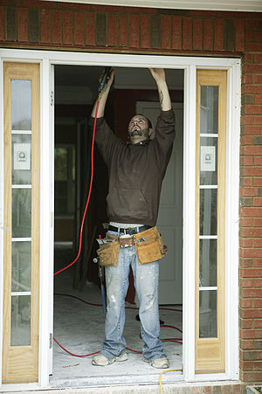
Career Opportunities…
Handyman - a person skilled at a wide range of repairs, typically around the home. These tasks include trade skills, repair work, maintenance work, are both interior and exterior, and are sometimes described as "side work", "odd jobs" or "fix-up tasks". Specifically, these jobs could be light plumbing jobs such as fixing a leaky toilet or light electric jobs such as changing a light fixture.
Plumber - a tradesperson who specializes in installing and maintaining systems used for potable (drinking) water, sewage and drainage in plumbing systems.
Electrician - a tradesman specializing in electrical wiring of buildings, stationary machines, and related equipment.
Construction Worker - a tradesperson, laborer, or professional employed in the physical construction of the built environment and its infrastructure.

Slide 15
whoosh – move very fast
P24,25
Nicky likes watching animals when he spends time on the raft.
The blue heron, bird, whooshes, or moves very quickly, onto the raft.
When something whooshes it makes a rushing or hissing sound.

Slide 16
Did it whoosh?
I will describe something, and you and your partner will decide whether it whooshes.
A jet plane speeding through the air
Would a jet plane speeding through the air whoosh? Why or why not? – Turn to your Partner
  A jet plane speeding through the air (would/would not) whoosh because…

Slide 17
Did it whoosh?
A snowball zipping past your ear
Would a snowball zipping past your ear whoosh? Why or why not? – Turn to your Partner
  A snowball zipping past my ear (would/would not) whoosh because…

Slide 18
Did it whoosh?
A leaf drifting slowly to the ground
Would a leaf drifting slowly to the ground whoosh? Why or why not? – Turn to your Partner
  A leaf drifting slowly to the ground (would/would not) whoosh because…

Slide 19
What’s the new word we are learning that means “move very fast”?
whoosh

Slide 20
Have a change of heart – change your opinion or the way you feel about something
The phrase “Have a change of heart” is another idiom.
Remember an idiom is an expression or phrase that means something different from what it appears to mean.

Slide 21
Have a change of heart
In the beginning of the story Nicky was reluctant to spend the summer at his grandma’s house, but by the end of the story, Nicky has had a change of heart.
Listen as I read this part of the story and think about why Nicky had a change of heart.

Slide 22
Have a change of heart
How has Nicky had a change of heart? Why did he have a change of heart? Turn to your Partner
  Nicky has a change of heart because…

Slide 23
Have a change of heart
When have you had a change of heart about something? Why did you have a change of heart? Turn to your Partner
  I had a change of heart about… because…

Slide 24
What’s the new phrase we are learning that means “change your opinion or the way you feel about something”?
Have a change of heart

Slide 25
Math Fluency & Focus Lesson!
10:15? – 10:40

Slide 26
Paired partners – Math Study Guide! ☺

Slide 27
Out of Classroom!
Recess 10:40 – 11:05

Slide 28
Math Test
Independent Daily Reading afterwards until everyone has finished
11:05 – 12:35

Slide 29

Out of Classroom!
Lunch 12:35 – 1:05

Slide 30
Restroom Break
1:05 – 1:10

Slide 31

Out of Classroom!
Activity 1:10 – 1:55

Slide 32

Reading Time
Objective: RL.3.3 Describe characters in a story and explain how their actions contribute to the sequence of events.
Objective: RL.3.5 Refer to parts of stories and poems when writing or speaking about a text, using terms such as chapter, scene, and stanza; describe how each successive part builds on earlier sections.
Objective: RL.3.7 Use information gained from illustrations, other visual elements, and the words in a text to demonstrate understanding of the text.
1:55 – 2:25

Slide 33
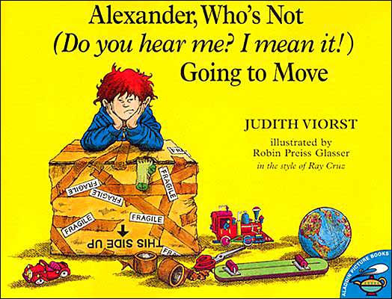
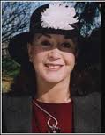
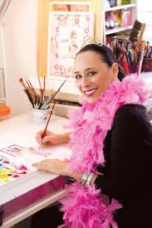
Author: Judith Viorst
What is this story about?
Illustrator: Robin Preiss Glasser

Slide 34
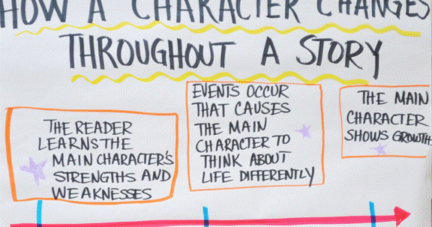
Character Changes
We explored how characters changed in this unit.
Today I want you to think about whether Alexander changes in the book we read, and if he does, how?

Slide 35
Student MM Response Journal p9
Double Entry Journal
I will read from the beginning of the story and from the end.
I want you to discuss with your partner what Alexander is like in each part of the story I read.
Record your ideas in your double-entry journal.

Slide 36

Pages 5-9
What is Alexander like at the beginning of the story? Turn to your Partner
Record in your Double-entry journal on the “Alexander at the beginning” column.

Slide 37
Pages 26-30
What is Alexander like at the end of the story? Turn to your Partner
Record in your Double-entry journal on the “Alexander at the end” column.

Slide 38

Classroom Discussion
Do you think Alexander changes in this story? Why or why not?
Do others agree with what he/she just said? Explain your thinking.

Slide 39
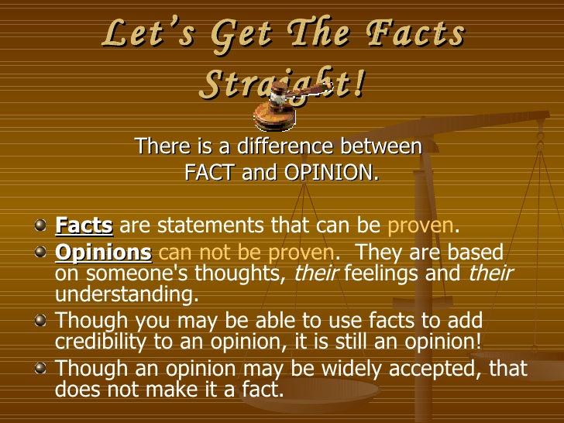
Back up your Opinion with Evidence
Readers may have different opinions whether a character changes and this is ok, but you must be able to explain your thinking and provide evidence from the text for why you think that way.

Slide 40

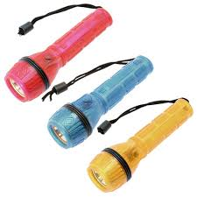
Flashlight Friday
Computers – Classworks Catch up if needed: Free choice - Amiyah- 1 Free choice - Emma - 2 Free choice - Adalyn - 3 Free choice - Elin - 4 Free choice - Noah – 5 Free choice - Cayli - 6 Free choice – Carleen - 7 Free choice - Cohen – 8 M – Jaylie - 9 M - Brena – TC
Mrs. Roby – LLI
2:25 – 2:50

Slide 41
Computer Time and/or Complete Any Unfinished Work
Computers – Classworks Catch up if needed: Free choice - Jearon- 1 Free choice - Alexis - 2 Free choice - Kaylee - 3 Free choice - Paisleigh - 4 Free choice - Paisleigh – 5 Free choice - Macon - 6 Free choice - ????????? - 7 Free choice - ????????? – 8 M – Brena 9 M – Jaylie - TC
2:50 – 3:10

Slide 42
Restroom Break
3:10 – 3:15

Slide 43

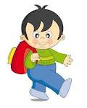


3:10 – 3:15 Wrap Up!
Pair-Up back to back and share one thing you learned in class today with your partner
Pack-Up
Office will announce:
Car Riders – Leave around 3:20
Bus Riders – (listen to intercom for dismissal)
2:30 – 3:20
How much time has elapsed?

