Slide 1
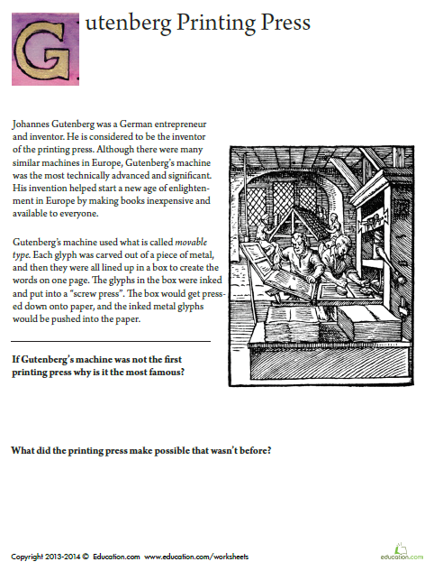
Monday, February 24, 2020
Superkids | Classworks
5 - Cohen | 1 – Amiyah - M 2 – Jaiden - M 3 – Addisen - R 4 – Lazerrick - R 6 – Macon - M 7 – Paisleigh - M 8 - Landon - M 9 – Caydance - M
7:55 – 8:30

Slide 2
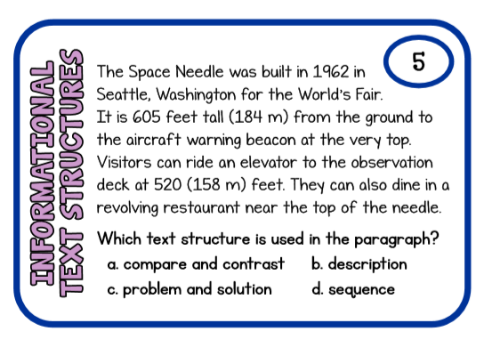

Slide 3
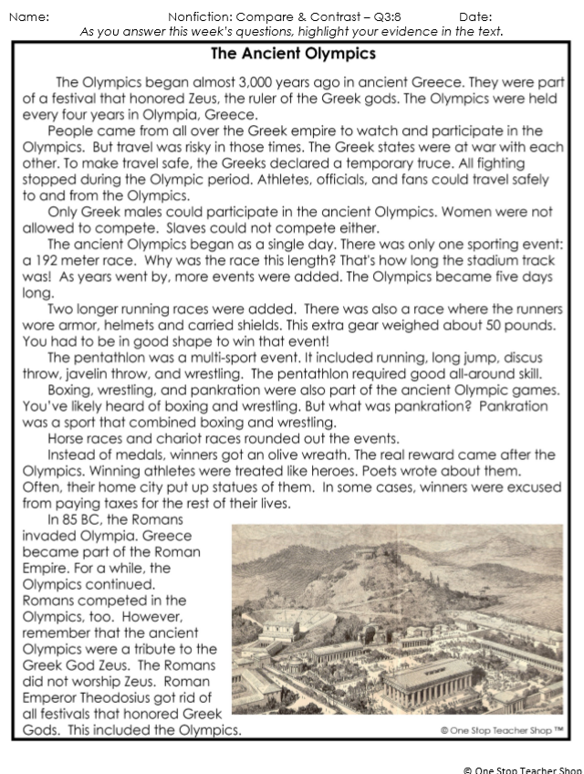
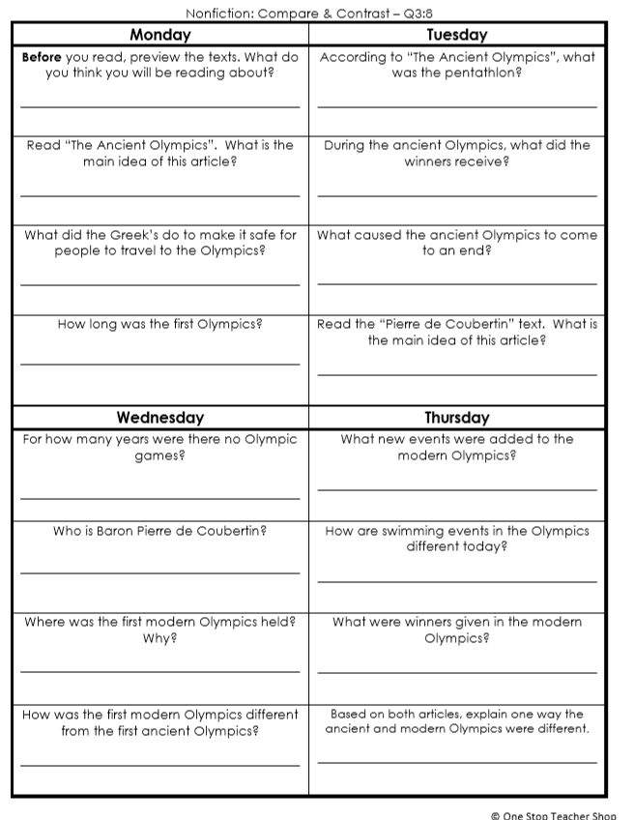
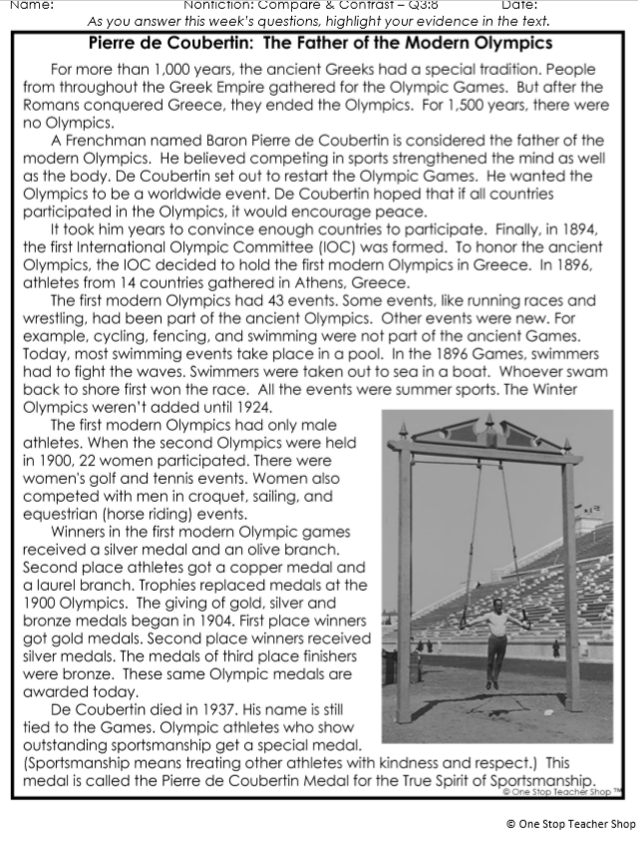
Reading Homework

Slide 4
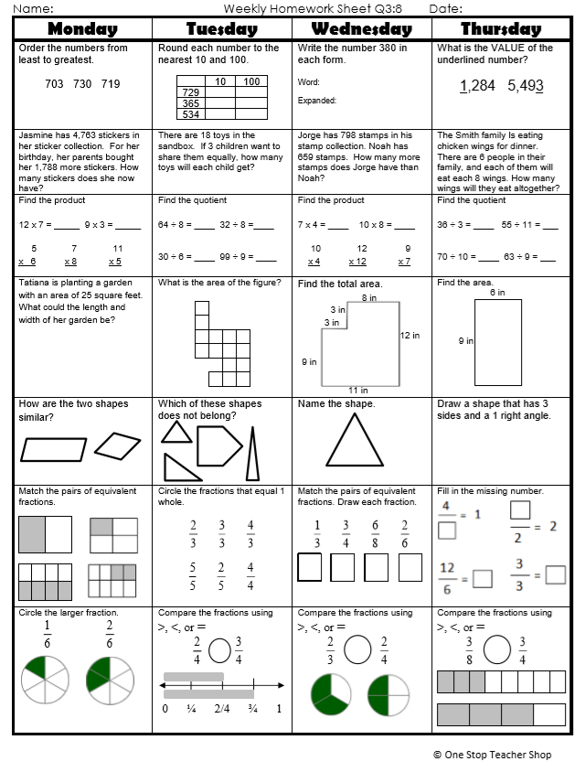
Math Homework

Slide 5

CHOMP TIME
F.A.S.T. Groups
Focused Academic Support Time

Slide 6
F.A.S.T. Designations
Classworks: 1 – Erin – Math 9 - Brena - Math 2 - Emma – Math 3 - Addisen - Math 4 – Jearon – Math 5 – Carleen - Math 6 – Kaylah - Reading 7 – Aiden - Reading 8 – Jaiden - Math | Mrs. Roby: Enrichment: Katelynn McKenzie Adalyn Khamani Elin Cayli | Mrs. T: SIPPS Amiyah Jaylie Caydance Lazerrick Kaylee Cohen Paisleigh
Landon – Phonics 1st with Mrs. Page
Macon – SIPPS with Mrs. Bess
8:40 – 9:10

Slide 7

Reading Time
9:10 – 9:45
RI.3.1 I can ask and answer questions to demonstrate understanding of a text, referring explicitly to the text as the basis for the answers.
RI.3.2 I can determine the main idea of a text; recount the key details and explain how they support the main idea.
RI.3.4 I can determine the meaning of general academic and domain-specific words and phrases in a text relevant to a grade 3 topic or subject area.
RI.3.5 I can use information gained from illustrations, other visual elements, and the words in a text to demonstrate understanding of the text.
SL.3.1c I can ask questions to check understanding of information presented, stay on topic, and link my comments to the remarks of others.

Slide 8

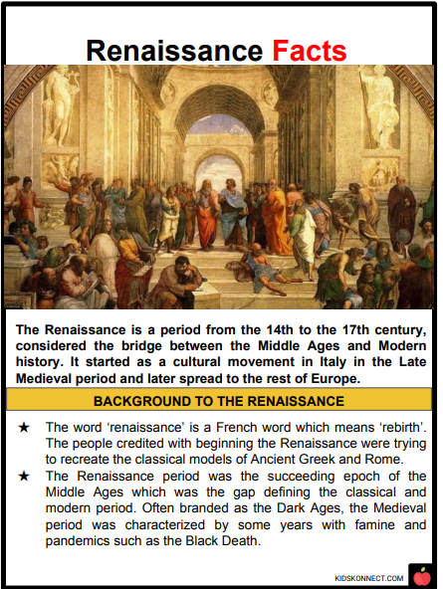
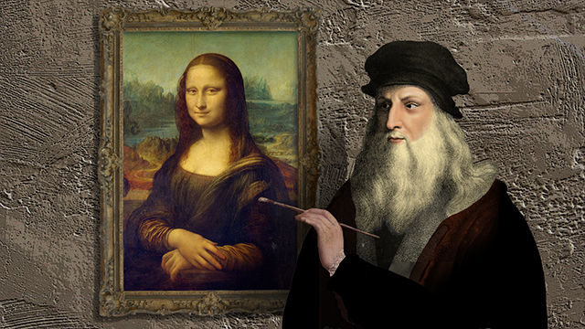

Slide 9
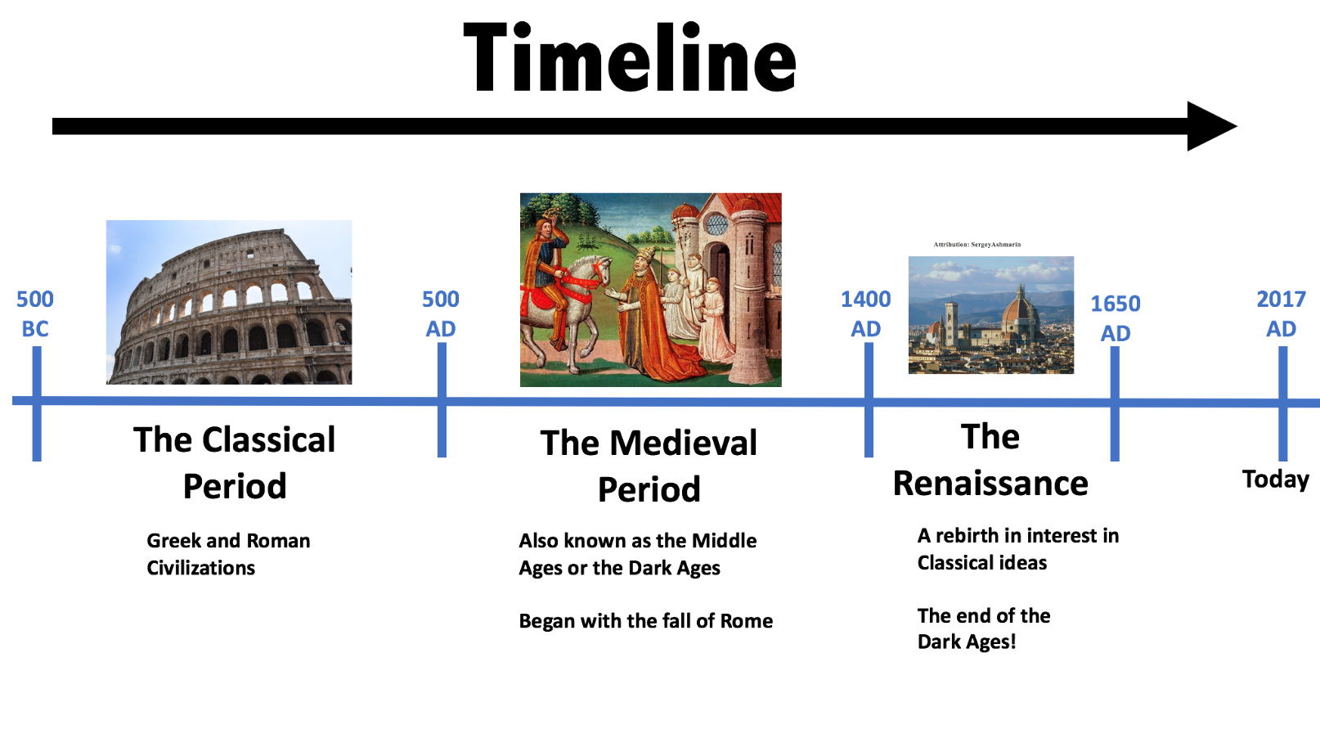
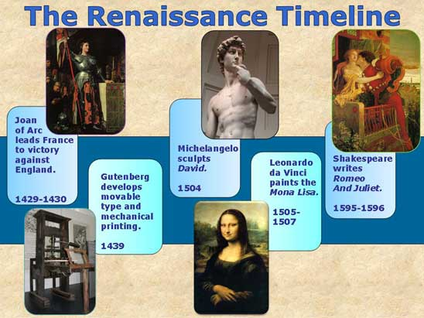

Slide 10
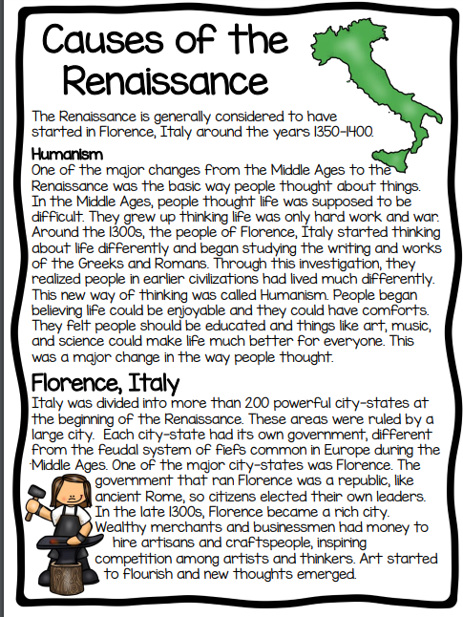
RI.3.3 I can describe the relationship between a series of historical events, scientific ideas or concepts, or steps in technical procedures in a text, using language that pertains to time, sequence, and cause/effect.
RI.3.4 I can determine the meaning of general academic and domain-specific words and phrases in a text relevant to a grade 3 topic or subject area.

Slide 11
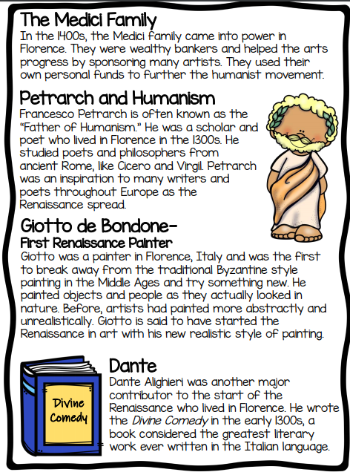

Slide 12
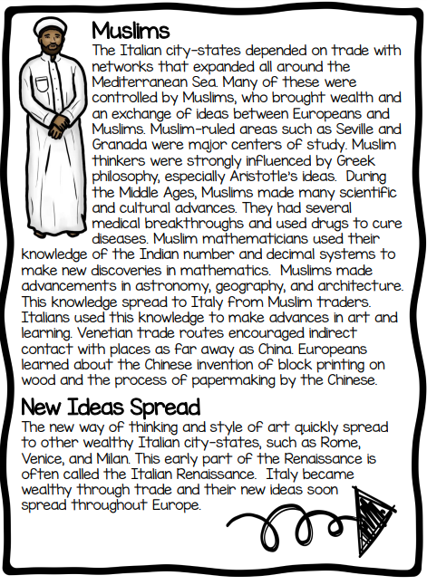

Slide 13
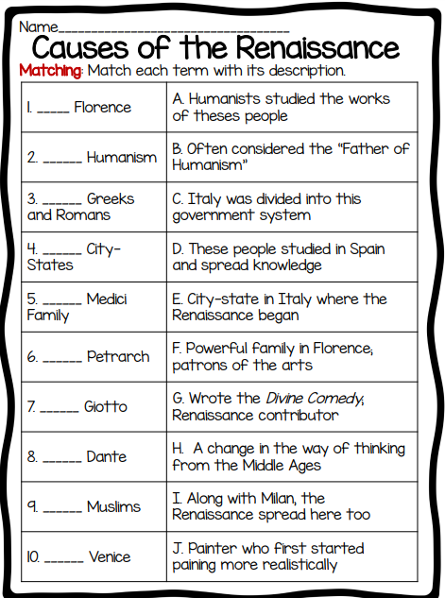
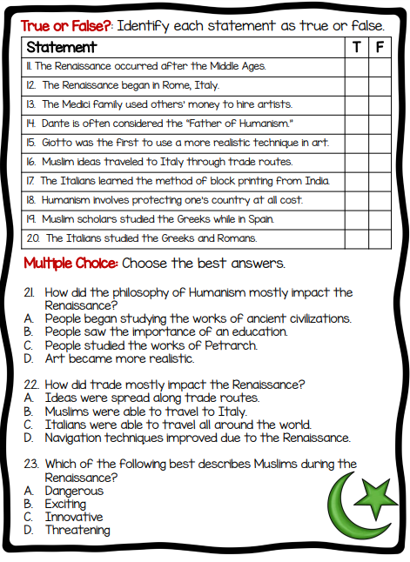
Finish during station Rotations

Slide 14

Restroom Break
9:45 – 9:55

Slide 15

Independent Daily Reading & Teacher Conferences
Superkids: 1 – Amiyah 9 – Kaylee 2 – Landon 3 – Macon 4 - Paisleigh | Epic: 5 – Khamani 6 – McKenzie 7 – Adalyn 8 - Cayli TC - Elin | Mrs. R: Remediation: Aiden Cohen Jaylie Kaylah | Mrs. T: LLI: Jearon Jaiden Brena Carleen Addisen
Everyone else – Independent Novel! ☺
9:55 – 10:25

Slide 16



Morning Work Skill & Snack
10:25 – 10:40

Slide 17
Morning Work Review

Slide 18
Out of Classroom!
Recess 10:45 – 11:05

Slide 19
Math Fluency & Focus Lesson!
11:05 – 11:15

Slide 20
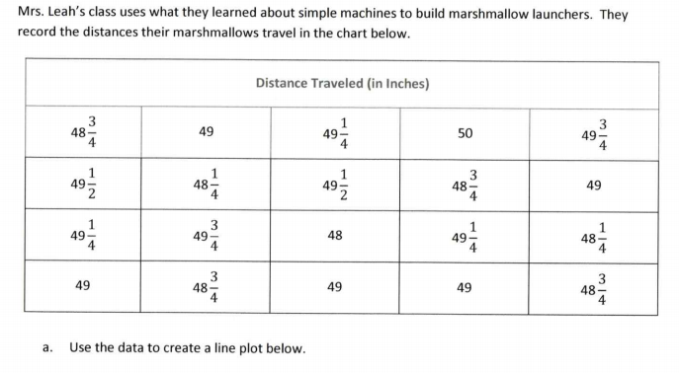

Slide 21
Math Rotation - separate tables
Review MS State Dept Testlet

Slide 22
Station Time!
11:15 – 12:35
Math 3.NF.1 I can understand that a fraction 1/b as the quantity formed by one part when a whole is partitioned into b equal parts. I can understand that a fraction a/b as the quantity formed by a parts of size 1/b.
Math 3.NF.2 I can represent a fraction 1/b on a number line diagram by defining the interval from 0 to 1 as the whole and partitioning it into b equal parts.
.

Slide 23
Finish during station Rotations

Slide 24
Rotation 1
11:15 – 11:30
Group 1 – Computers 1-5: Classworks Reading
Group 2 – Mrs. Roby – Review
Group 3 – Computers 6-TC: Classworks Math
Group 4 – Mrs. Thompson – Testing
Group 5 – Rotating Subjects
  (Monday: Math, Tuesday: Science,
  Wednesday: Reading, Thursday: Writing,
  Friday: Social Studies)

Slide 25
Rotation 2
11:30 – 11:45
Group 5 – Computers 1-5: Classworks Reading
Group 1 – Mrs. Roby – Review
Group 2 – Computers 6-TC: Classworks Math
Group 3 – Mrs. Thompson – Testing
Group 4 – Rotating Subjects
  (Monday: Math, Tuesday: Science,
  Wednesday: Reading, Thursday: Writing,
  Friday: Social Studies)

Slide 26
Rotation 3
11:45 – 12:00
Group 4 – Computers 1-5: Classworks Reading
Group 5 – Mrs. Roby – Review
Group 1 – Computers 6-TC: Classworks Math
Group 2 – Mrs. Thompson – Testing
Group 3 – Rotating Subjects
  (Monday: Math, Tuesday: Science,
  Wednesday: Reading, Thursday: Writing,
  Friday: Social Studies)

Slide 27
Rotation 4
12:00 – 12:15
Group 3 – Computers 1-5: Classworks Reading
Group 4 – Mrs. Roby – Review
Group 5 – Computers 6-TC: Classworks Math
Group 1 – Mrs. Thompson – Testing
Group 2 – Rotating Subjects
  (Monday: Math, Tuesday: Science,
  Wednesday: Reading, Thursday: Writing,
  Friday: Social Studies)

Slide 28
Rotation 5
12:15 – 12:30
Group 2 – Computers 1-5: Classworks Reading
Group 3 – Mrs. Roby – Review
Group 4 – Computers 6-TC: Classworks Math
Group 5 – Mrs. Thompson – Testing
Group 1 – Rotating Subjects
  (Monday: Math, Tuesday: Science,
  Wednesday: Reading, Thursday: Writing,
  Friday: Social Studies)

Slide 29

Out of Classroom!
Lunch 12:35 – 1:05

Slide 30
Restroom Break
1:05 – 1:10

Slide 31

Out of Classroom!
Activity 1:10 – 1:55

Slide 32
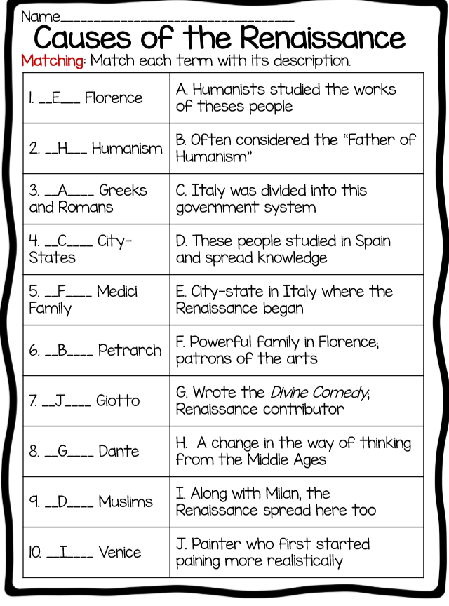
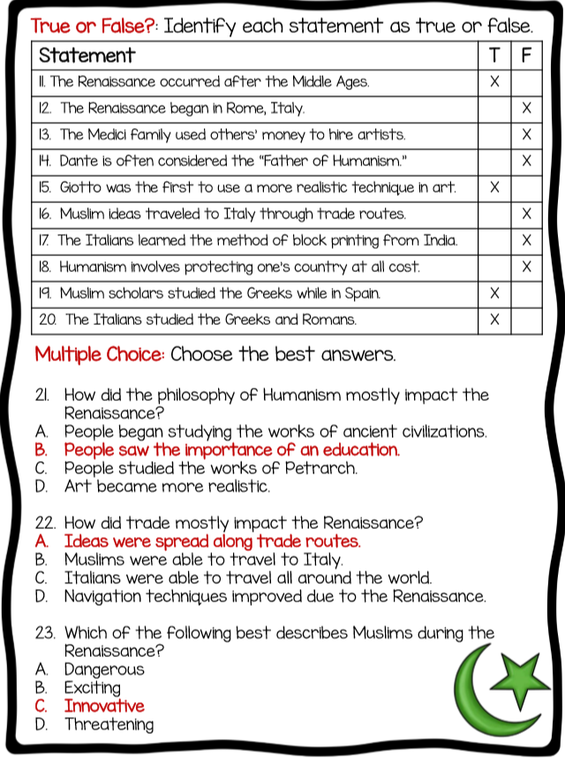

Slide 33
Reading Time
RI.3.1 I can ask and answer questions to demonstrate understanding of a text, referring explicitly to the text as the basis for the answers.
RI.3.2 I can determine the main idea of a text; recount the key details and explain how they support the main idea.
RI.3.3 I can describe the relationship between a series of historical events, scientific ideas or concepts, or steps in technical procedures in a text, using language that pertains to time, sequence, and cause/effect.
RI.3.4 I can determine the meaning of general academic and domain-specific words and phrases in a text relevant to a grade 3 topic or subject area.
RI.3.5 I can use information gained from illustrations, other visual elements, and the words in a text to demonstrate understanding of the text.
SL.3.1c I can ask questions to check understanding of information presented, stay on topic, and link my comments to the remarks of others.

Slide 34
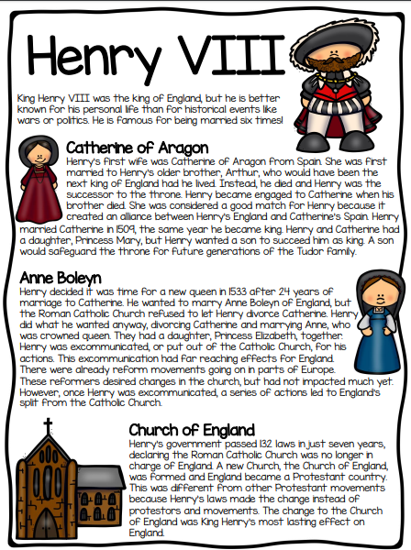
RI.3.3 I can describe the relationship between a series of historical events, scientific ideas or concepts, or steps in technical procedures in a text, using language that pertains to time, sequence, and cause/effect.
RI.3.4 I can determine the meaning of general academic and domain-specific words and phrases in a text relevant to a grade 3 topic or subject area.

Slide 35
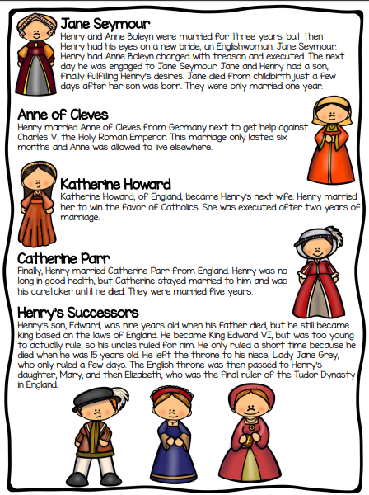
RI.3.3 I can describe the relationship between a series of historical events, scientific ideas or concepts, or steps in technical procedures in a text, using language that pertains to time, sequence, and cause/effect.
RI.3.4 I can determine the meaning of general academic and domain-specific words and phrases in a text relevant to a grade 3 topic or subject area.

Slide 36
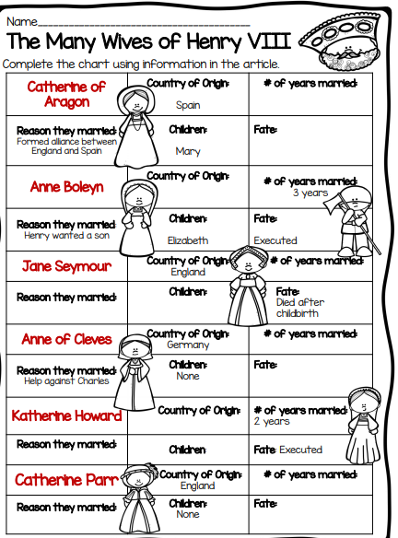

Slide 37
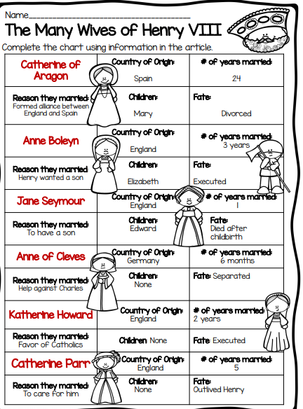
Answer Key

Slide 39
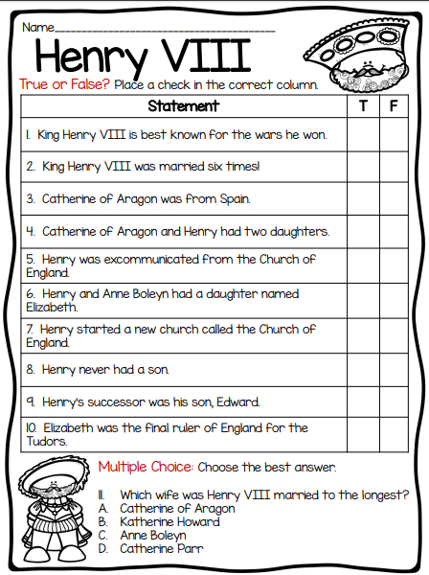
RI.3.1 I can ask and answer questions to demonstrate understanding of a text, referring explicitly to the text as the basis for the answers.
RI.3.2 I can determine the main idea of a text; recount the key details and explain how they support the main idea.
RI.3.3 I can describe the relationship between a series of historical events, scientific ideas or concepts, or steps in technical procedures in a text, using language that pertains to time, sequence, and cause/effect.
RI.3.4 I can determine the meaning of general academic and domain-specific words and phrases in a text relevant to a grade 3 topic or subject area.
RI.3.5 I can use information gained from illustrations, other visual elements, and the words in a text to demonstrate understanding of the text.
SL.3.1c I can ask questions to check understanding of information presented, stay on topic, and link my comments to the remarks of others.

Slide 40
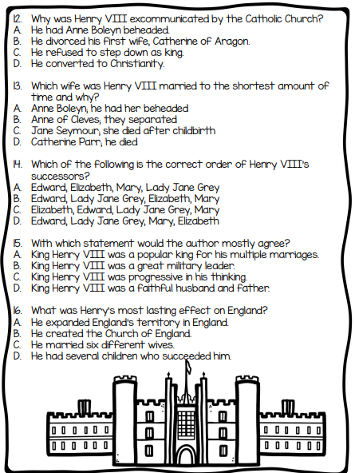

Slide 41
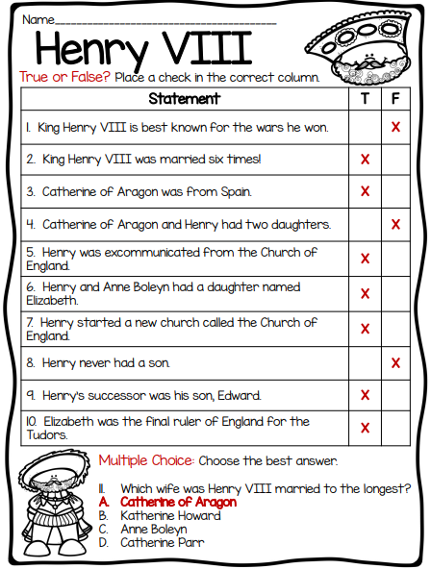
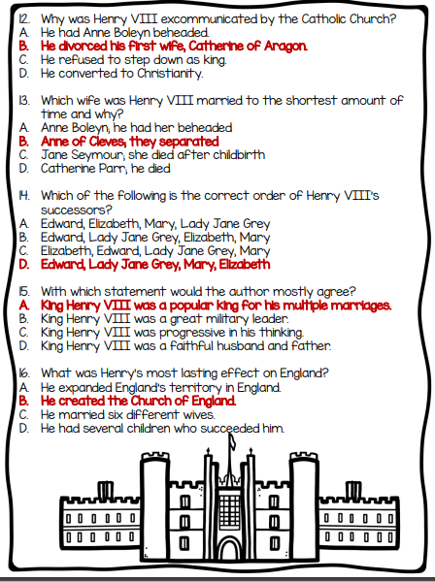
Answer Key

Slide 42
Restroom Break
3:10 – 3:15

Slide 43




3:20 – 3:25 Wrap Up!
Pair-Up back to back and share one thing you learned in class today with your partner
Pack-Up
Office will announce:
Car Riders – Leave around 3:25
Bus Riders – (listen to intercom for dismissal)
2:30 – 3:20
How much time has elapsed?

