Slide 1
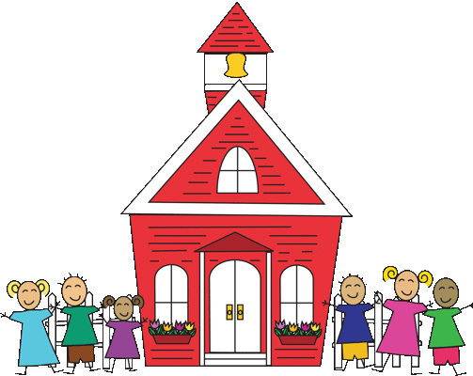
GES Kindergarten
Week 5- April 20-24

Slide 2
Standards
Reading:
R.I.8- Identify Main Idea and key details in a text
Writing:
W.K.1: Use a combination of drawing, dictating, and writing when composing opinion, narratives, and informative texts.
L.K.2: Use g appropriate capitalization, punctuation, and spelling when writing.
Phonics:
R.F.K.2: Demonstrate understanding of sounds (middle sounds, short vowels).
Sight Words:
R.F.K.3: Read common high frequency sight words.
Math:
KOA2 Solve addition problems within 10, as well as word problems

Slide 3
Reading
Essential Questions:
What is the author’s purpose of this text and how does she prove it to us?
What are the benefits of bees?
I Can:
I can state the author’s purpose and how is it proven.
I can state how bees are beneficial.

Slide 4
Reading
Activity: Read the books to a sibling, parent, pet, or toys.
Nonfiction:
Bees
Fiction:
The Very Greedy Bee

Slide 5
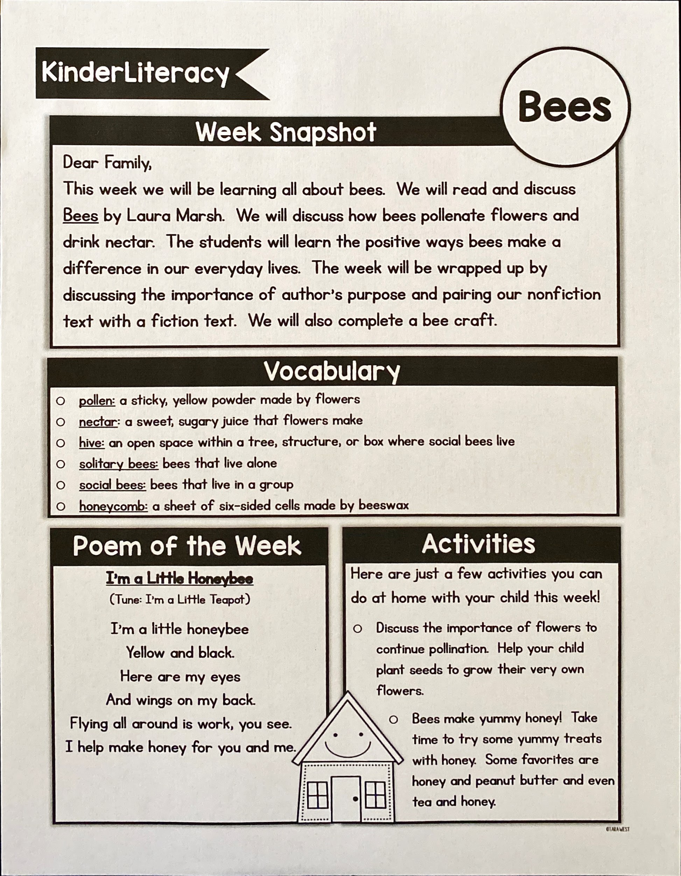
Reading newsletter

Slide 6
Day 1
Read for fun!
Make a list of things you know about bees.
Add new information after you read/listen to the book.
Capture This and That Activity:
Illustrate a solitary bee and social bees.

Slide 7
Day 2
Reread the text.
Ask and answer simple recall questions.
Introduce Vocabulary.
Write a sentence about a fact you learned today about frogs.
Listen and Draw Activity:
Illustrate a bee’s hive and a bee’s honeycomb.

Slide 8
Vocabulary
Pollen- a sticky, yellow powder made by flowers
Nectar- a sweet, sugary juice that flowers make
Hive- an open space within a tree, structure, or box where social bees live
Solitary bee- bees that live alone
Social bees- bees that live in a group

Slide 9
Day 3
Discussion:
*Based on page 5, how does the author try to sway our opinion of bees?
*We’ve learned several ways bees are helpful. Tell me ways they are helpful.
*Using pages 14-15, how does the author teach us the difference between bees and other insects?
*Compare and contrast social bees and solitary bees.
*How has your opinion of bees changed?
Directed Drawing Activity:
Bee Directed Drawing
Write two sentences about bees.

Slide 10
Day 4
Review vocabulary words.
Use glitter to represent pollen. Put glitter on your hand and give someone a high five.
What is more similar to nectar: juice or water? Why is that?
What is more similar to a hive for you: your school or your home? Why do you think that?
Using your toys, demonstrate a solitary bee and social bees.
Draw a honeycomb
Part 2: Read The Very Greedy Bee
Part 3: Label the parts of a bee

Slide 11
Day 5
Wrap up:
Discussion: How do bees make a difference in our everyday lives?
Journal Prompt: What might happen if there were no bees?
Theme Craft: Bee

Slide 12
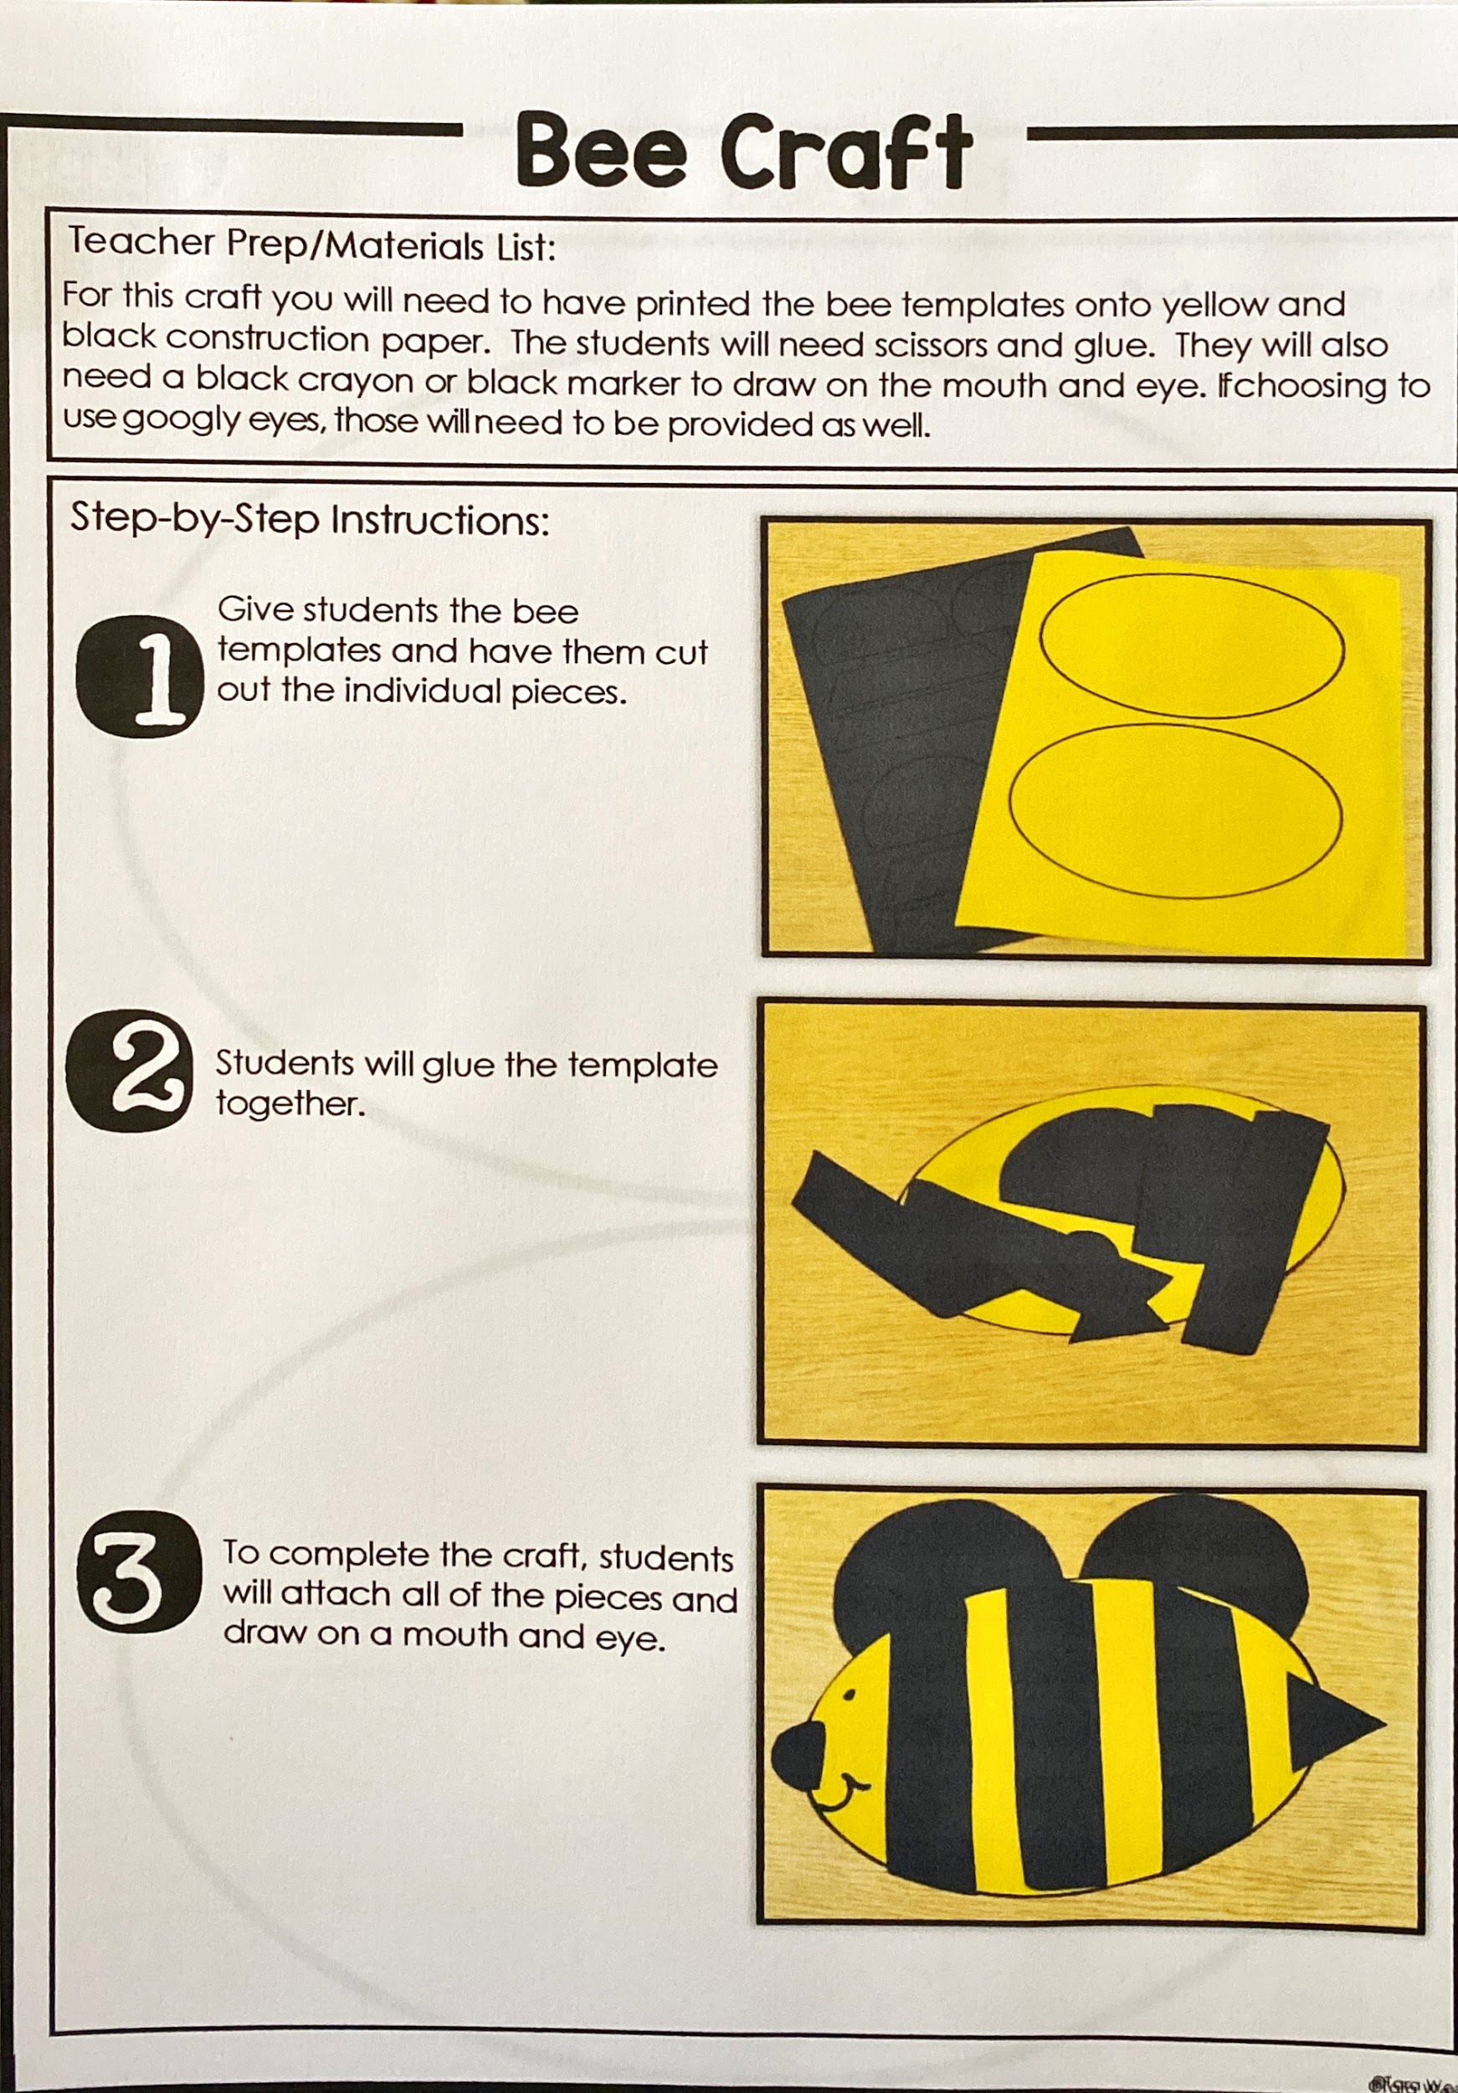
THeme craft

Slide 13
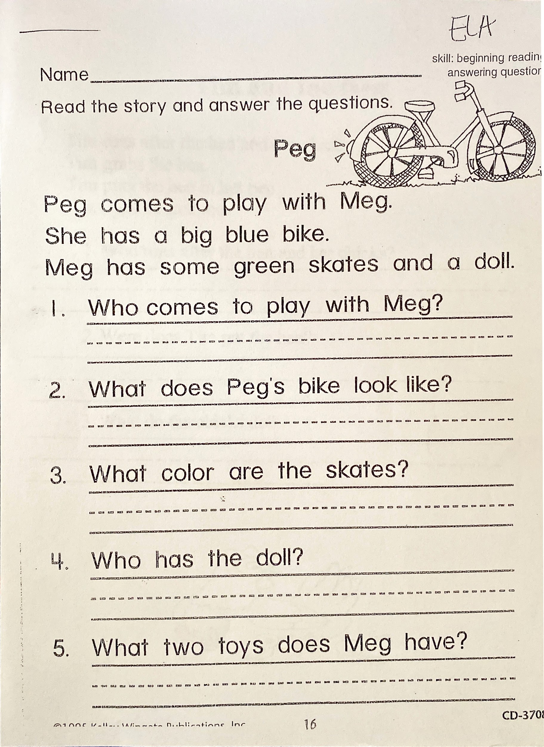

Slide 14
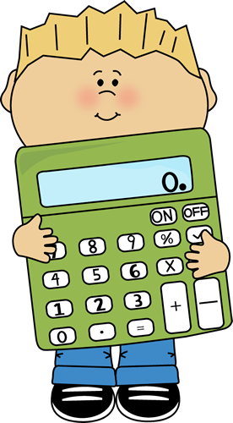
MATH:
Make up your own addition problems- Pick 2 numbers less than 10 and add them together, grab a dice and roll 2 numbers then add’em up, have a friend pick 2 numbers for you and add’em up.

Slide 15
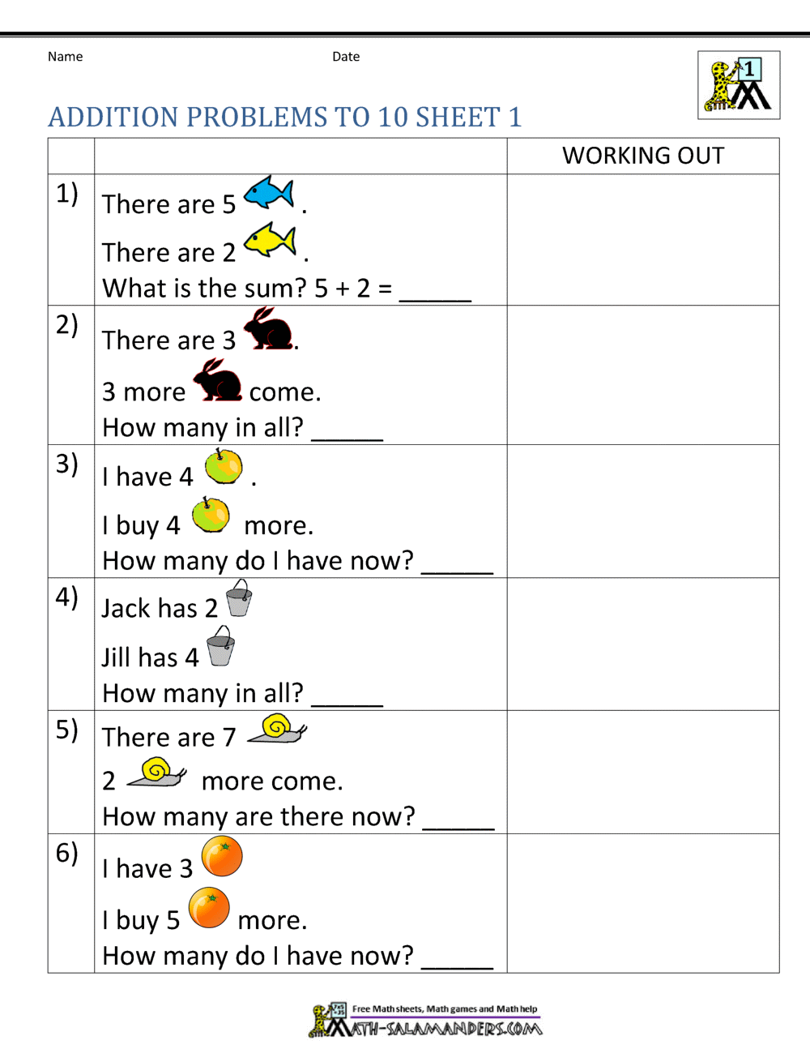

Slide 16
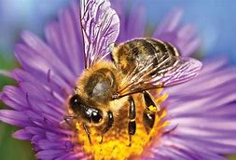
Science
L.K.3A Students will demonstrate an understanding of what animals and plants need to live and grow.
I
Continued on next slide...

Slide 17
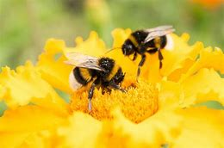
Science
Flower Power: Pollination
EssentialQuestion: What do plants need to survive?
Materials (per group or per student)
•3 cupcakeliners
•3 cotton balls
•1 cotton Swab
•Kool-Aid packets of three different colors (or three different colors of glitter). Can be shared among the groups/students
•Small amount of water in a cup

Slide 18
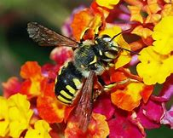
Science
Place one cotton ball in a cupcake liner. Sprinkle one color of glitter or Kool-Aid on the cotton ball. Repeat with the other two colors on the other two cotton balls (one color per cotton ball).
Have students dab the cotton swab in the water. Then squeeze the excess water off it. Gently rub the cotton swab across one of the cotton balls, slightly picking up the glitter/Kool-aid. Then continue on to another cotton ball. Do this with all three colors and all three cotton balls.
See next slide

Slide 19
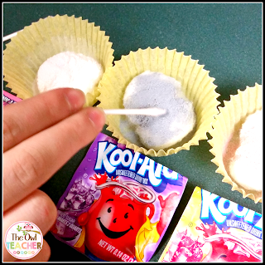

Slide 20
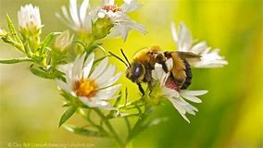
Science
Questions to ask:
What did you see happening to the cotton balls as you rubbed each one with the cotton swab?
What part of this experiment was the flower?
What part of this experiment was the bee?
What part of this experiment was the Kool Aid/glitter?

Slide 21
Writing
Activity:
Choose 1:
Write whether you would want to be a ladybug or a bee.(opinion)
write facts about honey bees. (narrative)
Write three sentences about how bees make honey.(informative)

Slide 22
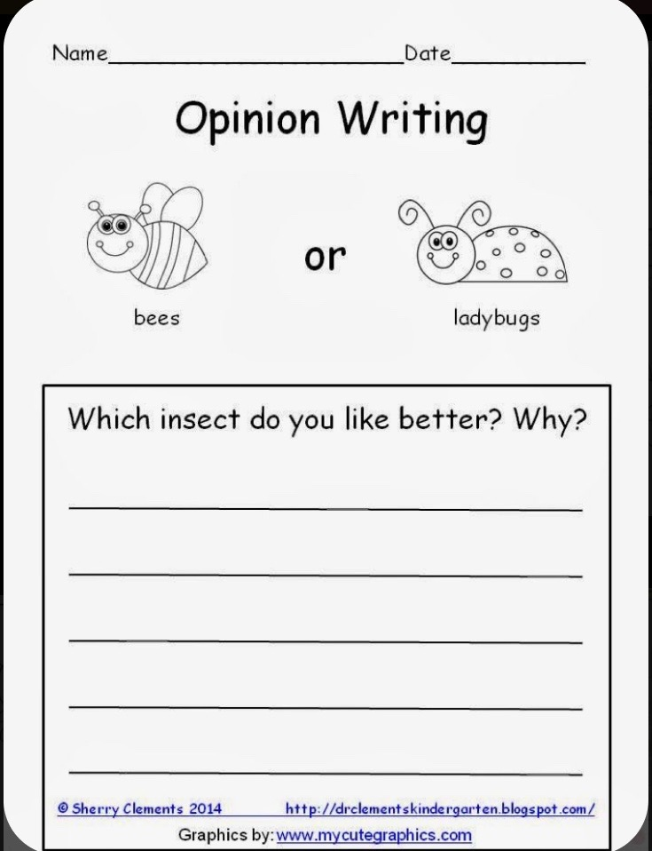

Slide 23
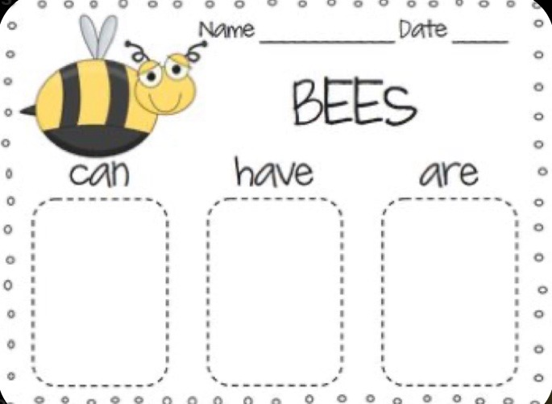

Slide 24
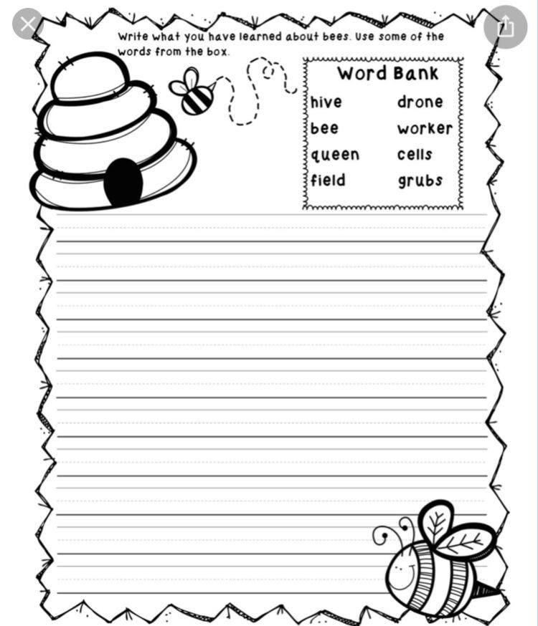

Slide 25
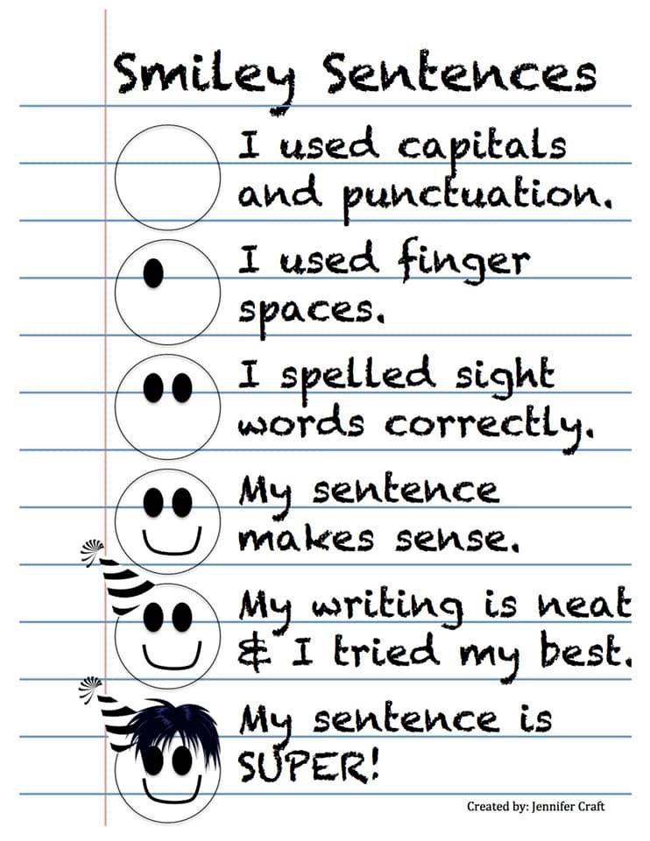

Slide 26
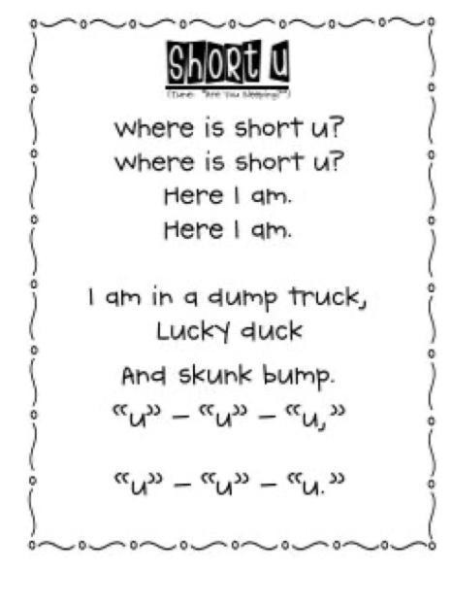
Phonics
The following word list includes words that use our short vowel addressed on the phonics worksheet given. You may practice these words all week by sounding them out and reading them, writing them with different fun materials, coming up with words that rhyme with these words, and even using them in sentences. At the end of the week a spelling test can be given to see if the words have been mastered.
Sun Fun
Cup Pup
Bug Rug
Tub Rub
Nut Cut
Bonus word: slugs

Slide 27
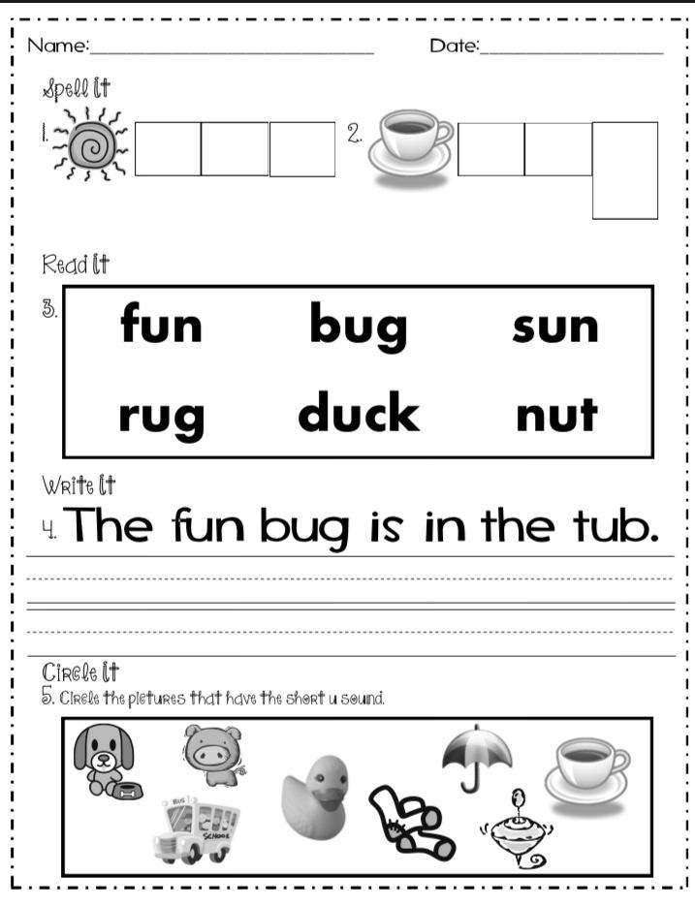

Slide 28
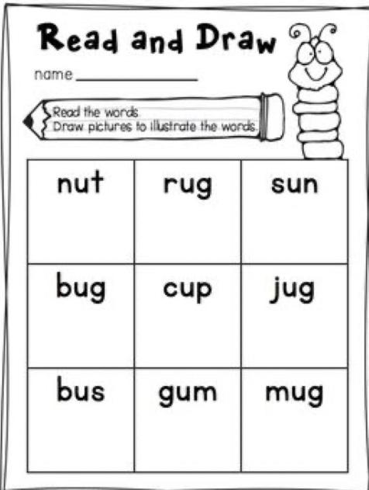

Slide 29
Sight Words
Sight Words: long, little, very, after
Activity: Make a song to help you learn to spell your sight words. Don’t be afraid to be silly! :)

Slide 30
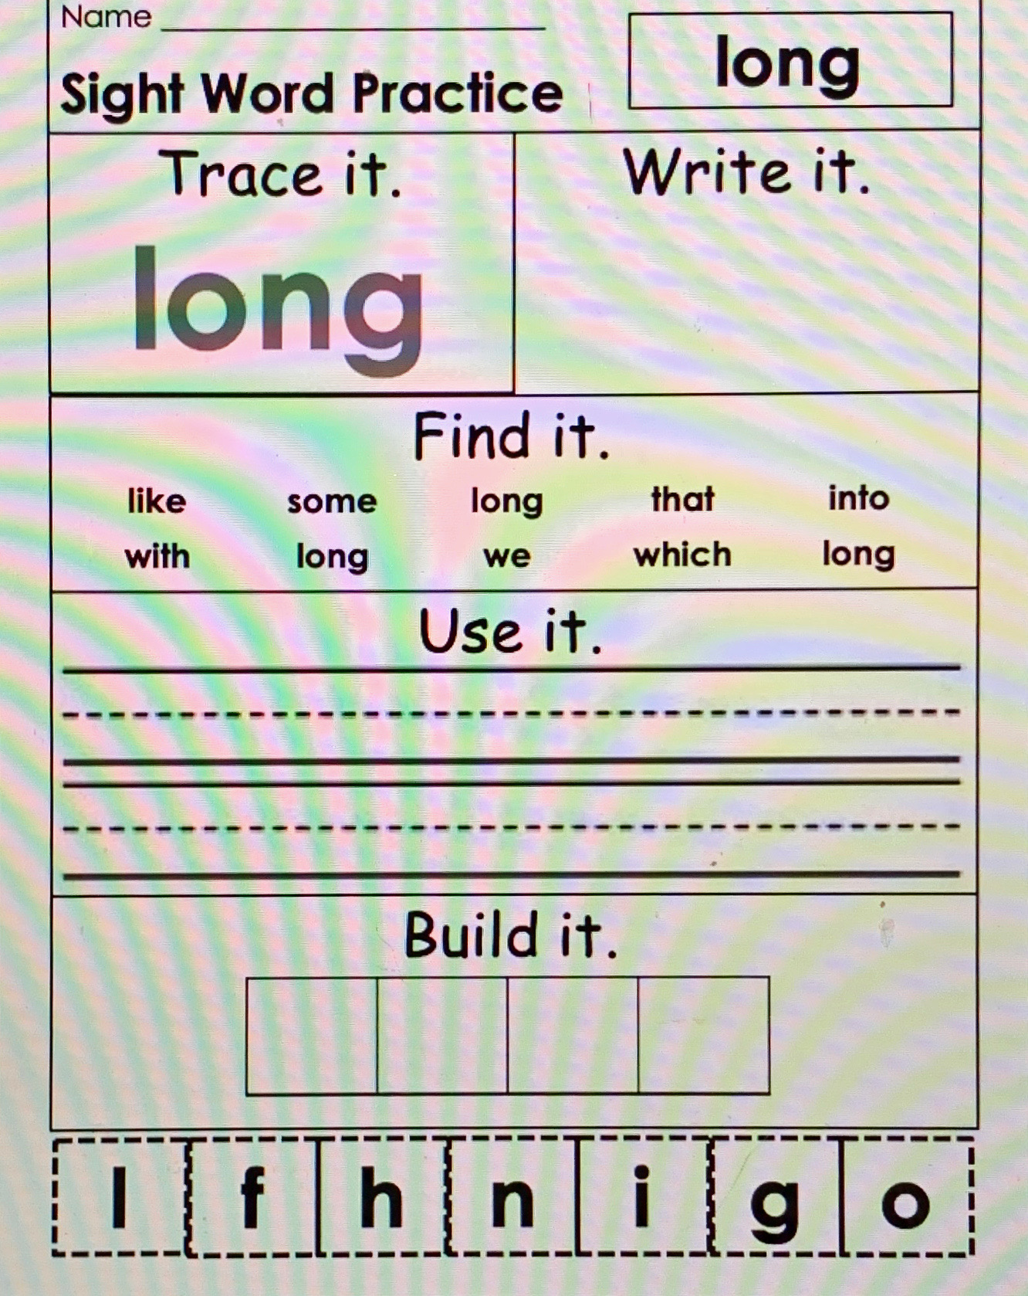

Slide 31
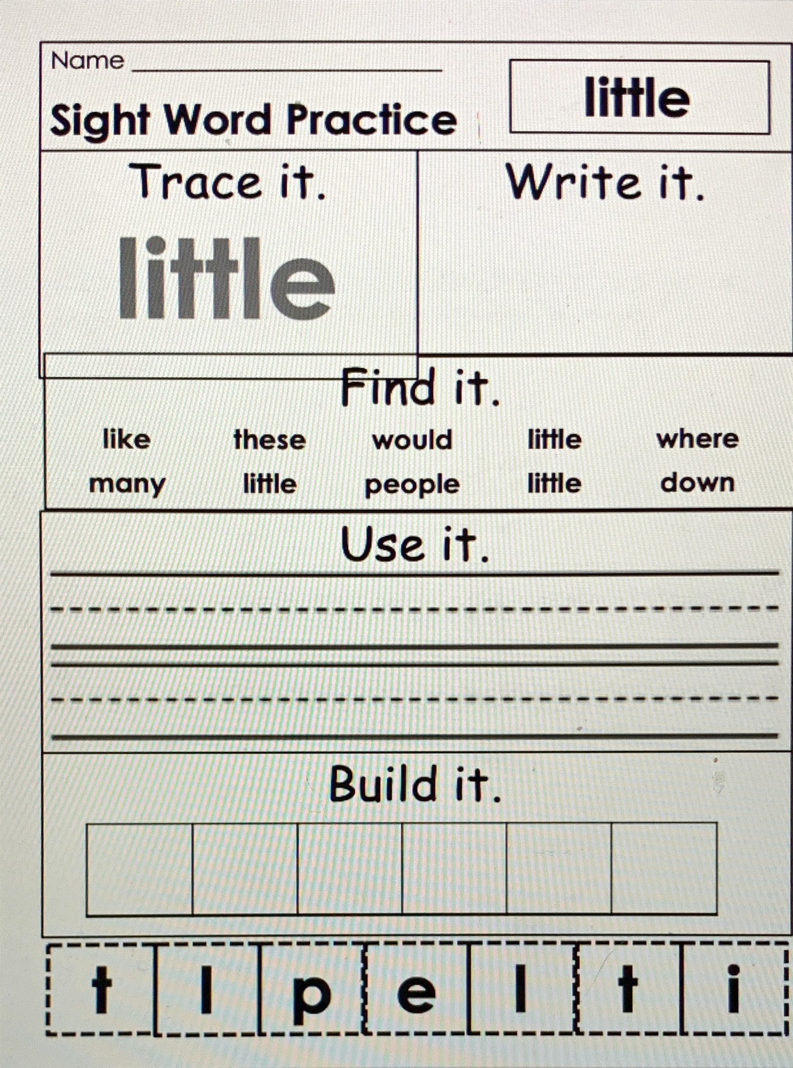

Slide 32
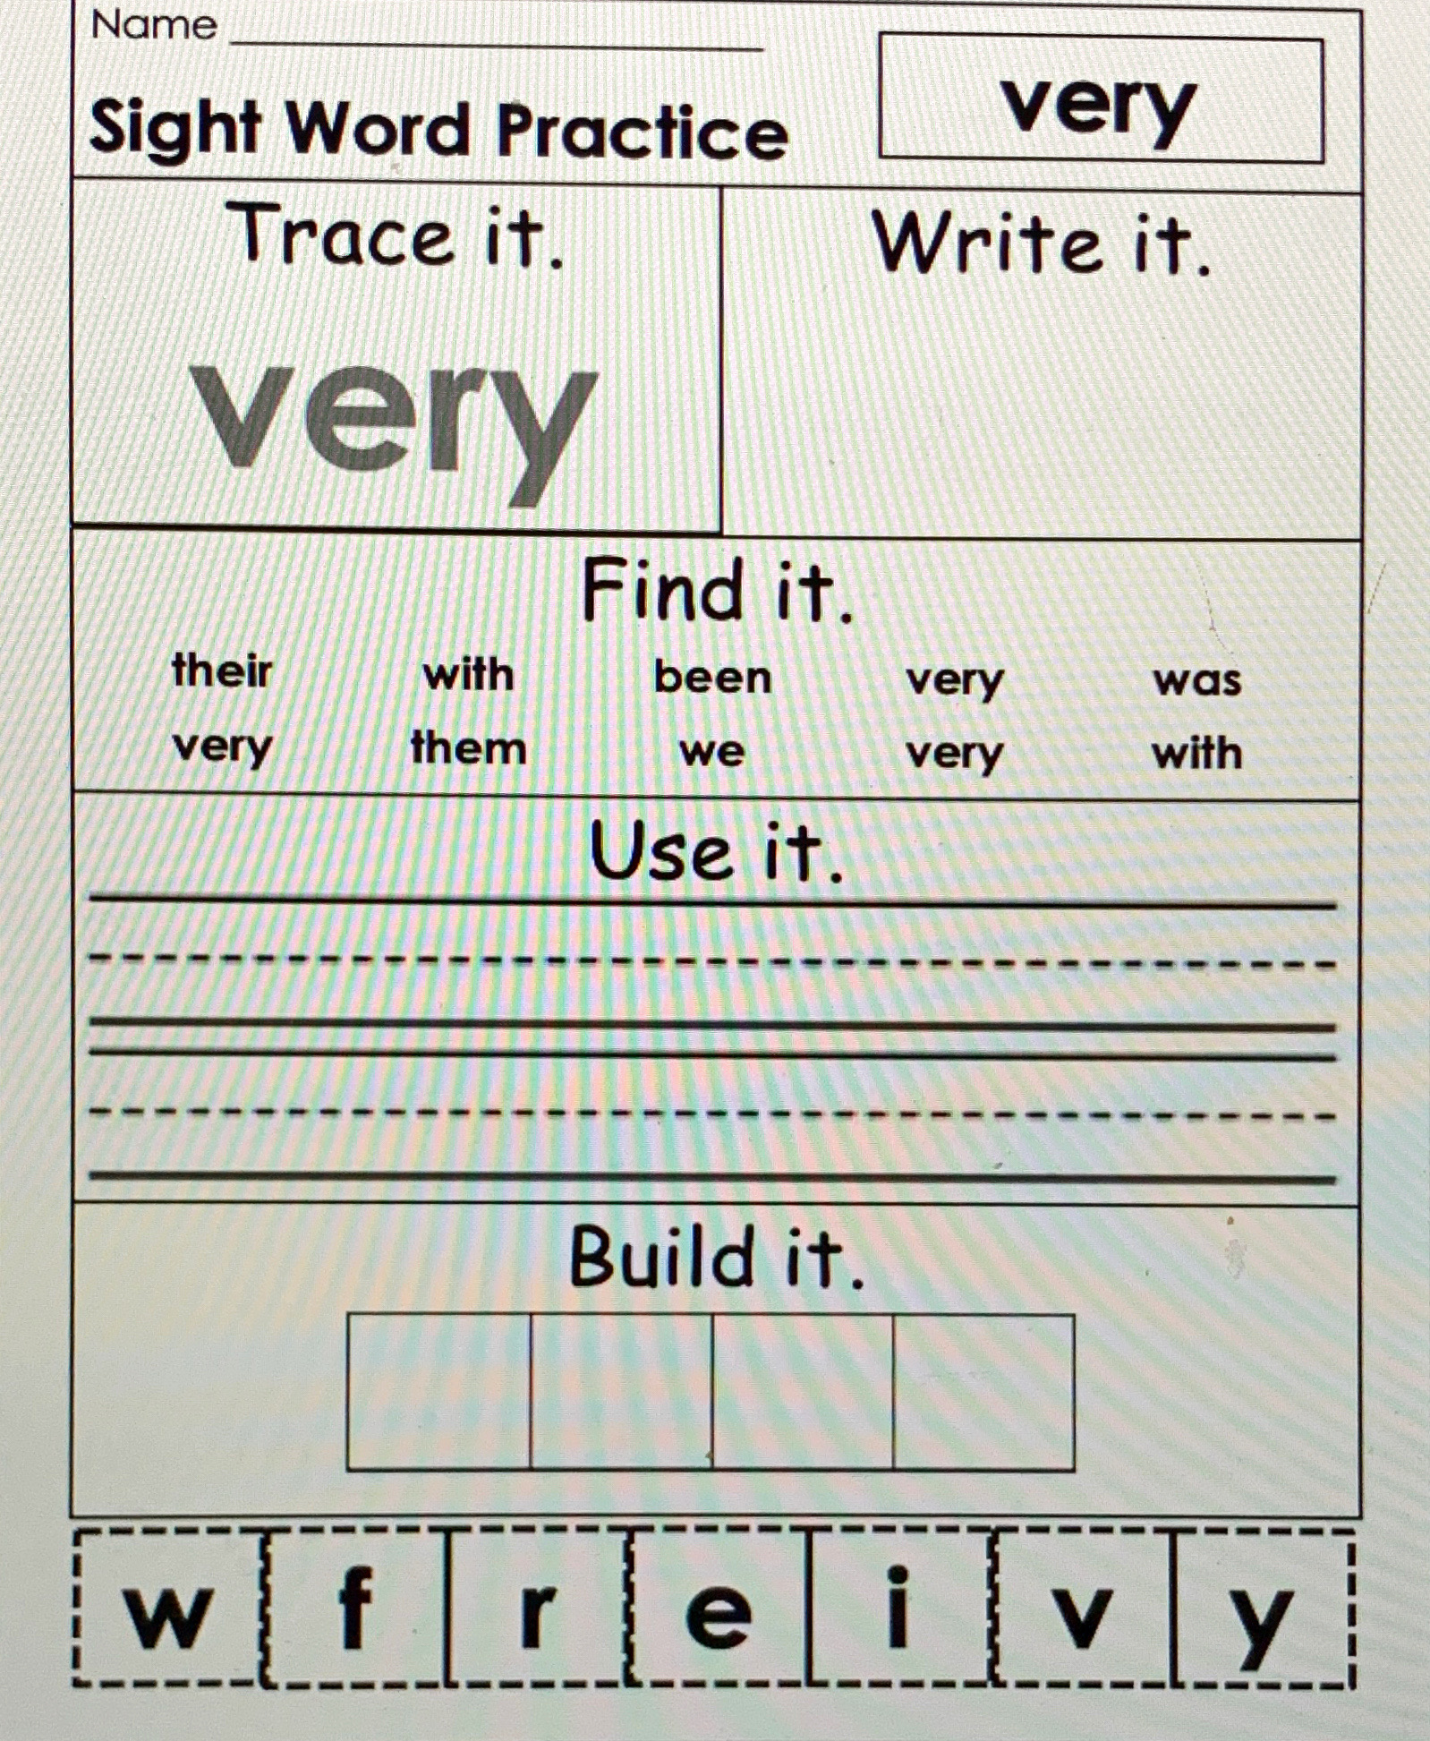

Slide 33
Baseball Words.mp4
Basketball words.mp4
Soccer ball words.mp4
These are review videos of our sight words with flash cards. Remember, though some words can be sounded out, you should remember these words and read them automatically. 😊

Slide 34
Football words.mp4
Volleyball words.mp4
Golfball words.mp4
These are review videos of our sight words with flash cards. Remember, though some words can be sounded out, you should remember these words and read them automatically. 😊

Slide 35
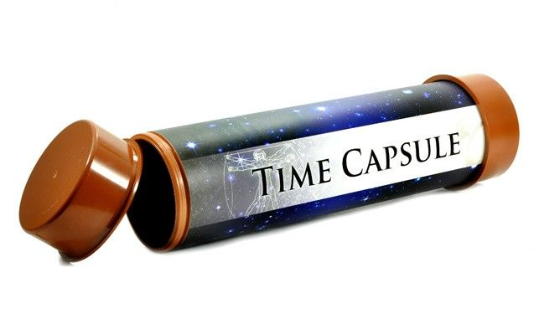
Optional Activity:
We are living in a moment in history and an unprecedented time. The students may not realize it right now, but one day they will think back on these times. This is an idea of a time capsule you could make to help them recall these times years from now.You can make an actual time capsule or you can just keep the paper somewhere safe. We will add a few new sheets each week that you can do with your child to keep in the capsule.

Slide 37
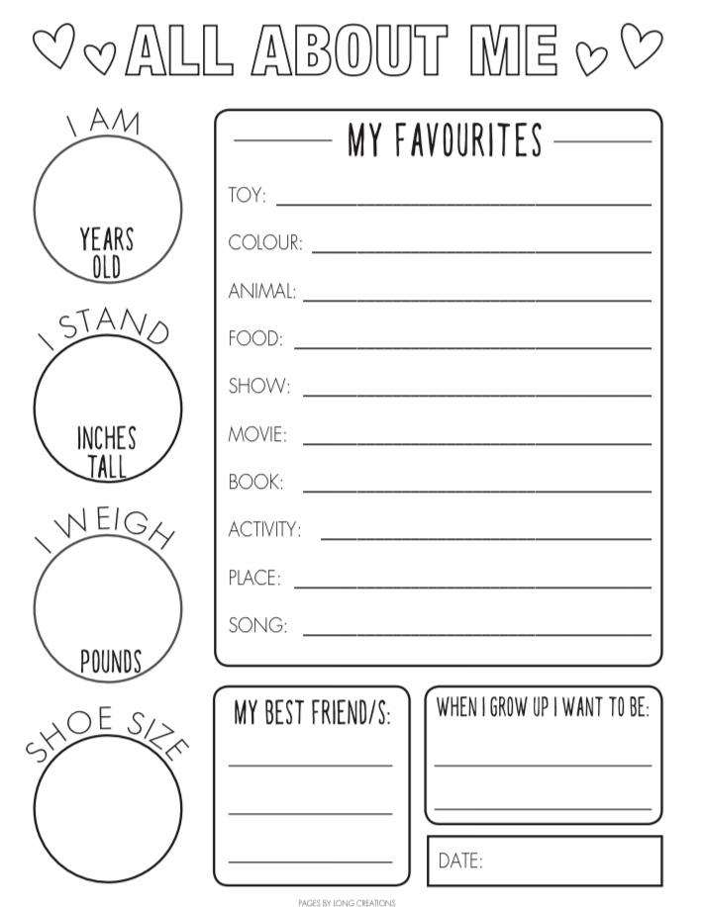
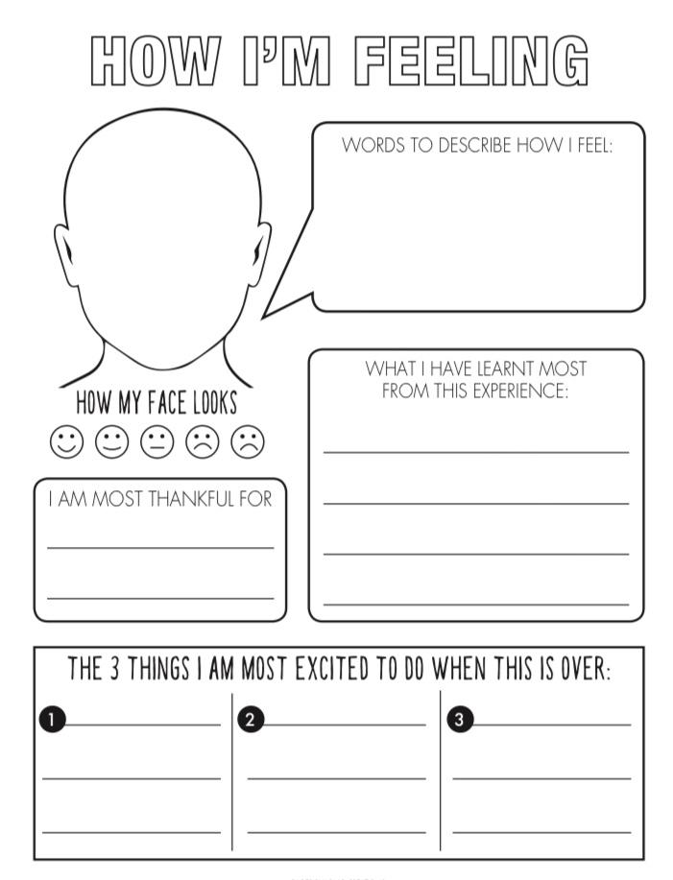

Slide 38
Online Resources Section
These are not links. On this page you will have to type the website name in the web browser, but these are great YouTube alternatives during this time of distance learning and all throughout the year!

Slide 39
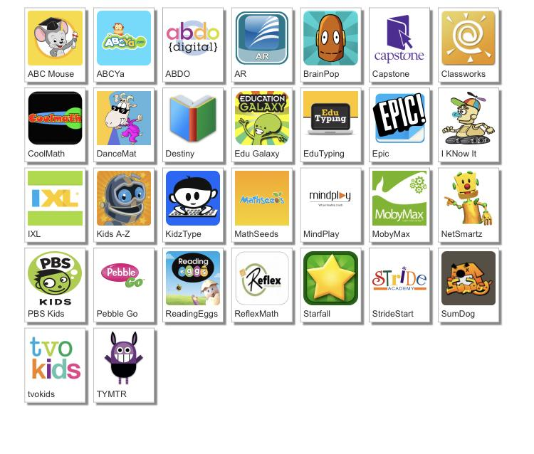
http://www.dcsdms.org/ll/

Slide 40
Message from the Teachers
We miss you guys. We are so proud of all of the hard work you guys have done. Listen to your parents. They are your teachers right now. We may do things differently, but we are all working together to do all that we can for you guys. We would love to see a picture of you working hard. You can send these to us via Remind. Keep working hard! :)

Slide 41
Note to the parents, thank you for investing in your child’s education!

