Slide 1
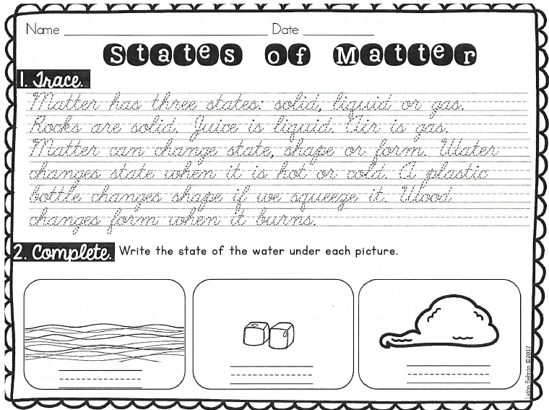
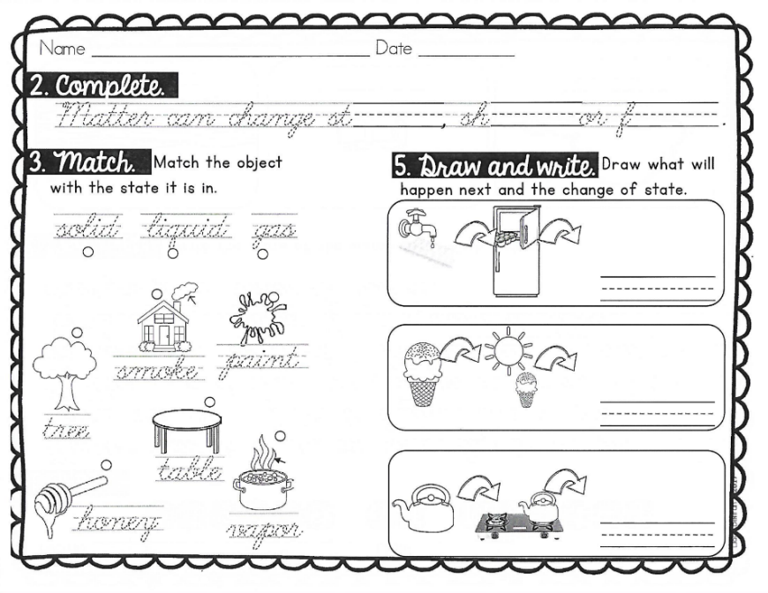
Thursday, August 15, 2019
Practice writing “d” in cursive when finished.
7:55 – 8:35

Slide 2
Cursive Practice

Slide 3

Cursive Practice

Slide 4
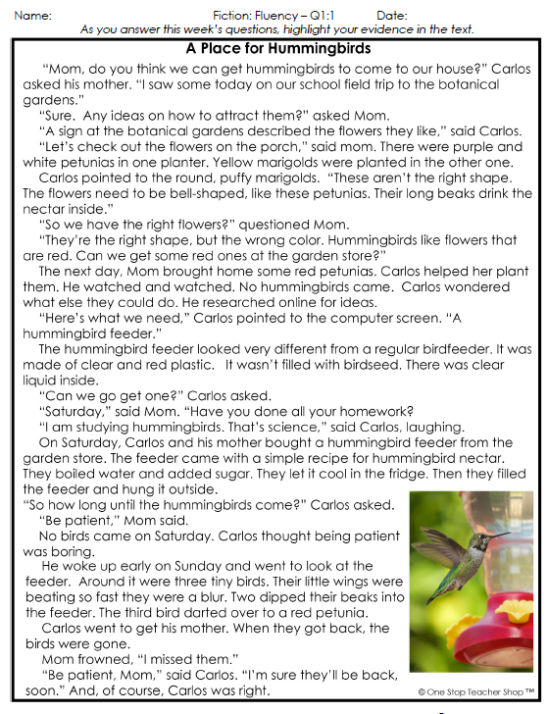
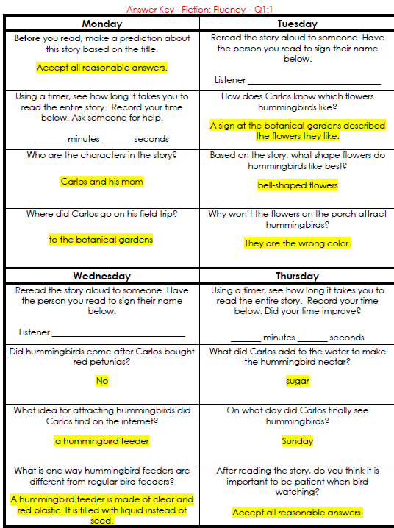
Reading Homework

Slide 5
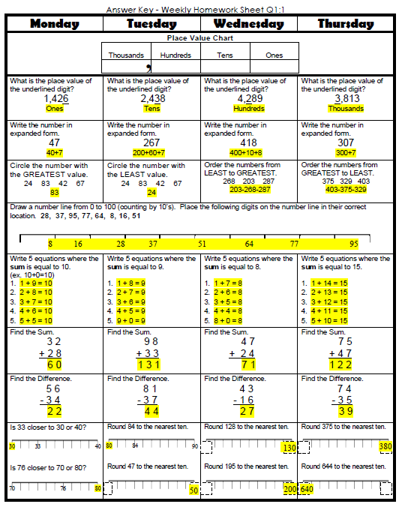
Math Homework

Slide 6

CHOMP TIME
F.A.S.T. Groups
Focused Academic Support Time

Slide 7

F.A.S.T. Designations
Computers – Epic: Jaiden Macon Kaylah Katelynn Carleen McKenzie Erin Noah Elin | Mrs. Roby: LLI Landon Paisleigh | Mrs. Thompson: LLI Jaylie Jearon Amiyah Cohen | IDR – 40 book challenge All others
8:40 – 9:10

Slide 8

Restroom Break
9:10 – 9:20

Slide 9
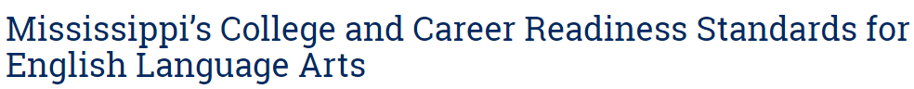

Reading Time
9:20 – 10:25
Objective: RL.3.2
I can recount stories; determine the central message, lesson, or moral and explain how it is conveyed through key details in the text.
Objective: RL.3.7
I can explain how specific images and illustrations contribute to or clarify a story.

Slide 10

Gather at the Carpet…
Are we still the best?

Slide 11

Review Nonfiction Story
What do you remember about this story?

Slide 12
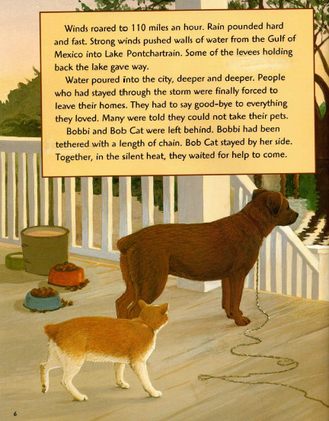
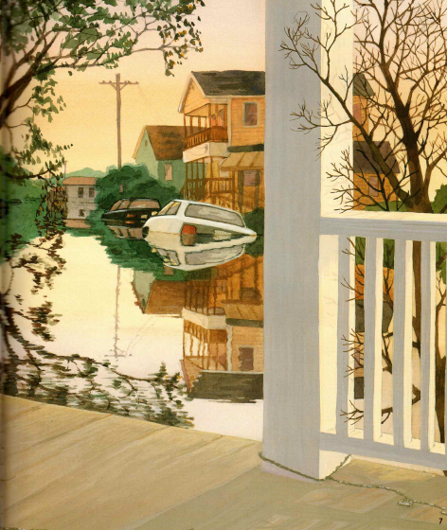
Reread page 6
How do you imagine Bobbi and Bab Cat’s owners felt when they had to leave their pets? How would you have felt in their place? Turn to your partner

Slide 13
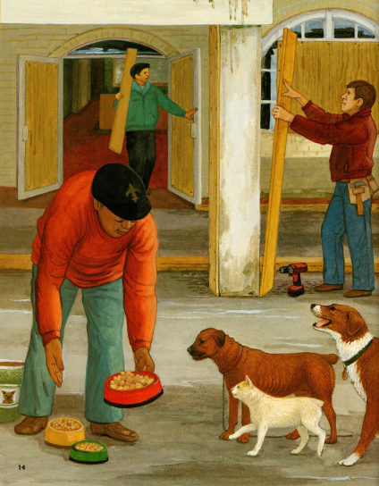
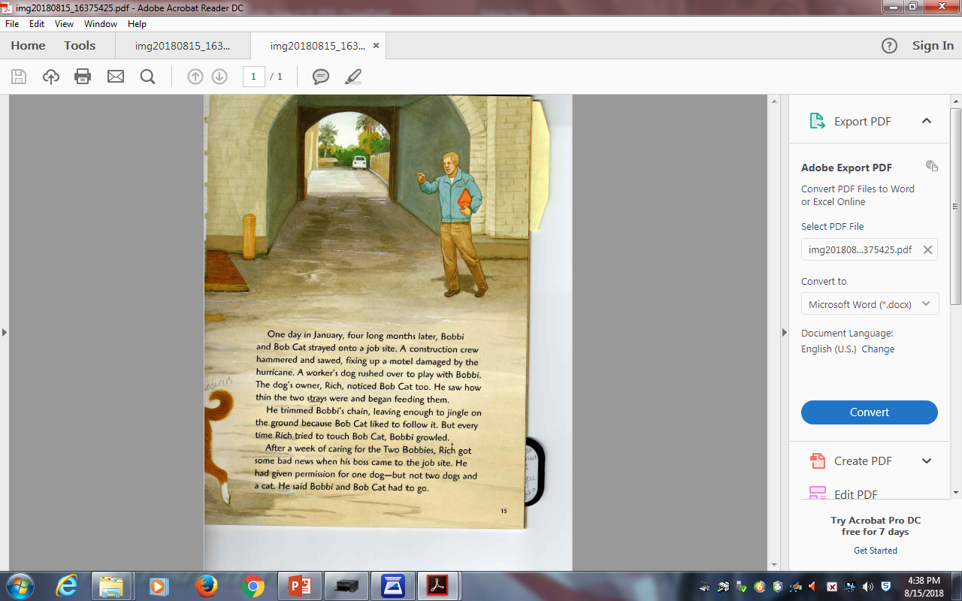
Reread page 15
Why do you think Rich decides to feed Bobbi and Bob Cat? What would you have done if you were him? Turn to your partner

Slide 14
Reread page 2nd paragraph
Why do you think Bobbi growls every time Rich tries to touch Bob Cat? Turn to your partner
Why do you think Bob Cat likes to follow the sound of Bobbi’s chain? Turn to your partner

Slide 15

Classroom Discussion
What did you do to take responsibility for your thinking and talking during “Think, pair, share” today?
How did that help your partner work go smoothly?

Slide 16
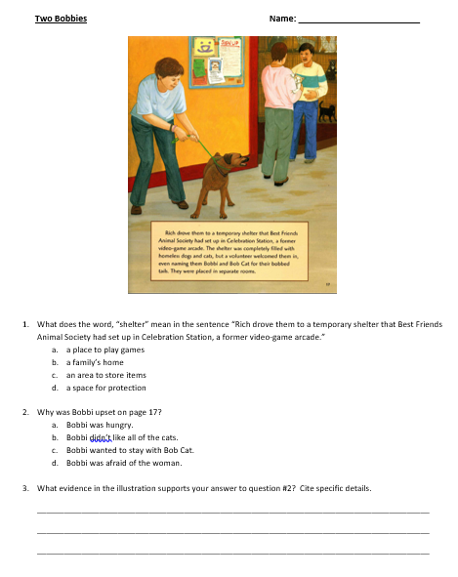
Comprehension Check

Slide 17

Computers - Epic:
  Amiyah
  Aiden
  Jearon
  Adalyn
  Jaylie
  Khamani
  Lexi
  Cayli
  Elin
  Landon
Independent Daily Reading & Teacher Conferences
  Mrs. Roby:
  LLI
  Emma
  Caydance
  Kaylee
  Jordyn
All others Independent Novel for Book Challenge! ☺
10:10 – 10:25

Slide 18



Vocabulary & Grammar Time
Snack Time
10:25 – 10:40

Slide 19
Review of Previous Words: whiz, squirm, rap
Which of these words do you think goes with bus? Why do you think that?
Which of these words do you think goes with rock? Why do you think that?

Slide 20
Out of Classroom!
Recess 10:40 – 11:05

Slide 21



Writing Time
Objective: W3.3
Write narratives to develop real or imagined experiences or events using effective technique, descriptive details, and clear event sequences.
11:05 – 11:35

Slide 22
Gather at the Carpet…
Was it a perfect transition?

Slide 23

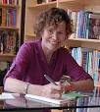
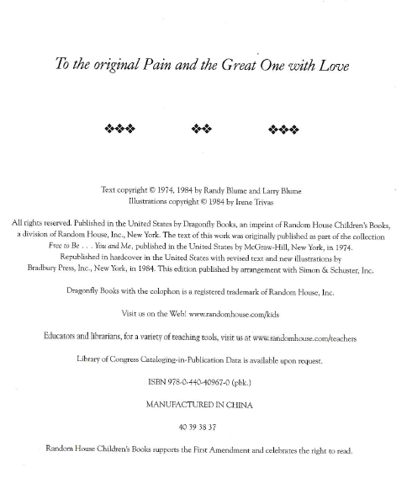
Author Study
Let’s read from page 2
Who do you think “the original Pain and the Great One” might be?
Turn to your Partner.

Slide 24

Listen carefully as I read about Judy Blume.
TE p22,23
What did you find out about Judy Blume?
Turn to your Partner

Slide 25

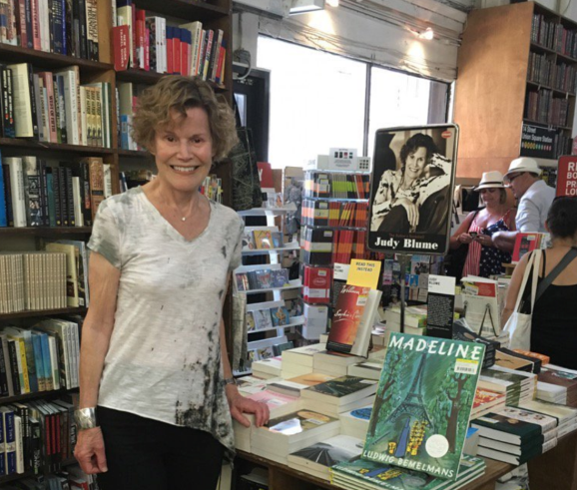




Share Time – Classroom Discussion
What did you do to be a responsible partner during “Turn to your Partner”?

Slide 26
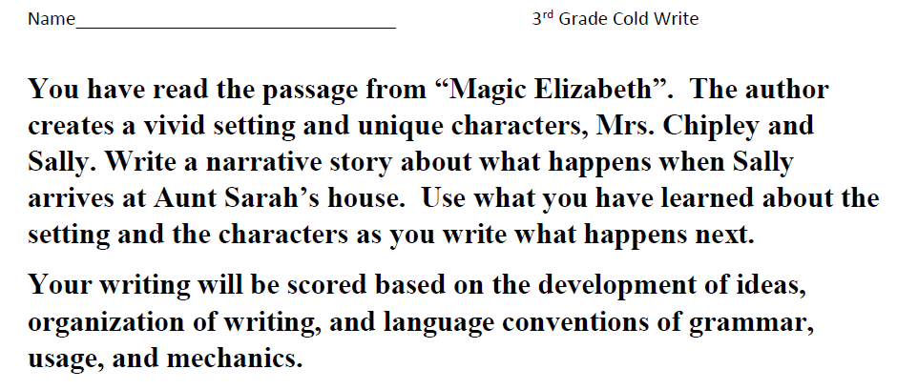
Writing Prompts – Break it Down!
What do you think this is asking you to do? – Let’s think about it and break it down.

Slide 27

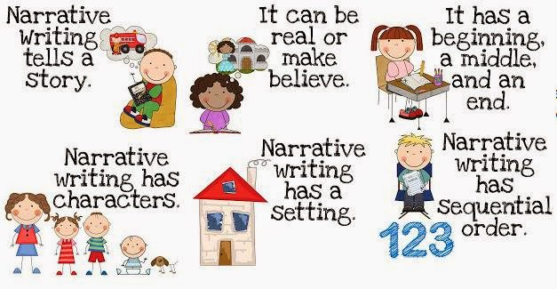
Narrative Review!

Slide 28
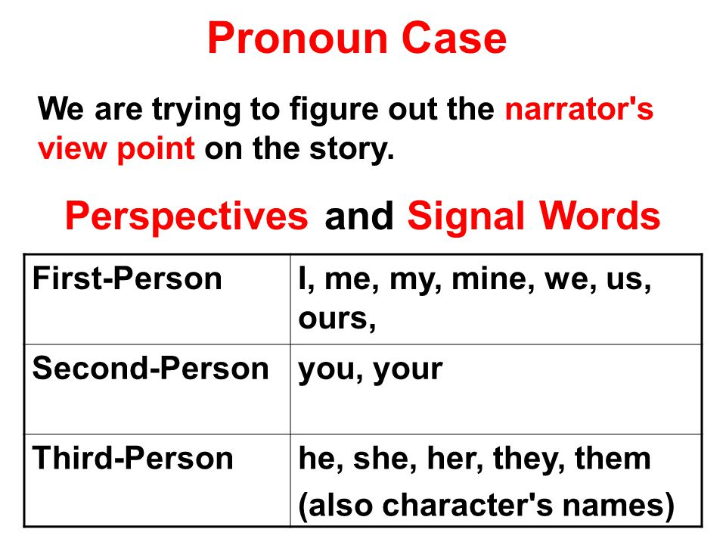
Think about whose perspective you will be writing from and which point of view you will be using.

Slide 29
Now, let’s look at that writing prompt again.
What do we have to be sure to do for our narrative or story?
– Let’s think about it and break it down.

Slide 30
Math Fluency & Focus Lesson!
11:35 – 11:55

Slide 31
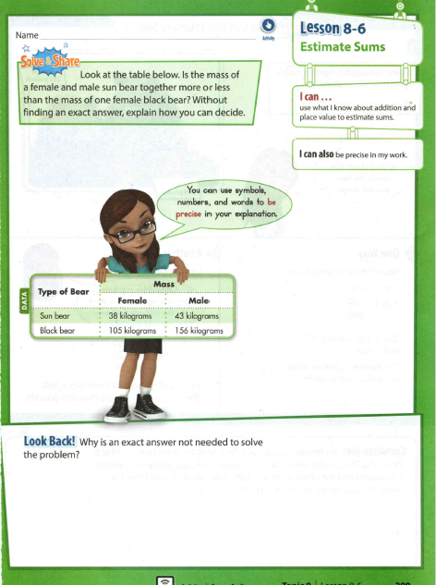
Solve & Share

Slide 32
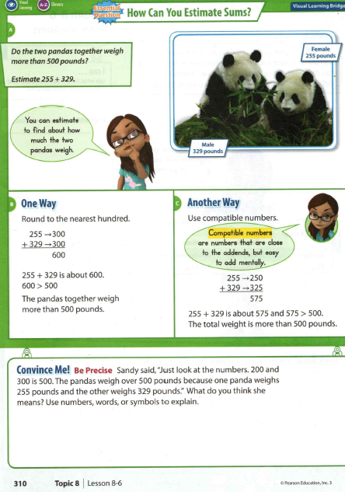
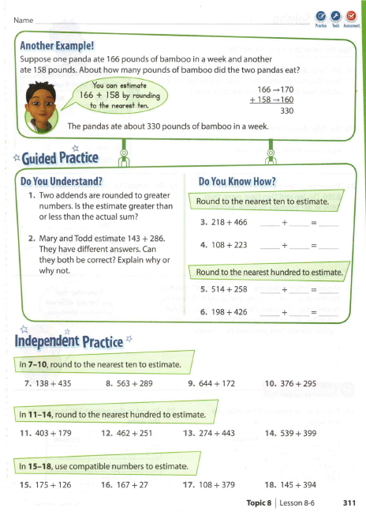

Slide 33
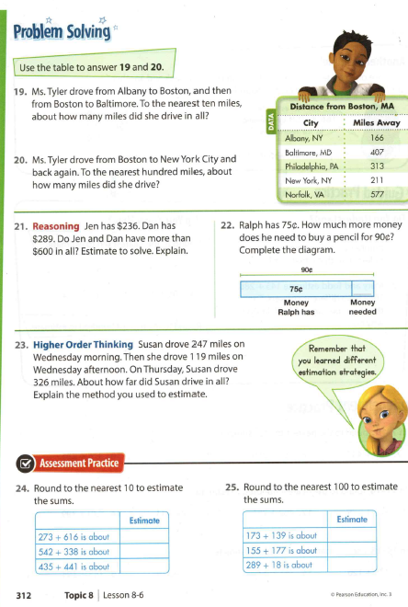

Slide 34
Small Group Rotations 1 & 2
  11:55 – 12:15
Group 1 – Computers (TC, A, B, C, D): Epic
Group 2 – Mrs. Roby: Math IP p311-312 even numbers
Group 3 – Computers (E, F, G, H, I): Imagine Learning/Epic
Group 4 – Mrs. Thompson: Reading Passage
Group 5 – Independent Practice Math p311-312 odd numbers
  12:15 – 12:35
Group 5 – Computers (TC, A, B, C, D): Epic
Group 1 – Mrs. Roby: Math IP p311-312 even numbers
Group 2 – Computers (E, F, G, H, I): Imagine Learning/Epic
Group 3 – Mrs. Thompson: Reading Passage
Group 4 – Independent Practice Math p311-312 odd numbers

Slide 35

Out of Classroom!
Lunch 12:35 – 1:05

Slide 36
Restroom Break
1:05 – 1:10

Slide 37

Out of Classroom!
Activity 1:10 – 1:55

Slide 38
Small Group Rotations 3 & 4
  1:55 – 2:15
Group 4 – Computers (TC, A, B, C, D): Epic
Group 5 – Mrs. Roby: Math IP p311-312 even numbers
Group 1 – Computers (E, F, G, H, I): Imagine Learning/Epic
Group 2 – Mrs. Thompson: Reading Passage
Group 3 – Independent Practice Math p311-312 odd numbers
  2:15 – 2:35
Group 3 – Computers (TC, A, B, C, D): Epic
Group 4 – Mrs. Roby: Math IP p299-300 even numbers
Group 5 – Computers (E, F, G, H, I): Imagine Learning/Epic
Group 1 – Mrs. Thompson: Reading Passage
Group 2 – Independent Practice Math p311-312 odd numbers

Slide 39
Small Group Rotation 5
  2:35 – 2:55
Group 2 – Computers (TC, A, B, C, D): Epic
Group 3 – Mrs. Roby: Math IP p311-312 even numbers
Group 4 – Computers (E, F, G, H, I): Imagine Learning/Epic
Group 5 – Mrs. Thompson: Reading Passage
Group 1 – Independent Practice Math p311-312 odd numbers

Slide 40
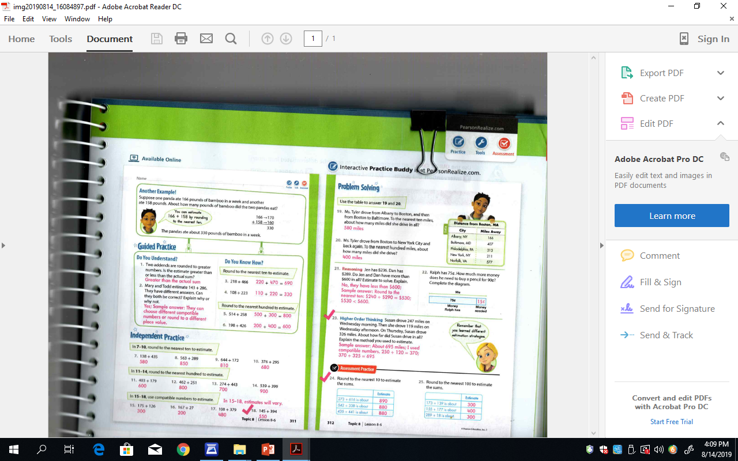

Slide 42
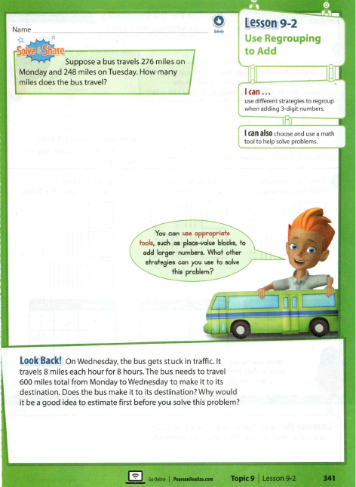
Additional Practice! ☺

Slide 43
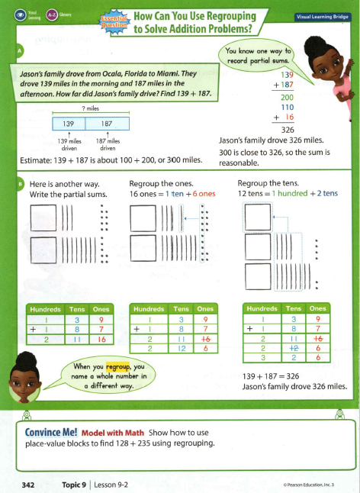
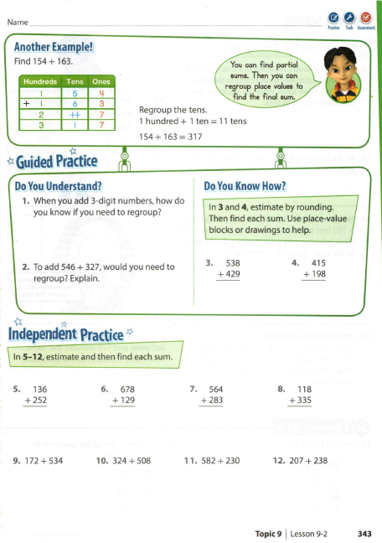

Slide 44
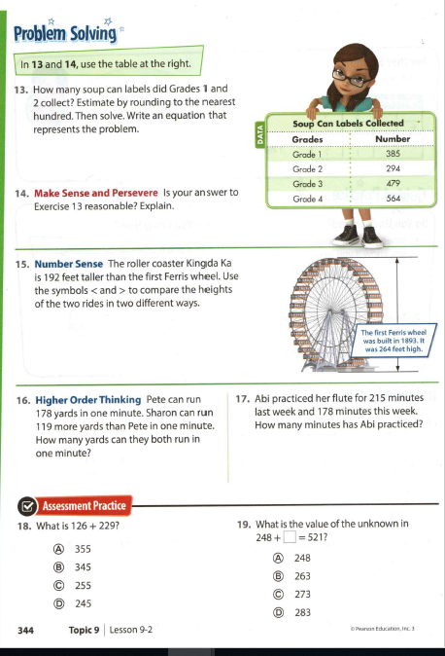

Slide 45
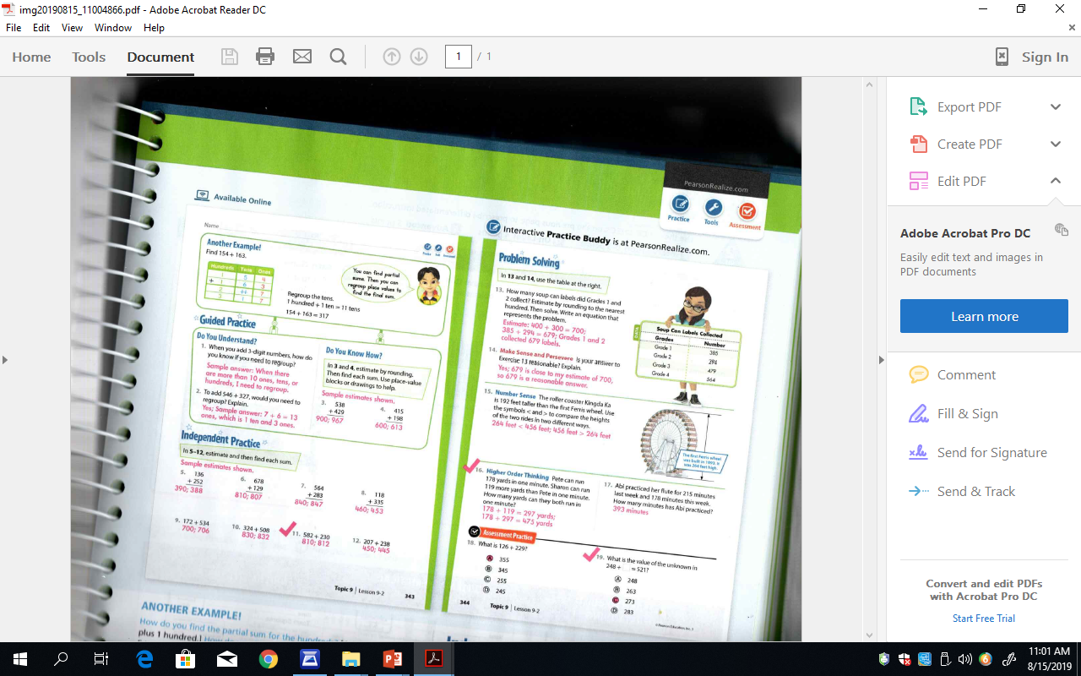

Slide 47
Restroom Break
3:10 – 3:15

Slide 48




3:15 Wrap Up!
Pair-Up back to back and share one thing you learned in class today with your partner
Pack-Up
Office will announce:
Car Riders – Leave around 3:20
Bus Riders – (listen to intercom for dismissal)
2:30 – 3:20
How much time has elapsed?

