Slide 1
WELCOME TO MARBURY HIGH SCHOOL!
8TH GRADE PARENT REGISTRATION

Slide 2
MARBURY HIGH SCHOOL
CLASS OF 2021
Begin with the END in Mind!!!!

Slide 3
GRADUATION REQUIREMENTS:
24 CREDITS
7 CLASSES PER YEAR=7x4=28
Must have 5 credits to be a Sophomore

Slide 4
REQUIRED CLASSES:
4X4=ENGLISH, SCIENCE, MATH, HISTORY(16)
1 Career Preparedness
1 CREDIT=PE
.5 CREDIT= HEALTH
3 Career Tech Education and/or Foreign Language and /or Arts Education
2.5 CREDITS ELECTIVES

Slide 5
Which diploma endorsement is best for my child?
Past Academic Performance
Standardized Test Results
Work Habits
Interests/Motivation
College/Career Goals

Slide 6
WHAT COUNTS?
P.E.
JROTC
L.I.F.E.

Slide 7
WHAT COUNTS?
Career Preparedness
Technology
Skills
Financial
Literacy
College and Career Readiness

Slide 8
WHAT COUNTS?
3 Units
Foreign Language
Art Education
Career Tech

Slide 9
Core Class Placement
Placement Determination
Performance Series Data
ASPIRE Scores
Current Placement
Semester Grades

Slide 10
ALABAMA HAS ONE DIPLOMA! “THE ALABAMA HIGH SCHOOL DIPLOMA”
HOWEVER, IT HAS SEVERAL ENDORSEMENTS!
STANDARD, HONORS, Honors CAREER AND TECHNICAL, Standard CAREER AND TECHNICAL

Slide 11
HONORS ENDORSEMENT
4 English-Honors
4 History- Honors
4 Science-Honors (Biology, Chemistry + 2 honors science electives
4 Math-Honors (Must include Alg. II w/Trig.)
2 Foreign Languages

Slide 12
Honors Course Sequencing
Must take Honors or AP English, Social Studies, Science, and Math
Math
Minimum 4 Credits Required
Algebra I/H
Geometry/H
Algebra II w/Trig
Pre-Calculus, Discrete or AP Stats
Geometry/H
Algebra II W/Trig
Pre-Calculus
Discrete, AP Stat or AP Cal
Science
Minimum 4 Credits Required
Physical Science/H
Biology/H
Chemistry/H
Physics, Genetics, or Anatomy
Biology/H
Physical Science/H
Chemistry/H
AP Biology or AP Chemistry
Biology/H
Chemistry/H
2 of the following: Physics, Genetics, Anatomy, AP Biology, AP Physics, AP Chemistry
English
Minimum 4 Credits Required
Pre-AP Eng 9
Pre-AP Eng 10
AP Eng 11
AP Eng 12
Eng 9/H
Pre-AP Eng 10
AP Eng 11
AP Eng 12
Eng 9/H
Eng 10/H
Eng 11/H
Eng 12/H
Eng 9/H
Eng 10/h
AP Eng 11
AP Eng 12
Eng 9/H
Eng 10/H
AP Eng 11
Dual Enrollment Eng 101/Eng 102
Social Studies
Minimum 4 Credits Required
Wld History/H or AP
US Hist 10/H or AP
US Hist 11/H or AP
US Gov/Economics/H or AP

Slide 13
STANDARD ENDORSEMENT
4 ENGLISH
4 MATH- (Must including Alg. II)
4 HISTORY
4 SCIENCE-BIOLOGY, PHYSICAL OR EQUIVALENT + 2 MORE

Slide 14
Standard Course Sequencing
Math
Minimum 4 Credits Required
Beginning 2012-2013
Algebra I-A
Algebra I-B
Geometry
Algebra II
Algebra I
Geometry
Algebraic Connections
Algebra II
Science
Minimum 4 Credits Required
Physical Science
Biology
Environmental Science
Chemistry
Physical Science
Biology
Earth Science
Environmental Science
Biology
Chemistry
Environmental Science
Earth Science
English
Minimum 4 Credits Required
Eng 9
Eng 10
Eng 11
Eng 12
Social Studies
Minimum 4 Credits Required
Wld History
US Hist 10
US Hist 11
US Gov/Economics

Slide 15
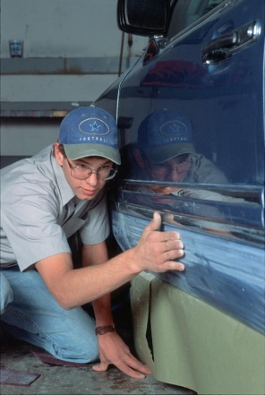
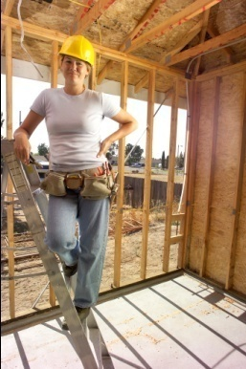
CAREER TECHNICAL ENDORSEMENT
Available for all diplomas options
Must have at least 3 credits in sequenced cluster
Courses taken at Autauga County Technology Center

Slide 16
NCAA ELIGIBILTY STANDARDS
16 core courses-Division I
16 core courses-Division II
ACT and SAT must be reported directly to NCAA
Division I has a sliding scale
Division II requires ACT sum score of 68 (English, math, reading and science
Only core courses are used to calculate GPA.
Division I GPA
Division II requires a minimum of 2.000

Slide 17
NCAA ELIGIBILITY STANDARDS
DIVISION I
16 Core-Course Rule
DIVISION II
14 Core-Course Rule
16 Core Courses:
4 years of English
3 years of mathematics (Algebra I or higher)
2 years of natural/physical science (1 year of lab if offered)
1 year of additional English, mathematics, or natural/physical science
2 years of social science
4 years of additional courses (from any area above, foreign language or non-doctrinal religion/philosophy)
16 Core Courses:
3 years of English
2 years of mathematics (Algebra I or higher)
2 Years of natural/physical science (1 year of lab if offered)
3 years of additional English, mathematics, or natural/physical science
2 years of social science
4 years of additional courses (from any area above, foreign language, or non-doctrinal religion/philosophy

Slide 18
What do colleges want and how do I get scholarships for my senior year?
High GPA!
High ACT Score!

Slide 19
Registration Process
Review/discuss tonight’s information with your child.
Turn in completed forms to Mrs. Tubbs March 31st.
Orientation in August for more details and schedule pickup.

Slide 20
REGISTRATION FORMS!
Choose Diploma Type
Student and Parent Sign the
Registration form (include a contact
number)
Choose LIFE Credit (Already completed
for you)
Choose Career Preparedness (Already
completed for you)
Choose elective
Choose 3 alternate electives

Slide 21
REGISTRATION FORMS!

Slide 22
REGISTRATION FORMS!
Course Override
If you want to change the suggested courses, you will enter the requested course(s), and sign/date at the bottom.

Slide 23
REGISTRATION FORMS!
…AND YOU THOUGHT THESE WERE THE ROUGH YEARS!

Slide 24
4 Year Plan
Please complete this form in pencil because it will change over the next 4 years.
Complete the four year plan and return it with registration forms.

Slide 25
Contact Information
Kimberley Hicks,
Guidance Counselor
Marbury High School
2360 Highway 31 North
Deatsville, AL 36022
(334) 387-1910
kimberley.hicks@acboe.net
Website: www.marburyhighschool.org

