Slide 1
Honors English 9
Survival Guide
2019-2020
Mrs. Michelle Cowan

Slide 2
Eligibility for Honors English 9
The Central Office of MCPSS has issued the following prerequisites for entering and requirements for remaining in Honors English 9:
  “Prerequisite: Students should have earned at least a 75/C average in Honors English 8 and at least an 80/B average in regular English 8 with the recommendation of the English teacher.
  Requirement: “Students who fail to maintain a 75/C or above will be removed from the Honors English Program for the next appropriate term.”

Slide 3

Supply List
3-Ring binder
Loose-leaf paper
Dividers: You may buy these or make your own. You will need the following divisions in your notebook: class paperwork, bellringers, vocabulary, grammar, literature, & writing.
3 packs of Post-It notes
Blue/Black Pens (Any other color or pencil is not permitted.) You will also need a colored pen to
check papers in class.
A highlighter
White-out
1 package of lined 4x6 index cards(for the research project)

Slide 4

Books to Purchase
To Kill a Mockingbird by Harper Lee
Animal Farm by George Orwell
*The Odyssey by Homer and Romeo and Juliet by William Shakespeare are in our literature textbook*
*No Fear Shakespeare: Romeo and Juliet

Slide 5

How Do I Get My Novels?
There is a $25.00 for this class which will pay for your copies of the required novels. If you do not pay the fee, you are required to get the novels on your own from a local bookstore, Amazon.com, or even borrow books from the library.
  It must be a PAPER copy of each book. E-books and Kindles are not acceptable copies of the books.
  YOU MAY NOT SHARE A NOVEL
  WITH ANOTHER STUDENT!!!!

Slide 6

Rules of the Game
*All Mobile County Board of Education rules will be enforced in my classroom, as well as those of Davidson High school.
Be on time and seated when the tardy bell rings.
  I will close the door once the tardy bell rings. If you come to class and the door is already closed, report to tardy hall
  Each tardy: Student is detained in tardy hall until the next class period, unless an administrator excuses the tardy. I will not accept a note from another teacher unless it is a VERY GOOD reason. I determine what is a GOOD
  REASON.
  3rd tardy: Parent is contacted
  4th tardy: Student is assigned to RETRACT for 3 days
  5th tardy: Student is suspended from school for 3 days
Students who enter class with a tardy hall pass will
not be able to make up quizzes or work missed after
the bell. They will receive an automatic zero on all
such work.

Slide 7


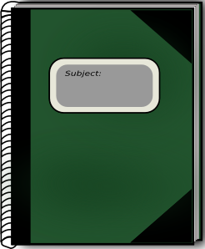

Be Prepared!
Come to class prepared.
  No one will be allowed to leave once the tardy bell has rung. If you do not have what you need for class, you will miss out on the lesson for the day.
  Bring your notebook, blue/black pen, colored pen, highlighter, paper, EVERYDAY!
  I will tell you when to bring your literature books.

Slide 8
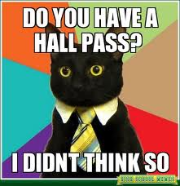
Potty Time
Go to the restroom before or after class. You will NOT interrupt class to visit the restroom unless you are ill or can provide at doctor’s note explaining a chronic illness.
-You will be given 4 restroom/hall passes for the ENTIRE SEMESTER. Use them sparingly. You will only be able to use them when it does not interrupt class activities and in case of emergency.
- Once you use all 4 passes, they are gone.

Slide 9
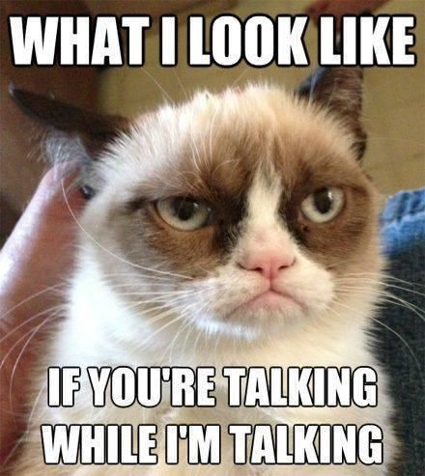
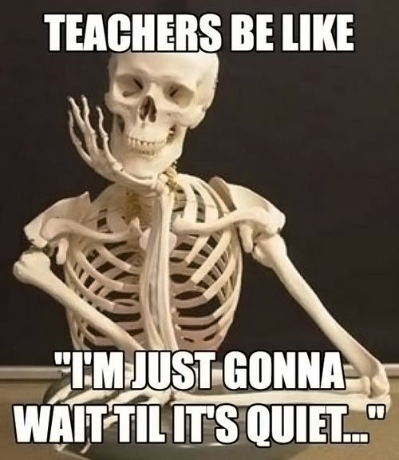
Rules of the Game Continued…
Raise your hand and wait to be recognized before speaking.

Slide 10

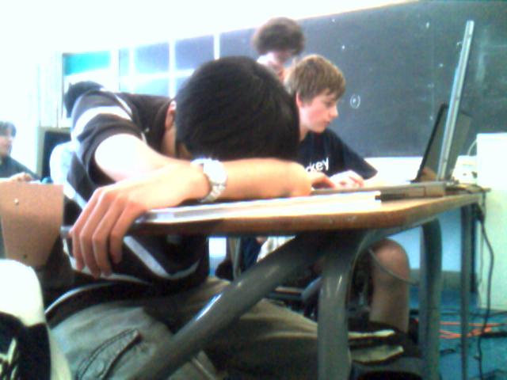
Sleeping in Class
If a student chooses to sleep in class, he or she will receive zeroes on all of the work he or she missed while napping. . If you wake up before the end of class, I will NOT give you any handouts you missed.

Slide 11
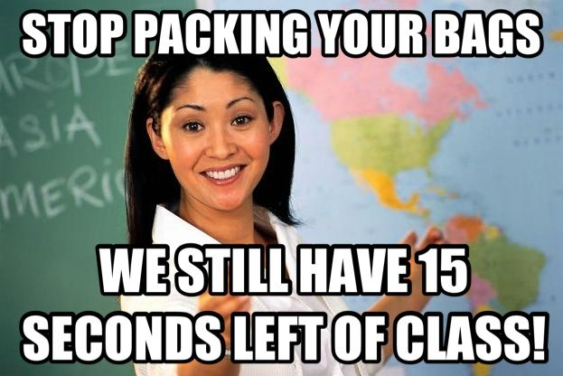
Rules of the Game Continued…
Remain in your assigned seat until you are dismissed or until you are given permission by the teacher.

Slide 12

Proper Heading
Heading goes in the top, left hand corner of your paper. Your heading should be double-spaced.
Jane Doe
Mrs. Cowan
Honors English 9
7 August 2019
*NO NAME = NO CREDIT for the assignment*

Slide 13
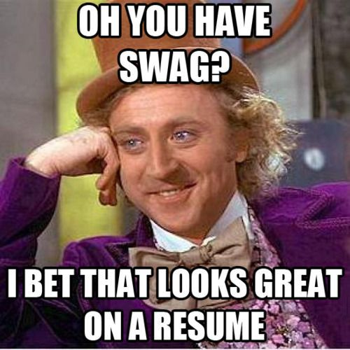
Uniforms and Cell Phones
I know that everyone here hates the policies on uniforms and cell phones. BUT I follow the rules.
  If you are out of uniform, you are not allowed into my classroom. If I have told you to fix your uniform and you are in the hallway when the bell rings, you must go to tardy hall.

Slide 14

Cell Phones
Students,
I know when you are
texting in class. Seriously,
no one just looks down at
his/her crotch and
smiles. ☺

Slide 15
Cell Phones
All cell phones will be placed in the pocket organizer hanging on the board. The only way you will be counted present for the period will be if you put your phone in the pocket organizer.
It is your responsibility to grab your phone before you leave at the end of class.
If Mrs. Cowan sees you with a cell phone on your person, she will refer you to the office and send the phone to the office to be picked up by a parent.
* This helps you focus and stay out of trouble.

Slide 16

Late Work Policy
I will not accept any work late unless you have an excused absence. This includes if you check in late. If you have a tardy, the work is still due that day.
  (You must find me before you leave school that day and turn the assignment in.)
All work must be turned in on the day it is due.
  If it is not in the classroom at our regular meeting time (in your locker, on your bed, in your mom’s car), it will not be graded.
  “If the work isn’t here, it doesn’t exist.”

Slide 17
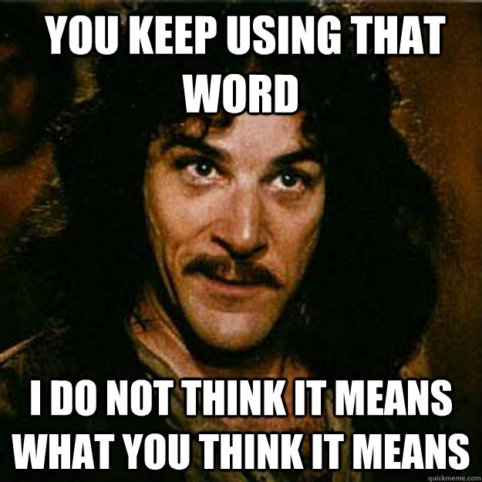
Rules of the Game Continued…
Respect your peers, your teacher, and yourself. (Profanity and degrading comments will not be tolerated.)

Slide 18

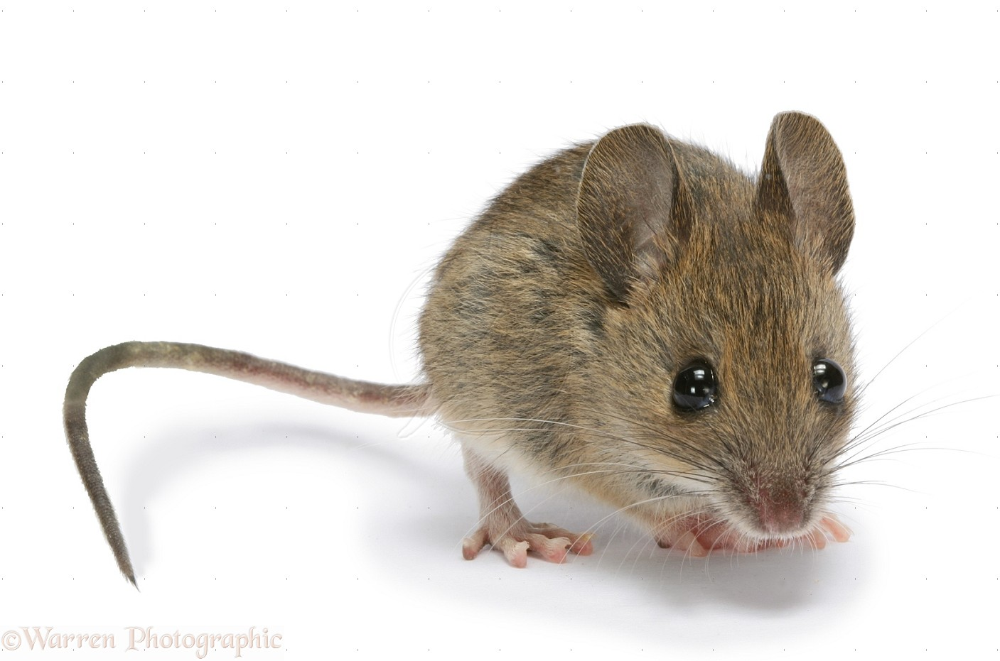
No Food or Drinks!!!
Do not bring your lunch or snacks to class.
We must keep the room clean to avoid furry friends. Yuck!
You may bring bottled water, but
nothing else is permissible.

Slide 19

The Golden Rule
The Golden Rule: “If it’s not yours, DON’T TOUCH IT!”
  Treat this classroom with respect. Keep it neat and clean.
    NO FOOD OR DRINKS! (only bottled water is permissible)
  Anything on my cart is off-limits unless you ask my permission.
  Do not go through other students’ book bags, purses, pants pockets, etc.
  “Do unto others as you would have them do to you.”

Slide 20
Consequences
If you choose to break the rules, this is what will happen.
Step 1: The student will be given a verbal warning to correct his/her behavior.
Step 2: If the undesirable behavior persists, Mrs. Cowan will speak with the student outside of the classroom about his/her disruptive behavior.
Step 3: The student will report to the retract room to complete his/her work in a quiet environment where he/she will not be distracted and will not distract other students. Mrs. Cowan will call the student’s parent.
Step 4: Some behaviors warrant Mrs. Cowan deviating from the three-step behavioral plan. If that is the case, Mrs. Cowan will send the student to office with a referral.
This is up to Mrs. Cowan’s professional discretion and is not for discussion with the student.

Slide 21
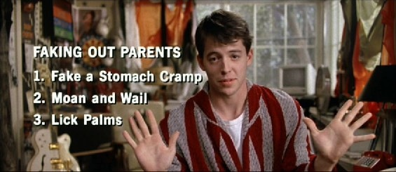
Attendance
If you do not attend class, you will not have a good grade in my class. Students who are absent will miss out on important discussions, homework, reviews, etc.

Slide 22
Attendance Policy
Your attendance is EXTREMELY important. We will be working EVERY day. One absence will set you back.
If you do miss class, you will have 3 days to bring in an excuse in order to make up your work.
If you have more than four unexcused absences you may not receive credit for the class.
You will receive a zero for any work missed due to unexcused absences or unexcused tardies. Please be aware that this includes tests and quizzes.
If your absence is excused, it is YOUR responsibility to check the make-up work notebook and turn in assignments within one week after your return to school. Any work not turned in after one week following your absence will become a zero.
You have one week to schedule a time for you to make up your
tests/quizzes. This can NOT be our scheduled class time.
If you do not show it’s a zero.

Slide 23
Make-Up Work
Bring a parent/doctor’s note to your first block teacher.
Check the “Missing Work” binder for the assignments you missed and write them down.
Ask Mrs. Cowan for any worksheets you missed.
Check the make-up work list on the dry erase board.
Turn in ALL make- up work by 3:00 on Friday, or it becomes a zero.
All tests and quizzes must be made up on your own time during the school day. They MAY NOT be made up during our class time.

Slide 24
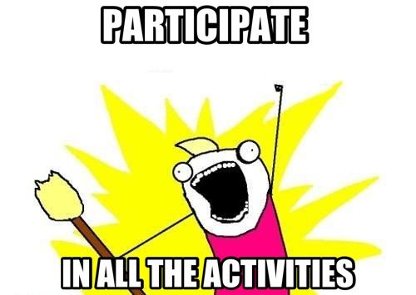
Class Participation
Class participation encompasses a variety of responsibilities and duties that each student should display on a regular basis. Your class participation grade will be worth 100 points each term. See the syllabus packet for details.
Please be aware that when a student has been detected cheating on an assignment, a zero will be assigned for the work, and the class participation grade will be lowered by one letter grade at the end of the term.

Slide 25
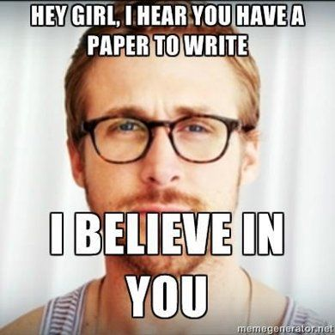
Writing Assignments
Essay Requirements:
  typed according to MLA format
  two full pages in length
  each essay must be submitted to turnitin.com. If the essay is not submitted to turnitin.com by 7:00 A.M. on the due date, then the essay will receive a zero. A hard copy of the essay will also be turned in on the due date. If a hard copy is not turned in, then the essay will receive a zero.
Students will sign a sheet outlining the essay policy the first week of school. This sheet describes the requirements. By signing this sheet, a student is acknowledging that they understand the requirements.

Slide 26
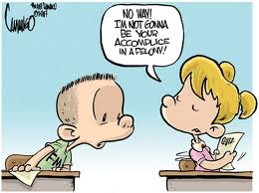
Cheating/Plagiarism
Cheating of any kind will not be tolerated.
-Any instance of plagiarism or cheating in Honors English 9 will result in a grade of 0% on the entire assignment.
-If the cheating involves more than one person, everyone involved will receive a 0% on the assignment. Let your friends do their OWN work.
-In cases of cheating/plagiarism, the teacher will insist on punishment to the fullest extent allowed.

Slide 27
EQT’s: End of Quarter Test
Honors students take the MCPSS-created EQT and are also required to write an in-class essay based on one of the selections read during the term.
  (First semester- the students will write about To Kill a Mockingbird; second semester-the students will write about Animal Farm.)
The essay counts 25% of the EQT grade.
The entire EQT grade (objective test and the essay) will count 20% of the quarter grade.

Slide 28
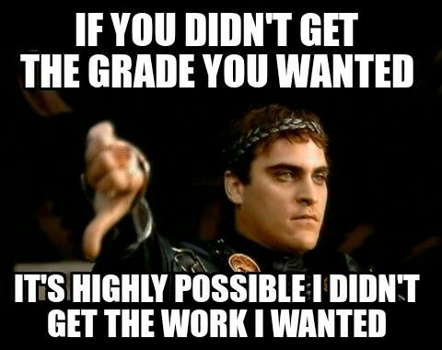
Mrs. Cowan’s Words of Wisdom

Slide 29
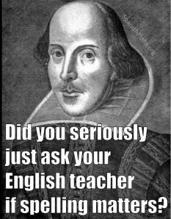
Mrs. Cowan’s Words of Wisdom

Slide 30
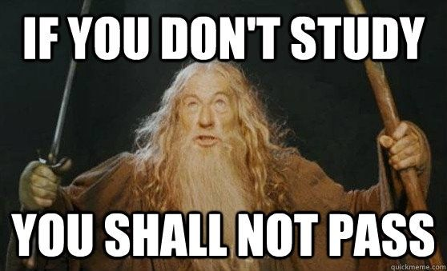
Mrs. Cowan’s Words of Wisdom

Slide 31

Mrs. Cowan’s Words of Wisdom

Slide 32
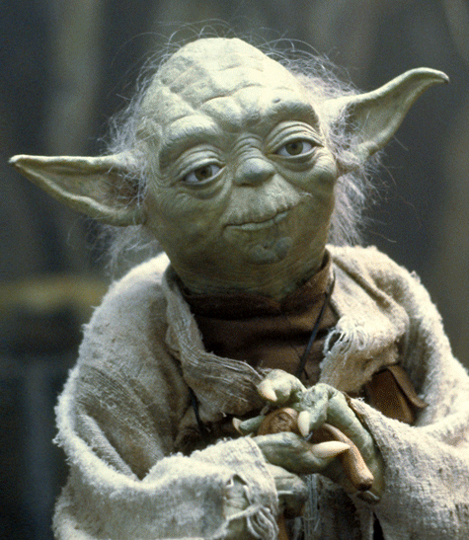
Mrs. Cowan’s Words of Wisdom
“Do or do not. There is no try.”
-Yoda,
Jedi Master

Slide 33

Mrs. Cowan’s Words of Wisdom

Slide 34
Calendar and Email Address
I will instruct you of upcoming assignments in class so that you can keep your calendar up-to-date.
If you need to email me, use this address:
        mcowan@mcpss.com

Slide 35
Parent Conferences
I am available to meet with
parents during my planning
period. Please let your parents
know that they must first call or
email me to set up a time. I will not
meet with parents unless they have already
scheduled a meeting.

