Slide 1
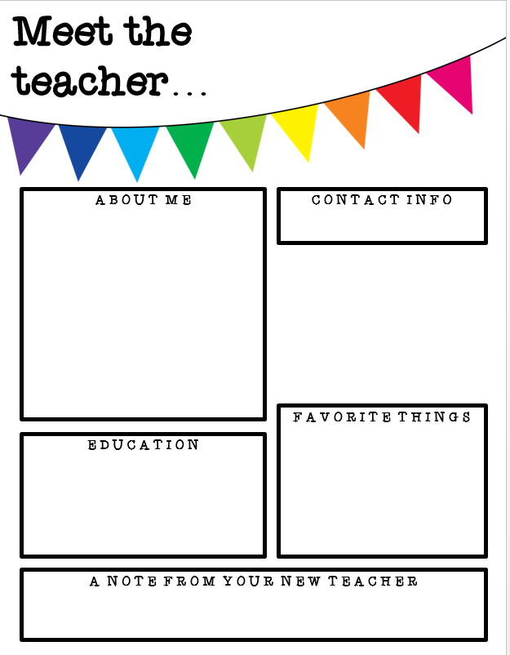
Mrs. Calhoun
My name is Mandy Calhoun and I grew up in Chauncey, GA. My teaching career started in Bibb County at Weaver Middle School. I taught in Macon, GA for 4 years. I have lived and taught in Perry for the last 17 years. I have been married to my husband, Ralie Calhoun for 4 years. I have an 18 year old step daughter, Ashlie and a 17 year old step daughter, Maya. I also have several fur babies; 2 dogs and 4 cats.
amanda.l.calhoun@hcbe.net
478-988-6285 Ext. 2977
A few of my favorite things…
Spending time with family, fishing (river & ocean), mystery movies/books, Netflix, anything Amazon, Starbucks
Bachelor’s Middle Grades: Georgia College & State University
Master’s Middle Grades: Troy University
Specialist in Curriculum & Instruction: Piedmont College
Welcome to 8th grade science! I am excited to be your teacher and to be back in school learning together. This year will be full of LOTS of new adventures.

