Slide 1
MISSISSIPPIAN INDIANS: STATION TASK DOCUMENTS
Station 1: Culture
Slides 1 & 2
Station 2: Food
Slides 3 & 4
Station 3: Weapons/Tools
Slide 6
Station 4: Shelter
Slides 7 & 8

Slide 2
CULTURE

Slide 3
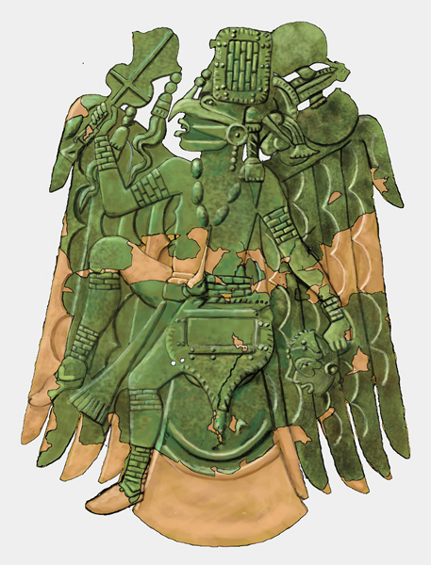
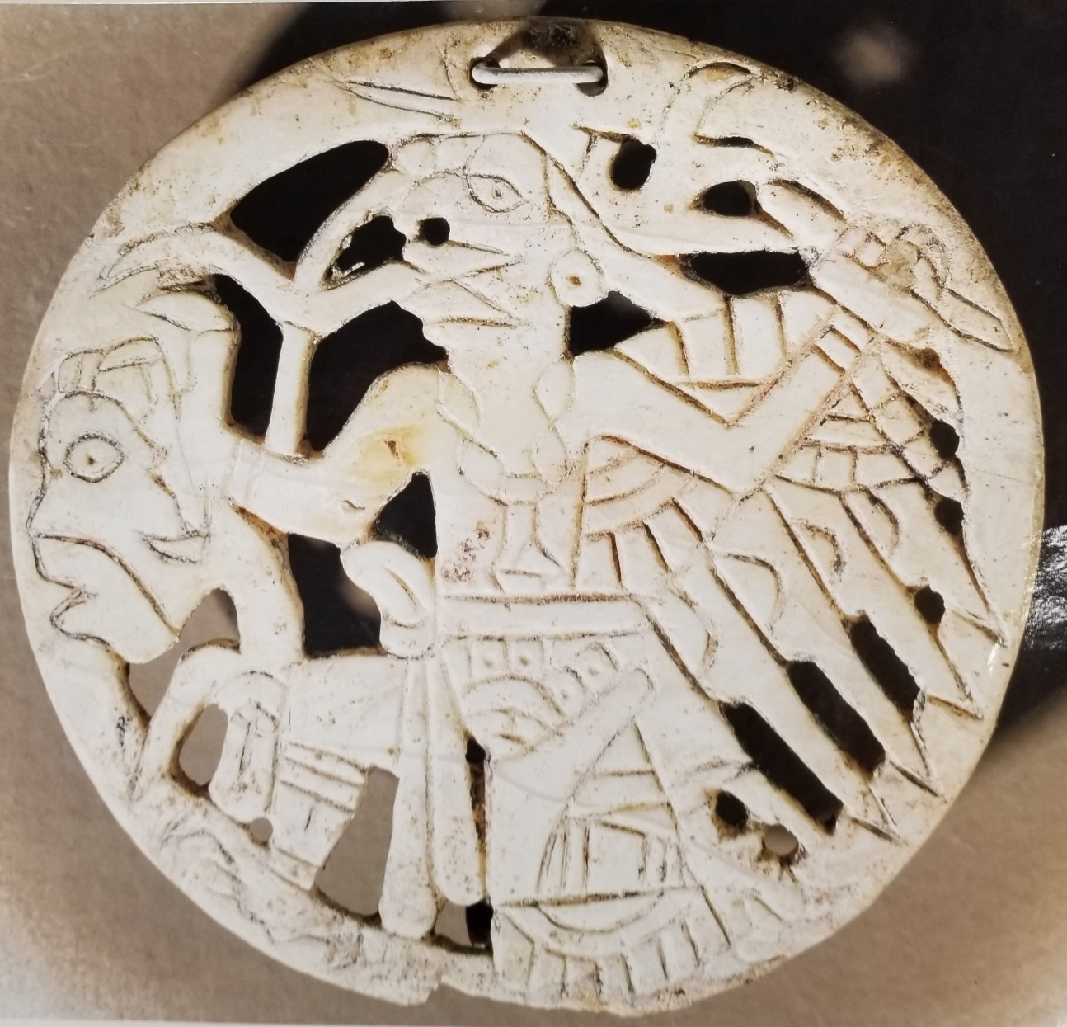
Shell Ornament from Etowah, GA. Circa 1000 A.D.
This ornamental collar depicts a flying shaman with the wings and talons of a bird of prey. The shaman holds a human head in his hand. This was found by archaeologists at the Etowah Indian Mounds.

Slide 4
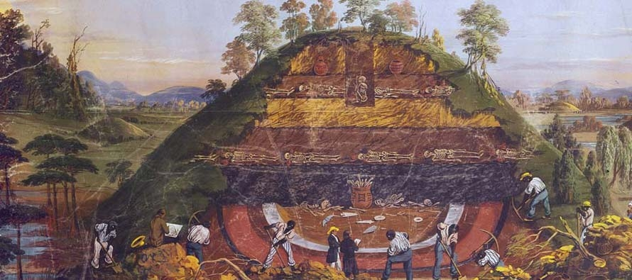
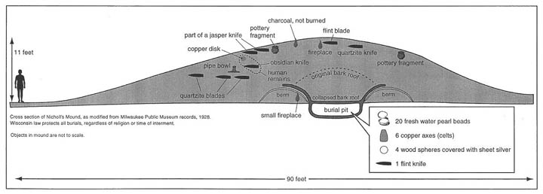
Archaeological excavation of a
Mississippian Burial Mound

Slide 5
FOOD

Slide 6
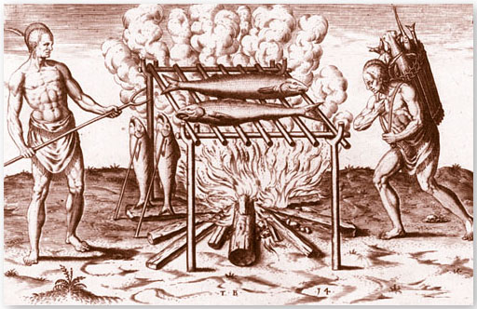

Slide 7
Notes:
Station 2 – Mississippian Indians cooking fish (Wikimedia Commons)

Slide 8
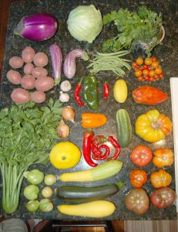
Notes:
Station 2 – Mississippian Indians Diet (Northwest Florida Travel)

Slide 9
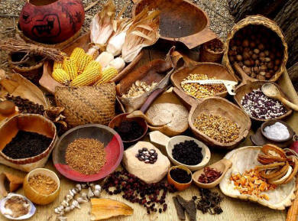

Slide 10
WEAPONS & TOOLS

Slide 11
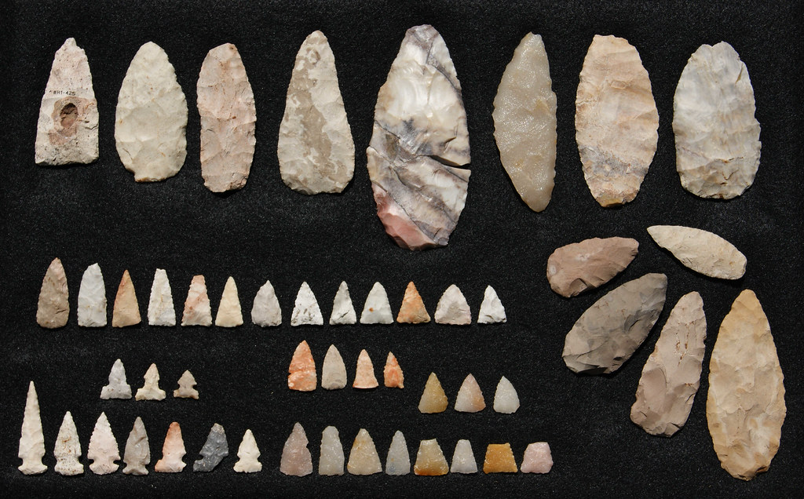
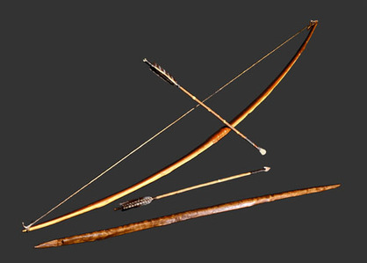
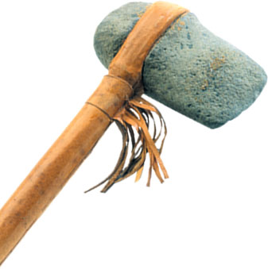
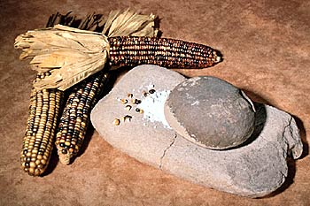
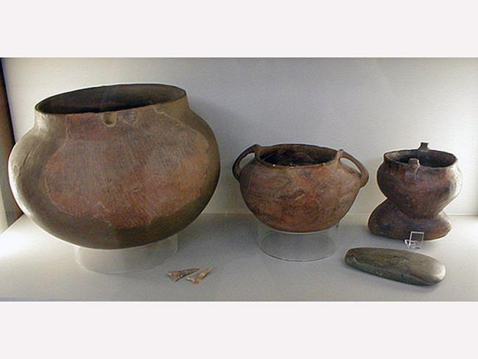

Slide 12
SHELTER

Slide 13
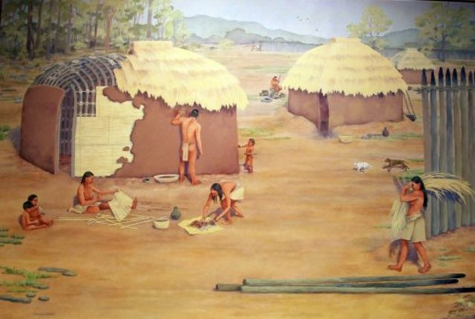

Slide 14
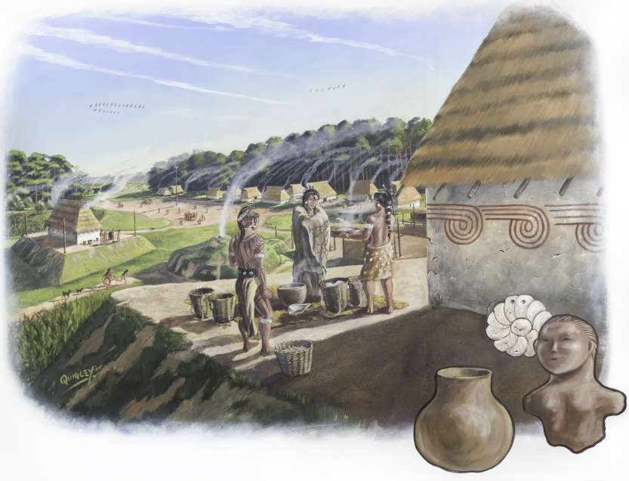

Slide 15
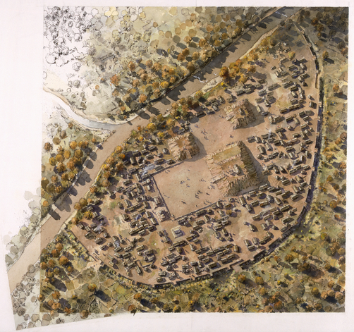

Slide 16
