Slide 1
Page 385

Slide 2
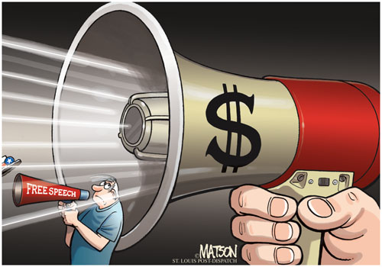
What is the cartoon about?

Slide 3
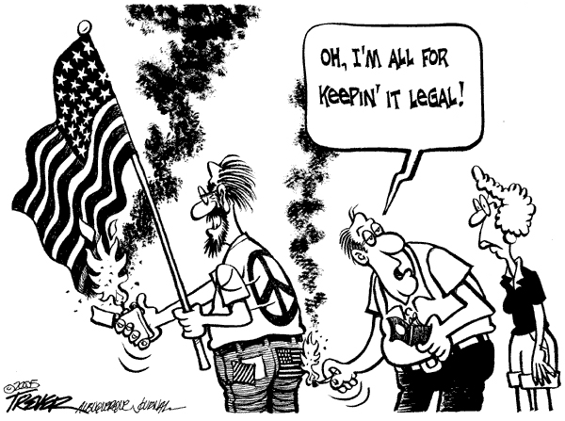

Slide 4
Review
Citizenship
Freedom of Religion
Freedom of Speech

Slide 5
Overview
Freedom of Speech and Press
Freedom of Assembly and Petition

Slide 6
Objectives :
Explain how civic responsibilities are important to Mississippians as citizens of the United States and residents of a global setting. MS5
Describe the roles of citizens in the state and nation. MS5b

Slide 7
Sedition
The advocacy of abstract doctrine is protected under the First Amendment.
Only speech explicitly inciting the forcible overthrow of the government is punishable under the Smith Act.

Slide 8
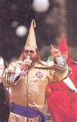
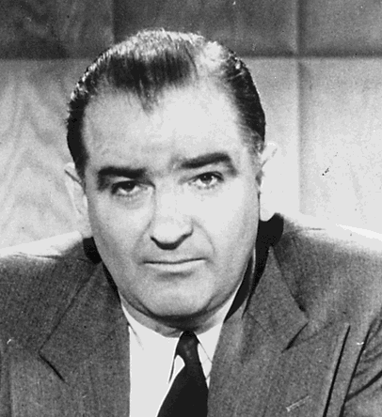
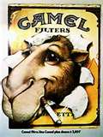
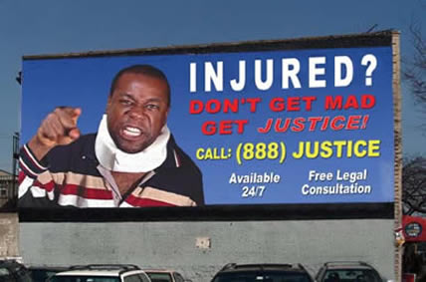
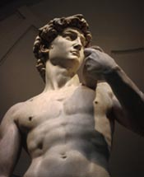
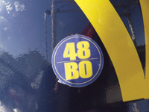
Freedom of Speech is Not an Absolute Right.
What types of speech do we control?
Obscenity
Defamation
Commercial
Fighting Words, Offensive Speakers, and Hostile Audiences
Symbolic
And so on
Former President Gerald R. Ford and famed football coach Glenn E. “Bo” Schembechler.
Senator Joseph McCarthy

Slide 9
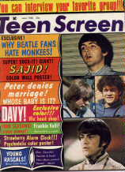
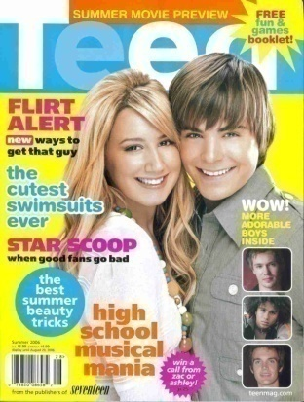
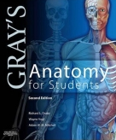
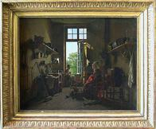
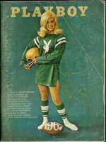
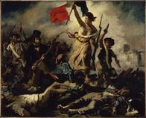
What makes something Obscene?

Slide 10
So what makes something Obscene?
In the 1973 in a ruling of the Supreme Court of the United States in Miller v. California established a three-tiered test.

Slide 11
The Three-Tiered Test
Step One
Whether “the average person”, applying contemporary community standards would find that the work, taken as a whole, appeals to the prurient interest.

Slide 12
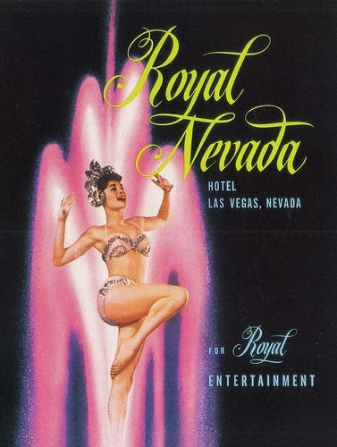
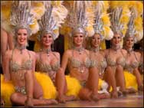
Las Vegas vs. Olive Branch

Slide 13
The Three-Tiered Test
Step two
Whether the work depicts or describes, in a patently offensive way, sexual conduct specifically defined by the applicable state law.

Slide 14
The Three-Tiered Test
Step three
Whether the work, taken as a whole, lacks serious literary, artistic, political, or scientific value.

Slide 15
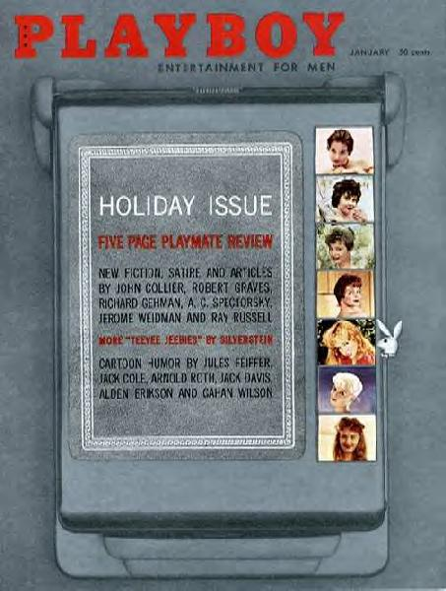
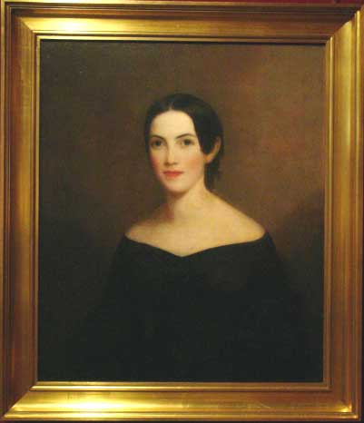
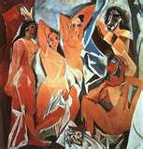
Lacks Serious Artistic Value
Stella Stevens
Comic Books
Pablo Picasso

Slide 16
Child Pornography
Child pornography is not subject to the Miller test, as the Supreme Court decided in New York v. Ferber.
The Court thought that the government's interest in protecting children from abuse was paramount.

Slide 17
Child Pornography Prevention Act of 1996
Prohibited "any visual depiction, including any photograph, film, video, picture, or computer or computer-generated image or picture" that "is, or appears to be, of a minor engaging in sexually explicit conduct.

Slide 18
PROTECT Act of 2003
Prohibits computer-generated child pornography when such visual depiction is a computer image or computer-generated image that is, or appears virtually indistinguishable from that of a minor engaging in sexually explicit conduct.

Slide 19
PROTECT Act of 2003
Prohibits drawings, sculptures, and pictures of such drawings and sculptures depicting minors in actions or situations that meet the Miller test of being obscene, OR are engaged in sex acts that are deemed to meet the same obscene condition.

Slide 20
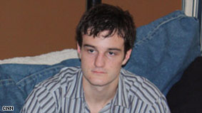
Sexting
Phillip Alpert sentenced to 5 years probation.
The act of sending explicit photographs through text messages or using mobile devices.
Phillip Alpert is a registered sex offender .

Slide 21
Phillip Alpert's offence
Sending a nude picture of his 16-year-old girlfriend to her friends and family after a fight. It was a picture she had sent him.
Phillip Alpert is now a convicted felon.

Slide 22
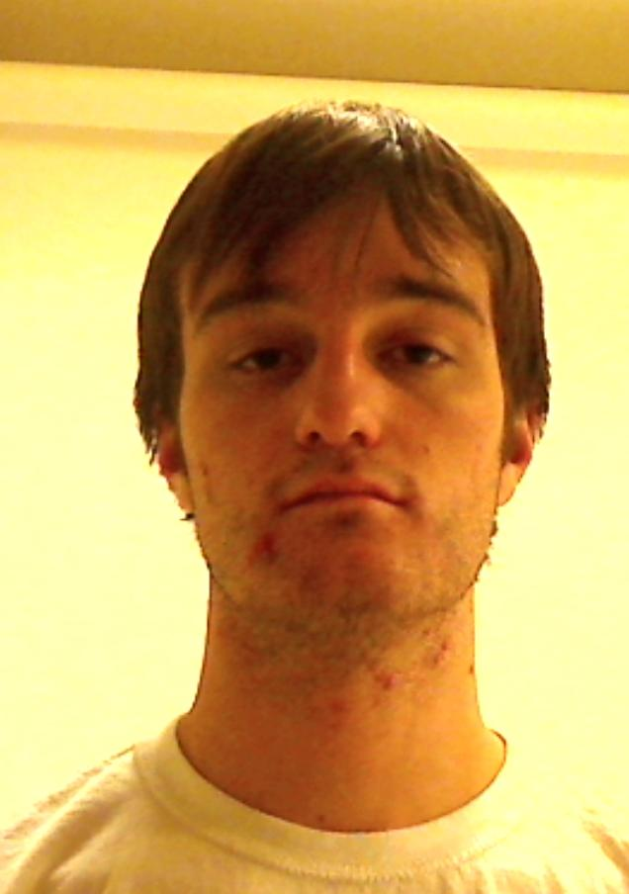
Florida Department of Law Enforcement - Sexual Offender / Predator Flyer
Click Here to Track this Offender
Designation: | Sexual Offender
Name: | Phillip Michael Alpert
Status: | Supervised - FL Dept of Corrections
Department of Corrections #: | X61836 Search the Dept of Corrections Website
Date of Birth: | 09/22/1989
Race : | White
Sex: | Male
Hair: | Blond
Eyes: | Black
Height: | 5'11"
Weight: | 125 lbs
Alpert is registered as a Sexual Offender. Positive identification cannot be established unless a fingerprint comparison is made.
Phillip Michael Alpert Date Of Photo: 09/28/2011

Slide 23
Sexting Stats
A new report has shown that nearly one-third of teens have had X-rated images or videos sent to their cell phones. Most are from a boyfriend or girlfriend, but they often find their way to other young people's cellular devices as well.
More police departments across the country are investing more resources into the investigation of sexting, as it is illegal to possess, distribute or manufacture pornography involving anyone under the age of 18

Slide 24
Defamation
People may not slander or libel others.
What is slander?
Is a spoken statement made with the purpose of harming a person’s character or reputation.
What is libel?
Is a printed or published statement maliciously (with intent to harm) made to injure a person’s character or reputation.

Slide 25
In order to win damages in a libel case.
The plaintiff must prove that the defendant made a false and defamatory statement concerning the plaintiff.
The plaintiff must prove that the defendant made an unprivileged publication to a third party.

Slide 26
In order to win damages in a libel case.
Prove that the publisher acted at least negligently in publishing the communication.
In some cases, the plaintiff must prove special damages.

Slide 27
Commercial Speech
In general courts allow the government to ban commercial speech that is false or misleading or that provides information about illegal products.

Slide 28
Example
Subliminal messaging
During the presentation of the movie Picnic, used a tachistoscope to project the words "Drink Coca-Cola" and "Hungry? Eat popcorn" for 1/3000 of a second at five-second intervals.
During the movie, sales of popcorn and Coke theater increased 57.8 percent and 18.1 percent respectively.

Slide 29
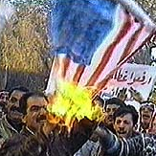
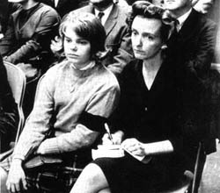
Symbolic Speech
Flag Burning
Arm Band

Slide 30
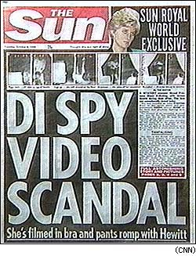
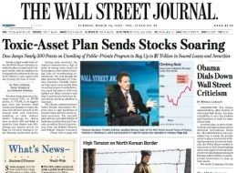
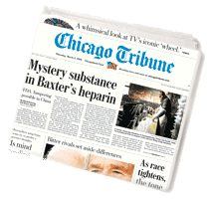
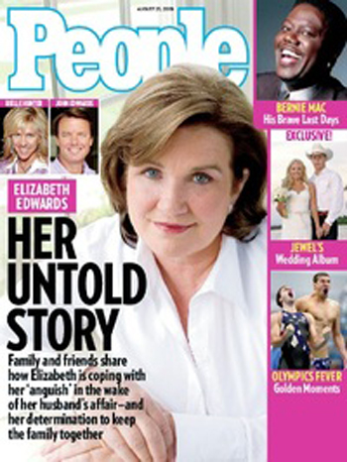
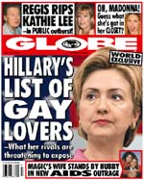
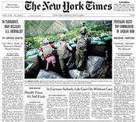
The Press

Slide 31
What allows the United States to have a free press?
Traditionally, the courts have protected the press from government censorship.
The 1st Amendment protests a reporter’s sources. (privileged communications)

Slide 32
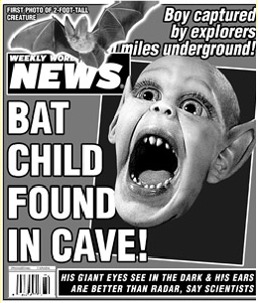
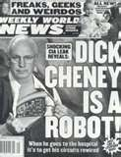
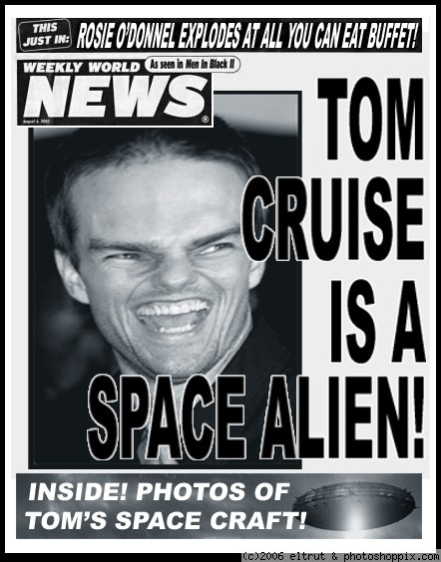
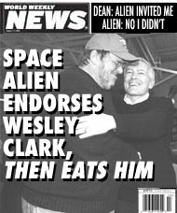
Defamation

Slide 33
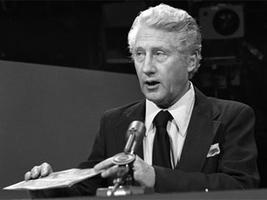
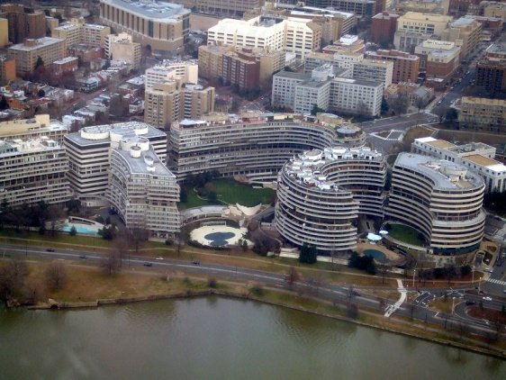
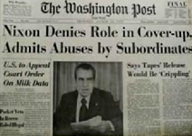
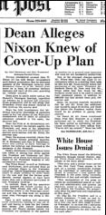
Watergate Scandal
“Deep Throat” W. Mark Felt Dies at 95
Former No. 2 at FBI.

Slide 34
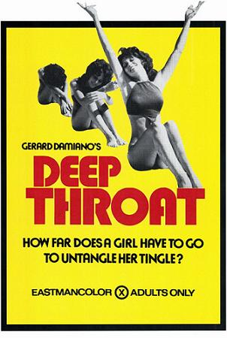
One of the first truly pornographic films in the United States to feature a plot, character development and relatively high production standards, .
Not name after the film!
Staring
Linda Lovelace

Slide 35
Freedom of Assembly and Petition
Which amendment do we find freedom of assembly and petition?
The First

Slide 36
What does the 1st Amendment say about assembly and petition?
“Congress shall make no law respecting an establishment of religion, or prohibiting the free exercise thereof; or abridging the freedom of speech, or of the press; or the right of the people peaceably to assemble, and to petition the Government for a redress of grievances.”

Slide 37
Right to Assemble
Individuals have the right to gather peacefully to:
Discuss issues
Express their opinions
March or demonstrate

Slide 38
Can the Boy Scouts of America keep gay leaders out?
The Boy Scouts of America has policies which prohibit atheists, agnostics, and "known or avowed" homosexuals from membership in its Scouting program.

Slide 39
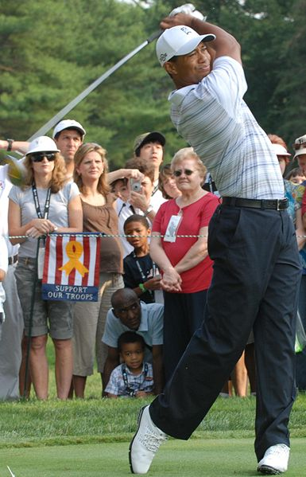
Who is Tiger Woods?
The first golfer to win three consecutive U.S. Amateur titles and won the NCAA individual golf championship.
Eldrick Tont "Tiger" Woods
Tiger Woods became a professional golfer in August 1996, and signed endorsement deals worth $40 million from Nike, Inc. and $20 million from Titleist.

Slide 40
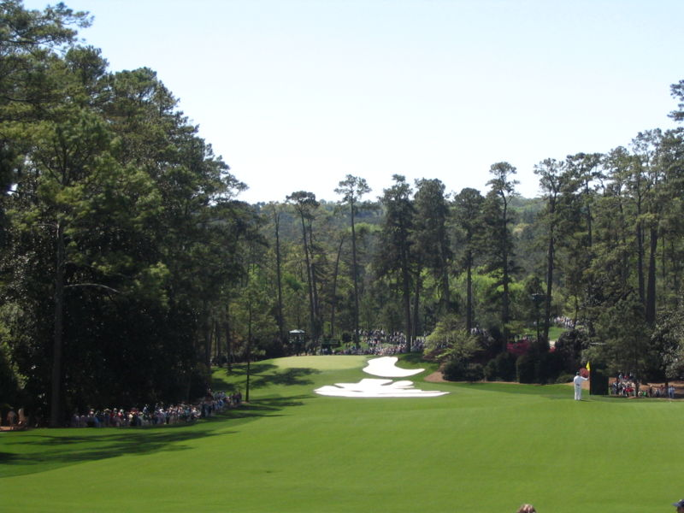
What is the Grand Slam of golf?
What is the THE MASTERS?
The
Augusta National Golf Club, located in city of Augusta, Georgia, is one of the most storied and exclusive golf clubs in the world.
U.S. OPEN
CHAMPIONSHIP
Augusta accepted a black member in 1990.
BRITISH OPEN
The 10th green at Augusta

Slide 41
What is petition?
To request in writing that officials do or not do certain things.
A request to a court or public official.

Slide 42
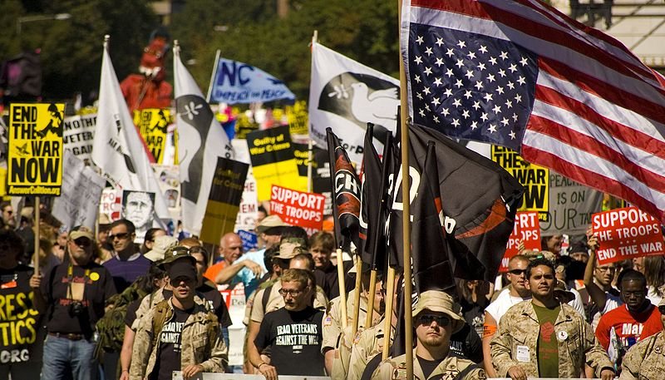
What kinds of way do we have to made a request?
Lobbyist
Write
Call
Email
Protest
@

Slide 43
Review
Freedom of Religion
Freedom of Speech and Press
Freedom of Assembly and Petition

Slide 44
Homework
Read pages 386 to 388.

