Slide 1
Page 144

Slide 2
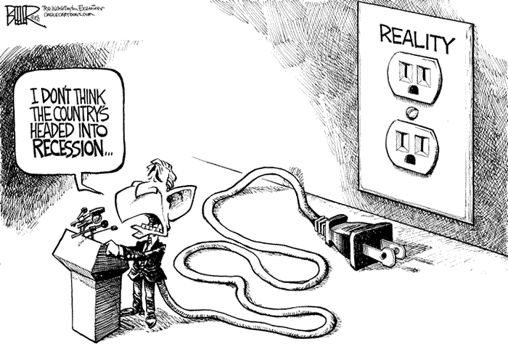

Slide 3
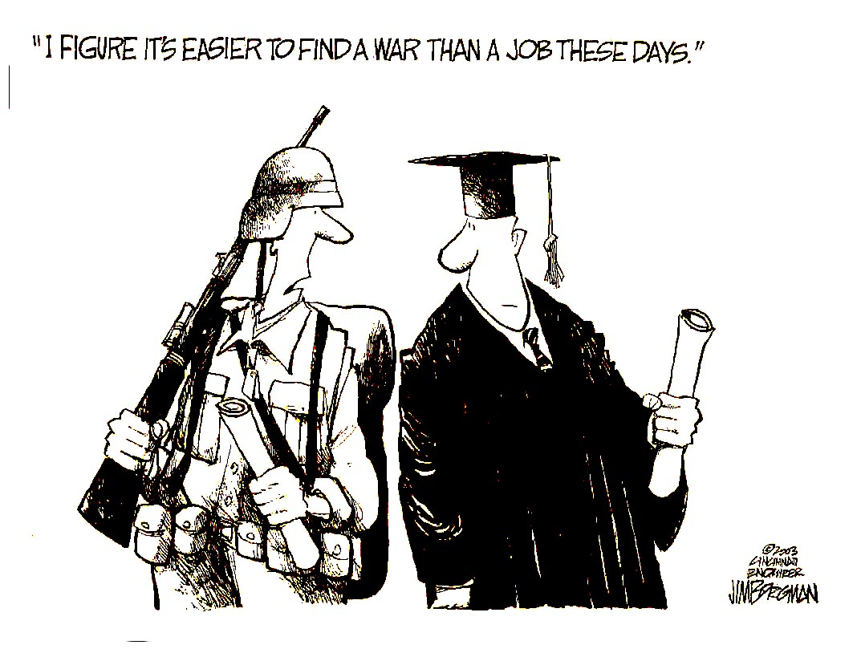
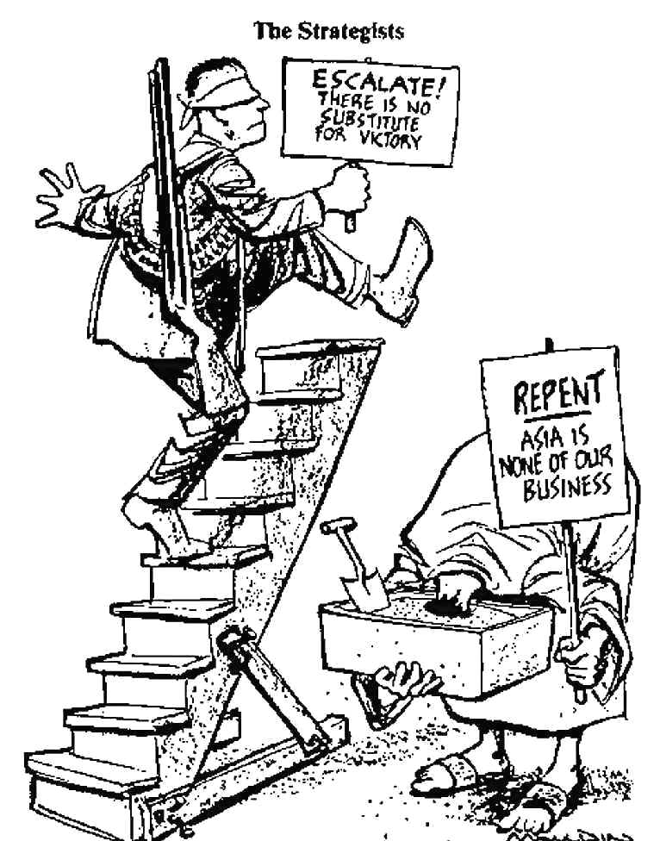
1966

Slide 4
Objectives
MS1 Explain how geography, economics, history, and politics have influenced the development of Mississippi.
MS1e Analyze the historical and political significance of key events in our state's development (e.g., Civil War, Civil Rights Movement, etc.).

Slide 5
Objectives
MS2a Identify the influence of the industrial and agricultural revolution in our state.
MS3d Analyze the significance of key events in our state's history.
MS3e Analyze the ways Mississippians have resolved conflict and adapted to change, and continue to address cultural issues unique to our state.

Slide 6
Objectives
MS4 Demonstrate the ability to use social studies tools (e.g., timelines, maps, globes, resources, graphs, a compass, technology, etc.).

Slide 7
Review
Constitution Convention of 1865
Election of 1865
Mississippi’s Black Code
Congressional Reconstruction
Constitution of 1868
Republican Rule in Mississippi
Black Political Power

Slide 8
Overview
School (Public, Colleges and University)
End of Republican Rule
Election of 1875
Presidential Election of 1877
Constitution of 1890
State Flag and Coat of Arms

Slide 9
Education
A major accomplishment of Mississippi’s Reconstruction government was the establishment of a system of tax-supported public schools.
In 1850, only about 13 percent of the state’s white children attended Mississippi schools.
No schools for black and Native American children.

Slide 10
Education
During the war, education suffered even more.
In 1865, the only schools operating were those run by the Freedmen’s Bureau and private groups.
In 1869, the new state constitution provided for public schools for all races.

Slide 11
Schools
In 1870, the state legislature established a school system in each county under the leadership of an elected state superintendent and county superintendents appointed by a state board of education.

Slide 12
Cost
How much did it cost to operate the school systems that first year?
More than $1 million
How much did each county spend on construction of school buildings that first year?
$2 million

Slide 13
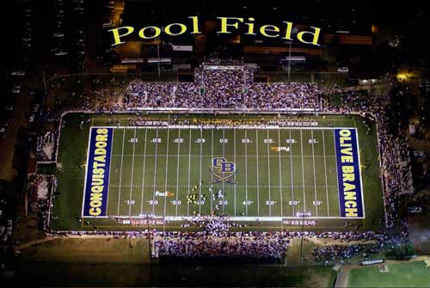
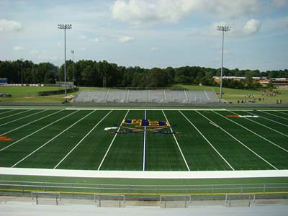
How much will $1,000,000 get you today?
Let me give an example.

Slide 14
Public School
By 1875, public school enrollment stood at:
How many black students?
89,813 black students.
How many white student?
78,404 white students.

Slide 15
State Supported Colleges
The Republican government also brought improvements to higher education.
University of Mississippi (1848)
Oxford, Mississippi
Alcorn Agricultural and Mechanical College (1871)
Oakland College, Lorman, Mississippi
At the end of the war, the property was sold to the state of Mississippi.
Black school.
Today it is Alcorn State University.

Slide 16
State Supported Colleges
Mississippi Agricultural and Mechanical College (1878)
Starkville, Mississippi
White school
Today it is Mississippi State University.
Industrial Institute and College (1884)
Columbus, Mississippi
The first public women's college in the United States.
Today it is Mississippi University for Women or the W.

Slide 17
Church Supported Colleges
Mississippi College (1826)
Clinton, Mississippi
Second-oldest Baptist affiliated university in the world.
Shaw University (1866)
Holly Springs, Mississippi
Affiliated with the United Methodist Church
One of only ten historically black colleges and universities (HBCUs) founded before 1868 still to be in operation. The name was finally changed to Rust College in 1915.

Slide 18
Church Supported Colleges
Natchez Seminary for Freedmen (1877)
Moved to Jackson, Mississippi (1882) to the site where Millsaps College now stands. Natchez Seminary soon relocated from its site in north Jackson (1902).
A private school, under the auspices of the American Baptist Home Mission Society of New York. In 1934, the school was transferred to the state education system and renamed Jackson State College.
Today it is Jackson State University

Slide 19
Church Supported Colleges
Tougaloo University (1871)
Tougaloo, Mississippi
In 1869, the American Missionary Association of New York purchased 500 acres.
In 1954, merge with Southern Christian Institute becoming Tougaloo Southern Christian College.
In 1962, the school's name changed to Tougaloo College.
Protestant

Slide 20
Church Supported Colleges
Millsaps College (1892)
Jackson, Mississippi.
(C.S.A.) Major Reuben Webster Millsaps donated the college's land and $50,000.
Religious affiliation is United Methodist Church.
Despite its religious affiliation, the curriculum is secular. (Liberal Arts College)

Slide 21
End of Republican Rule
Who are redeemers?
White Mississippians who wanted to return control of state government to native whites.
The downfall of the Republicans began with three years of violence surrounding the election of 1875.
White Democrats had to regain the loyalty of white Republicans and control the large number of black voters.

Slide 22
White Republicans and Blacks
Threats of economic reprisals and physical abuse and the fear of becoming social outcasts in their own state convinced a number of white Republicans to join the Democrats.
How can he become a social outcasts?

Slide 23
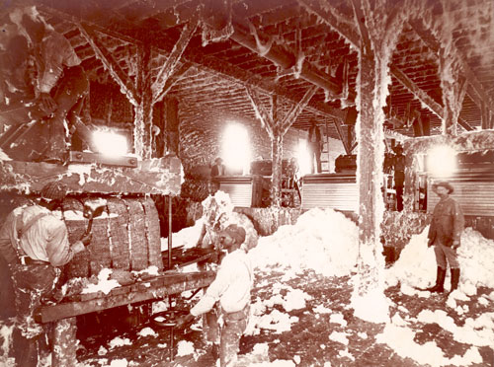
Take Cotton to sale.

Slide 24
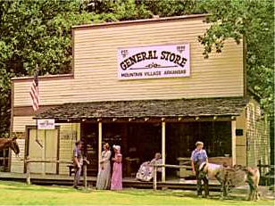
Buy seed at the General Store.

Slide 25
White Republicans and Blacks
Economic pressure and violence were also used to control blacks.
Employers threatened the jobs of black workers if they refused to vote as instructed.
Can I tell how you voted?
Yes

Slide 26
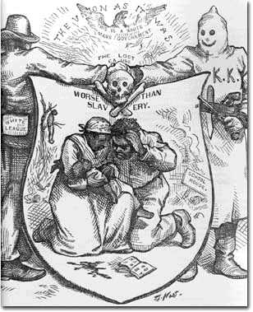
Violence and Intimidation
The Ku Klux Klan and other groups used intimidation and outright violence to prevent blacks from voting or to frighten them into voting for the Democratic candidates.
Harper's Weekly cartoon by Thomas Nast.

Slide 27
Sheriff Peter Crosby
Vicksburg, Mississippi
About 500 whites in Warren County gathered at the courthouse and forced sheriff Peter Crosby to resign.
After whites demanded the resignation of a black sheriff, violence erupted between his black supporters and city officials.

Slide 28
Sheriff Peter Crosby
When blacks came from throughout the county to help Crosby get back his job, a riot erupted in which 2 whites and 29 blacks were killed.
Armed bands of the local White Man's Party, as it was called, roamed the countryside with long rifles, murdering as many as 300 black people.
President Grant ordered in troops to restore Sheriff Peter Crosby.

Slide 29
Clinton Riot
In September 1875, the Clinton Riot occurred in downtown Clinton during a political rally of about 3000 people.
Approximately 50 people were killed, mostly African-American, and all Republican.
The lack of response from the U.S. government in retaliation signaled the beginning of the end of reconstruction.

Slide 30
Election of 1875
Without help from the federal government, the white Democrats’ strategies worked.
The Democrats won four of the six congressional seats.
62 of the 75 seats in the state legislature.
The state was still represented in the U.S. Senate by two Republicans, James L. Alcorn and Blanche K. Bruce.

Slide 31
Impeachment
Lieutenant Governor Alexander K. Davis was impeached.
The charges were politically motivated and were used to drive the Republicans from office.
When it became apparent that Governor Ames would be convicted and removed from office, his lawyers arranged a compromise with the state legislature.

Slide 32
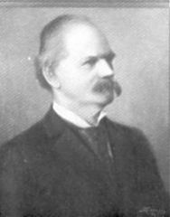
John Marshall Stone
Governor Ames resigned from office, and the impeachment charges were dropped.
The legislature chose John M. Stone, president pro tem of the senate, to serve as governor until the 1877 election.
John Marshall Stone

Slide 33
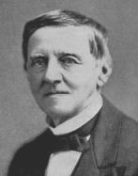
Presidential Election
The presidential election of 1876 led the way for the final blow to Reconstruction.
Democratic candidate Samuel Tilden was just 1 vote short of the majority needed for victory.
19 votes in three southern states—Louisiana, South Carolina, Florida —and one vote in Oregon.
Samuel Jones Tilden

Slide 34
Presidential Election
Congress established a commission to decide which candidate would receive the disputed votes.
The commission consisted of 15 members: 5 from the House, 5 from the Senate and 5 from the Supreme Court.
The commission, composed of 8 Republicans and 7 Democrats, awarded all twenty votes to Hayes.

Slide 35
Presidential Election
The ruling followed party lines: 8 to 7 voted for Hayes winning in all of the contested 20 electoral votes.
Congress accepted the commission’s decision only after a secret compromise ended a filibuster by southern Democrats.
At 4:10 A.M. on 2 March 1877, Mr. Ferry president of the Senate, announced that Hayes and Wheeler had 185 votes to 184 for Tilden and Hendricks.

Slide 36
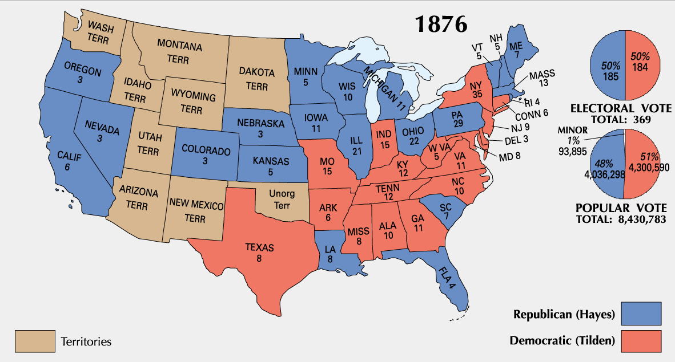
Presidential Election

Slide 37
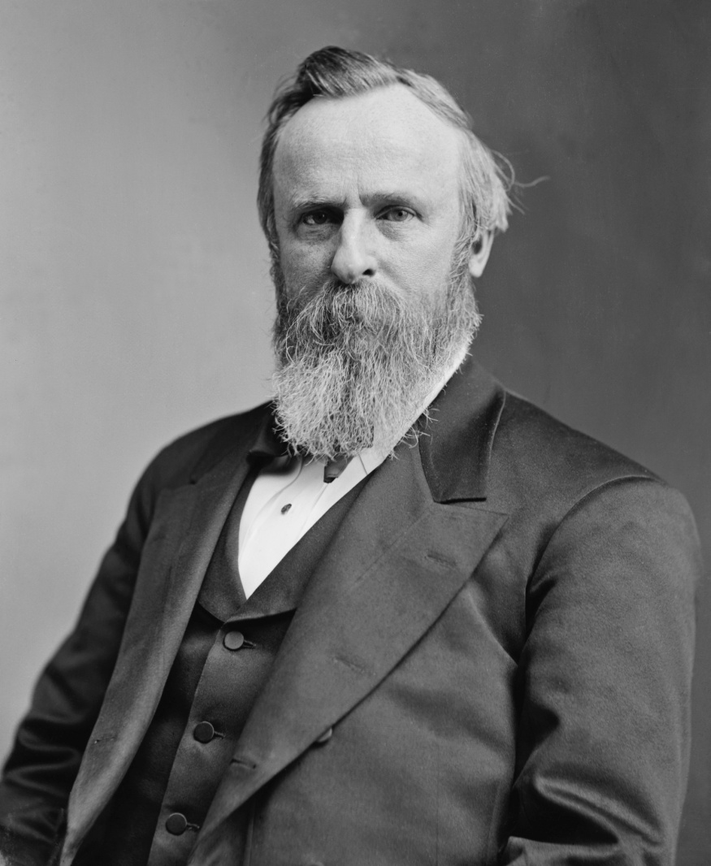
Rutherford B. Hayes
Because March 4, 1877 was a Sunday, Hayes took the oath of office in the Red Room of the White House on March 5.
Becoming the first president to take the oath of office in the White House. This ceremony was held in secret.

Slide 38
Rutherford B. Hayes
April 27, 1877 President Hayes removes Federal troops from Louisiana, ending Reconstruction.

Slide 39
Blacks Voting
After 1875, violence, intimidation, and voter fraud drastically decreased black voting.
What kind of voter fraud?
Ballot stuffing, misreporting of votes, cast votes at multiple booths, intimidation, vote buying, a person pretends to be someone else and so on.
Only 38 percent of eligible blacks voted in the governor’s election of 1881.

Slide 40
Democrats in Control
Democrats reduced taxes, decreased government jobs, and drastically cut funds for public schools.
Why cut Taxes?
Taking my money out of their homes and work place.
By the 1880s, the state revenues had fallen too low to adequately support schools, colleges, and other state institutions.

Slide 41
The Constitution of 1890
In the mid-1880s, there was a call for a constitutional convention to replace the constitution of 1868.
Despite considerable opposition, the convention met in Jackson in August 1890.
Conservative Democrats dominated the convention.

Slide 42
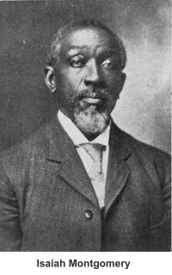
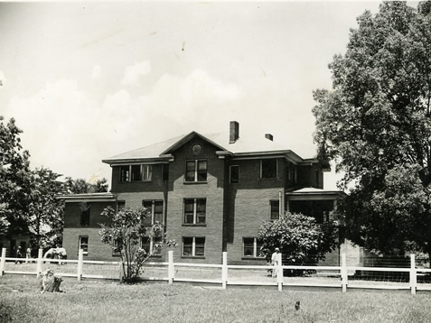
Blacks at the Convention
Any blacks at the convention?
Isaiah T. Montgomery
Montgomery, a wealthy planter and founder of the all-black town of Mound Bayou.

Slide 43
Eliminate Blacks from Politics
James Zacharias George, who represented Mississippi in the U.S. Senate, wrote much of that scheme.
As a member of the Mississippi Secession Convention, George signed the Ordinance of Secession.

Slide 44
Eliminate Blacks from Politics
Adult males who wanted to vote had to:
Register at least four months before an election.
Live in the state for two years and in the voting district for one year.
Pay an annual $2 poll tax.
Read any section of the state constitution or understand it when read to them.
Anything violation of the United States Constitution?

Slide 45
Eliminate Blacks from Politics
What about the 15th Amendment?
Section 1. The right of citizens of the United States to vote shall not be denied or abridged by the United States or by any State on account of race, color, or previous condition of servitude.
Section 2. The Congress shall have power to enforce this article by appropriate legislation.

Slide 46
Eliminate Blacks from Politics
How did the 1890 Constitution keep black voters away from the polling place?
Annual $2 poll tax.
Read any section of the state constitution or understand it when read to them. (The understanding clause.)
How did the $2.00 poll tax keep black voters away from the polling place?

Slide 47
Eliminate Blacks from Politics
Most black people could not afford to pay a $2.00 poll tax.
How did the understanding clause work?
If you can read you can vote. Most people could not read.
If you can not read, then someone would read it to you and you would then explain it to them.

Slide 48
Eliminate Blacks from Politics
If a white person came in, who could not read, he would read something like this.
Article 1, Section 2. “The House of Representatives shall be composed of member chosen every second year by the people of the several states, …”

Slide 49
Eliminate Blacks from Politics
If a black person came in, who could not read, he would read something like this.
Article 1, Section 2. “The actual enumeration shall be made within three years after the first meeting of Congress of the United States, and within every subsequent term of ten years, in such manner as they shall by law direct.”

Slide 50
Eliminate Blacks from Politics
With in 2 years, black registered voters dropped from 142,000 to 8,615.
Whites were also affected by this plan although not as much as blacks.
More than 30,000 whites who were too poor to pay the poll tax were eliminated from the voting lists.

Slide 51
State Flag
The committee to design a State Flag was appointed by legislative action February 7, 1894, and provided that the flag reported by the committee should become the official flag.

Slide 52
State Flag
The items found on the flag have meaning. This true of all state and national flags.
So what are the stars represent on our flags?
Thirteen (13) mullets or five-pointed stars, corresponding with the number of the original States of the Union.

Slide 53
Coat of Arms
The committee to design a Coat of Arms was appointed by legislative action February 7, 1894, and the design proposed by that committee was accepted and became the official Coat of Arms.
The motto to be --“VIRTUTE et ARMIS” which means by valor and arms.

Slide 54
Coat of Arms
2001 Regular Session, Senate Bill 2285, AN ACT TO ADOPT THE MISSISSIPPI COAT-OF-ARMS.

Slide 55
REview
School (Public, Colleges and University)
End of Republican Rule
Election of 1875
Presidential Election of 1877
Constitution of 1890
State Flag and Coat of Arms

Slide 56
Homework
Review for Chapter 6 Test.

