Slide 1
Endocrine & Cell Communication Part I: Introduction to Communication
Notes:
Enduring Understanding 3.D Cells communicate by generating, transmitting and receiving chemical signals.
You may wish to print a copy of slide 20 and distribute it ahead of time. Ask them to use scissors and cut the pieces apart and bring them to class. They will be using the pieces to construct a “concept map” near the conclusion of this lesson.

Slide 2
How does a cell communicate?
He uses a cell phone.
HA HA HA

Slide 3
AP Biology Curriculum Framework
Enduring Understanding 3.D Cells communicate by generating, transmitting and receiving chemical signals.
EK 3D1:Cell communication processes share common features that reflect a shared evolutionary history.
C. In single-celled organisms, signal transduction pathways influence how the cell responds to its environment.
D. In multicellular organisms, signal transduction pathways coordinate the activities within individual cells that support the function of the organism as a whole.
Notes:
Ask students to cite specific examples they’ve learned thus far that involve cell to cell communication.
Emphasize that this “cell communication” concept is a central concept in this course and that students will see it over and over again. Encourage them to choose a specific example of cell communication (or two) for this unit and become an expert on it. Let them practice explaining it in detail to each other. They need to be able to write about 4 points worth on their example when faced with a free response question.

Slide 4
Why do cells need to communicate?
There are many reasons, so name a few.
Notes:
Think about this question. Write an answer on the side of your paper. Show your answer to a neighbor. Sample answers are on the next slide. Expect students to justify/explain their answers.

Slide 5
Why do cells need to communicate?
Here are a few reasons:
Coordinate activities in multicellular organisms
Hormone actions
Cell recognition
To find mates (yeast cells)
Turn pathways on/off
apoptosis
Notes:
Coordinate activities such as development and movement, hormones and neurotransmitters are chemical communications, cell recognition such as for antibodies, yeast exchange mating factors, pathways such as signal transduction pathway that are a series of steps by which a signal on the cell’s surface is converted to a specific cellular response, and apoptosis is a type of programmed cell death (think embryonic development of fingers and toes, the disappearance of a tadpole’s tail, etc.), just to name a few.

Slide 6
Evolutionary ties of cell communication
Cell-to-cell communication is everywhere in biological systems from Archaea and bacteria to multicellular organisms.
The basic chemical processes of communication are shared across evolutionary lines of descent.
Signal transduction is an excellent example

Slide 7
Signal Transduction Animation
Click on this link to access the animation:
http://www.wiley.com/college/boyer/0470003790/animations/signal_transduction/signal_transduction.htm
Notes:
At this point, we just want to introduce the concept of signal transduction. Preface this animation with a brief discussion of the “fight or flight” response. “Imagine observing a bear in its natural habitat…” is an appropriate introduction, then click on the animation link. Only explore the “overview” portion of the animation at this time.

Slide 8
Chemical Communication
Outside the body
Ex. Pheromones
Inside the body
Short Distance
Long Distance
Ex. Quorum sensing
Notes:
Pheromones are chemicals that are produced by organisms to aid in communication by members of the same species, quorum sensing is used by organisms to react as a group usually in bacteria.

Slide 9
Pheromones
Members of the same animal species sometimes communicate with pheromones, chemicals that are released into the environment.
Pheromones serve many functions, including marking trails leading to food, defining territories, warning of predators, and attracting potential mates.
Here’s an example of a termite following a “manmade” trail: http://edutube.org/en/video/termites-and-pheromones-ink-trails
Notes:
The video shows a gentleman laying down a PaperMate Ink trail on a plain white piece of paper. Next, he places a termite onto the paper and within seconds the termite follows the trail (with a bit of trial and error on the termite’s part). Students love this!

Slide 10
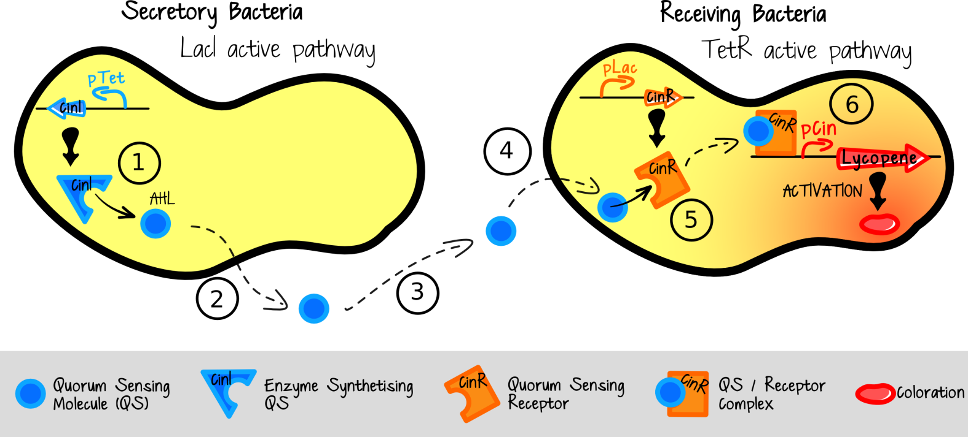
Quorum sensing
Quorum sensing in bacteria – single celled bacteria monitor their environment by producing, releasing and detecting hormone-like molecules called autoinducers.
Notes:
This process, termed quorum sensing, allows bacteria to monitor the environment for other bacteria and to alter behavior on a population-wide scale in response to changes in the number and/or species present in a community. THERE IS NO NEED TO DESCRIBE THE DETAILS of the image shown.

Slide 11
Chemical Communication
Inside the body
Short Distance
Long Distance
Paracrine
Autocrine
Hormones
Example Prostaglandin
Example Interleukin
Example Insulin
Notes:
This flow chart shows a simplified classification system for the cell communication occurring within the body. The dividing lines between hormones, paracrine and autocrine signals have blurred. In our study of hormones we will mostly focus on hormones as long distance communicators. Paracrine refers to a secreted molecule that acts on a neighboring cell, autocrine refers to a secreted molecule that acts on the cell that secreted it.

Slide 12
AP Biology Curriculum Framework
EK 3.D.2 Cells communicate with each other through direct contact with other cells or from a distance via chemical signaling.
a. Cells communicate by cell-to-cell contact.
b. Cells communicate over short distances by local regulators that target cells in the vicinity of the emitting cell.
c. Signals released by one cell type can travel long distances to target cells of another type.

Slide 13
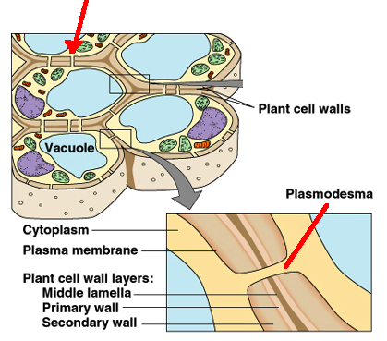
Direct Contact Communication
Ex. Plant cells communicate directly through openings called plasmodesmata.
Notes:
Another example would be helper T cells bind with Killer T cells in the immune system.

Slide 14
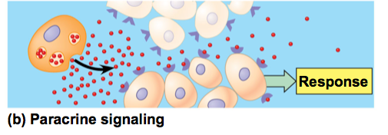
Short Distance Communication
Paracrine signals diffuse to and affect nearby cells
Ex. Neurotransmitters
Ex. Prostaglandins
Notes:
The next four slides outline the different “categories” of cell to cell communications involved in the endocrine system. Students should know an example for each one as well as the basics of how each type of communication works.
Paracrine chemical signals work in cells that are near the secreting cell. For example, neurotransmitters released by a presynaptic cell move across the synapse and impact the post synaptic cell.
In the immune system, prostaglandins promote fever and inflammation and intensify the sensation of pain.
Prostaglandins help regulate aggregation of platelets, an early step in formation of blood clots.

Slide 15
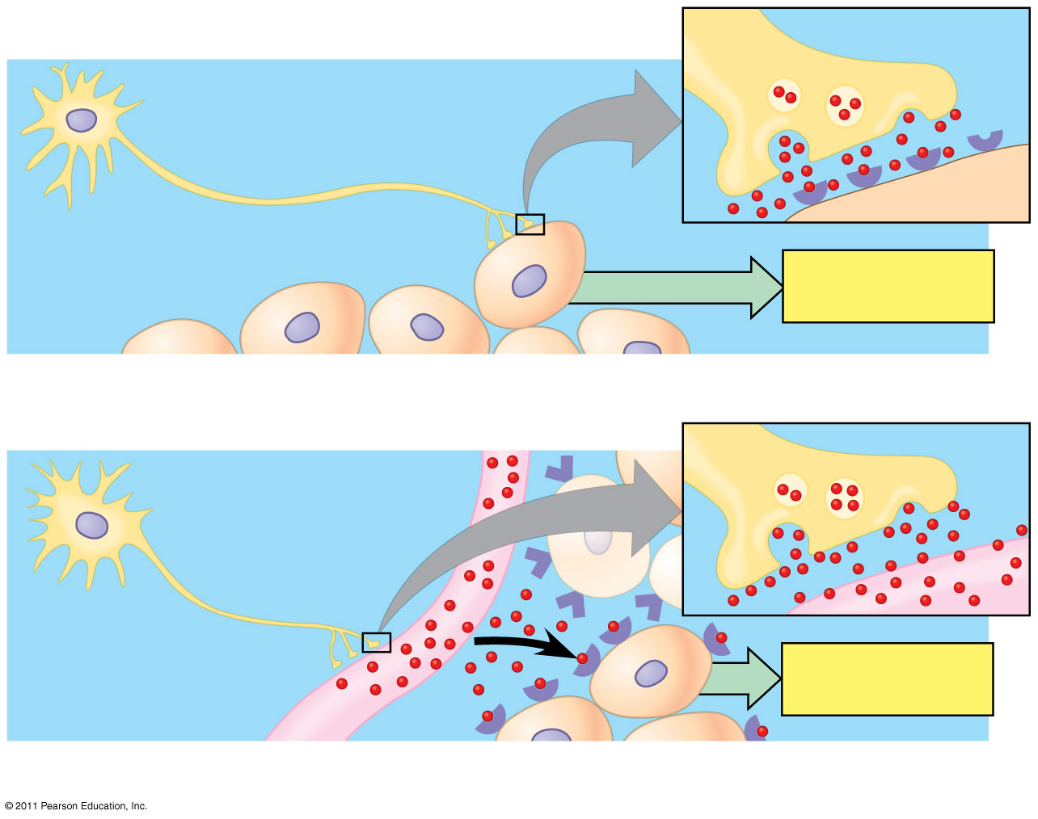
Neurotransmitters and Neurohormones
Neuron
Synapse
Response
Synaptic signaling
Neurosecretory cell
Blood vessel
Response
Neuroendocrine signaling
Notes:
Intercellular communication by secreted molecules.

Slide 16
Autocrine signals
These chemicals affect the same cells that release them.
Ex. Interleukin-1 produced by monocytes and can bind to receptors on the same monocyte.
Tumor cells reproduce uncontrollably because they self-stimulate cell division by making their own division signals.
Notes:
Again…students need to become an expert on “an” example while have knowledge of various examples.

Slide 17
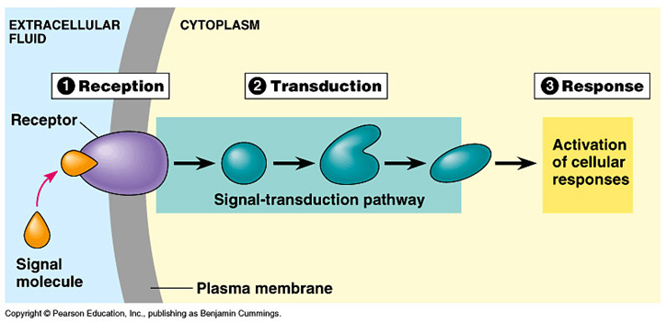
Long Distance Communication
Endocrine hormones via signal transduction pathway:
Notes:
The word transduce means to convert. A signal transduction pathway “converts” the original signal molecule into a cellular response. This conversion requires several intermediate messenger molecules (sometimes called “second messengers”), so the signal is actually “converted” or transduced several times, as shown in the blue box above labeled Transduction. The concept of signal transduction pathways will be seen over and over again in AP Biology and is certain to be on the exam.

Slide 18
Long Distance Communication
Endocrine hormones via signal transduction pathway:
Notes:
The word transduce means to convert. A signal transduction pathway “converts” the original signal molecule into a cellular response. This conversion requires several intermediate messenger molecules (sometimes called “second messengers”), so the signal is actually “converted” or transduced several times, as shown in the blue box above labeled Transduction. The concept of signal transduction pathways will be seen over and over again in AP Biology and is certain to be on the exam.

Slide 19
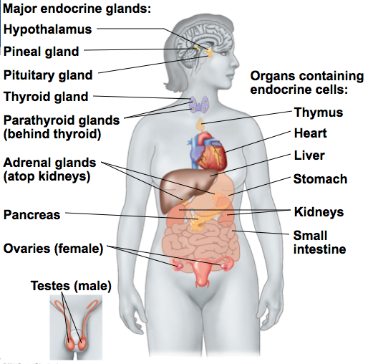
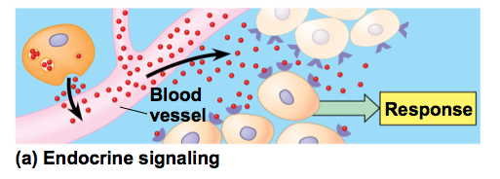
Hormones
Endocrine glands produce hormones which are
Chemical signals
Transported in tissue fluids
Detected only by target cells
Notes:
Ask students to name some hormones. Testosterone and estrogen are sure to be in their list! Either of those make perfect “expert” examples.

Slide 20
Practice: Use the labels provided to create a cell communication graphic organizer.
Long Distance Signaling | Pheromone | Autocrine Signaling | Oxytocin
Short Distance Signaling | Quorum Sensing | Interleukin | Neuro- transmitter
Outside the Body Signaling | Paracrine Signaling | Prostaglandin | Direct contact communication
Inside the Body Signaling | Endocrine Signaling | Testosterone | Estrogen
Notes:
Students are basically being asked to create a concept map. You may wish to print a copy of this slide and distribute it ahead of time. Ask them to use scissors and cut the pieces apart and bring them to class.

Slide 21
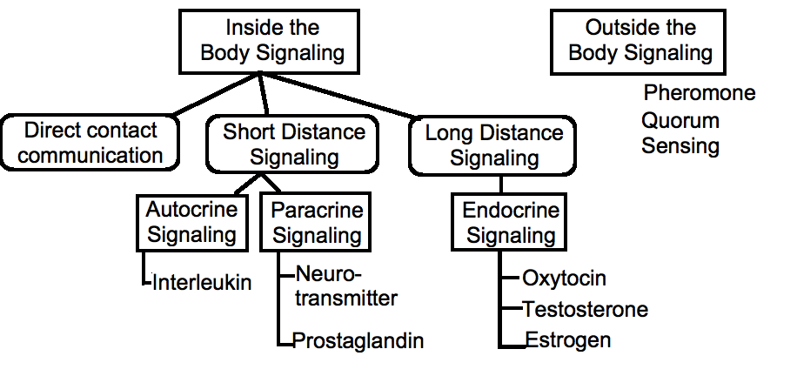
How does your arrangement compare?
Possible Solution
Notes:
Allow students to correct their misconceptions before moving on. It would be great if they could leave class with a complete and ACCURATE concept map!

Slide 22
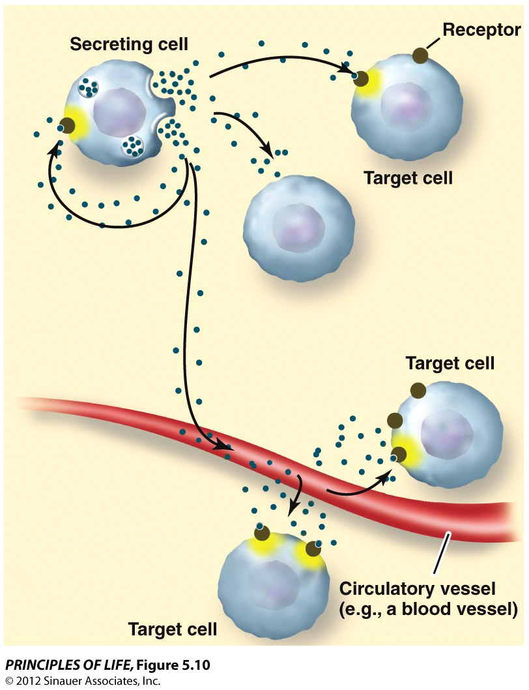
Communication Features
Secreting cell - releases the signal
Signal = chemical = ligand
Receptor - accepts and temporarily joins with the ligand forming receptor/ligand complex
Target cell – contains the receptor
Notes:
A ligand is in a narrow sense, a signal triggering molecule, binding to a site on a target protein. The word “binding” refers to intermolecular forces (IMFs) rather than an actual chemical (covalent or ionic) bond. While actual chemical bonds can form, it is very rare. It is far more common for the “binding” to be more of an electrostatic attraction. You can demonstrate this for students using small pieces of torn paper and an ordinary comb. “Charge” the comb by combing it through someone’s hair (ions from the keratin protein of hair will adhere to the plastic comb). The comb will then attract the small pieces of paper. It is obvious that these attractions are not actual chemical bonds.
Historical note: In 1970, Dr. Martin Rodbell examined the effects of glucagon on a rat's liver cell membrane receptor. He noted that guanosine triphosphate disassociated glucagon from this receptor and stimulated the G-protein, which strongly influenced the cell's metabolism. Thus he deduced that the G-protein was a transducer that accepted glucagon molecules and affected the cell. For this he shared the 1994 Nobel Prize in Physiology or Medicine with Dr. Alfred G. Gilman. Dr. Gilman became Chairman of the Department of Pharmacology at the University of Texas Southwestern Medical Center in 1981 and then in 2006 he became Executive Vice President for Academic Affairs and Provost of the University of Texas Southwestern Medical Center in Dallas, TX. In short, he is a teacher as well as a Nobel Prize Winner! He has worked with the NMSI science staff on several teacher training projects including the development of a virtual microscope. He is a long standing supporter of LTF and of NMSI and an advocate of science education.

Slide 23
Apply the features
Insulin is secreted by beta cells of the pancreas. Once secreted, insulin travels around the body. When insulin docks with an integral protein on the membrane of a muscle cell, glucose can enter the cell.
What is the secreting cell, the target cell, ligand, and the receptor?
Notes:
Insulin makes another excellent “expert” example. Students often know someone who is diabetic, so they may have a keen interest in learning more about diabetes.
Secreting cells are the pancreatic beta cells. Target cells (in this example) are muscle cells. The ligand is insulin. The receptor is an integral protein in the membrane of the muscle cell.

Slide 24
Next time: Endocrine System

Slide 25
Created by:
Debra Richards
Coordinator of Secondary Science Programs
Bryan ISD
Bryan, TX

