Slide 1
Food Allergies and Anaphylaxis in School: What School Staff Need to Know

Slide 2
What is an Allergy?
When the body’s immune system wrongly identifies an otherwise harmless substance (an allergen) as harmful.

Slide 3
What is an Allergen?
Allergens are substances that cause an overreaction of the body’s defense mechanisms
Allergens may be:
  Inhaled (pollen, dust, molds, fumes)
  Touched (soap, plants)
  Injected (insect venom, medicines)
  Eaten (food and medicines)

Slide 4

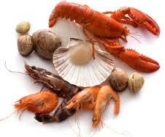

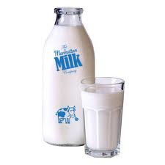

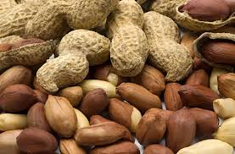
The Major 8 Food Allergens
Milk
Eggs
Peanut
Tree nut
Fish
Shell fish
Soy
Wheat
These make up 90% of all food allergies in the United States

Slide 5
Symptoms
Swelling or redness
Hives
Watery or swollen eyes
Nausea and vomiting
Cough and scratchy throat
Difficulty breathing
Changes in voice or cry
Anxiety
Dizziness and faintness
Unconsciousness
These symptoms can range from mild to severe, they can occur very suddenly or gradually

Slide 6
Food Allergy Facts
Anaphylaxis (anaphylaxis shock): an allergic reaction in which the release of histamines causes extreme symptoms including: swelling, difficulty breathing, heart failure, sometimes death

Slide 7
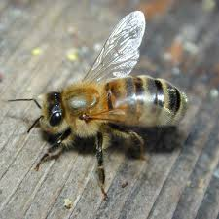
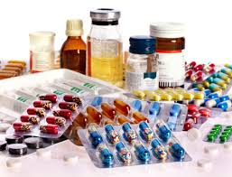
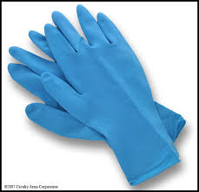

Other Causes of Anaphylaxis
Stinging insects
Latex
Medication
Exercise
Environmental triggers
Cold environment
Unknown reason
*Discuss appropriate management with your school nurses

Slide 8
Treatment Options
Remove the child from contact with known or suspected allergen
Refer to their plan of care for directions
Give medications as directed (anti-histamines or epinephrine injection)
Monitor for symptoms
Notify parents as noted in the care plan

Slide 9
Children’s Descriptions of Reactions
Complains of tongue: hot, tingling, burning, itching or feeling funny, full or heavy
Feels like:
  there is a frog in my throat
  bump on the back of my tongue
  lips feel tight
  bugs in ears
  Something poking my tongue

Slide 10
Call 911 for any of the following
Sudden or increasingly severe
  swelling and/or hives
  abdominal pain, nausea or vomiting
  difficulty breathing or speaking

Slide 11
Key Points about Food Allergy Reactions
1st time allergic reactions can happen in school
Fatal or near-fatal reactions are rare but do occur
40 deaths annually from insect stings
200 deaths annually from allergic responses to food
3-5% of children under 6 and 2-2 ½% of adults have food allergies
Early recognition and treatment of anaphylaxis can be life saving

Slide 12
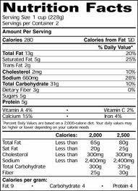
Label Reading is Key
Each label on food should be read every time
  Ingredients in products can change without warning
Understanding labeling laws and their limitations is important

Slide 13
Food Allergen Labeling and Consumer Protection Act:
Exceptions:
  Foods that do not need clear labeling
    Any food not regulated by the FDA
      Includes most meats, poultry, certain egg products and most alcoholic beverages
    Any other foods not in the major 8, such as:
      Sesame or other seeds
      Molluscan shellfish (oysters, clams, mussels, scallops and others)
      Gluten (except for wheat)
        Barley, rye, or oats (hidden in malt, dextrins, flavors)

Slide 14
Avoid products with advisory labeling for allergen of concern
Statements (numerous formats and no regulation)
  “may contain…”
  “processed in a facility that…”
  “manufactured on shared equipment with…”
  Etc.

Slide 15
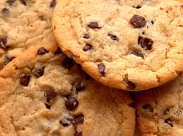

Hidden Ingredients
Not an obvious component of food
Just looking at the food is not enough to tell if an allergen is in it
If there is an item that does not have a label, it is safest to avoid eating it

Slide 16

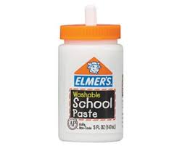

Food Sources in Non-Edible Items
Finger paint: milk or egg whites
Shaving cream: milk
Paste: wheat
Play dough: wheat
Bean bags: beans, nuts or seeds

Slide 17
High Risk Situations
Outside food in schools (birthdays, celebrations, cultural days, bake sales, etc.)
Breaks in school routine and field trips
School bus and transportation
Transitions in care and substitute staff

Slide 18
For More Information
The Food Allergy Network: www.foodallergy.org
American Academy of Allergy, Asthma, and Immunology: 1-800-822-2762
American Academy of Pediatrics: 1-800-433-9016

