Slide 1
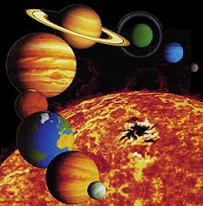
Our Solar System
Students of all ages enjoy being engaged in learning about the planets that make up our solar system. This classroom lesson includes a NASA video that walks you through the planets providing factual information. Students learn a song to help them retain what they learn and complete a hands-on activity to make their own solar system model.
Grades: K-12

