Slide 2
DEFINING
DIFFICULT WORDS
If you were asked to define the word garrulous, what might you guess it means?
TKAMB
Journals
© Presto Plans

Slide 3
DEFINING
DIFFICULT WORDS
What if you read the word in a sentence?
Unlike his quiet and low key family, Brad is garrulous.
TKAMB
Journals
© Presto Plans

Slide 4
CONTEXT CLUES
Unlike his quiet and low key family, Brad is garrulous.
If you read these words in a sentence, you might be able to determine the meaning based on context clues. In this sentence, the context—the words surrounding the new vocabulary word—provide clues to help you determine garrulous means talkative.
TKAMB
Journals
© Presto Plans

Slide 5
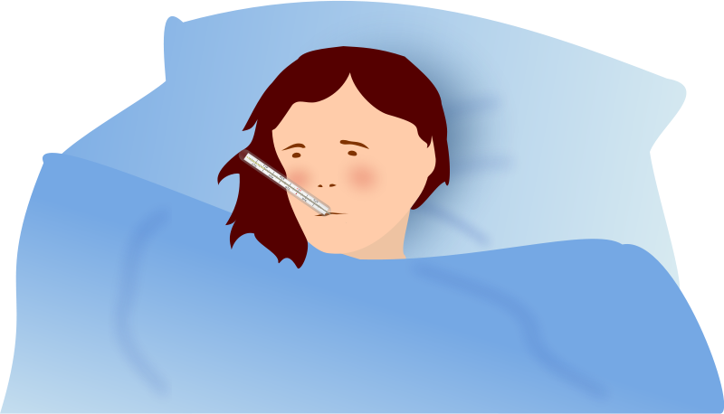
TYPES OF CONTEXT CLUES
1. Using Examples
An author may give you examples to help you understand the meaning of an unknown word.
“Suzanne had many ailments including a rash, allergies, and a chronic headaches” . The examples—rash, allergies, headaches— help you figure out that the word ailment means “a minor illness.”
TKAMB
Journals
© Presto Plans

Slide 6
TYPES OF CONTEXT CLUES
2. Using Synonyms
A context clue can be in the form of a synonym: a word that means the same or almost the same as the unknown word. A synonym may appear anywhere in a passage to provide the same meaning as the unknown word.
“My doctor said smoking could terminate my life. But I told him, ‘Everybody’s life has to end some time.’ ”
The synonym that helps you understand the word terminate is “end.”
TKAMB
Journals
© Presto Plans

Slide 7
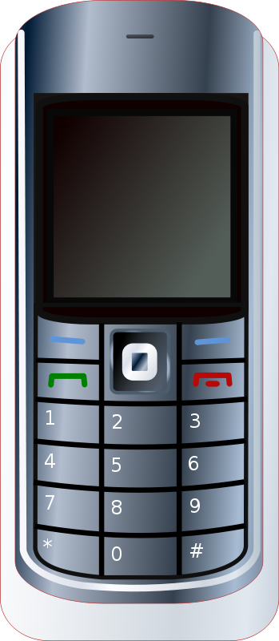
TYPES OF CONTEXT CLUES
3. Using Antonyms
An antonym is a word that means the opposite of another word. Antonyms as context clues are often signaled by words and phrases such as however, but, yet, on the other hand, and in contrast.
Many people have pointed out the harmful effects that cell phones in school have had, yet there are many salutary effects as well.
Using the antonym context clue ‘harmful’, we can figure out that salutary means beneficial.
TKAMB
Journals
© Presto Plans

Slide 8
TYPES OF CONTEXT CLUES
4. General Meaning
Sometimes it takes a bit more work to figure out the meaning of an unfamiliar word. When this happens, you must draw conclusions and ask questions about the information given with the word.
An employee, irate over being fired, stormed out of the office pushing everyone in his way.
Using the information in this
sentence, we can assume the
man is angry – which is the
meaning of irate.
TKAMB
Journals
© Presto Plans

Slide 9
Use what you have learned about context clues to determine the meaning of the following new words.
© Presto Plans

Slide 10
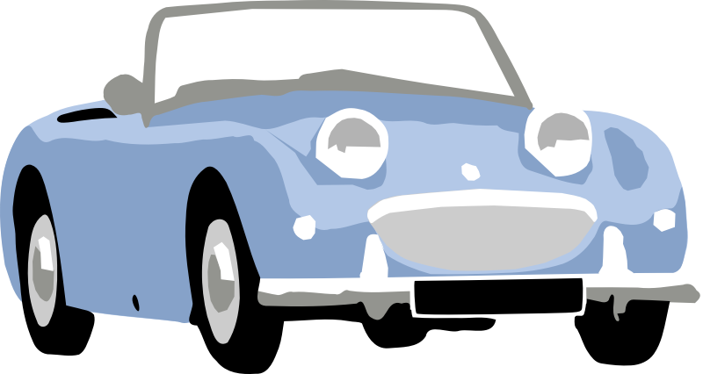
CHAPTER 1 - 2
“Not like the Socs, who jump greasers and wreck houses and throw beer blasts for kicks, and get editorials in the paper for being a public disgrace one day and an asset to society the next” (3).
“I drew in a quivering breath and quit crying. You just don’t cry in front of Darry” (8).
“He liked fights, blondes, and for some unfathomable reason, school” (10).
“‘Nice-lookin’ bruise you got there, kid.’ I touched my cheek gingerly. ‘ Really?’ (12)
© Presto Plans
© Presto Plans

Slide 11
CHAPTER 1 - 2
5. “She gave him an incredulous look; and then she threw her Coke in his face” (24).
6. “‘You heard me. Leave her alone”. Dallas scowled for a second” (24).
7. “‘Y’all sit up here with us. You can protect us’...Would we ever have something to tell the boys! We had picked up two girls, and classy ones at that...‘Okay,’ I said nonchalantly, “might as well’ (25).
8. “‘It was the Socs’ I said nervously, because of there plenty of Socs milling around and some of them were giving me funny looks, as if I shouldn’t be with Cherry or something” (31).
© Presto Plans

Slide 12
CHAPTER 1 - 2
Synonyms/Definitions of Words
Asset – a useful or valuable thing, person, or quality
Quivering – tremble or shake with a slight rapid motion
Unfathomable – incapable of being fully understood
Gingerly – in a careful or cautious manner
Incredulous –unwilling or unable to believe something
Scowled – an angry or bad-tempered expression
Nonchalantly – feeling or appearing casually calm and relaxed; not displaying anxiety, interest, or enthusiasm
Milling - to move about in a disorganized way (people)
© Presto Plans

Slide 13
CHAPTER 3 - 4
“After the movie was over it suddenly came to us that Cherry and Marcia didn’t have a way to get home. Two-Bit gallantly offered to walk them home” (37).
“That was the truth. Socs were always behind a wall of aloofness, careful not to let their real selves show through” (38).
“He kicked other horses and was always getting into trouble. ‘I’ve got me a ornery pony, Soda’d tell him” (39).
“Johnny’s eyes went round and he winced as though I’d belted him (42).
© Presto Plans

Slide 14
CHAPTER 3 - 4
5. “My teeth chattered unceasingly and I couldn’t stop them” (56).
6. “‘He appeared in a few minutes, clad only in a pair of low cut blue jeans” (59).
7. “So we’d have to be hermits for the rest of our lives, and never see anyone but Dally” (65).
8. “‘But this church gave me a kind of creepy feeling. What do you call it? Premonition”(67).
© Presto Plans

Slide 15
CHAPTER 3 - 4
Synonyms/Definitions of Words
Gallantly– brave; heroic; giving respect to women
Aloofness– not friendly or forthcoming; cool and distant
Ornery– bad-tempered and combative
Winced– give an involuntary grimace/shrinking movement of the body out of or in anticipation of pain or distress
Unceasingly–not coming to an end; continuous
Clad– clothed
Hermits– any person living alone or seeking to do so
Premonition- a strong feeling that something is about to happen
© Presto Plans

Slide 16
CHAPTER 5 - 6
“I looked at Johnny imploringly. Johnny sighed. ‘I’m gonna cut mine too, and wash the grease out’” (72).
2. “‘I guess we’re disguised’. I leaned back next to him sullenly. ‘I guess so’” (73).
3. “I was trying to find the meaning the poet had in mind, but it eluded me” (78).
4. “‘I never thought I’d live to see the day when I would be so glad to see Dally Winston, but right then he meant one thing: contact with the outside world. And it suddenly because real and vital” (80).
© Presto Plans

Slide 17
CHAPTER 5 - 6
5. “‘‘You’re starved?’ Johnny was so indignant he nearly squeaked” (80).
6. “‘I had thought about turning ourselves in lots of times, but apparently the whole idea was a jolt to Dallas” (87).
7. “‘‘My parents,’ Johnny repeated doggedly, ‘did they ask about me?’”(88)
© Presto Plans

Slide 18
CHAPTER 5 - 6
Synonyms/Definitions of Words
Imploringly– to beg someone to do something
Sullenly– bad-tempered and sulky; gloomy
Eluded– (of an idea or fact) fail to be grasped or remembered
Vital– absolutely necessary or important; essential
Indignant–feeling or showing annoyance at what is perceived as unfair treatment
Jolt– give a surprise or shock to (someone) in order to make them act or change
Doggedly– having or showing persistence
© Presto Plans

Slide 19
CHAPTER 7 - 8
“Soda was awake by then, and although he looked stony-faced, as if he hadn’t heard a word the doctor had said, his eyes were bleak and stunned” (103).
2. “Two-Bit’s mother warned us about burglars, but Darry, flexing his muscles so that they bulged like oversized baseballs, drawled that he wasn’t afraid of any burglars” (106).
3. “Steve made the mistake of referring to him as ‘all brawn and no brain,’ and Darry almost shattered Steve’s jaw” (109).
4. “‘Work?’ Two-Bit was aghast. ‘And ruin my rep?’” (112)
© Presto Plans

Slide 20
CHAPTER 7 - 8
5. “Two-Bit was telling me about one of his many exploits while we did the dishes” (113).
6. “I hated them as bitterly and as contemptuously as Dally Winston hated” (115).
7. “‘It was the reward of two hours of walking aimlessly around a hardware store to divert suspicion” (125).
8. “‘All right,’ Two-Bit said reluctantly. ‘But, Darry’ll kill me if you’re really sick and go ahead and fight anyway” (126).
© Presto Plans

Slide 21
CHAPTER 7 - 8
Synonyms/Definitions of Words
Bleak - cold and forbidding
Drawled - speak in a slow, lazy way with prolonged vowels
3. Brawn - physical strength in contrast to intelligence
4. Aghast - filled with horror or shock
5. Exploits - An act /deed, esp. a brilliant, bold or heroic one
6. Contemptuously - the feeling that a person or a thing is beneath consideration, worthless, or deserving of hate
7. Divert - distract (someone or their attention) from something
8. Reluctantly – hesitant or unwilling; disinclined
© Presto Plans

Slide 22
CHAPTER 9 - 10
“Then I hurried to take a shower and change clothes. Me and Soda and Darry always got spruced up before a rumble” (131).
2. “‘I don’t know if you ought to be in this rumble, Pony,’ Darry said slowly. Oh no, I thought in mortal fear, I’ve got to be in it. Right then the most important thing in my life was helping us whip the Socs” (134).
3. “We stood there clenching our teeth and grimacing, with sweat pouring down our faces” (134).
4. “‘‘Curly’s in the reformatory for the next six months,’ Tim grinned ruefully, probably thinking of his
roughneck hard-headed brother” (139).
© Presto Plans

Slide 23
CHAPTER 9 - 10
5. “One of the Brumly guys waved me over. We mostly stuck with our own outfits, so I was a little leery” (139).
6. “‘He was very still for a moment and I thought in agony: He’s dead already. We’re too late” (148).
7. “Dally had taken the car and I started the long walk home in a stupor. Johnny was dead” (150).
8. “‘Today’s Tuesday, and you’ve been asleep and delirious since Saturday night. Don’t you remember?” (157)
© Presto Plans

Slide 24
CHAPTER 9 - 10
Synonyms/Definitions of Words
Spruced - neat in dress and appearance
Mortal - very great
Grimacing - an ugly, twisted expression on a person's face,
Ruefully – expressing sorrow or regret, esp. when in a slightly humorous way
Leery - cautious or wary due to realistic suspicions
Agony - extreme physical or mental suffering
Stupor - a state of near-unconsciousness or insensibility
Delirious –A disturbed state of mind resulting from illness
© Presto Plans

Slide 25
CHAPTER 11 - 12
“Did he have a kid brother who idolized him?” (162)
2. “If the judge decides Darry isn’t a good guardian or something, I’m liable to get stuck in a home somewhere” (165).
3. “Randy shook his head...‘You almost drowned...Bob scared [Johnny] into doing it. I saw it’. I was bewildered” (165).
4. “Darry said ‘Yes, sir,’ looking straight at the judge, not flinching” (168).
© Presto Plans

Slide 26
CHAPTER 11 - 12
5. “Then he said I was acquitted and the whole case was closed” (168).
6. “I used to make A’s in English, mostly because my teacher made us do compositions all the time. I mean, I know I don’t know good English..., but I can write it good when I try” (169).
7. “I was sitting on the fender of Steve’s car, smoking and drinking a Pepsi” (170).
8. “‘Taking into consideration the circumstances’ -- brother, was that ever a way to tell me he knew I was goofing up because I’d been in a lot of trouble. At least that was a roundabout way of putting it” (170).
© Presto Plans

Slide 27
CHAPTER 11 - 12
Synonyms/Definitions of Words
1. Idolized - admire, revere, or love greatly or excessively
2. Liable - likely to do or to be something
3. Bewildered to become confused
4. Flinching - make a quick, nervous movement of the face or body as an instinctive reaction to surprise, fear or pain
5. Acquitted - free (someone) from a criminal charge
6. Compositions – a written work by a school/college student
7. Fender – the area around the wheel well of a vehicle
8. Roundabout - not saying what is meant clearly and directly
© Presto Plans

Slide 28
The original purchaser of this document is granted permission to copy for teaching purposes only. If you are NOT the original purchaser,
please download the item from my store before making any copies. Redistributing, editing, selling, or posting this item or any part
thereof on the Internet are strictly prohibited without first gaining permission from the author. Violations are subject to the penalties of
the Digital Millennium Copyright Act. Please contact me at prestoplans@gmail.com if you wish you be granted special permission
You can visit my store at
http://www.teacherspayteachers.com/Store/Presto-Plans
© Presto Plans

