Slide 1


Budget Hearing
Elmore County Public Schools
Jason Mann, CSFO
September 5, 2019
“Every Student Empowered, Every Student Succeeds”

Slide 2

Collaborative Effort
Meetings/discussions with:
  Superintendent and Central Office Department Heads
  Chief School Financial Officer
  Human Resources Senior Coordinators
  Principals
  School Board Attorneys
  Alabama State Department of Education
  Veteran Central Office staff in other school systems
This Photo by Unknown Author is licensed under CC BY

Slide 3

Budget Update
Areas of Concentration for FY’20 Budget
Sustainability of programs and educational services
  Alternative Education
  Virtual “EDGE” Program
  Expanding Career-Technical Education and Dual-Enrollment
Construction of new instructional spaces
Continue to move toward goal of 2+ months reserve
Potential for additional educational resources to support classroom instruction needs (technology and instructional materials)
Increased support for professional development for teachers—PLCs
Use all available resources to lessen the stress on general fund budget
Maintain current staffing and address areas of need to improve the learning environment for ECBOE students and strive towards lower teacher to student ratios

Slide 4


Funding Sources

Slide 5
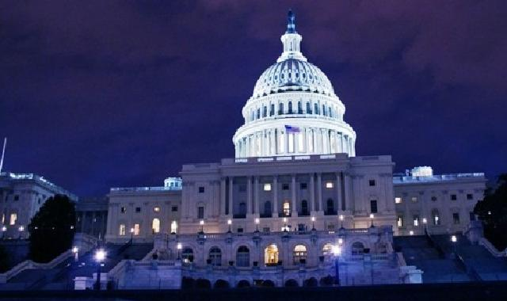
Federal Funds
Title I – all K-4 and 5-8 schools (9)
  Budget - $2,464,812
  Funds allocated based on per pupil allocation (PPA); determined by various factors including lunch status, total enrollment, hold harmless formula, etc.
Title II – Professional Development
  Budget - $374,986 (decrease of $37,000 from FY’19)
  Used towards class-size reduction (CSR) units – used in some of our middle schools and high schools
  Mentoring Program (used to assist our younger teachers using veteran teachers or retired contract teachers)
  Set Aside for FY’20 – Off the top allocation of $19,174 to serve private schools' students who live in Elmore (PCA)
  Continuing to look at new opportunities to expand the professional develop for our schools' facilities (ways which provide advanced learning platforms for EC students)
Title III – ESL
  Budget – $21,876
  No Title III funds cover salaries
  Professional development and instructional resources ONLY
This Photo by Unknown Author is licensed under CC BY-NC

Slide 6
Federal Funds
Special Education
  IDEA Allocation of $2,394,374
  IDEA Part B – Preschool Allocation of $46,946
  Used almost solely for salaries and benefits
  **These two programs alone are why it vital that our residents complete the upcoming census reports; this will assist us in being able to possibly obtain much need increased funding to meet these students needs.
Career Technical Education – Carl Perkins Act
  Allocation of $137,800
  Covers travel, purchased services, computers and audio-visual equipment, software, and instructional equipment, material and supplies
  **FY21 will move to incorporate down to as low as 5th Grade
This Photo by Unknown Author is licensed under CC BY-NC

Slide 7
Federal Funds
Title IV, Part A
  Allocation of $174,979
  >20% Well-Rounded Education, >20% Improvement of School Conditions for Learning, <15% Technology
  American Behavioral
  Added Success Coaches
  Instructional Software and devices
  Social Services additions
  PD focused toward Mental Health
This Photo by Unknown Author is licensed under CC BY-NC

Slide 8

Child Nutrition
$7.9 million operating budget
  Salaries
  Equipment
  Purchased Food and Supplies
  Staff Professional Development
  Continued upgrades to facilities, as well as improving meal offerings to students
  Program now offers Breakfast in the Classroom, a Supper Program , as well as a strong Summer Feeding Program

Slide 9

Our Goals with Federal Funding
Use wisely and within the law (following the guidelines of the newly added Procurement Policy Part 200 - Uniform Administrative Requirements for Federal Awards)
Financially support the mission of the system while minimizing any decrease to the general fund balance
Keep student needs 1st!
This Photo by Unknown Author is licensed under CC BY-SA-NC

Slide 10
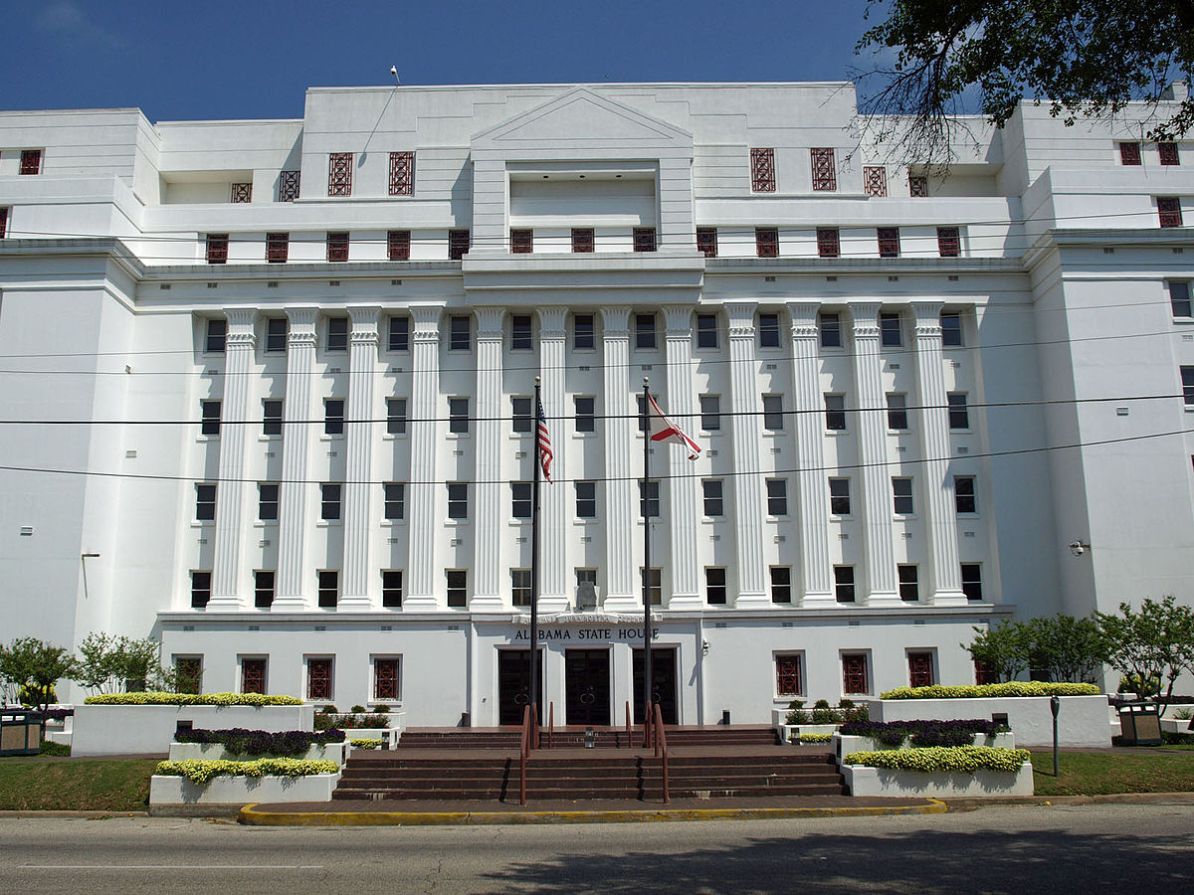
State Funding
“AKA” Foundation Program
Assign all Foundation Program units to schools
  Teachers
  Principals
  Assistant Principals
  Counselors
  Librarians
  Career Tech Director
  Career Tech Counselor
  REQUIRED before ANY federal funds can be used to support instructional programs
Based on student average daily membership (ADM) of 11,421.35
**Currently up over 190 students this year from this time last year.
This Photo by Unknown Author is licensed under CC BY-SA

Slide 11

Foundation Program – State & Local Funds
Salaries
Fringe Benefits
Other Current Expense (OCE)
-Support staff and Additional Certified Staffing Needs
Classroom Instructional Support
  Student Materials - $600/unit
  Technology - $350/unit
  Library Enhancement - $157.73/unit
  Professional Development - $100/unit
  Common Purchase - $0/unit
  Textbooks - $75/student (ADM)

Slide 14
Other State Funds
Foundation Program – Education Trust Fund (ETF – increased $3,705,218)
Allocation increase of $9,851funding for School Nurses ($429,568)
Allocation increase of $5,859 funding for Technology Coordinator ($61,799)
At Risk – ECAP, counseling program, at-risk/intervention programs, homebound, and student tutoring ($276,857)

Slide 15
Other State Funds
Transportation
  Operations - $5,169,010
  Fleet Renewal - $8,326/bus = ($957,490) *to be dedicated to pay for the 59 new bus units added
Career-Technical Education
  Operations & Maintenance (O & M)
    $61,500
    State budget line item for FY20
    Will be used for classroom supplies for ECTC Staff

Slide 16
Other State Funds
First Class Pre-K Grants - $915,924
Four First Class Pre-K Classrooms
1 Classroom EES
1 Classroom HES
5 Classrooms WES
4 Classrooms CES
**Considering possible additional classrooms for FY’20-21 if continued space available to do so.

Slide 17
Local Funds
Tax Revenue
  Property tax
  Sales Tax
  ABC
  Helping Schools tags
  Manufactured Homes
  Business Privilege
  **NEW – Portion of EC SSUT Tax Proceeds
Other Revenue
  Food Service Income
  Interest
  Local School Authority - Public (GF, athletics, etc.)
  Local School Authority - Non-Public (clubs/activities)
  Other Local Revenue

Slide 18
2018-2019 Revenue Sources

Slide 19
2019-2020 Revenue Sources

Slide 20
Fiscal Year Comparison
Source | 2019-2020 | % of Budget | 2018-2019 | % of Budget | Variance
State | $72,263,372 | 64.16% | $67,155,865 | 63.60% | $ 5,107,507
Federal | $10,504,995 | 9.33% | $10,337,326 | 9.79% | $ 167,669
Local | $29,571,407 | 26.26% | $27,786,535 | 26.31% | $ 1,784,872
Other | $286,862 | 0.25% | $316,023 | 0.30% | $ (29,161)
TOTAL | $112,626,637 | 100.00% | $105,595,749 | 100.00% | $ 7,030,887

Slide 21

Budget Year 2019-2020
Local Revenue |  |  | $29,571,407 |  | FY '18-19 Total Local Revenues
4 Mill | $3,800,000 |  | 12.85% |  | $26,937,474
1 Cent Sales | $10,000,000 |  | 33.82%
ABC Tax | $430,000 |  | 1.45%
3 Mill | $3,100,000 |  | 10.48%
3 Mill AMD778 | $3,400,000 |  | 11.50%
Food Sevice Income | $1,488,128 |  | 5.03%
Interest | $20,075 |  | 0.07%
Other Local Revenue | $1,757,091 |  | 5.94%
LSA - Public | $3,728,630 |  | 12.61%
LSA - Non-Public | $1,807,983 |  | 6.11%
Manufactured Homes | $12,000 |  | 0.13%
Business Privilege | $15,000
Helping School Tags | $12,500
Estimated Total Increase from Prior Year |  |  | $2,633,933.01

Slide 22
Budget Year 2019-2020
State Revenues |  | $72,088,167 | Budget FY'19 | Variance | % Var.
 | Amount | Percent
Foundation Program | $60,564,724 | 84.01% | $56,599,506 | $3,965,218 | 7.0%
School Nurse Program | $429,568 | 0.60% | $419,717 | $9,851 | 2.3%
Technology coordinator | $61,799 | 0.09% | $55,940 | $5,859 | 10.5%
Career Tech O & M | $61,500 | 0.09% | $60,281 | $1,219 | 2.0%
Alabama Reading Initiative | $317,286 | 0.44% | $314,714 | $2,572 | 0.8%
English Second Language | $41,300 | 0.06% | $18,158 | $23,142 | 127.4%
Gifted Education | $46,845 | 0.06% | $27,253 | $19,592 | 71.9%
Hippy | $82,950 | 0.12% | $73,000 | $9,950 | 13.6%
Transportation | $5,169,010 | 7.17% | $4,713,608 | $455,402 | 9.7%
At Risk | $276,857 | 0.38% | $290,691 | ($13,834) | -4.8%
Preschool Special Ed. | $87,190 | 0.12% | $31,027 | $56,163 | 181.0%
OSR Pre-K Program | $915,924 | 1.27% | $619,000 | $296,924 | 48.0%
Public School Capital Fund | $2,915,724 | 4.04% | $2,702,253 | $213,471 | 7.9%
Fleet Renewal | $957,490 | 1.33% | $888,625 | $68,865 | 7.7%
Other State Grants | $160,000 | 0.22% | $160,000 | $0 | 0.0%
TOTAL | $60,564,724 | 100.00% | $66,973,773 | $5,114,394 | 7.6%

Slide 23
Budget Year 2019-2020
Expenditures by Object |  | $111,020,764 | FY 2018-2019 | Variance
Salaries | $59,701,654 | 53.78% | $57,103,150 | $2,598,504 | 4.55%
Employee Benefits | $24,189,751 | 21.79% | $23,879,124 | $310,627 | 1.30%
Purchased Services | $9,422,516 | 8.49% | $8,733,510 | $689,006 | 7.89%
Materials and Supplies | $10,796,080 | 9.72% | $9,833,083 | $962,997 | 9.79%
Capital Outlay | $293,000 | 0.26% | $643,169 | ($350,169) | -54.44%
Other Expenditures | $336,804 | 0.30% | $813,548 | ($476,744) | -58.60%
Debt Service | $6,280,959 | 5.66% | $6,719,367 | ($438,408) | -6.52%
 |  |  | $107,724,951 | $3,295,813 | 3.06%
 | $111,020,764 | 100.00%

Slide 24
Budget Year 2019-2020
Total Expenditures by Function
Instructional Services | $61,566,300 | 55.40%
Instructional Support | $13,483,770 | 12.13%
Operation and Maintenance | $7,541,330 | 6.79%
Auxiliary Services | $13,451,300 | 12.10%
Administrative Services | $4,343,492 | 3.91%
Capital Outlay | $250,000 | 0.22%
Debt Services | $6,280,959 | 5.65%
Other Expenditures | $4,220,039 | 3.80%
Total | $111,137,189 | 100.00%

Slide 25
General Fund Balance ‘13-’20

Slide 26
One-Month Reserve Progress

Slide 27

Construction Needs Facing ECBOE

Slide 28

Expansion of the Elmore County Technical Center
Construction of New Redland Middle School
Construction of New Band Room for Stanhope Elmore High School
Wing Additions (ARIS, WHS)
Security Entrances at ECHS and HHS

Slide 29
Construction of a Maintenance Facility
New Field House at Holtville High School for Baseball/Softball
Coosada Elementary and Wetumpka Elementary Parking Solutions
SEHS Renovations to Cafeteria/Gym/Fine Arts Building

Slide 30
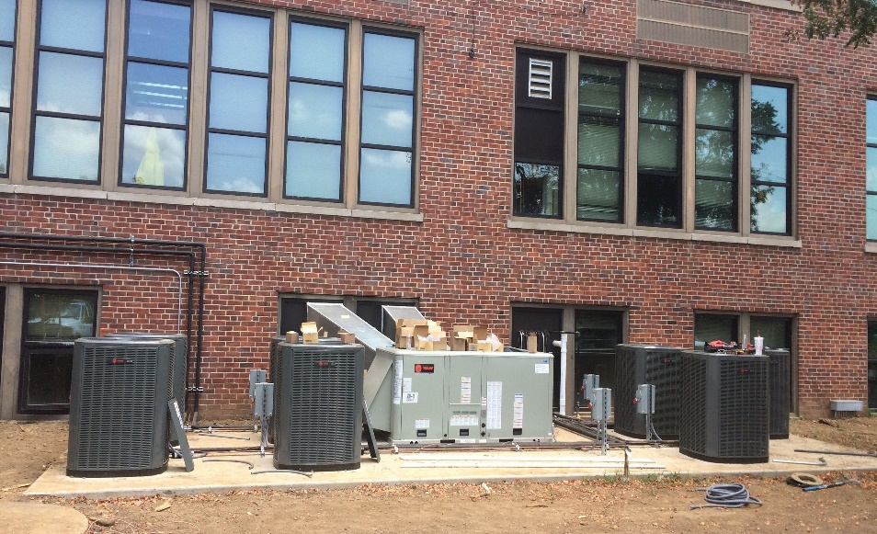
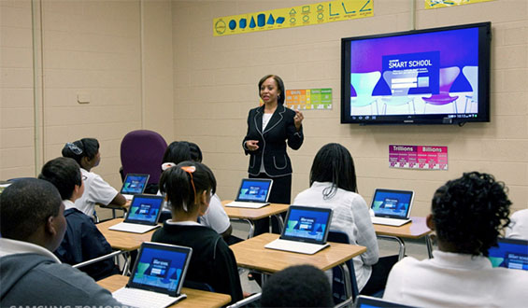
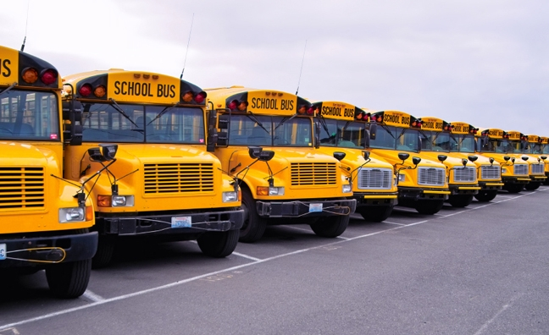

Other Important Needs Facing ECBOE This Year

Slide 31

Financial Future
Continued allowances for Out of District Participation
Working with Military families and informing them of Out of District opportunities available to them via Military Compact
Issuance of New Construction Bond
Expansion of SRO’s on campuses
Expanded Mental Health Services
Expanded Growth Opportunities for students through new ECAP programs
Upcoming Decisions about student after school programs with possible losses 21st Century Federal Funds

Slide 32
Financial Future (cont.)
Increased Enrollment will force Issues
FY20 seeing increased enrollment for 200+ students
Multiple schools are at or are very close to capacity
Will have need for more teachers to keep productive teacher to student ratios
Will face more needs in areas of furniture, technology, and cafeteria setups
Major result of this is with the increased enrollments we are seeing; we are not seeing those same increases in tax revenues to a keep up with this spike. That said, now is the time that we must begin the real discussions about tax increase in Elmore County to generate the much-needed revenues to support its growing school system and the students it serves. This is the only way to give our students the true educational experience and tools they deserve.

Slide 33
Wrap Up
The FY’20 Budget Packet it will be posted on our website for those who would like to view a copy.
Questions can be directed to:
Jason Mann, CSFO via email at: jason.mann@elmoreco.com

Slide 34

QUESTIONS???

