Slide 1
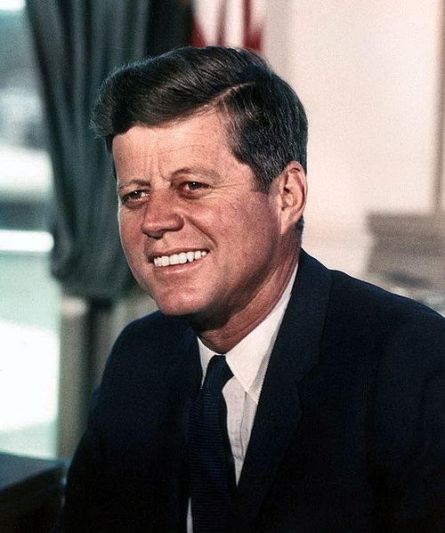
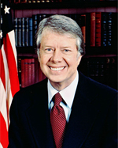
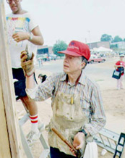
Responsibilities of Citizenship
"Ask not what your country can do for you; ask what you can do for your country."
John F. Kennedy
Inaugural address
James Earl "Jimmy" Carter, Jr.
Page 390

Slide 2
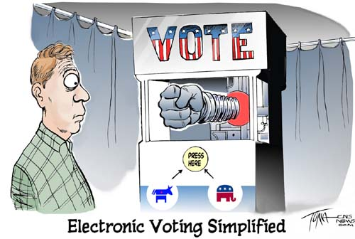

Slide 3
Touch Screen Voting System
Choose One
LOSE MY VOTE NOW.
LOSE MY VOTE LATER.
LET A HACKER CHANGE MY VOTE.
VOTE

Slide 4
Review
Right to bear Arms
Property Rights
Rights of the Accused
Equal Protection Under the Law

Slide 5
Objectives
Explain how civic responsibilities are important to Mississippians as citizens of the United States and residents of a global setting. MS5
Describe the roles of citizens in the state and nation. MS5b

Slide 6
Responsibilities of Citizenship (Voting, obeying law, juries, paying taxes, staying informed and getting involved.) Teenagers and the Law
Overview

Slide 7
Responsibilities of Citizenship
Voting.
Obeying the law.
Serving on a jury.
Paying taxes.
Stay informed.
Getting involved.

Slide 8
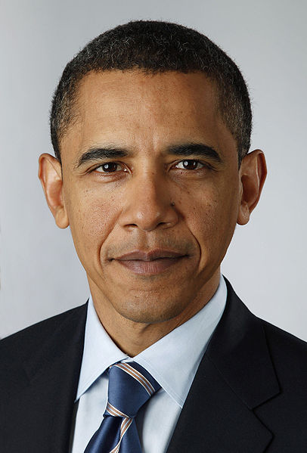
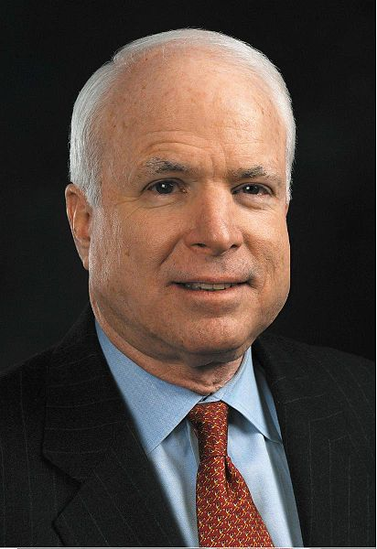
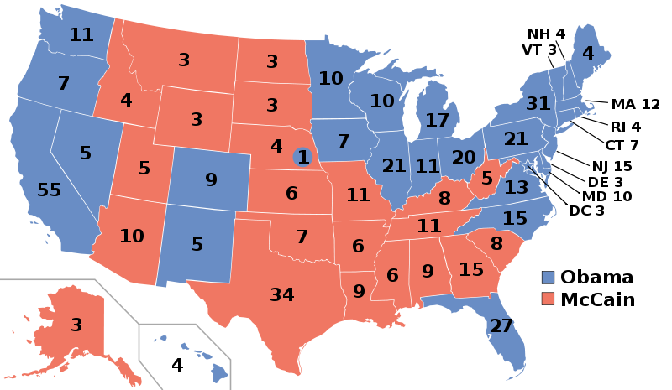
Voting
Nominee | Barack Obama | John McCain
Party | Democratic | Republican
Home state | Illinois | Arizona
Running mate | Joe Biden | Sarah Palin
Electoral vote | 365 | 173
States carried | 28 + DC + NE-02 | 22
Popular vote | 69,456,897 | 59,934,814
Percentage | 52.9% | 45.7%
63.0% of eligible voters.

Slide 9
Turnout in national lower house elections, 1960–1995
Voting
Country Compulsory № Turnout
1 Australia Y 14 95%
2 Malta N 6 94%
34 United N 9 54%*
States
* Only Congressional elections held the same year as presidential ones. Turnout rates for midterm election are approximately 10–15 percentage points lower than the general election immediately preceding it.

Slide 10
Mississippi law requires that a person register in order to vote.
Registration
Mississippi has permanent registration, which means that a person remains registered until he or she moves or is dead.

Slide 11
A citizen may register in the circuit clerk’s office in the county courthouse City residents, can also register at the city clerk’s office. You can also register by mail if the application is witnessed and signed by a resident of the same county. When renewing your driver's license.

Slide 12
Registration entitles a person to vote in federal, state, county, and city elections. In Mississippi, you do not register by party. Citizens must register at least thirty days before an election.
Registration

Slide 13
Qualifications
1. Is a United States citizen and has not been declared mentally
incompetent
2. Is at least 18 years old or will be by the next general election
3. Has been a resident of the state, county, and supervisor’s
district for at least thirty days
4. Has never been convicted of murder, rape, bribery, burglary,
theft, arson, obtaining money or goods under false pretenses,
perjury, forgery, embezzlement, or bigamy.

Slide 14
Registered voters are assigned to certain voting precincts. Each precinct has a designated polling place where voters go to cast their ballots.
Voting Precincts

Slide 15
On election day, precinct polling places are open from 7 a.m. to 7 p.m.
Polling Places

Slide 16
If a person will be out of town on election day, or having surgery, or in a nursing home, in the military, he or she can request an absentee ballot (list of candidates), which must be returned by noon on the Saturday before election day.
Absentee Ballot

Slide 17
Primaries
Types of Elections
are one means by which a political party nominates candidates for the following general election.
Mississippians do not register by party, so
voters can participate in any party primary of their choice.

Slide 18
Types of Elections
General Elections
To determine who will hold a particular
office.
All candidates nominated in a primary and any other independent candidates who qualify appear on the ballot.

Slide 19
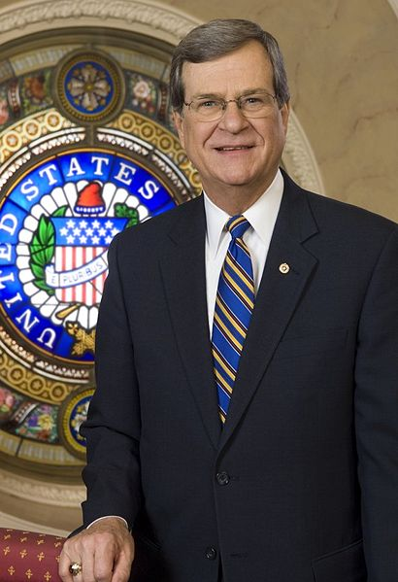
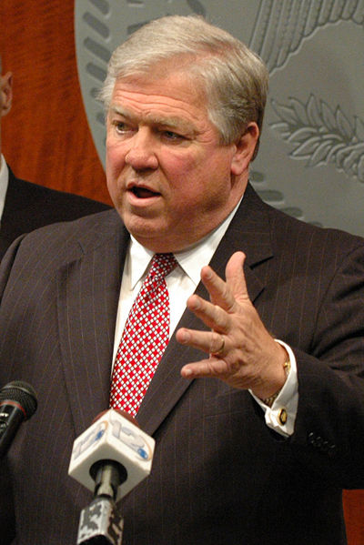
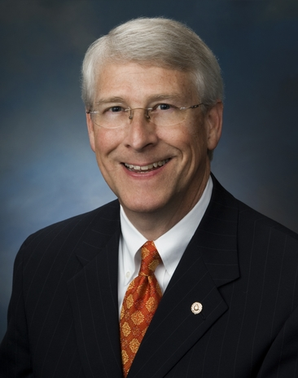
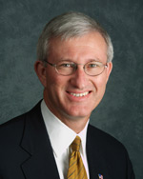
Sometimes a special election is held to replace elected officials who have died or resigned from office or to settle a controversial issue.
Special Elections
Example:
Trent Lott
Haley Barbour
Roger Wicker
Ronnie Musgrove
Governor of Mississippi.
Resigned
United States Senator
Court said NO!
United States Senator
Roger Wicker

Slide 20
Citizens who do not vote are ignoring one of their constitutional rights. Those who do not participate in the election process strengthen the value of someone else’s vote. Occasionally, an election has been decided by one vote.
Why Vote?

Slide 21
Laws are rules are created to provide order to our society. Without laws, – chaos and anarchy (mob rule).
Obeying the law.
2001

Slide 22
In Mississippi, jurors are randomly selected from a list of registered voters who are 21 years of age, are literate, and have never been convicted of a felony.
Jury Duty

Slide 23
Individuals who fail to appear for a call to jury duty may be fined or imprisoned. Individuals may request to be excused.
Jury Duty

Slide 24
A trial jury has 12 jurors whose job it is to determine the guilt or innocence of an accused person (defendant). In criminal cases, a unanimous decision is necessary to return a verdict.
Trial Jury

Slide 25
In civil cases (law suit), 9 of the 12 jurors must agree on a verdict.
Civil Cases (Torts)

Slide 26
A jury consists of 15 to 20 citizens whose responsibility it is to determine if there is enough evidence against an accused person to issue an indictment.
Grand Jury

Slide 27
A tax is an amount of money charged citizens by their government to provide services. As long as citizens demand services, there will be taxes.
Paying Taxes

Slide 28
Newspapers
Stay Informed
How many ways are there to stay informed?
Internet
Television
Unions
Churches
Government Meeting
Work Place
Other Informed Citizens

Slide 29
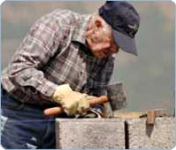
A democratic government works best when its citizens are involved.
Getting Involved
"Ask not what your country can do for you; ask what you can do for your country."
Jimmy Carter
John F. Kennedy
Inaugural address

Slide 30
Age 21
Mississippi Teens and the Law
When do you become an adult?

Slide 31
Many exceptions are made for 18-year-olds.
Legal Status
At what age can you sign a contracts (binding legal agreements) for a car?
Age 18

Slide 32
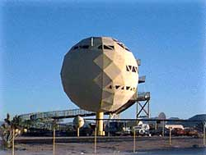
If married, can make contracts for real property (home).
Can you buy a house?
For Sale
Cheryl Fair
For Sale
Cheryl Fair
On Interstate 40 west of Flagstaff, Arizona.

Slide 33
Any married minor can sue or be sued for divorce, child custody, child support, or alimony (money paid by one ex-spouse to the other).
Married Minor

Slide 34
At what age can you get married in Mississippi?
Marriage
If either party is younger than 21, the parents or guardians must be notified, one of them must sign the license.
How many states?

Slide 35
Marriage Licenses
Marriage licenses cannot be issued to a male under 17.
Marriage licenses cannot be issued to a female under 15 unless a chancellor approves.

Slide 36
A delinquent child is one between the ages of 10 and 18 who has committed a delinquent act.
Juvenile Justice System
A delinquent act is any act that if committed by an adult would be a crime.

Slide 37
A “child in need of supervision” is between the ages of 7 and 18.
Juvenile Justice System
This child either cannot be controlled by her or his parents, constantly violates school rules, runs away without good cause, or commits a delinquent act.

Slide 38
Youth court proceedings are not open to the public and are done without a jury.
Juvenile Justice System
Records are kept confidential and may be ordered sealed once a case is dismissed or the youth reaches age 20.

Slide 39
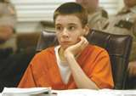
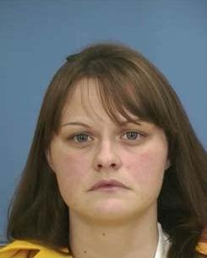
A person under 18 may be tried as an adult for certain serious crimes.
Juvenile Justice System
In July 2004, after almost two years of county jail incarceration awaiting trial after his arrest at age 13, Tyler Edmonds was tried for the murder of his half sister's husband in Starkville, Mississippi. Sentence to life in prison. Tyler is now out of prison after a
second trial in 2007. Kristi Fulgham
sentenced to death. She is now
sentenced to life.

Slide 40
As in other states, the legal drinking age is 21, and an individual must also be 21 to work as a bartender or to handle alcohol in a liquor store.
Restrictions on Alcohol
However, it is legal to work in a restaurant selling alcohol at age 18.
Born before
We
I.D.
In Mississippi, it is unlawful for any person under age 21 to have or to buy alcoholic beverages.
May 24, 2012
1991

Slide 41
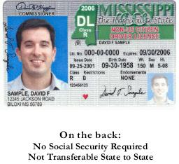
Any teenager convicted of possessing alcoholic beverages may be fined up to $100.
Conviction
Using fake identification to purchase alcoholic beverages is punishable by a fine of up to $200 or by a jail term of five to thirty days.

Slide 42
You are eligible if you are fifteen (15) years of age or older and held a Learner's Permit for a minimum of 12 months.
Driver’s License
An intermediate license allows unsupervised driving from 6:00 a.m. to 10:00 p.m.

Slide 43
By getting a license, a person gives law enforcement officers permission to check for blood alcohol concentration levels if stopped lawfully while driving a vehicle.
Implied Consent Law

Slide 44
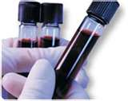
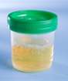
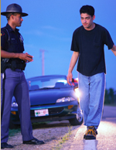
If you are arrested in Mississippi for driving under the influence (DUI) and you refuse a breath, blood or urine test, you basically have two cases.
Implied Consent Law

Slide 45
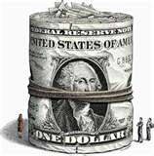
First there is the criminal case where a DUI conviction can result in fines, jail time, mandatory alcohol education programs, and more.
Case 1

Slide 46
The second case is the administrative hearing where the Department of Public Safety attempts to suspend your license (90 days) for refusing the blood, breath or urine test.
Case 2
suspended

Slide 47
If a driver’s blood alcohol level registers 0.08 percent or above, he or she can be charged with driving under the influence (DUI).
Blood Alcohol

Slide 48
Mississippi law puts drugs into five categories (schedules) based on their potential for abuse and medical use.
Drugs

Slide 49
Controlled Substance Abuse (CSA) Schedules (Some drugs appear on more than one schedule) Schedule I: Amphetamine Variants, Hashish, Hashish Oil, Heroin, LSD, Marijuana Mescaline and Peyote, Methaqualone, and Phencyclidine Analogues Schedule II: Amphetamines, Barbiturates, Cocaine, Codeine, Hydromorphone, Meperidine (Pethidine), Methadone, Methylphenidate, Morphine, Opium, Phencyclidine, Phenmetrazine, and Tetrahydrocannabinol Schedule III: Barbiturates, Codeine, Glutethimide, Morphine, and Opium Schedule IV: Barbiturates, Benzodiazepines, and Chloral Hydrate Schedule V: Codeine and Opium
Drugs

Slide 50
Penalties for the possession, sale, and manufacture of controlled substances are based on the type and amount of drug possessed and whether or not a conviction is a first, second, or third offense.
Penalties
Drug Distribution
Possession of Precursors
Possession with Intent
Prescription Forgery
Drug Manufacturing
Possession of Paraphernalia

Slide 51
Under Mississippi law, it is unlawful for any person under 18 to buy or be given tobacco products (cigars, cigarettes, etc.) without written authorization by a parent or guardian.
Tobacco

Slide 52
A penalty of up to $100 and three months in the county jail may be imposed on any person convicted of selling tobacco to anyone under age 18.
Penalty

Slide 53
Students between the ages of 6 and 21 have a right to a free public education.
School

Slide 54
Compulsory Attendance Laws
Mississippi students to attend school until the age of 17 on or before September 1 of the calendar year.
In 1918 Mississippi was the last state to enact a compulsory attendance law.

Slide 55
Students have the right to expect that their academic and personal records (transcripts) will be kept private.
Family Educational Rights and Privacy Act of 1974 and the Privacy Act of 1974

Slide 56
Responsibilities of Citizenship (Voting, obeying law, juries, paying taxes, staying informed and getting involved.) Teenagers and the Law
Review

Slide 57
Study for Chapter 16 Test.
Homework

