Slide 1
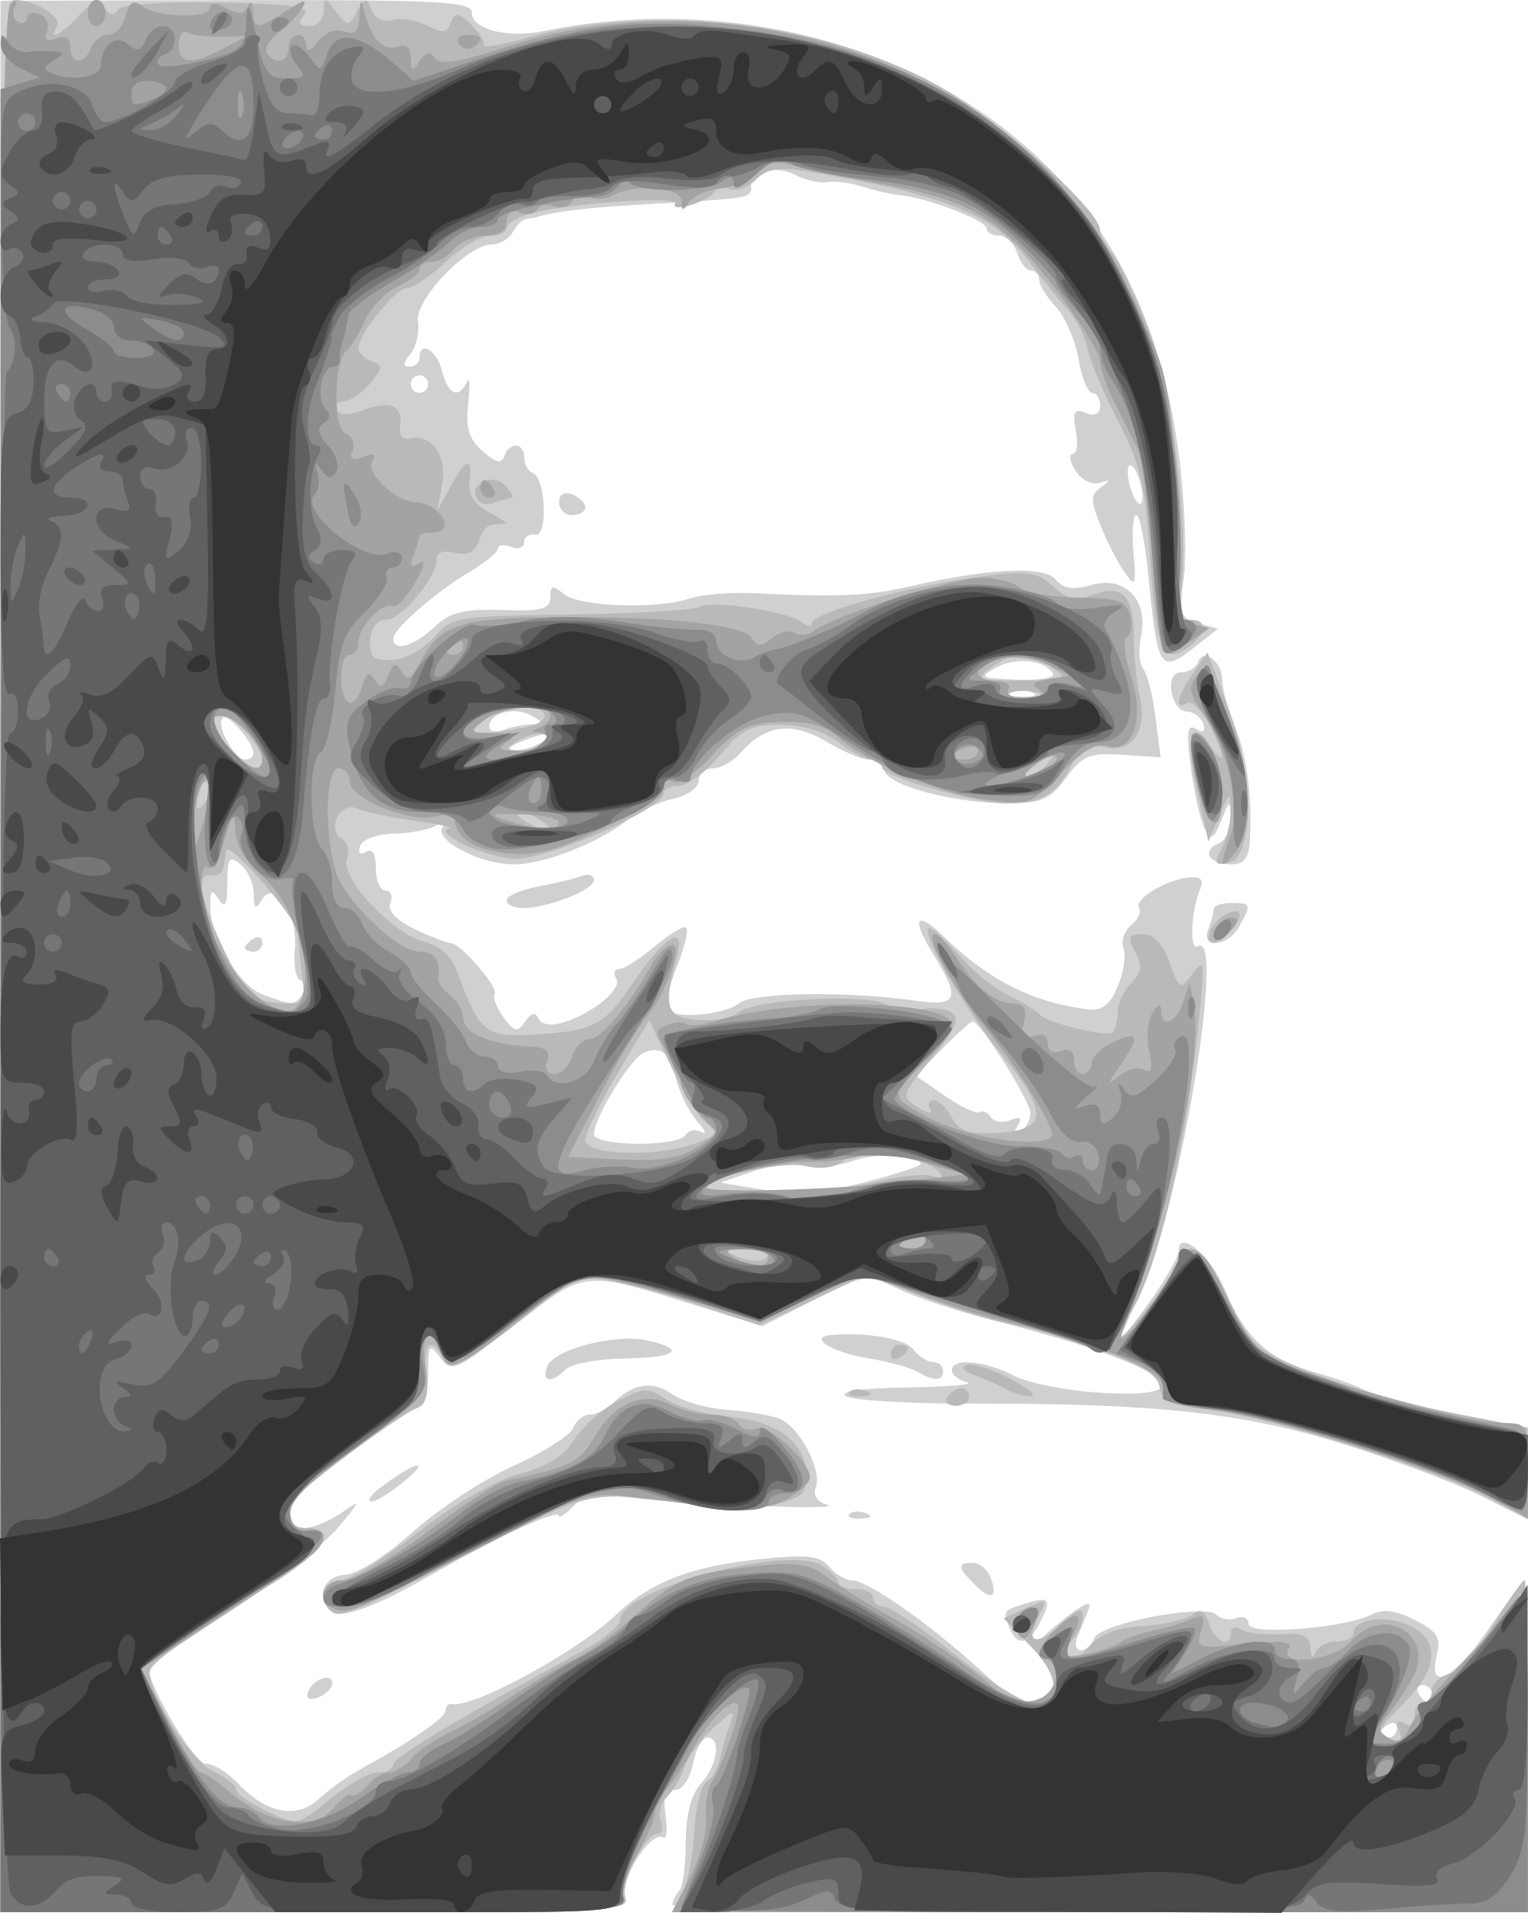
THE LIFE & TIMES OF
Martin
Luther
King, Jr.
1929- 1968
© Presto Plans
© Presto Plans

Slide 2
MARTIN
KWL Chart
LUTHER
Fill in the first two columns of the KWL Chart.
KING, JR
© Presto Plans
© Presto Plans

Slide 3
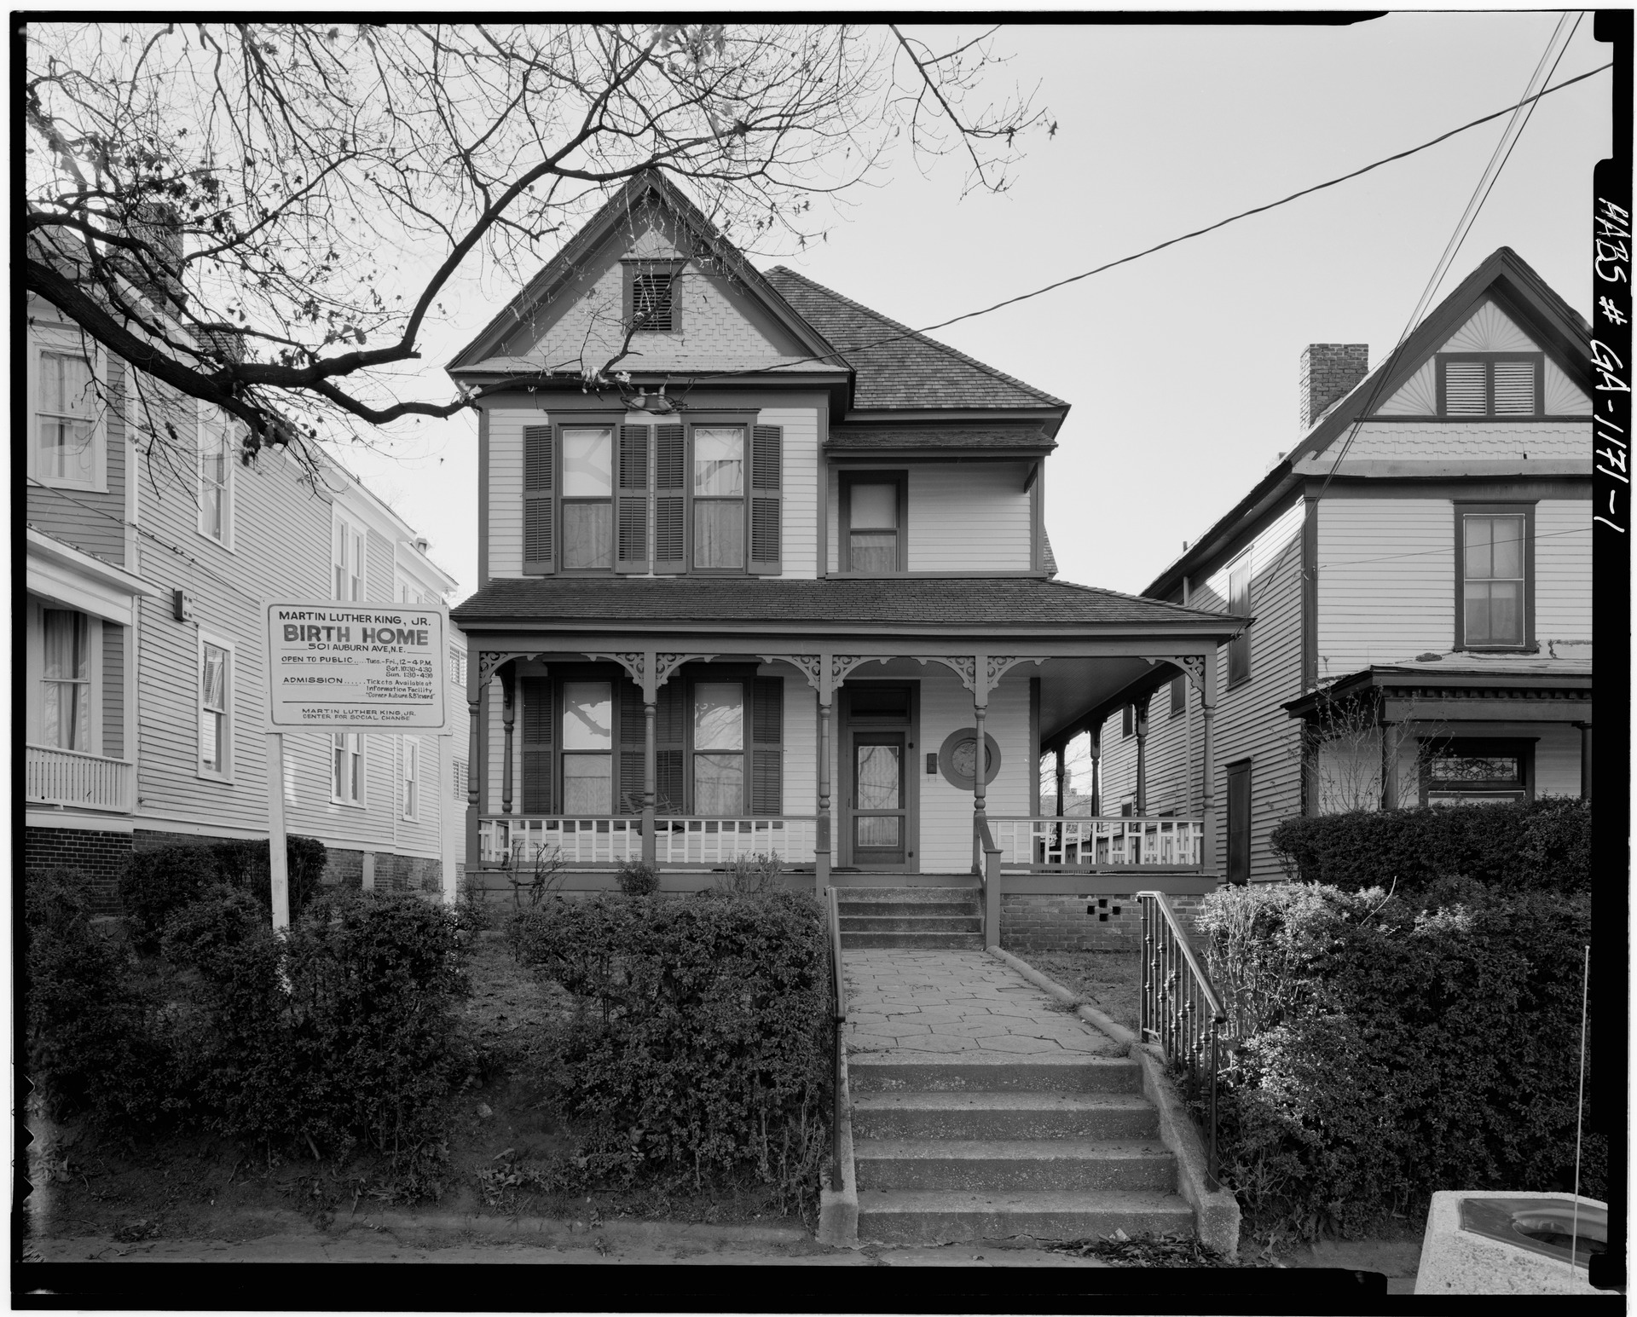
MARTIN
Family
LUTHER
Michael Luther King, Jr. was born in 1929 in Georgia. His mother was a teacher and his father was a Baptist minister.
KING, JR
Martin Luther King Jr. Birth Home, 501 Auburn Avenue, Atlanta
© Presto Plans
© Presto Plans

Slide 4
MARTIN
Family
LUTHER
KING, JR
MLK was raised in the church and, following family tradition, he also decided to become a minister.
© Presto Plans
© Presto Plans

Slide 5
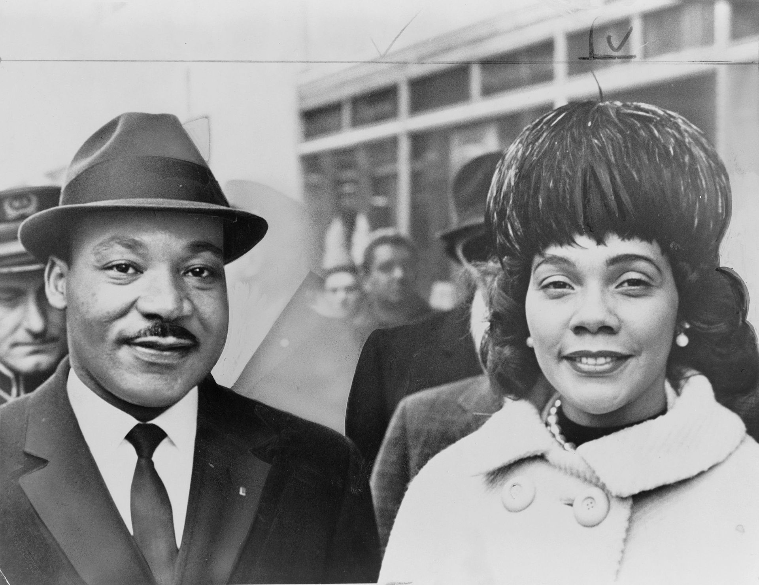
MARTIN
Family
LUTHER
King married Coretta Scott in 1953. They had 4 children together:
Yolanda
Martin
Dexter
Bernice
KING, JR
© Presto Plans
© Presto Plans

Slide 6
MARTIN
Schooling
LUTHER
Morehouse College: Attended at the age of 15 and graduated with a Bachelor of Arts in Sociology.
Crozer Theological Seminary: He received a Bachelor of Divinity.
KING, JR
Boston University: He received a Doctorate of Philosophy in Systematic Theology.
© Presto Plans
© Presto Plans

Slide 7
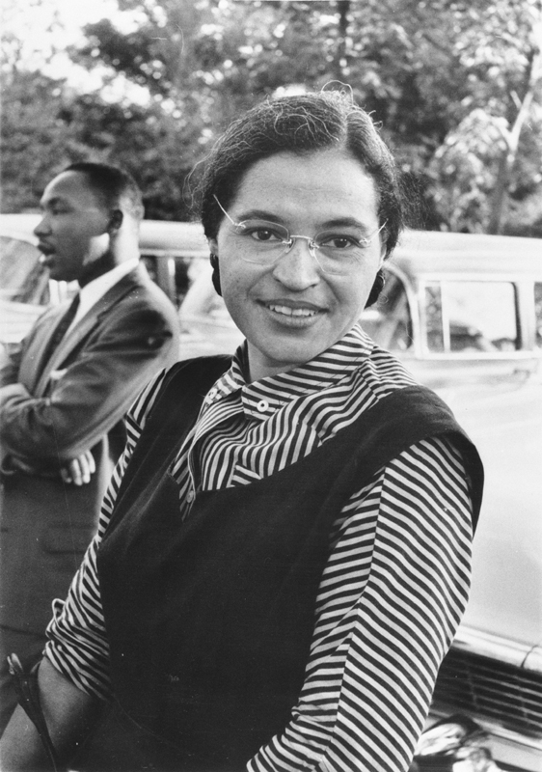
MARTIN
Rosa Parks
LUTHER
In 1955, a woman named Rosa Parks refused to give up her seat to a white passenger on a bus. This event was a catalyst for the Civil Rights Movement.
KING, JR
© Presto Plans
© Presto Plans

Slide 8
MARTIN
Rosa Parks
LUTHER
Click to watch Rosa Parks tell her story!
KING, JR
Rosa Parks
https://www.youtube.com/watch?v=eP1PeR4huuM
-
© Presto Plans
© Presto Plans

Slide 9
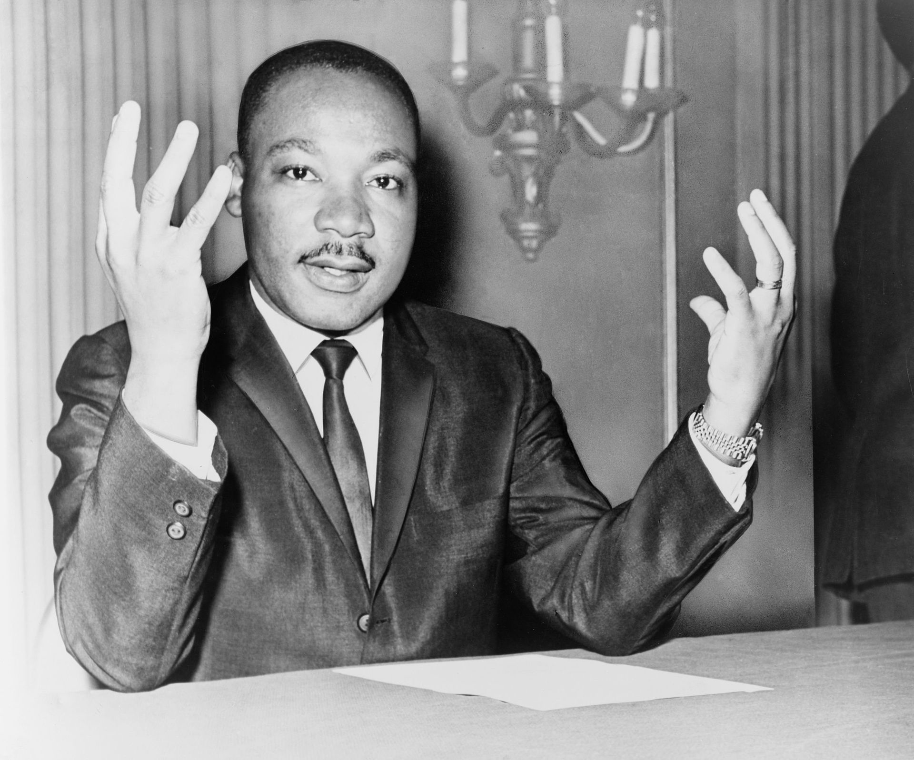
MARTIN
Martin Luther King
LUTHER
Following this event, King became the president of the Montgomery Improvement Association.
KING, JR
© Presto Plans
© Presto Plans

Slide 10
MARTIN
Non-Violence
LUTHER
KING, JR
King encouraged non-violent protests including:
- Sit-ins at all white restaurants
- Boycotts
- Staging protests
- Rallies
© Presto Plans
© Presto Plans

Slide 11
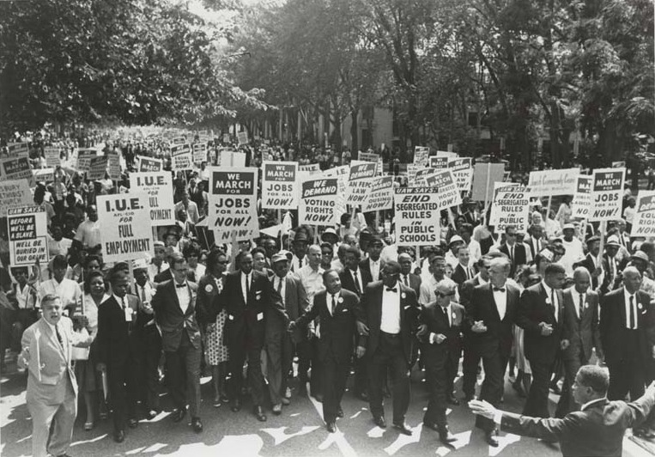
MARTIN
Civil Rights Movement
LUTHER
With his strong involvement in boycotts and protests, King soon became known as the national leader of the civil rights movement.
KING, JR
© Presto Plans
© Presto Plans

Slide 12
MARTIN
Obstacles
LUTHER
King faced many obstacles as the leader of this movement. He was stabbed, arrested, and bullets were fired at his home.
KING, JR
© Presto Plans
© Presto Plans

Slide 13
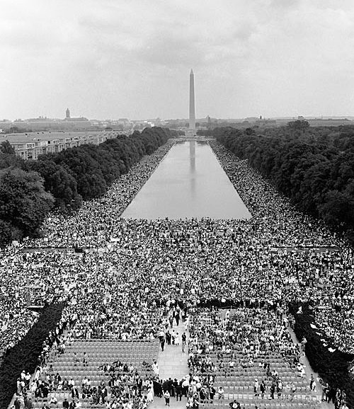
MARTIN
Famous Speech
LUTHER
King is most famous for the speech he gave during the March on Washington in 1963 where he spoke to 250,000 civil rights supporters.
KING, JR
© Presto Plans
© Presto Plans

Slide 14
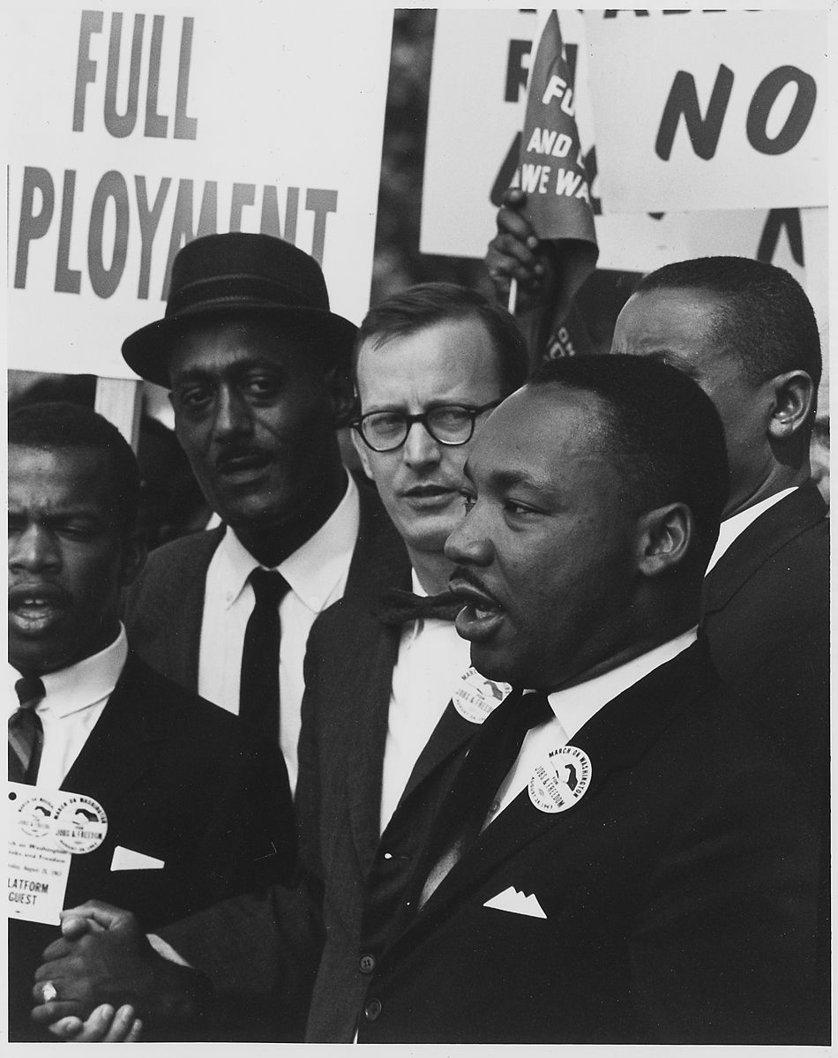
MARTIN
I Have A Dream
LUTHER
KING, JR
The speech is now known as the I Have A Dream speech, named after its most famous line.
© Presto Plans
© Presto Plans

Slide 15
MARTIN
I Have A Dream
LUTHER
Quotes from that speech:
KING, JR
I have a dream that my four children will one day live in a nation where they will not be judged by the color of their skin but by the content of their character.
© Presto Plans
© Presto Plans

Slide 16
MARTIN
I Have A Dream
LUTHER
Quotes from that speech:
KING, JR
I still have a dream. It is a dream deeply rooted in the American dream. I have a dream that one day this nation will rise up and live out the true meaning of its creed: “We hold these truths to be self-evident: that all men are created equal.”
© Presto Plans
© Presto Plans

Slide 17
MARTIN
I Have A Dream
LUTHER
Click to watch a clip about The March On Washington
KING, JR
I Have A Dream
https://www.youtube.com/watch?v=lOig2v7ZfcA
-
© Presto Plans
© Presto Plans

Slide 18
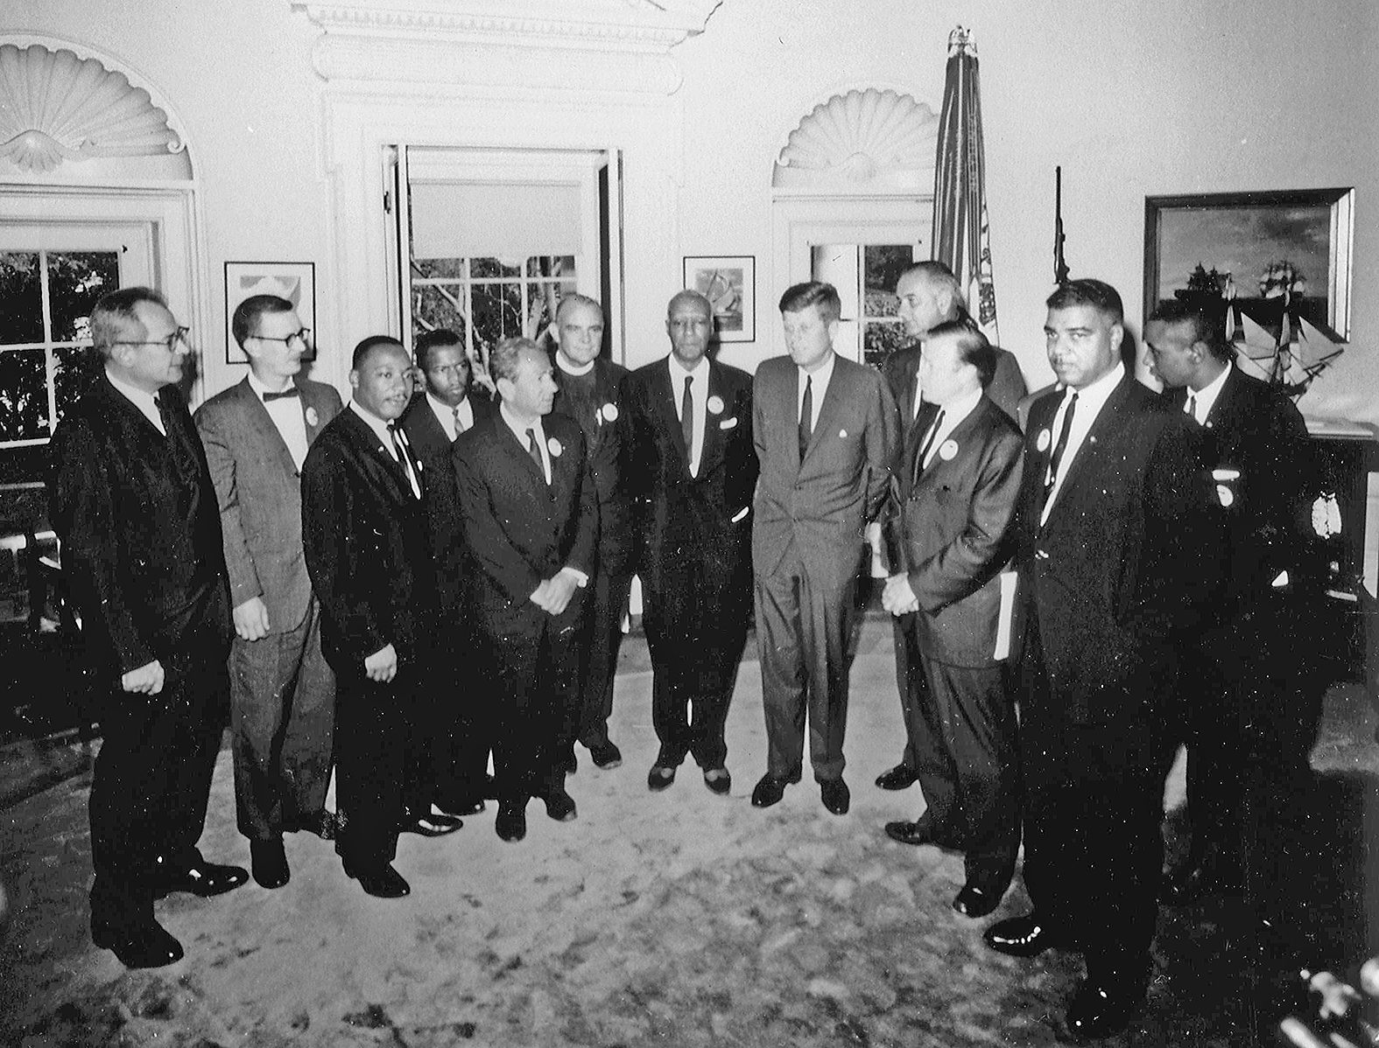
MARTIN
Civil Rights Act of 1964
LUTHER
The civil rights legislation was proposed by President John F. Kennedy in 1963. He was assassinated soon after.
KING, JR
© Presto Plans
© Presto Plans

Slide 19
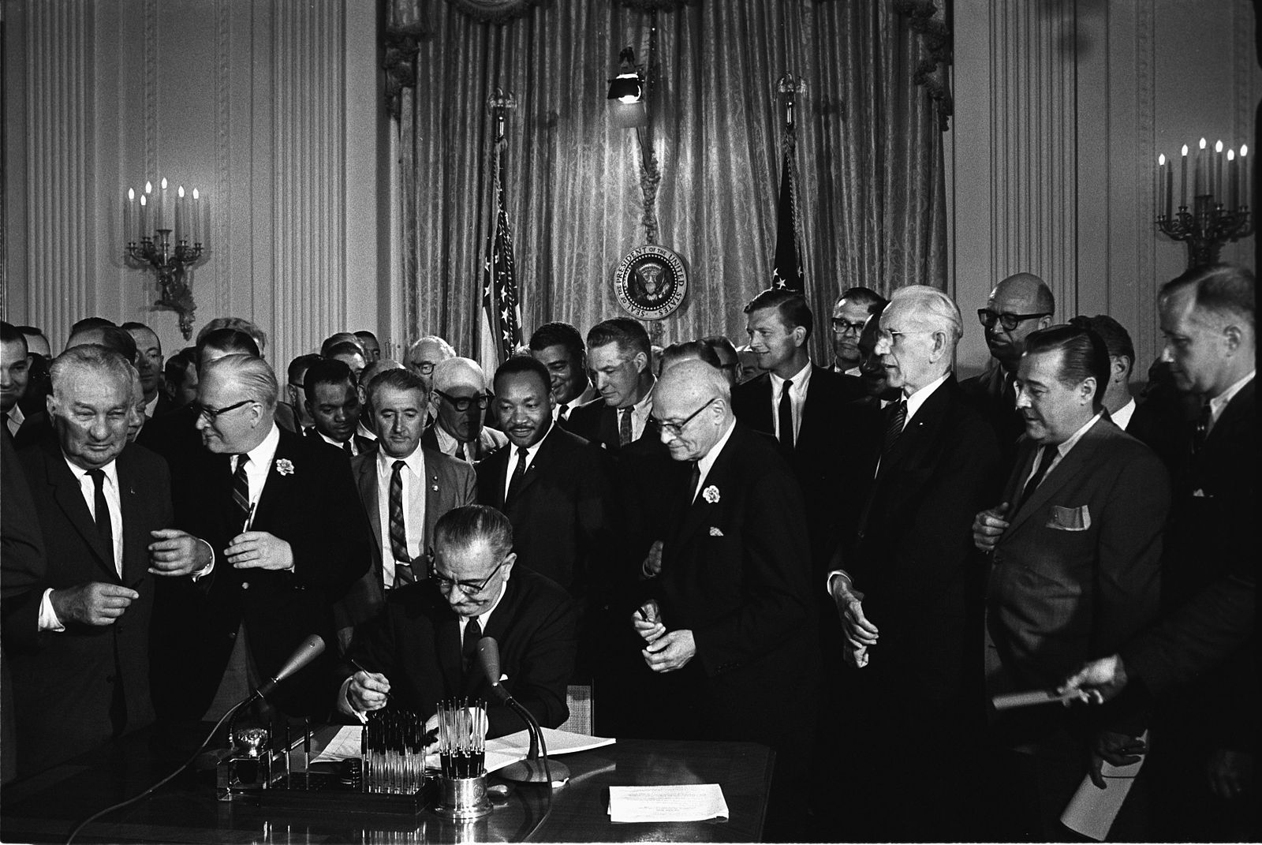
MARTIN
Civil Rights Act of 1964
LUTHER
President Lyndon B. Johnson signed the Civil Rights Bill into law in 1964 and said the following:
KING, JR
“Those who are equal before God shall now be equal in the polling booths, in the classrooms, in the factories, and in hotels, restaurants, movie theaters, and other places that provide service to the public.”
© Presto Plans
© Presto Plans

Slide 20
MARTIN
Nobel Peace Prize
LUTHER
In 1965, King won the Nobel Peace Prize for non-violent resistance to end racial prejudice in the United States. At 35 years old, he was the youngest recipient ever to receive the Nobel Peace Prize.
KING, JR
© Presto Plans
© Presto Plans

Slide 21
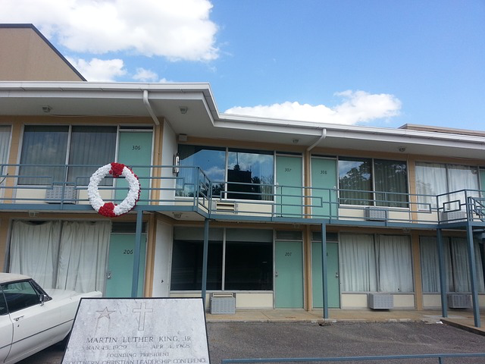
MARTIN
Death
LUTHER
In 1968, King was assassinated by James Earl Ray in Memphis while standing on a balcony at the Lorraine Motel.
KING, JR
© Presto Plans
© Presto Plans

Slide 22
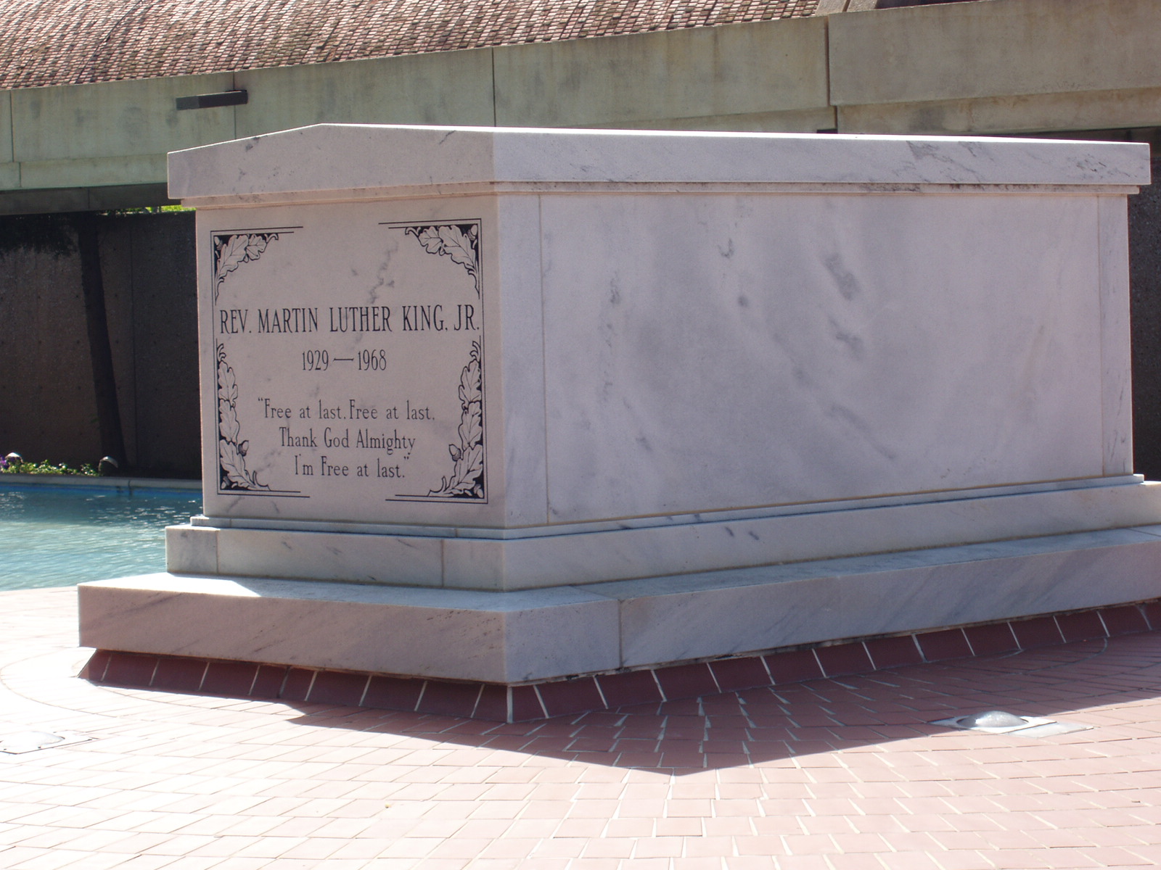
MARTIN
Legacy
LUTHER
Dr. Martin Luther King, Jr’s burial site is listed as a National Historic Landmark and Site.
KING, JR
© Presto Plans
© Presto Plans

Slide 23
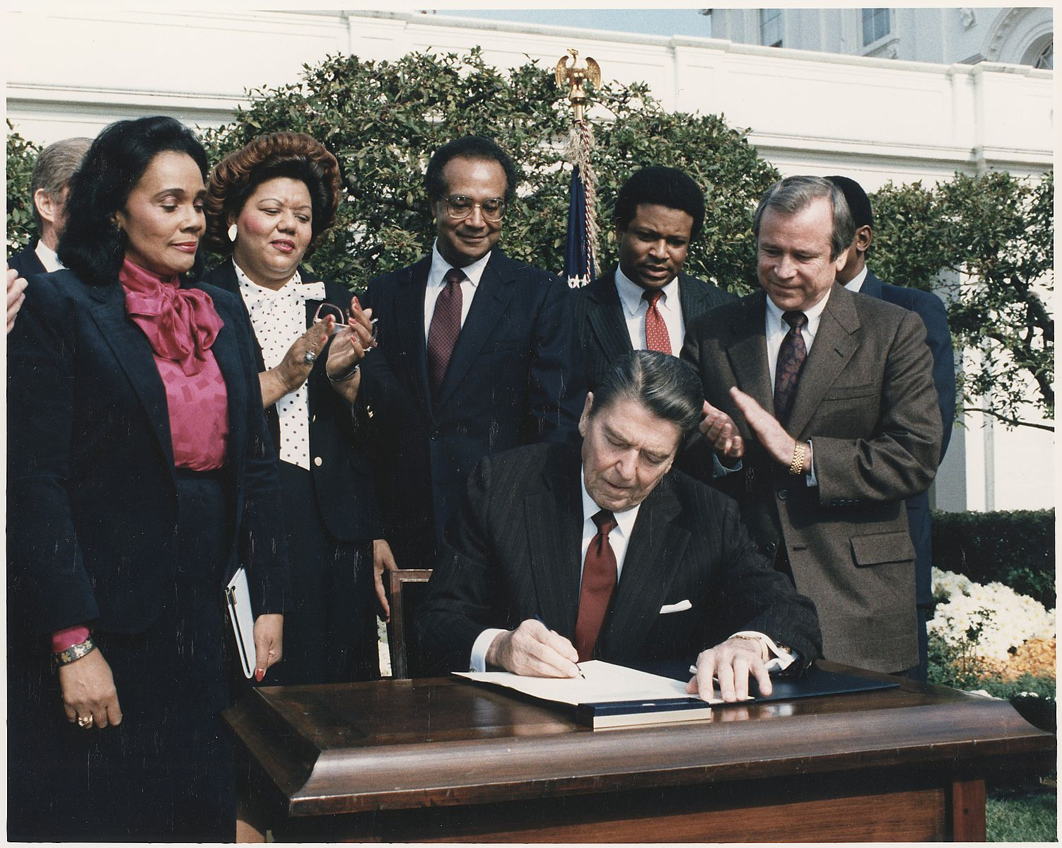
MARTIN
Legacy
LUTHER
President Ronald Reagan signed the bill to make January 20th, the celebration of Dr. King’s birthday a national holiday.
KING, JR
© Presto Plans
© Presto Plans

Slide 24
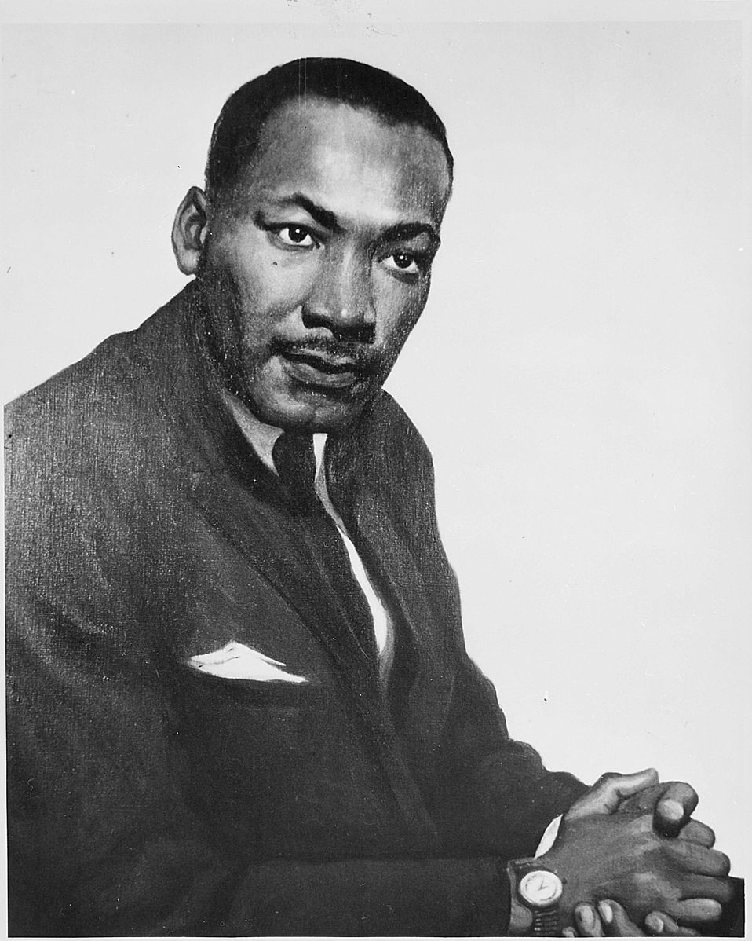
MARTIN
Legacy
LUTHER
Martin Luther King inspired hundreds of thousands of people in the United States into peaceful actions against racism and poverty and his influence, and legacy continues today.
KING, JR
© Presto Plans
© Presto Plans

Slide 25
MARTIN
KWL Chart
LUTHER
Write at least 5 pieces of information in the last column.
KING, JR
© Presto Plans
© Presto Plans

Slide 26
The original purchaser of this document is granted permission to copy for teaching purposes only. If you are NOT the original purchaser, please download the item from my store before making any copies. Redistributing, editing, selling, or posting this item or any part thereof on the Internet are strictly prohibited without first gaining permission from the author. Violations are subject to the penalties of the Digital Millennium Copyright Act. Please contact me at prestoplans@gmail.com if you wish you be granted special permission
You can visit my store at
http://www.teacherspayteachers.com/Store/Presto-Plans
© Presto Plans

