Slide 1

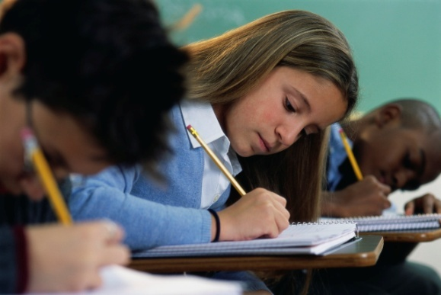
Lesson 6.SP.3 (ALT 1)
Mean, Median, Mode, and Range
Obj. 6.SP.3
Notes:
Have students follow along in their student notes.

Slide 2
Introduction
Today we will be learning about Statistics.
Statistics is a branch of mathematics that deals with collecting and analyzing a set of data.
When data has been collected, statisticians like to “measure” two things:
1) Center
2) Variability

Slide 3

Section 1:
Measures of Center

Slide 4
Measures of Center
A measure of center is one number that represents the center of a set of data.
There are two different ways you can find the center:
Mean
Median
Mode

Slide 5

Mean
Mean = Average

Slide 6
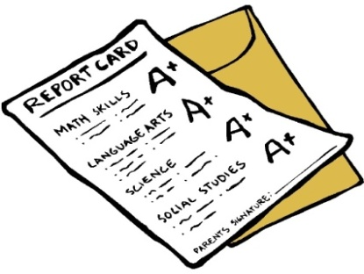
What is the Mean?
Your report card has an average on it.
The Mean is the average.
Two simple steps will give you the
mean of a set of numbers.
Mean = Average
Step 1
Add the numbers.
Step 2
Divide by the # of items in the dataset.

Slide 7
Example of Mean:
Step 1
Add the numbers.
Step 2
Divide by the # of items in the dataset.
DATASET: 2, 3, 1, 1, 0, 1, 2, 4
Add the numbers: 2 + 3 + 1 + 1 + 0 + 1 + 2 + 4 =
Divide by total items: 14 ÷ 8 =
Mean
14
1.75

Slide 8

Median
Median = Middle

Slide 9


What is the Median?
The Median is the middle number.
How do you find the Median?
Median = Middle
If there is just 1 middle #:
your done!
ORDER
the numbers.
FIND
the middle #.
If there are 2 middle #’s
Average the 2 middle numbers.
Notes:
Discuss median.
Show picture of Destiny’s Child. Point out Beyonce in the middle. How do I know Beyonce is in the middle?
Well, there is one person on each side of Beyonce, leaving her in the middle!
Show picture of Original Destiny’s Child with the 4th member. Now, who’s in the middle?
Students will say… there are two girls in the middle!
Demonstrate how to find the median.

Slide 10

Example of Median
If there is just 1 middle #:
your done!
ORDER
the numbers.
FIND
the middle #.
If there are 2 middle #’s
Average the 2 middle numbers.
DATASET: 2, 3, 1, 1, 0, 1, 2, 4
Arrange in order:
Add the 2 middle numbers
Then, Divide by 2
1 + 2 = 3
3 ÷ 2 =
1.5
Median

Slide 11

Mode
Mode = Most

Slide 12
What is Mode?
The Mode is the number (or item) that appears the Most often.
You can have 1 mode.
You can have more than 1 mode.
There may be no mode at all!
Mode = Most

Slide 13
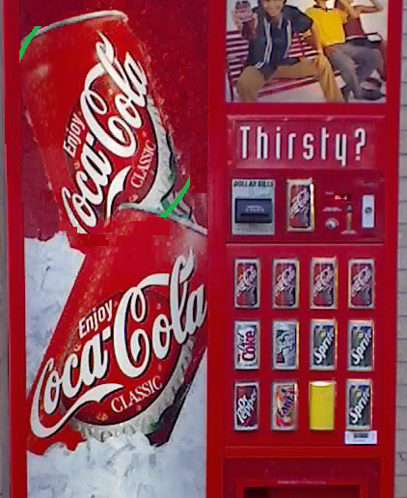
Example of Mode
You can determine Mode with numerical or non-numerical data.
Which beverage appears
most often? Cokes
That’s your mode!
Notes:
Vendors will want to stock their machines with what people want the most (mode).

Slide 14
Example of Mode
DATASET: 2, 3, 1, 1, 0, 1, 2, 4
Mode
1

Slide 15
Section 2:
Measures of Variability

Slide 16
Measures of Variability
A measure of variability (or variation) is used to describe how spread out the data is.
There are two different ways to determine variation.
Range
Interquartile Range (IQR)
Today we will just look at RANGE.

Slide 17
Range
Range = Biggest – Smallest

Slide 18
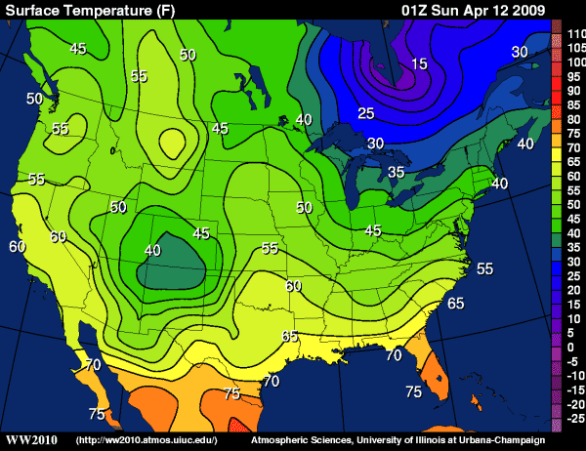
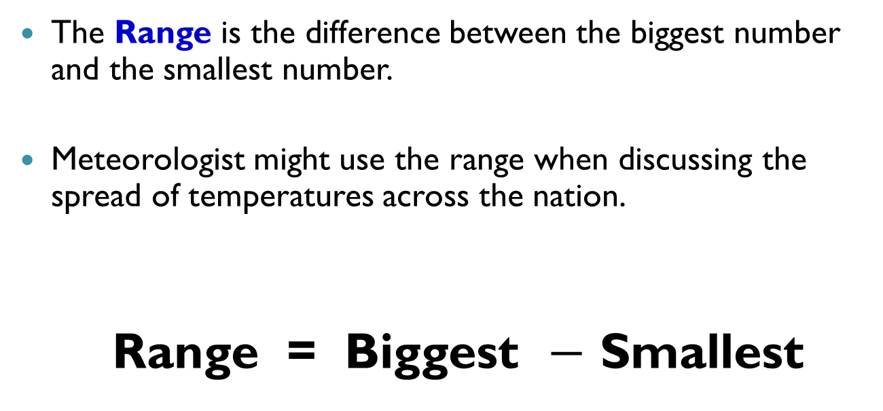
What is the Range?
The Range is the difference between the biggest number and the smallest number.
Meteorologist might use the range when discussing the spread of temperatures across the nation.
Range = Biggest $−$ Smallest
Notes:
Temperature Range
Michigan: 35 degrees Florida: 75 degrees
Temperature Range was 40 degrees!

Slide 19
Example of Range
Range = Biggest – Smallest
DATASET: 2, 3, 1, 1, 0, 1, 2, 4
Subtract: 4 – 0 =
4
Range

Slide 20
You Try #1
Mandy’s math test scores:
90, 85, 80, 70, 90, 65
Mean _____
Median _____
Mode _____
Range _____
Notes:
Order the numbers.
Mean: 80 Median: 82.5 Mode: 90 Range: 25

Slide 21
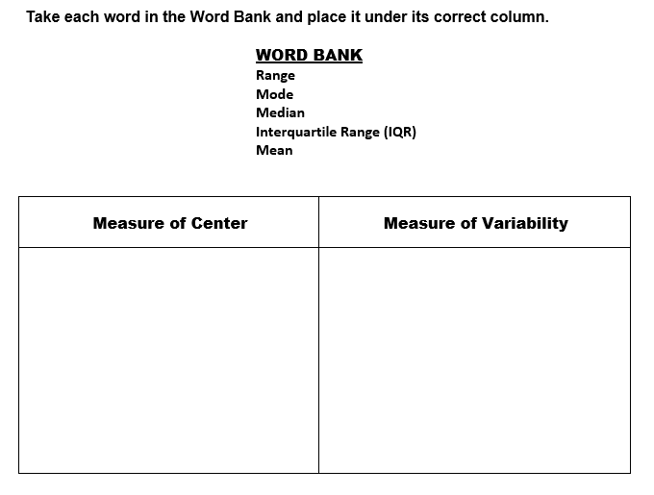
You Try #2
Notes:
Center: Mean Median Mode
Variability: Range, IQR

Slide 22
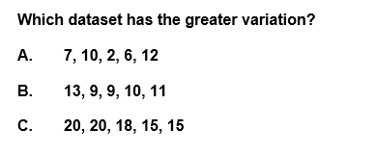
You Try #3
Notes:
Answer: A (Dataset A has the greater RANGE)

Slide 23
Summary....
Average
Mean =
Median =
Mode =
Range =
Middle
Most
Biggest – Smallest

Slide 24
Remember....
Mean measures Center
Median measures Center
Range measures Variability

Slide 25
End of PowerPoint

