Slide 1
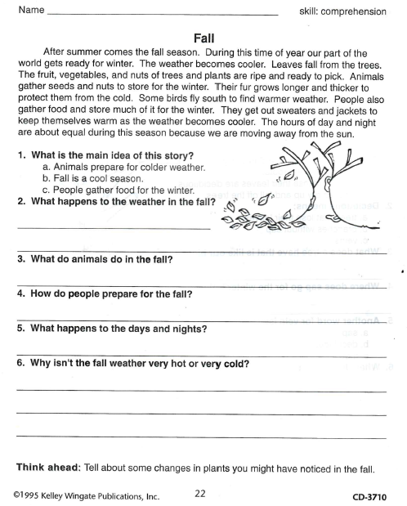
Thursday, October 10, 2019
Thursday: Classworks
M - Amiyah - 1
M – Erin - 2
M – Jaiden – 3
R – Caydance - 4
M – Jaylie – 5
R – Paisleigh – 6
R – Kaylee - 7
M – Jearon - 8
M – Carleen - 9
Landon & Macon– LLI w/Mrs. Thompson
7:55 – 8:30

Slide 2
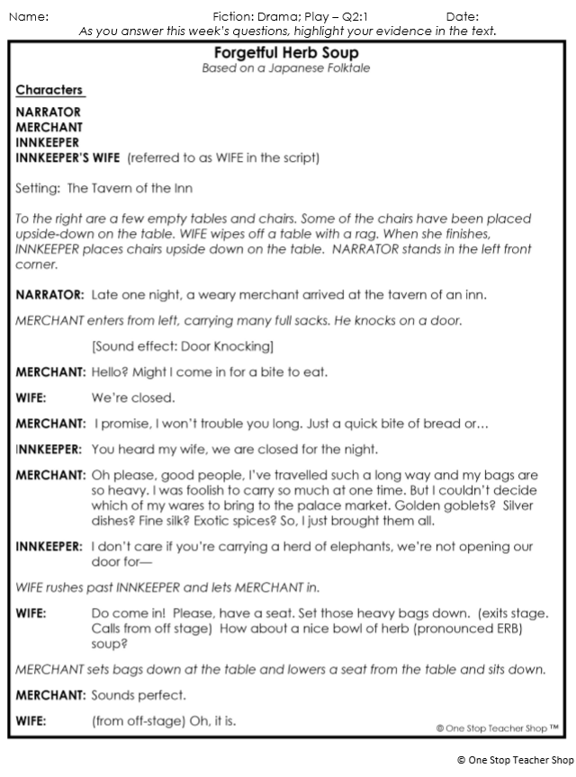
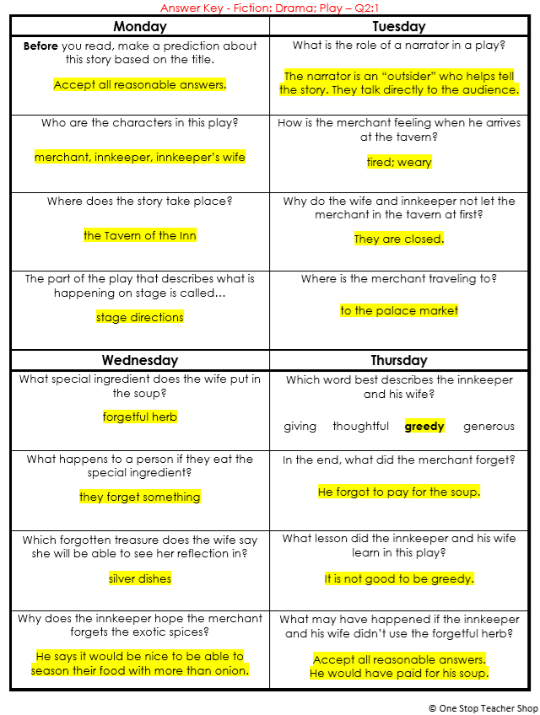
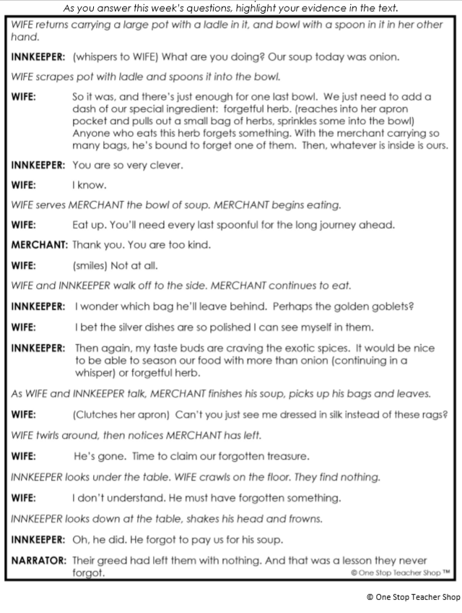
Reading Homework

Slide 3
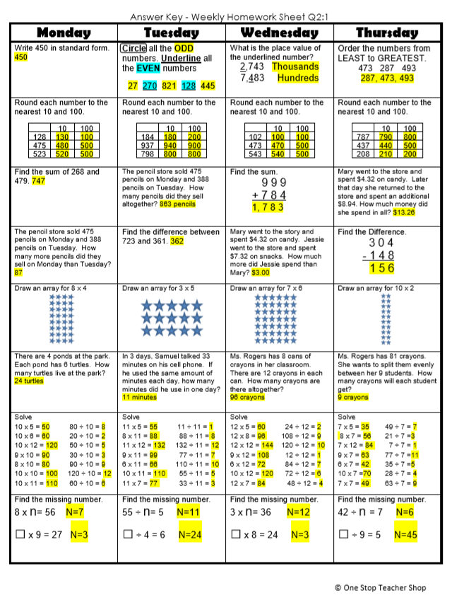
Math Homework

Slide 4

CHOMP TIME
F.A.S.T. Groups
Focused Academic Support Time

Slide 5
F.A.S.T. Designations
Computers – Classworks: R - Khamani- 1 M - Erin - 2 R - Jearon - 3 R - Kaylah - 4 R – Katelynn – 5 R – McKenzie - 6 R - Noah - 7 R - Brena - 8 R - Carleen – 9 M – Elin - TC | Mrs. Roby: LLI: Jaiden Paisleigh | Mrs. Thompson: SIPPS Jaylie Amiyah Cohen Caydance Kaylee
Landon to Ms. Page for Phonics First
Macon to Ms. Bess for SIPPS
8:40 – 9:10

Slide 6

Reading Time
Objective: RL.3.3 Describe characters in a story and explain how their actions contribute to the sequence of events.
Objective: RL.3.5 Refer to parts of stories and poems when writing or speaking about a text, using terms such as chapter, scene, and stanza; describe how each successive part builds on earlier sections.
Objective: RL.3.7 Use information gained from illustrations, other visual elements, and the words in a text to demonstrate understanding of the text.
9:10 – 9:45

Slide 7

Gather at the Carpet.
Are we still the best?

Slide 8
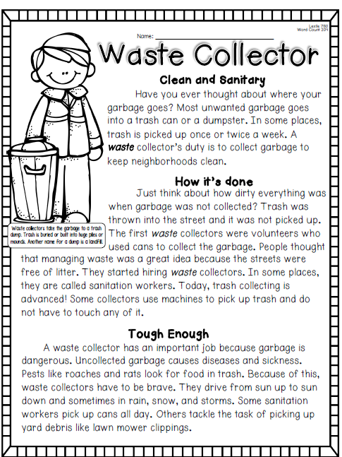
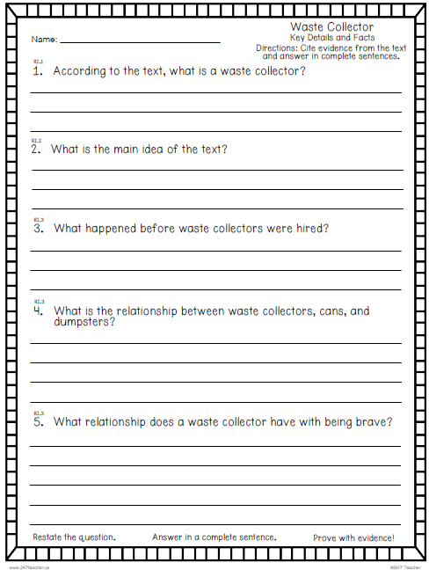

Slide 9
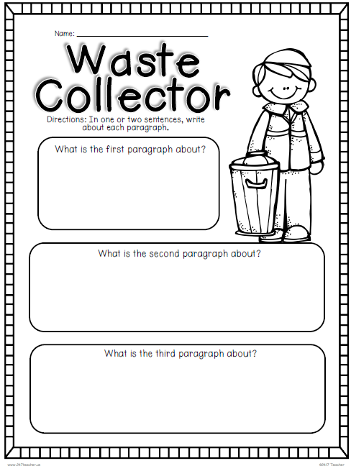

Slide 10
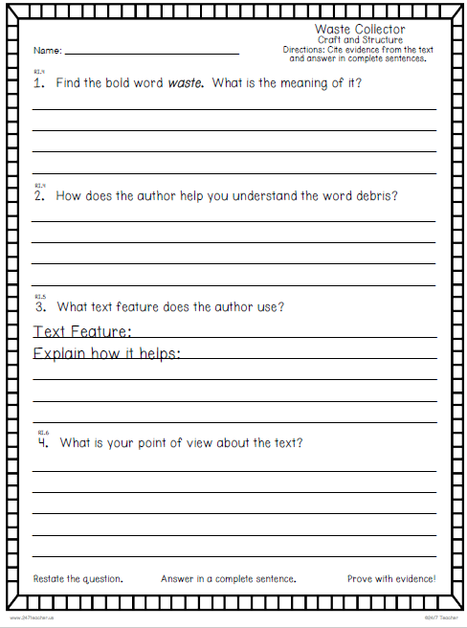

Slide 11
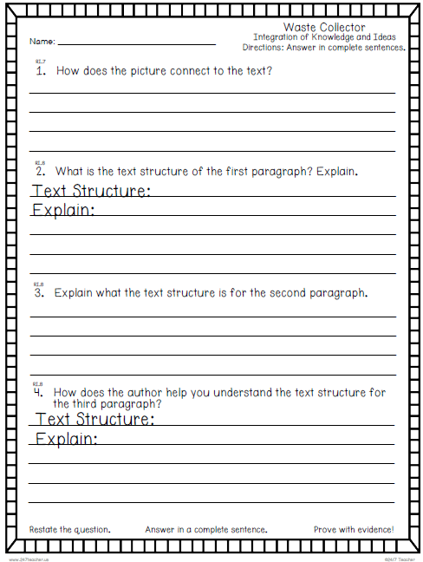

Slide 12

Restroom Break
9:45 – 9:55

Slide 13
School Pictures

Slide 14
Out of Classroom!
Recess 10:40 – 11:05

Slide 15

Computers – Classworks:
Erin - 1
  Make up test Kaylah -2
  Khamani - 3
  R – Elin - 4
  R - Noah - 5
  Carleen - 6
  R – Jaiden - 7
  McKenzie - 8
  M - Landon – 9
  R – Katelynn - TC
Independent Daily Reading & Teacher Conferences
  Mrs. Roby
  LLI:
  Emma
  Caydance
  Kaylee
  Macon
  Mrs. Thompson:
  LLI
  Amiyah
  Jaylie
  Jearon
  Cohen
Everyone else – Independent Novel
11:05 – 11:35

Slide 16

Writing Time
Objective: W3.3
I can write narratives to develop real or imagined experiences or events using effective technique, descriptive details, and clear event sequences.
11:35 – 12:05

Slide 17
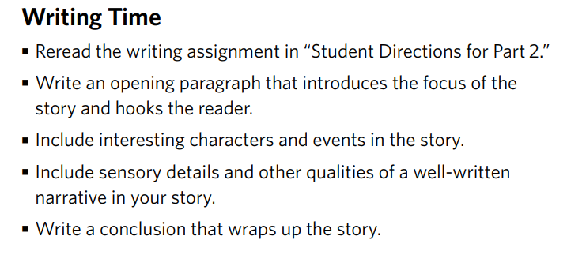
11:35 – 12:05

Slide 18
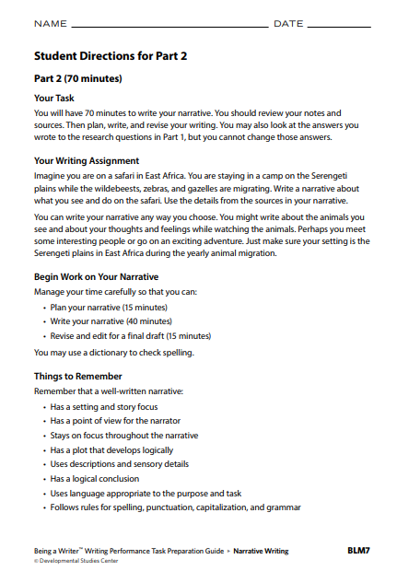

Slide 19

You should finish today! ☺

Slide 20
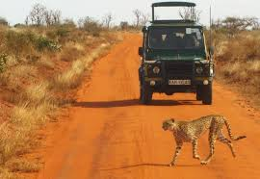
Narrative Share Time Tomorrow!

Slide 21
Math Fluency & Focus Lesson!
12:05 – 12:35

Slide 22
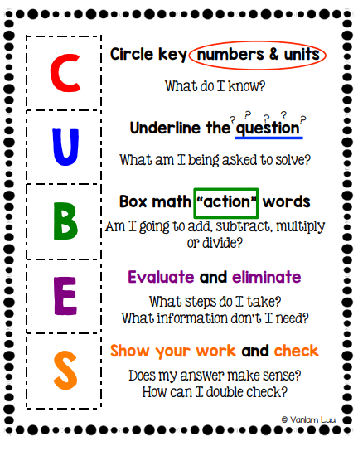
Math Stash

Slide 23
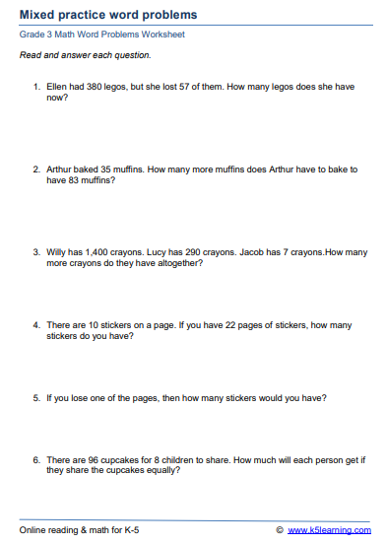

Slide 24
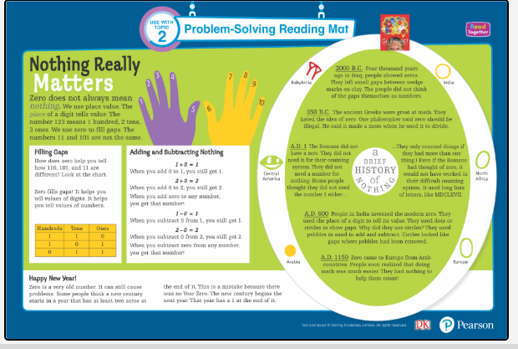

Slide 25
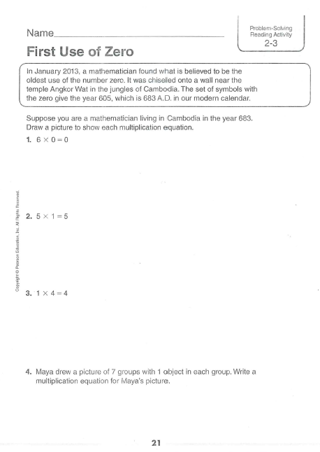
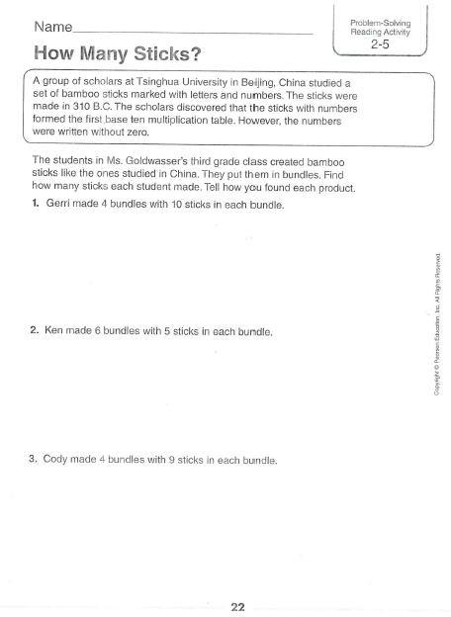

Slide 26

Out of Classroom!
Lunch 12:35 – 1:05

Slide 27
Restroom Break
1:05 – 1:10

Slide 28

Out of Classroom!
Activity 1:10 – 1:55

Slide 29
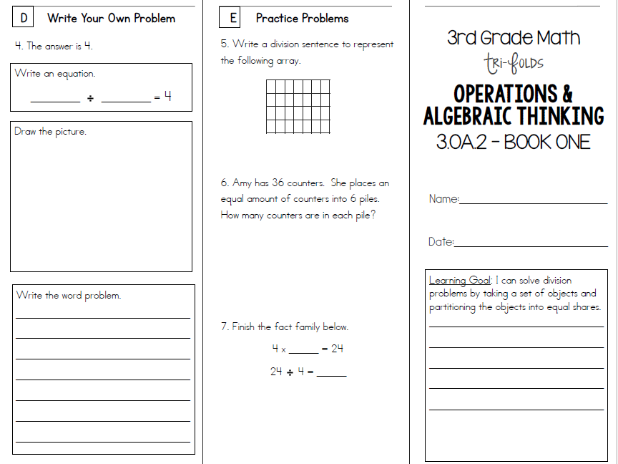

Slide 30
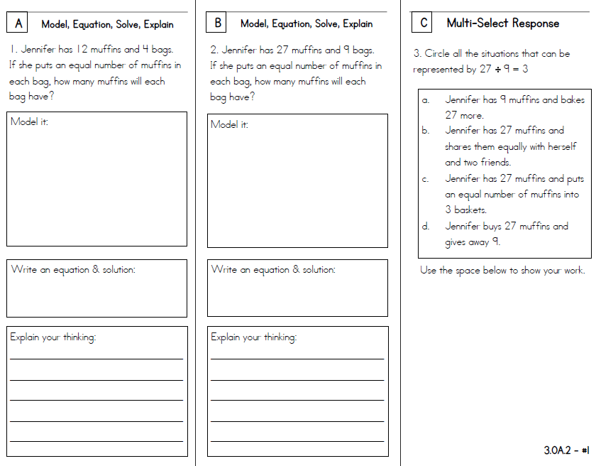

Slide 31


Slide 32
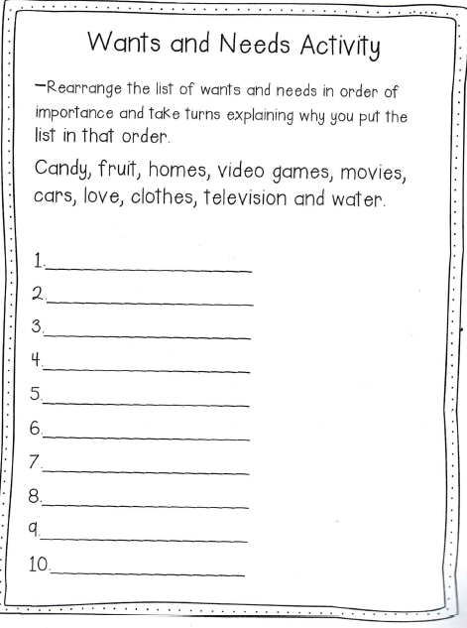

Slide 33
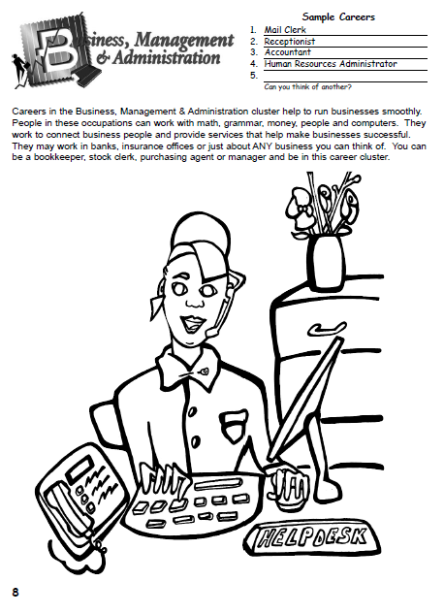

Slide 34
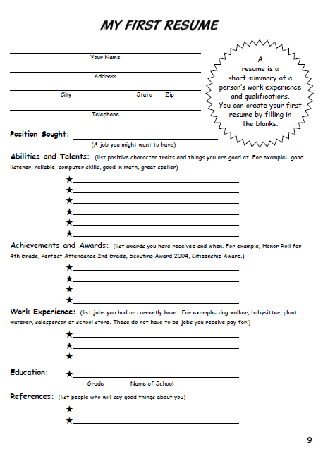

Slide 35
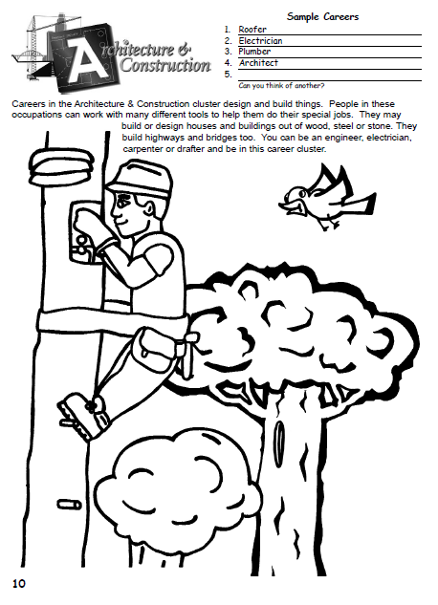

Slide 36
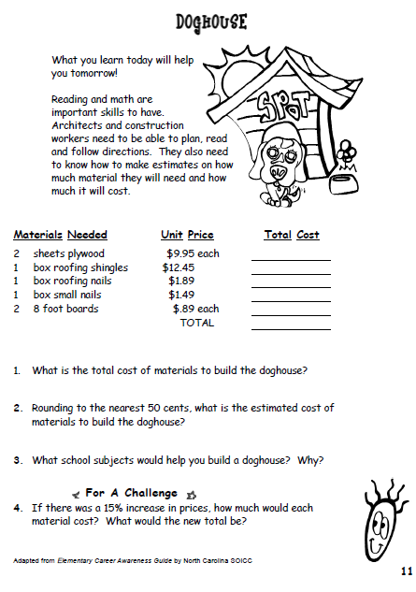

Slide 37
Restroom Break
3:10 – 3:15

Slide 38




3:10 – 3:15 Wrap Up!
Pair-Up back to back and share one thing you learned in class today with your partner
Pack-Up
Office will announce:
Car Riders – Leave around 3:20
Bus Riders – (listen to intercom for dismissal)
2:30 – 3:20
How much time has elapsed?

