Slide 1
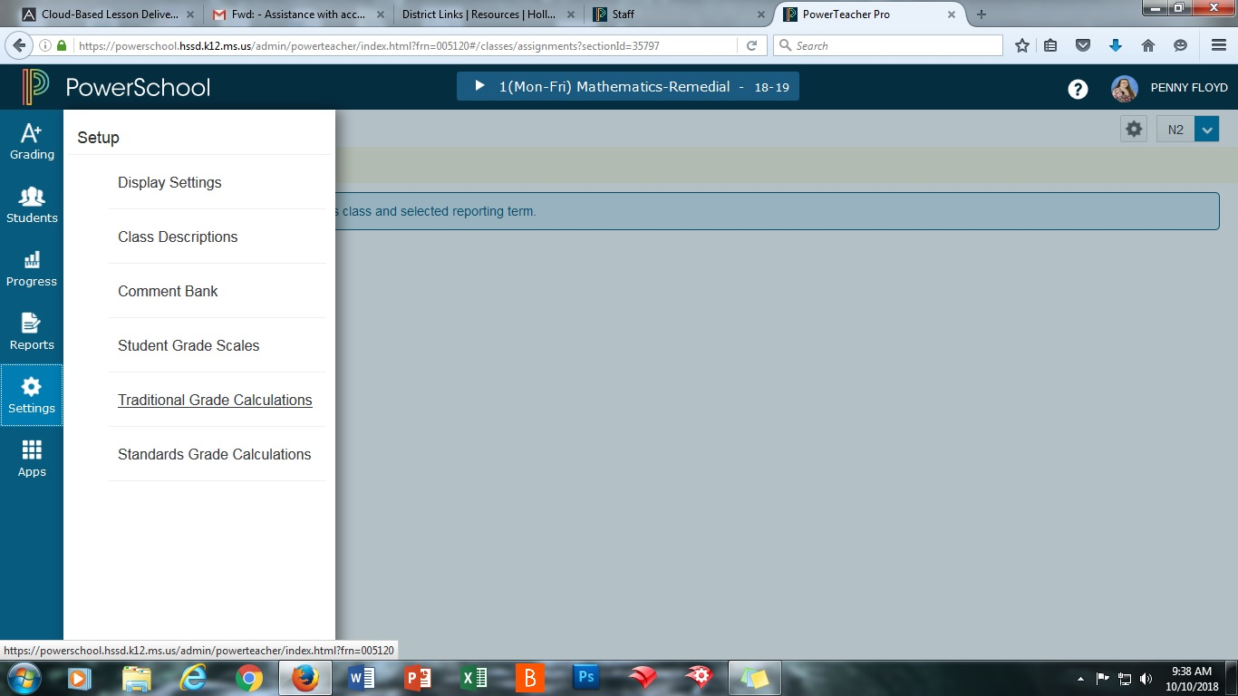
Open PowerTeacher Pro, click on Settings, and then on Traditional Grade Calculations

Slide 2
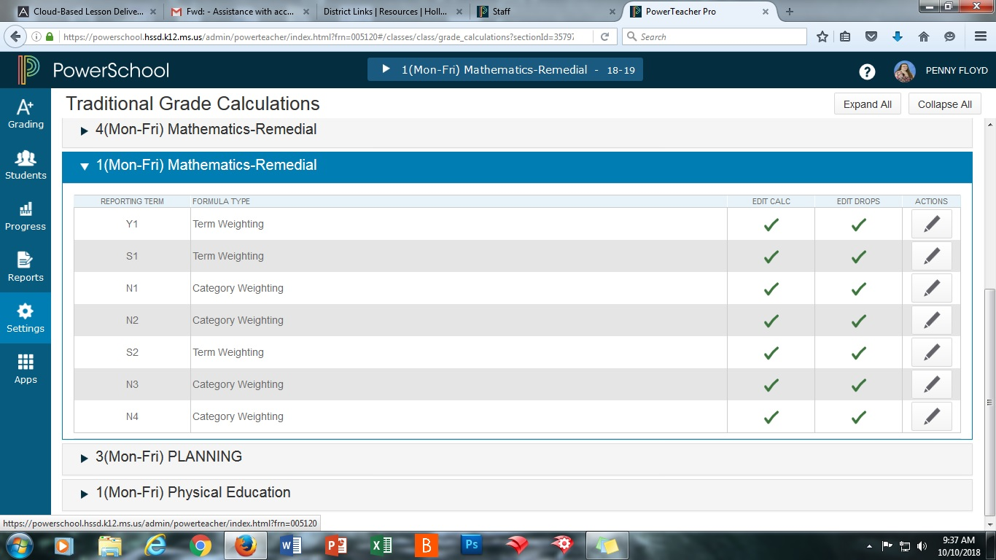
Pick a class to work on (1st period is best because it’s easiest to remember) and expand it using the arrow

Slide 3
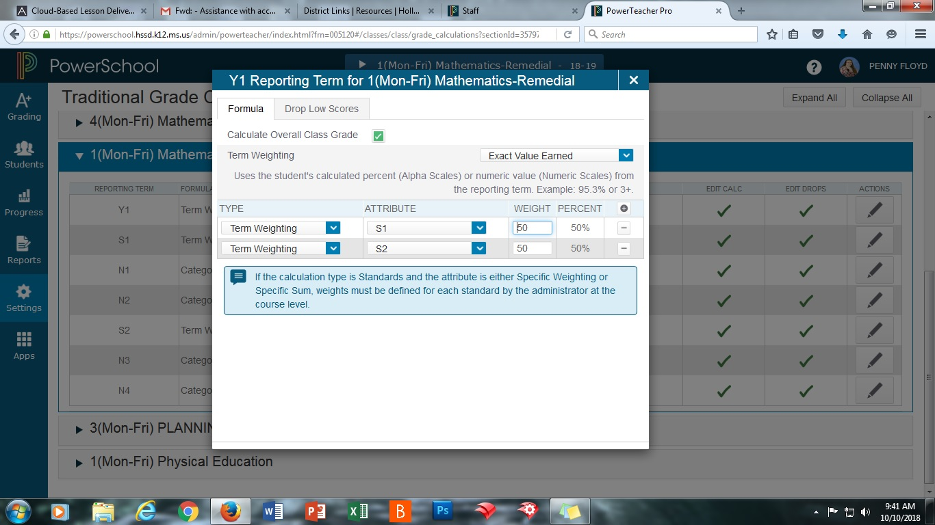
First, at the end of the Y1 row, click on the Actions button
Then, make the following changes to Type, Attribute, and Weight. Use the button with the plus sign to add another line. Click save after changes are made.

Slide 4
Click on the Action button at the end of the S1 row. Then make the following changes to Type, Attribute, and Weight. Again, use the button with the plus sign to add another line/item. After changes, click save

Slide 5
Do S2 the same way you did S1 except you are using N2 and N3 in the Attribute spot this time. Remember to click save after making the changes.

Slide 6
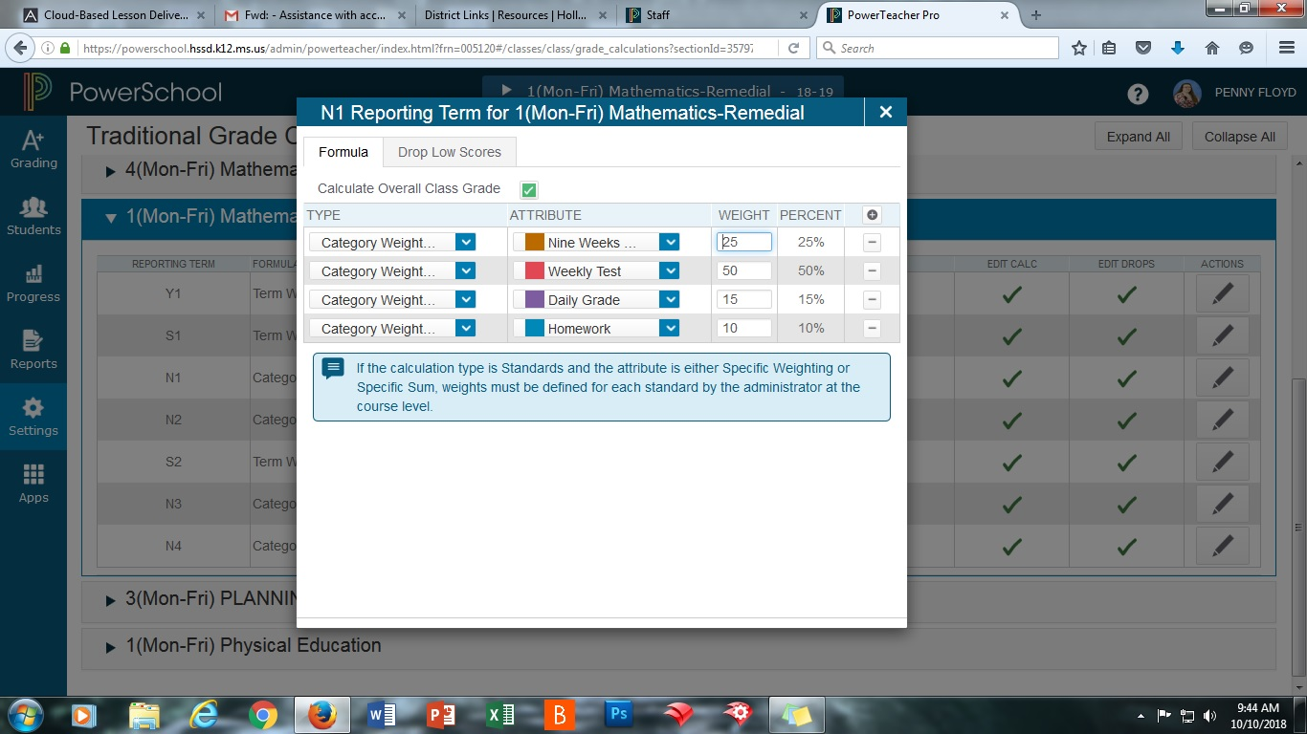
For N1, the Type is going to be Category Weighting this time instead of Term Weighting. You’ll need 4 lines/items. Your Attributes are going to be Nine Weeks Test, Weekly Test, Daily Grade, and Homework. Change the Weights as shown above. Click save when you finish.

Slide 7
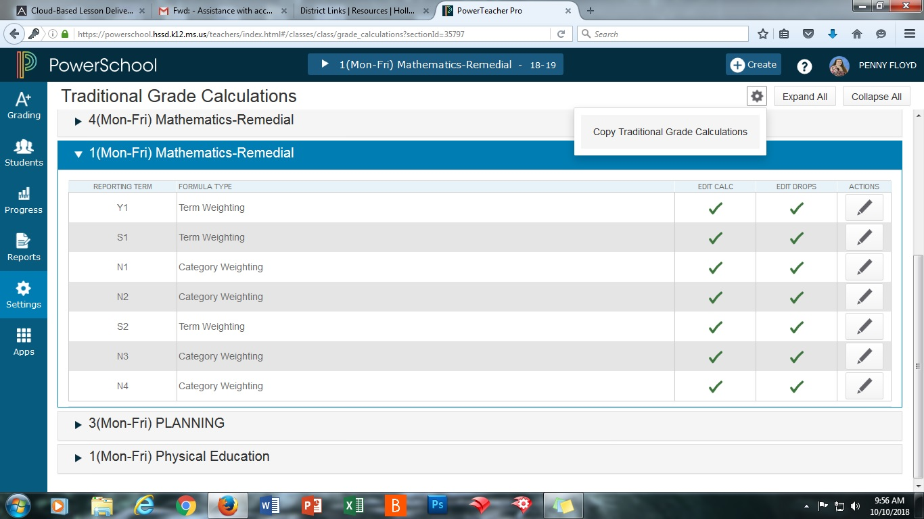
After finishing N1 click on the button with the gear and then click Copy Traditional Grade Calculations.

Slide 8
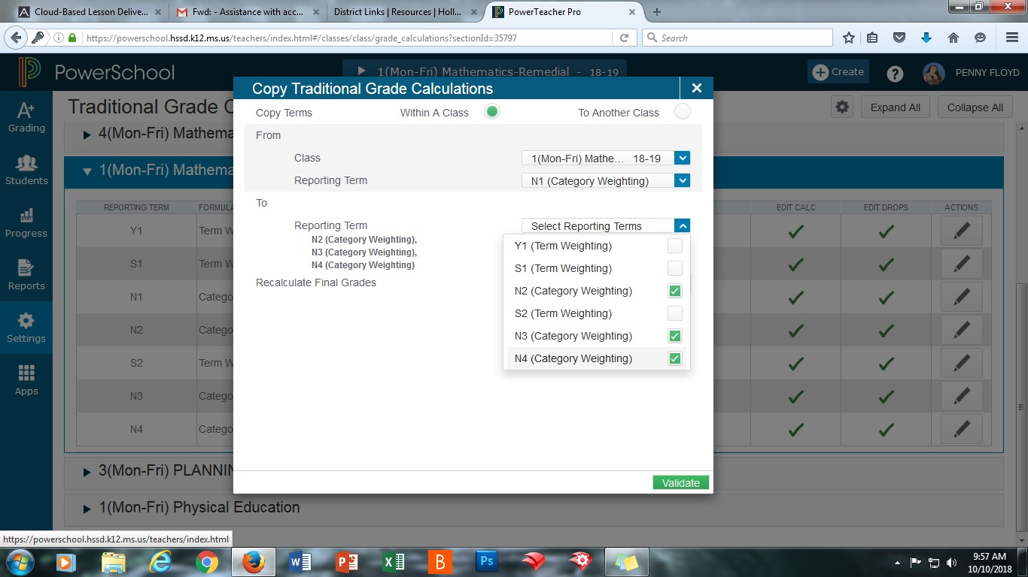
1.
2.
3.
Choose “Within a Class” at the top. Then in the first drop down box, choose the class you’ve been working on. The second drop down box needs to be N1. Finally, in the third one check N2, N3, and N4. Click validate and copy.

Slide 9
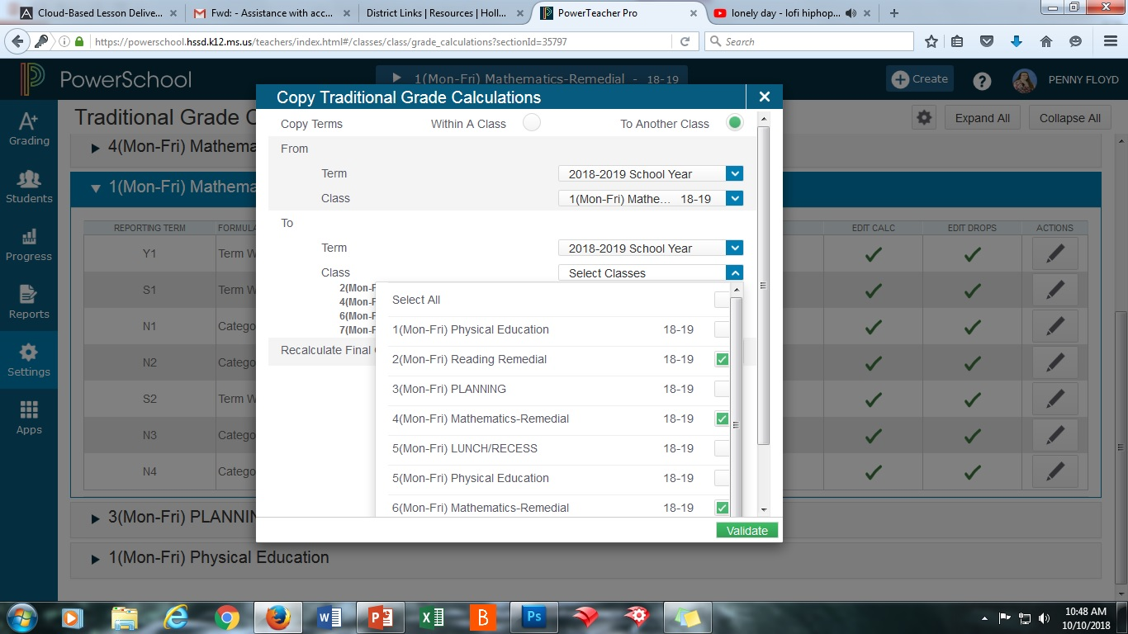
Click on the button with the gear again. This time choose “To Another Class” at the top. The first and third drop down boxes are labeled “Term.” These are both going to be 2018-2019 School Year.
1
2
3
4
For the second drop down box, choose the class you’ve been working on up to this point. Then in the fourth drop down box, check all the classes that will have grades put in. After that, click on validate and copy.

Slide 10
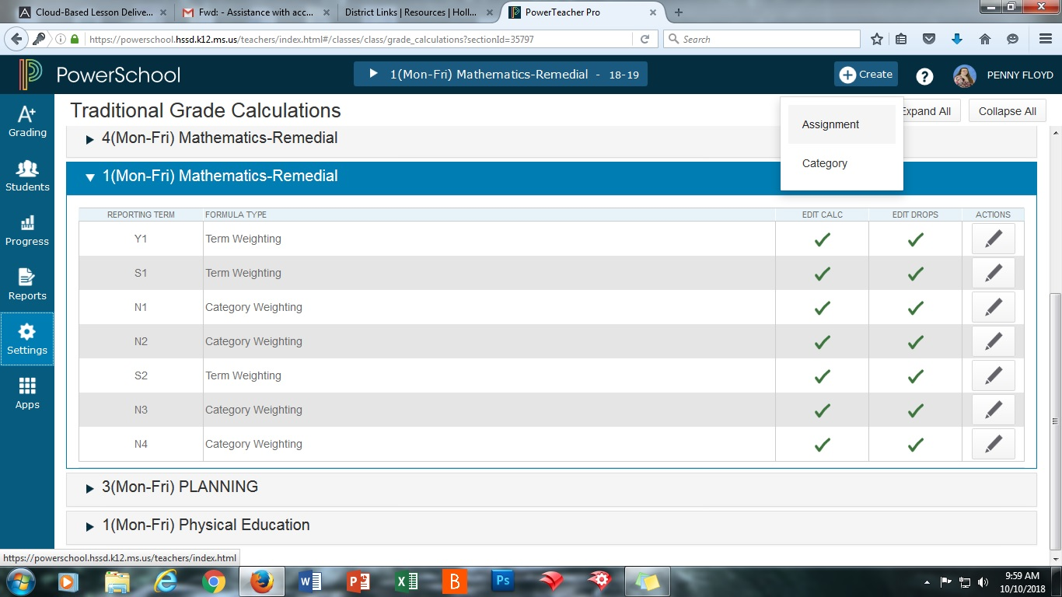
For creating assignments, click on Create at the top and then Assignment.

Slide 11
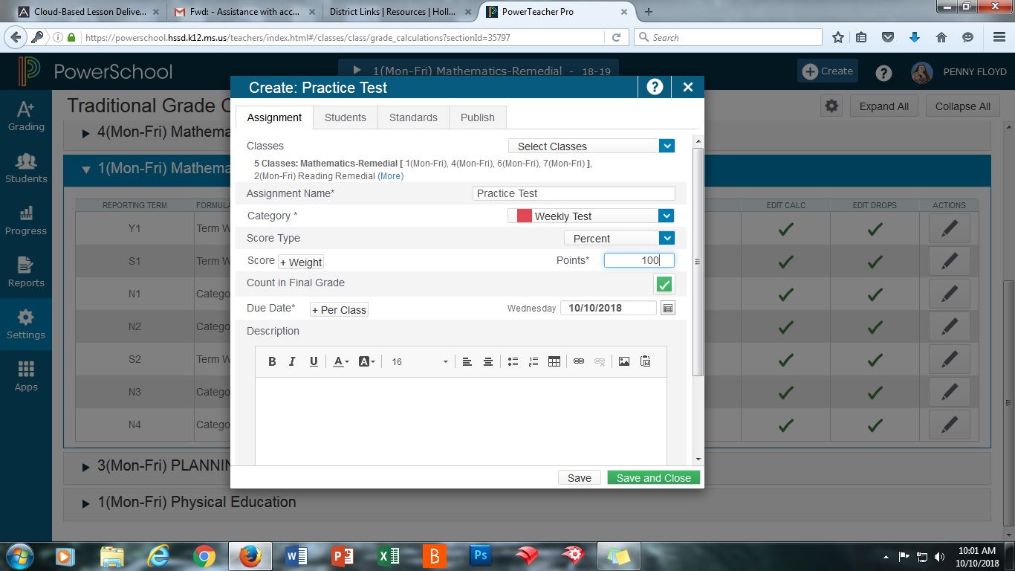
When creating Assignments you must make the following changes:
Check all classes you want the assignment to apply to
Name it
Choose a Category
Change Points to Percent
Click Remove Weight here
Change this to 100
It’s important to note that you may see more than just the 4 categories you assigned weights to. Be careful not to use those because it will mess up your grades

