Slide 1
Schoology Student User Guide

Slide 2
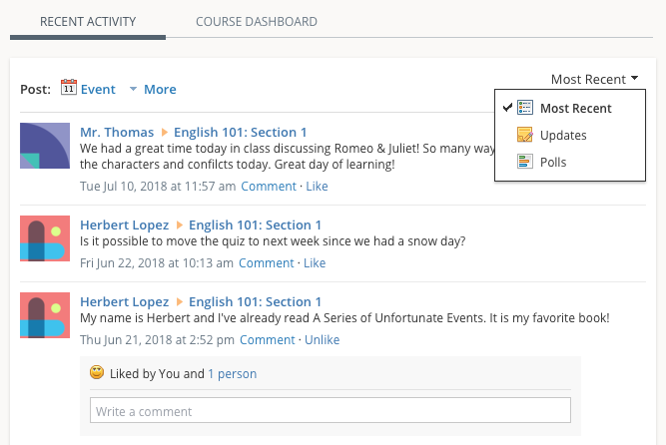
Recent Activity
Recent Activity shows all comments and updates pertaining to your schools, courses and groups. To filter your feed to view only Updates, Polls, or Blog posts, click the Most Recent link in the top corner, and select a filtering option.

Slide 3
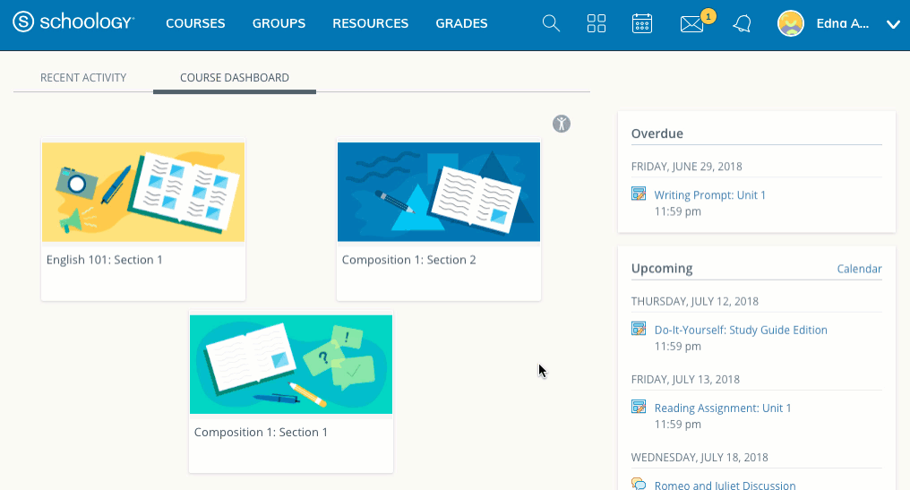
Course Dashboard
Under the Course Dashboard tab, you will find the classes you are enrolled in. From there, you can click on your class to access your assignments.

Slide 4
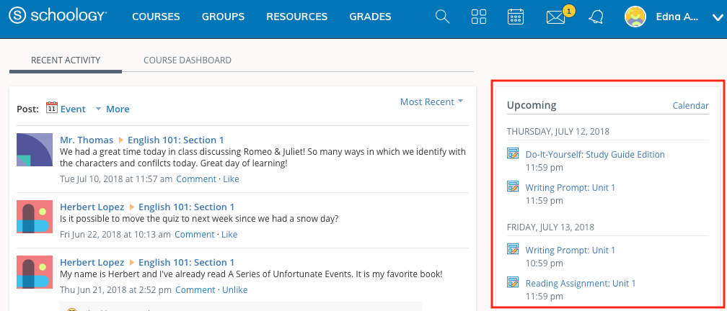
Upcoming
The Upcoming area on the right side of your homepage displays events, assignments, tests/quizzes, and discussions with a due date. Hovering over each item displays the course or group associated with the item.

Slide 5
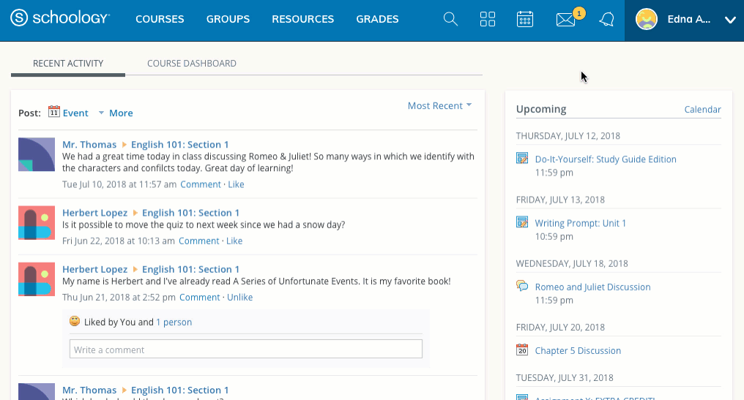
Grades and Attendance
Select Grades at the top of Schoology and select either a Grade Report or Attendance.
Grade Report
The Grade Report displays a breakdown of your grades for each course. Click a specific course to view each graded item, your grade, the max points, and any comments from the instructor.
You may also download a Student Report by clicking the button in the top right of the page.

Slide 6
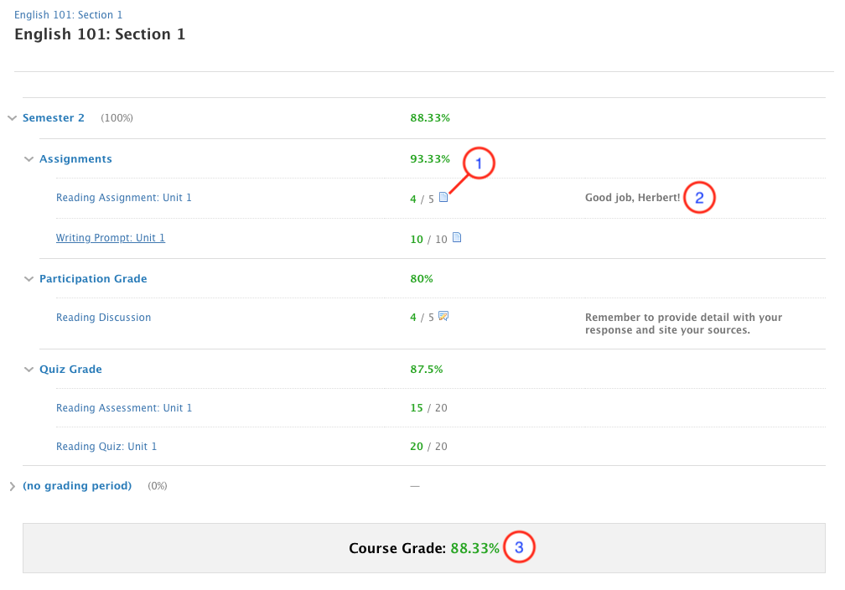
Grades
The Grades area of the course profile displays your grades for the assignments, tests/quizzes, and discussions within a course. When an item is graded by your instructor, the grades and comments will immediately display in this area. Your overall grade for the course is listed at the bottom of each page.

Slide 7
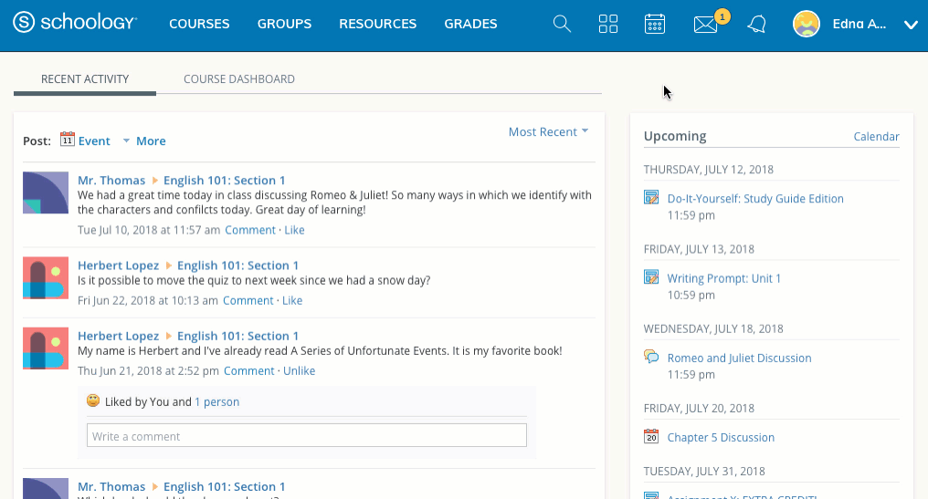
Grades and Attendance
The attendance area displays a record of the days you were marked absent, late, or excused. Instructors can also leave comments, which will appear in the Comments section.

Slide 8
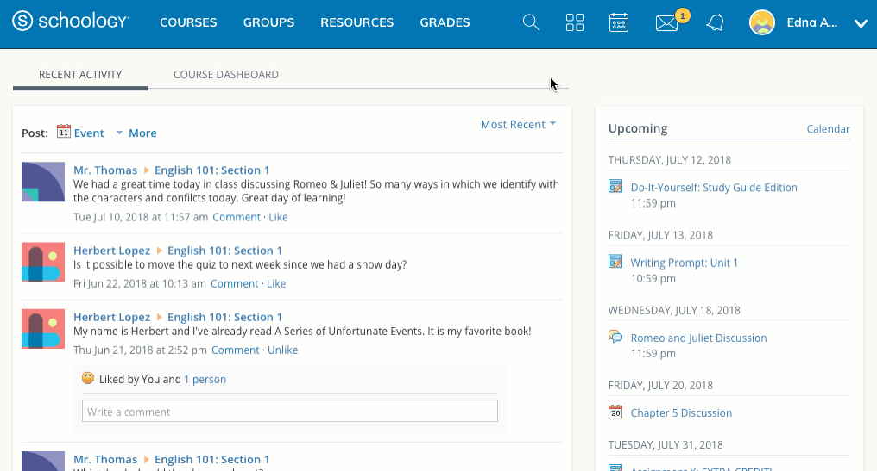
Search
Use the Search tool (magnifier icon) to search for your teachers, courses and groups.

Slide 9
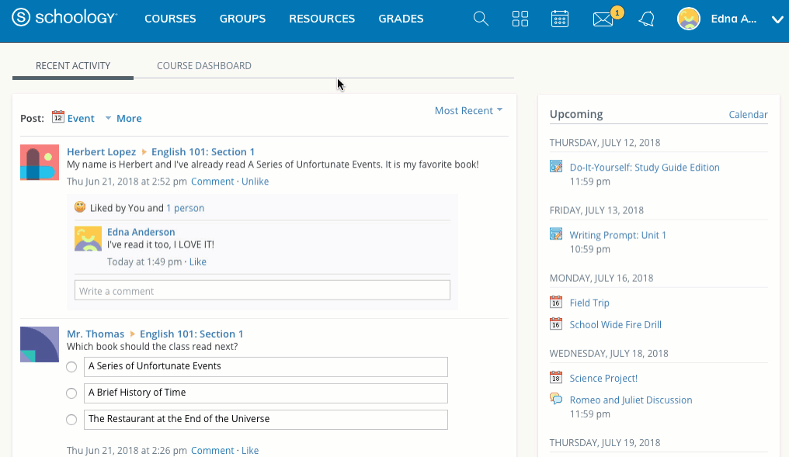
Attendance
The attendance area displays a record of the days you were marked absent, late, or excused. Instructors can also leave comments, which will appear in the Comments section.
There are two ways to check your attendance in Schoology:
Grades
Click Grades at the top of Schoology.
Select Attendance.
Course
Click Courses at the top of Schoology.
Select a course.
Click Attendance on the left.

Slide 10
App Center
Schoology’s App Center allows your teachers to provide you with access to content and software developed by other companies from directly within the Schoology website.

Slide 11
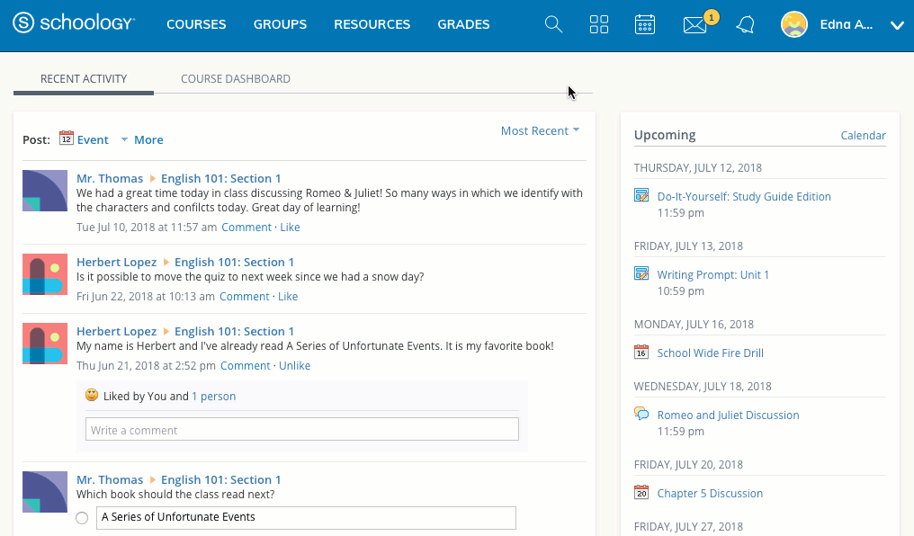
Calendar
The Schoology Calendar is an important, organizational element for your connections, courses, and groups. It keeps events and due dates organized and easily accessible. By clicking the Calendar icon at the top of Schoology, you can view events and due dates by the month, week, or day. Each item is color-coded depending on the courses, groups, school, or your own personal events. Due dates for assignments, assessments and important course related events are automatically added to your calendar and managed by your instructor.

Slide 12
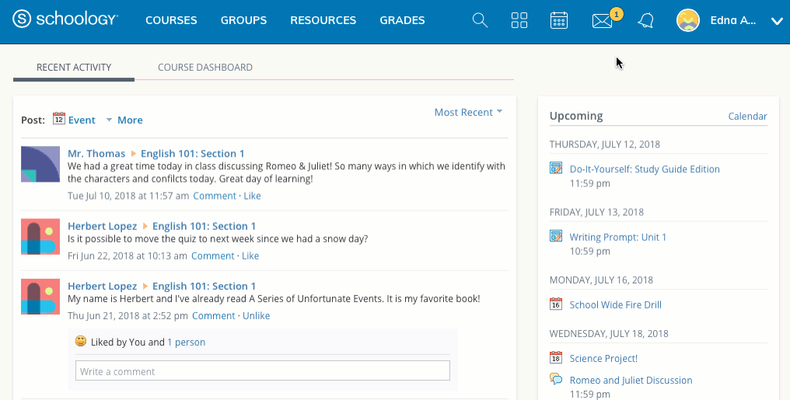
Messages
Depending on the settings in place at your school, you may be able to receive messages from teachers at your school, and send messages to teachers at your school.

Slide 13
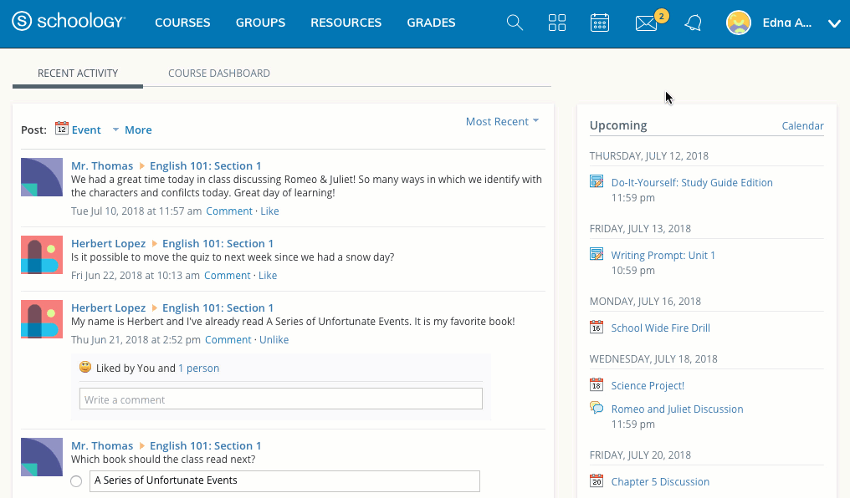
Messages
When you have a new message in your inbox, the Messages icon on the top menu displays an updated number.
Navigate to your Messages area by clicking the envelope icon on the top menu.
Click the message you'd like to read. New messages have an indicator to the left of the message.
To reply to a message, enter a comment in the Message area, and click Send.

Slide 14
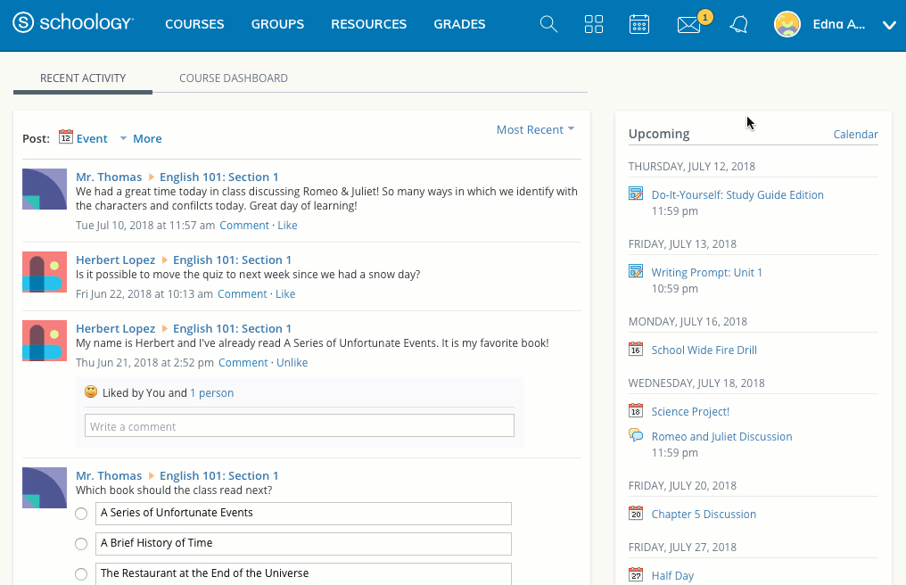
Messages
Navigate to your Messages area by clicking the envelope icon on the top menu.
Click View All.
Select the Sent Messages tab.
To read a message, click on a message you've sent in the past.

Slide 15
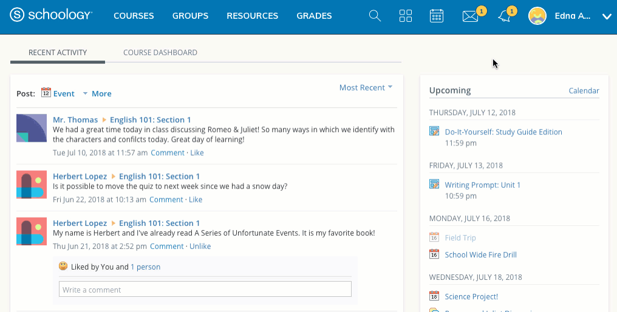
Notifications
Notifications display course events in chronological order as well as Requests to RSVP calendar events. New notifications/requests are indicated by a number on the bell icon. Clicking a notification or request will allow you to view the related content.

Slide 16
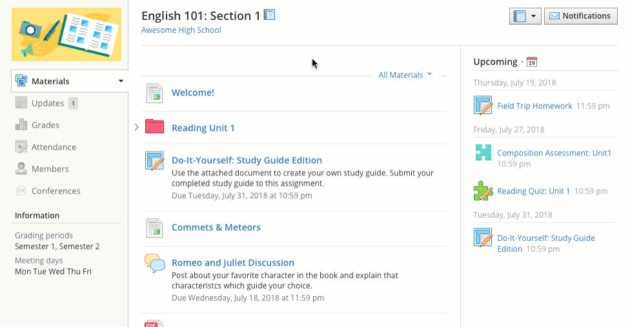
Course Folders
Folders organize course materials, and they're distinguished by the folder icon next to their name.
Inside of a folder, you will find an assortment of course materials:
Assignments
Tests/Quizzes
Assessments
Files/Links
Discussions
Media Albums
Pages

Slide 17
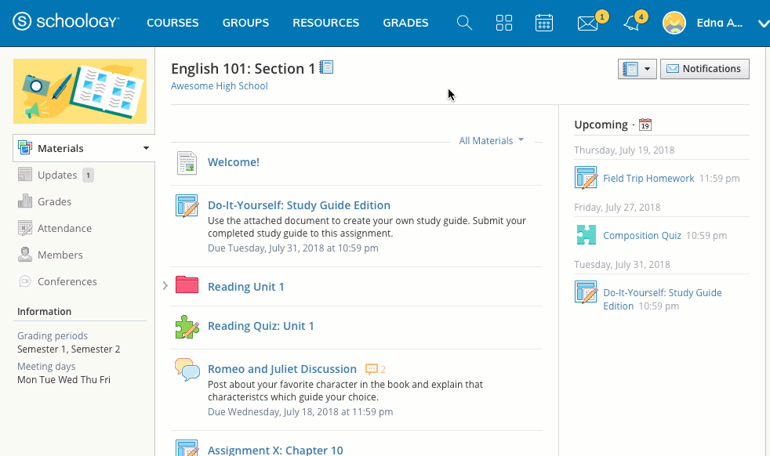
Course Assignments
Assignments are graded items. Each assignment may require you to make a submission. Once you've made a submission, the instructor can grade the assignment, provide feedback, and upload a file back to you.
To submit a file to an assignment, follow these steps:
1. In the Assignment, click Submit Assignment.
2. Use the Add a Comment area for questions and concerns (optional).
3. Select one of these options:
- Upload: Select a file from your computer.
- Create: Create a document on the web using the text editor.
- Resources: Select a file from your Resources, which can be a Google Doc if you have linked your account (See Account Settings for more details).
4. Click Submit to finish.

Slide 18
Course Assignments
Assignments can also be given a Due Date, which will automatically display the assignment in your personal Calendar and Upcoming area on your homepage. Assignments also might not be graded, depending on the settings set by the instructor of the course.

Slide 19
Tests/Quizzes
Tests/quizzes can remain open for a maximum of 6 hours before the session expires. Please make sure you exit the test/quiz and resume it at a later time if the test will take longer than 6 hours to complete.
After you submit a test/quiz, your grades may appear in the Grades area. Tests/quizzes may be timed or may allow multiple submissions. Each test/quiz will vary depending on the instructor and the course.
The tests/quizzes material is one type of online assessments for courses. These tests/quizzes can have an assortment of the following question types:
True/False
Multiple Choice
Ordering
Short-Answer/Essay Questions
Fill in the Blank
Matching

Slide 20
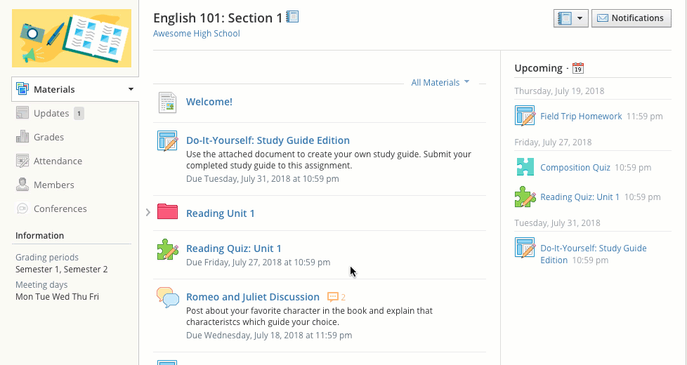
Tests/Quizzes
How do I take the Test/Quiz?
1. Click on the name of the test/quiz.
2. Click Start New Attempt.
3. Answer the questions appropriately.
4. Click Submit when you are ready to submit the test/quiz to your instructor.

Slide 21
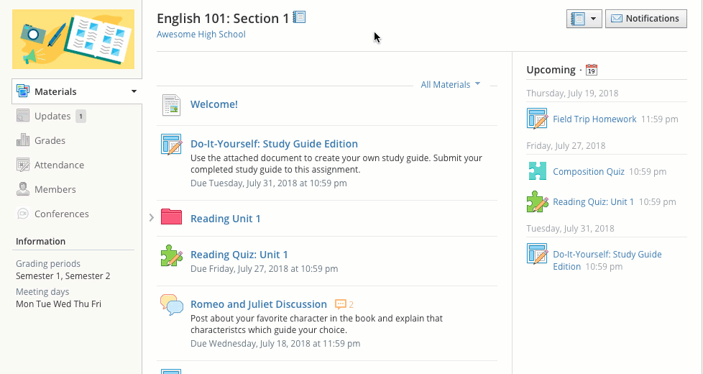
Past Submissions
For some tests/quizzes, your instructor may allow you to view your past submissions. If this is the case, when you enter the Test/Quiz, you will see an additional tab titled: My Submissions. This tab will show you a list of all your submissions, with links on the right to View Assessment.

Slide 22
Assessments
Assessments are another type of online assessment in courses. Assessments have a larger complement of question types:
Multiple Choice
True/False
Matching
Ordering
Fill in the Blank Text
Short Answer/Essay
Audio
Video

Slide 23
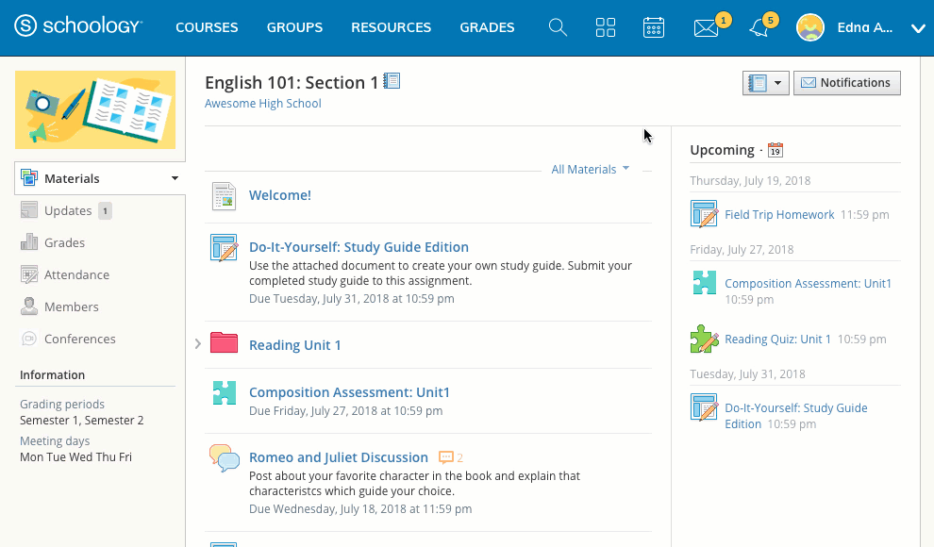
Assessments
How do I take the Assessment?
1. Click on the name of the Assessment.
2. Click Start Attempt.
3. Answer the questions appropriately.
4. Click Review to review your answers.
5. Click Finish when you have completely reviewed your answers.
6.Click Yes to submit your Assessment attempt. Click No if you need to continue the review of your attempt.

Slide 24
Assessments
After you submit an Assessment, your grade may appear in the Grades area. Assessments may be timed or may allow multiple submissions. Each Assessment will vary depending on the instructor and the course.

Slide 25
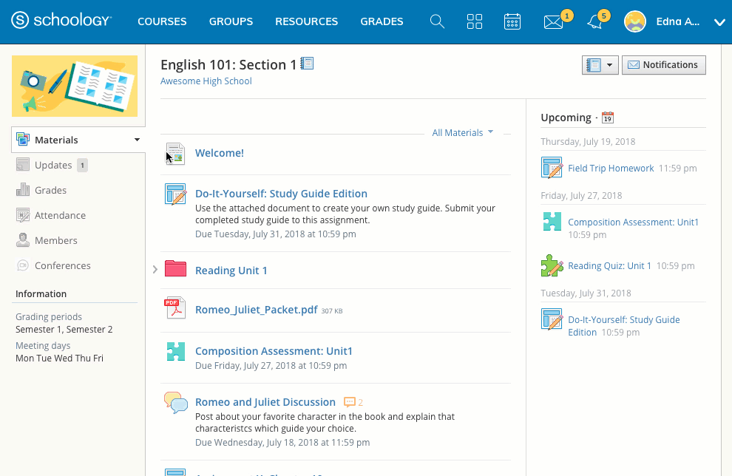
Course Files/Links
Files that have been added to your course can appear inside of Folders or in the Files/Links area of the Materials Index. Typical file types can be viewed in your browser without having to download the file. These include:
Word (.doc, .docx)
Excel (.xls, .xlsx)
Powerpoint (.ppt, .ppt)
PDF (.pdf)

Slide 26
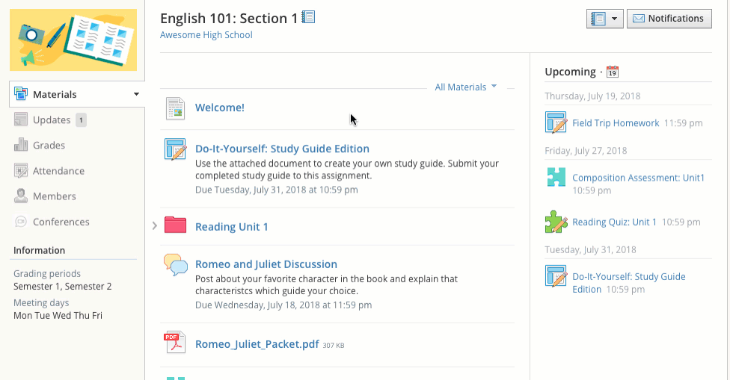
Course Discussions
Discussions are interactive conversations that allow participation between you, your classmates, and your instructor. Each discussion has threaded commenting, allowing you to respond to any post by another student.
For some courses, instructors may choose to moderate the discussion posts. Moderation requires a course admin to approve each post before it is published. When this feature is turned on, your posts will not be immediately visible to other students.

Slide 27
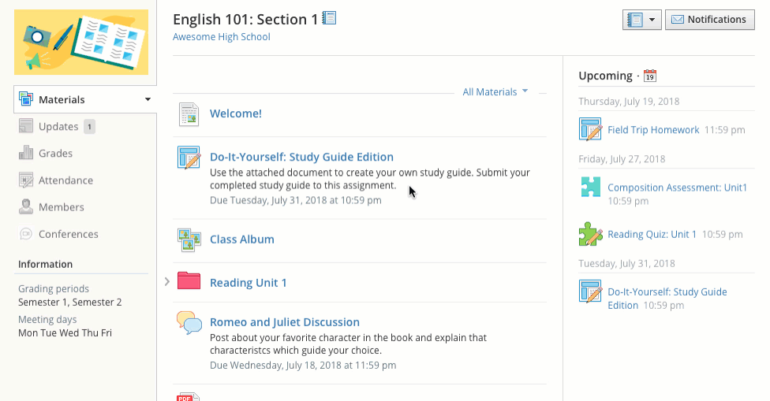
Course Media Albums
Media albums can contain photos, videos, and/or audio files. With your instructor's permission, you may comment on each item within the album or even upload your own files. Your instructor can also tag you and your classmates in specific photos. Tagged photos of you will also appear on your profile page.

Slide 28
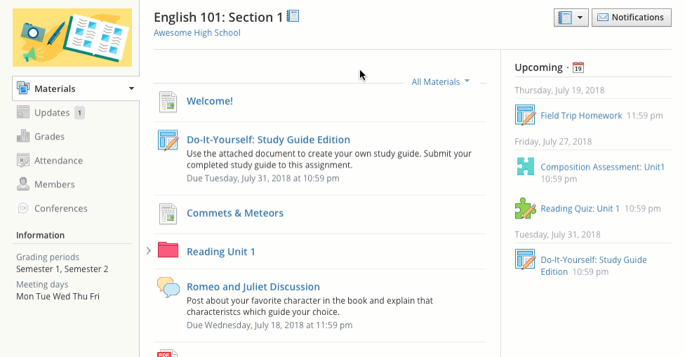
Course Pages
Pages are resources created by your instructor to supplement the course. These pages are highly versatile, allowing for the inclusion of text, image, outside link, and video information.

Slide 29
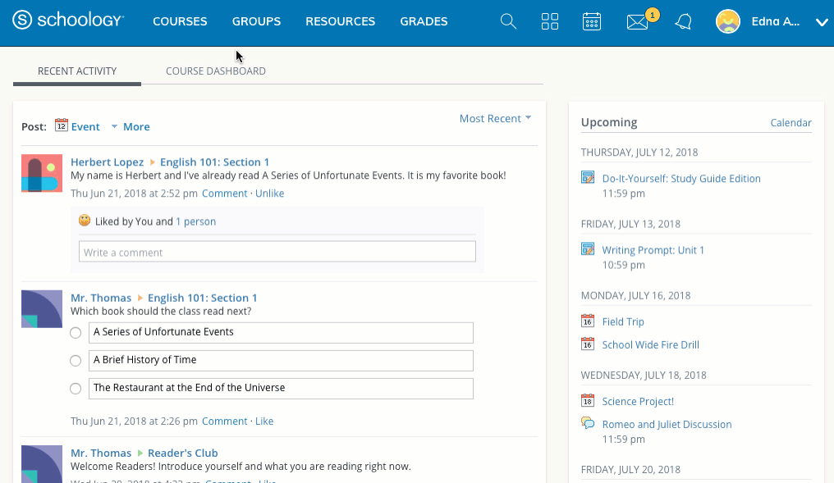
Course Updates
The Updates area of the course profile is used by instructors to create announcements and brief messages for the course. Updates will appear in the Updates section of your course as well as on your homepage.
You and your classmates may comment on each Update. In some courses, your instructors may also allow you to post updates.

Slide 30
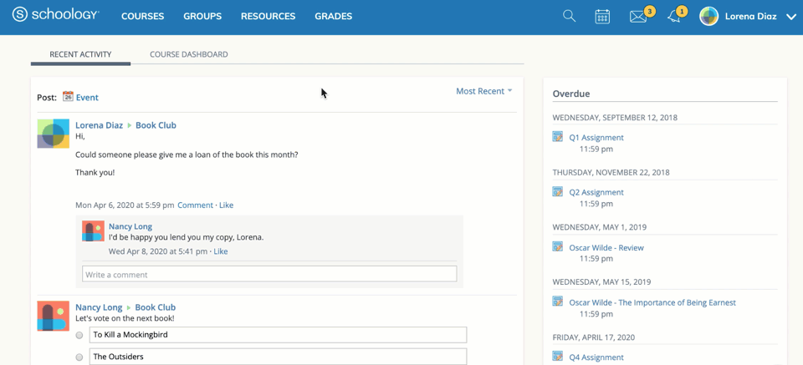
My Resources
My Resources is your own personal library of documents that you create in Schoology or download from other sites. It's easy to organize, create, and copy/move your resources right from the My Resources page. Saving your documents in this personal library enables you to access them for years to come and use them in any courses you take in the future.
To view your resources, click Resources at the top of Schoology.

Slide 31
Adding Collections to Resources
Collections are like containers that store folders and files in your Resources, to help you organize your work. They are located in the left menu of your Personal Resources.
To add a collection, follow these steps:
Select the Resources dropdown from the top menu.
Click Personal.
Click the Add Collection Icon (the beige box with a green and white plus sign).
Title your new collection.
Click Create to finish.

Slide 32
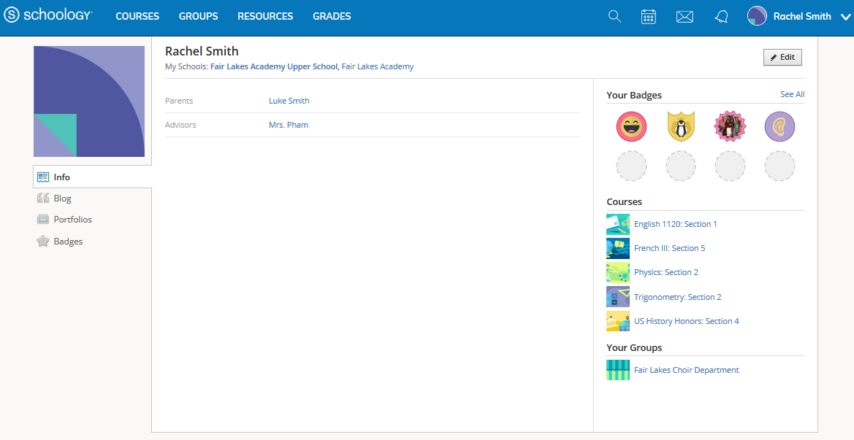
Student Profile
Your personal profile contains information about you and your activity on Schoology such as your interests, parents/advisors, and course/group enrollments.
To access your profile:
Click your name in the upper-right of the header in Schoology.
Click Your Profile.
Schoology users that click on your name in Schoology will also be taken to your profile. Depending on the settings in place at your school, you may control who can view your profile by adjusting your Account Privacy Settings.

Slide 33
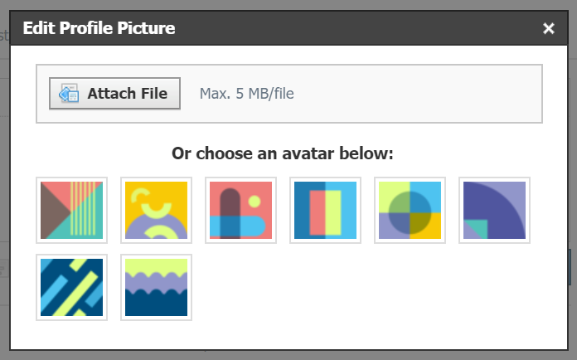
Change your Profile Picture
To change your profile picture:
Note: If the Edit Picture option does not appear when you hover over your picture, your school may have different rules for profile pictures.
Hover over the profile picture and click Edit Picture.
If you already have a photo in place, click Remove Picture to remove your current picture from view.
Click Attach File.
Choose a JPEG, PNG, or GIF file from your device. There is a 5 MB limit per photo file.
If you'd like to use an avatar instead, choose an avatar below.

Slide 34
Student Info Section
The Info tab provides other users with additional information about you. Some information, such as parents and advisors with whom you are associated, may be included by default due to the settings in place at your school.
Click Edit in the upper-right corner of your profile to edit or add information.
Note: You may not be able to edit your profile information based on settings in place at your school. Contact your teacher with any questions.

Slide 35
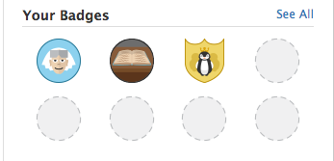
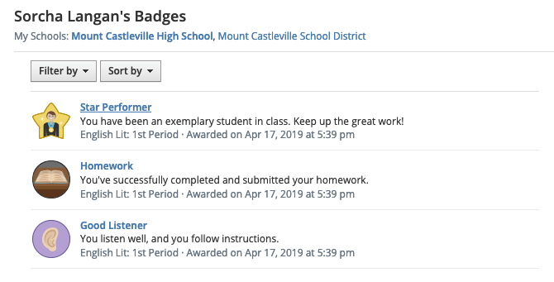
Student Badges
The Badges area displays all of the badges your instructors have awarded you in a course. You may filter badges by current and past courses, and sort the order of badges into your newest or oldest badges.

