Slide 1
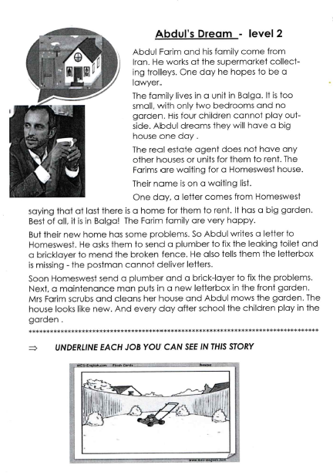
Tuesday, October 8, 2019
Tuesday: Classworks
M - Amiyah - 1
M – Erin - 2
M – Jaiden – 3
R – Brena - 4
M – Jaylie – 5
R – Paisleigh – 6
R - Kaylee - 7
M – Jearon - 8
M – Carleen - 9
LLI with Mrs. Thompson
- Landon & Macon
7:55 – 8:30
Everyone else – Independent Novel

Slide 3
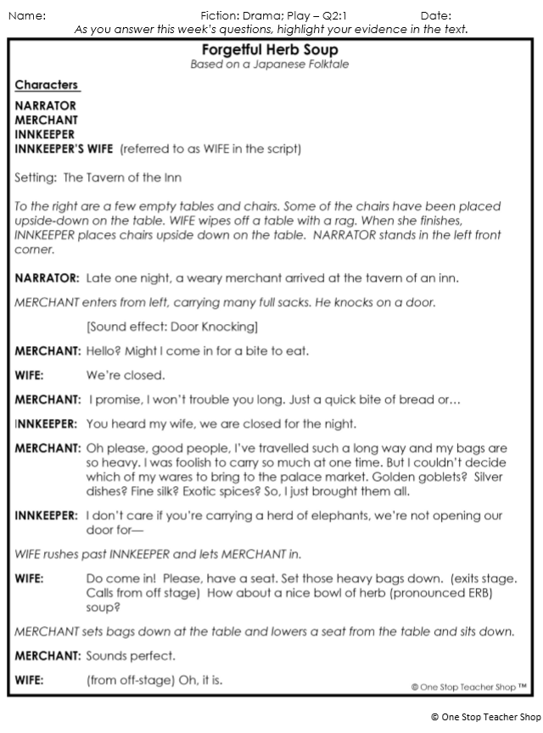
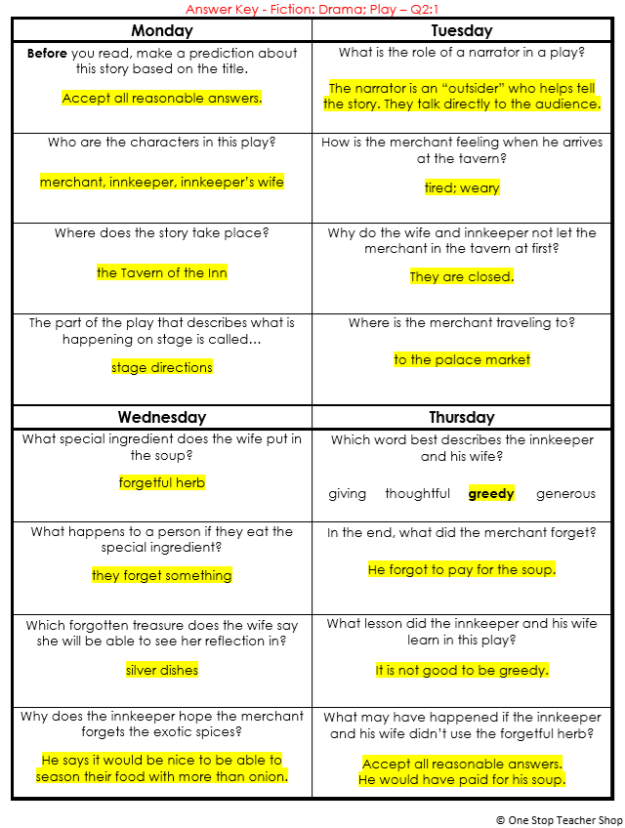
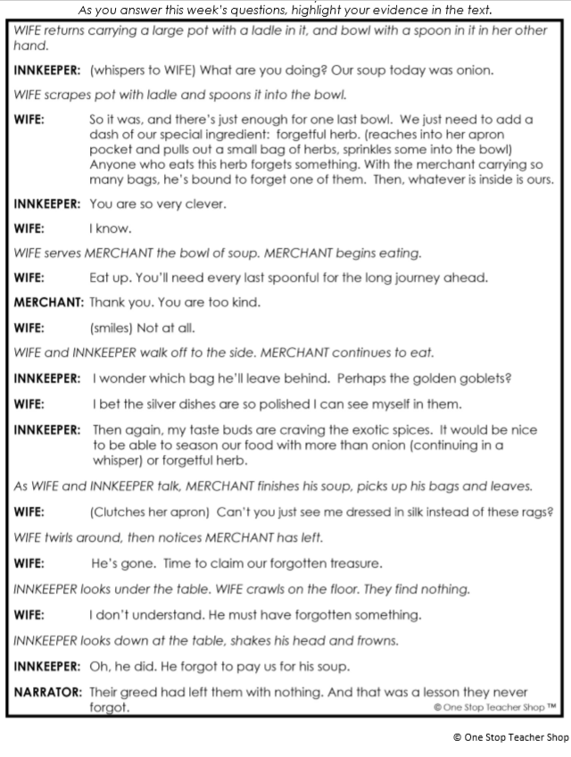
Reading Homework

Slide 4
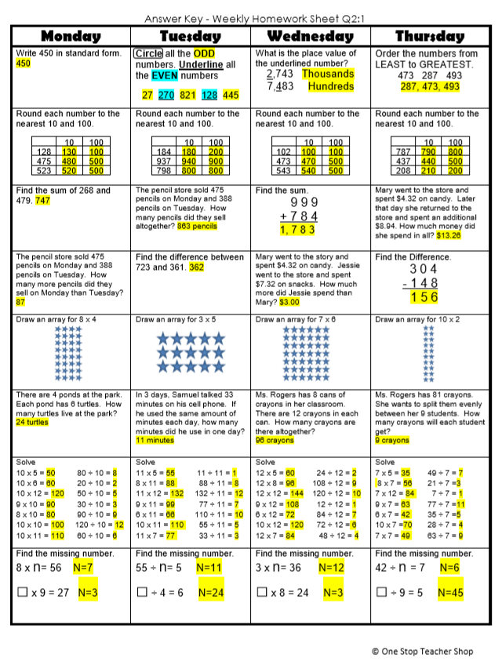
Math Homework

Slide 5

CHOMP TIME
F.A.S.T. Groups
Focused Academic Support Time

Slide 6
F.A.S.T. Designations
Computers – Classworks: R - Aiden- 1 M - Erin - 2 R - Jearon - 3 R - Kaylah - 4 R – Emma – 5 R – Adalyn - 6 R - Alexis - 7 R - Brena - 8 R - Carleen – 9 | Mrs. Roby: LLI Paisleigh Jaiden | Mrs. Thompson: SIPPS Jaylie Amiyah Cohen Caydance Kaylee | Paired Partners Book Club: Khamani - Katelynn McKenzie – Cayli Noah - Elin
8:40 – 9:10

Slide 7



VocabularyQuiz
9:10 – 9:15

Slide 8

Reading Quiz

Slide 9
Math Quiz
9:35 – 9:45

Slide 10

Restroom Break
9:45 – 9:55

Slide 11

Writing Time
Objective: W3.3
I can write narratives to develop real or imagined experiences or events using effective technique, descriptive details, and clear event sequences.
9:55 – 10:25

Slide 12
Writing Task
In a few minutes you will examine another source about the yearly migration in East Africa.
Then you will use all of the sources and your notes to answer some questions and write your own narrative about going on an East African safari during migration.

Slide 13
Vocabulary Review
migration: when animals move from one place to another, usually as the seasons change
safari: a trip to watch animals where they live in the wild

Slide 14
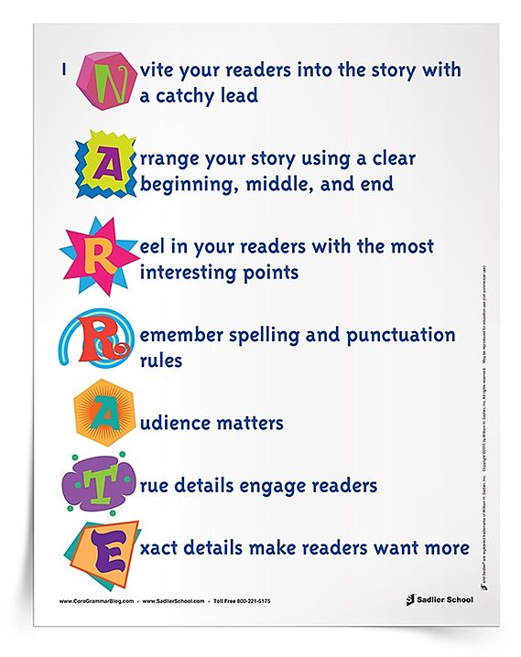
Remember, a well-written narrative:
Has a setting and story focus
Has a point of view for the narrator
Stays on focus throughout the narrative
Has a plot that develops logically
Uses descriptions and sensory details
Has a logical conclusion
Uses language appropriate to the purpose and task
Follows rules for spelling, punctuation, capitalization, and grammar

Slide 15
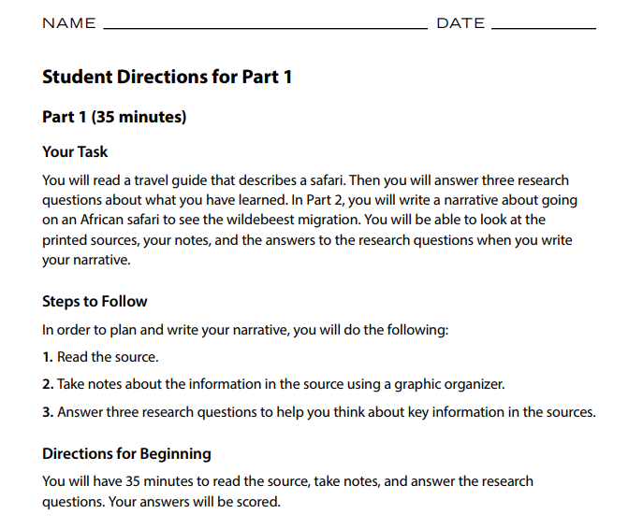

Slide 16
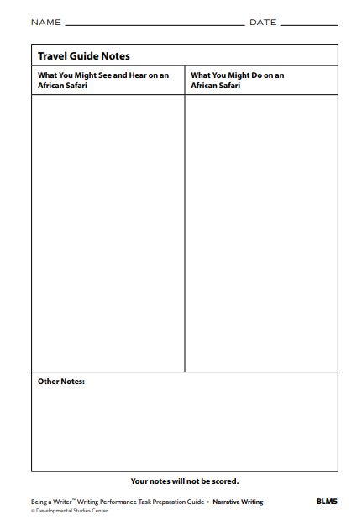
Graphic Organizer

Slide 17
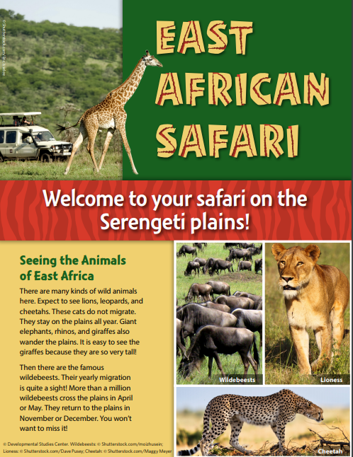
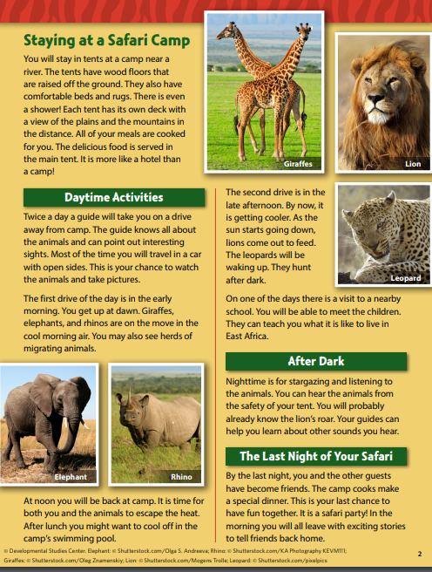

Slide 18
Out of Classroom!
Recess 10:40 – 11:05

Slide 19
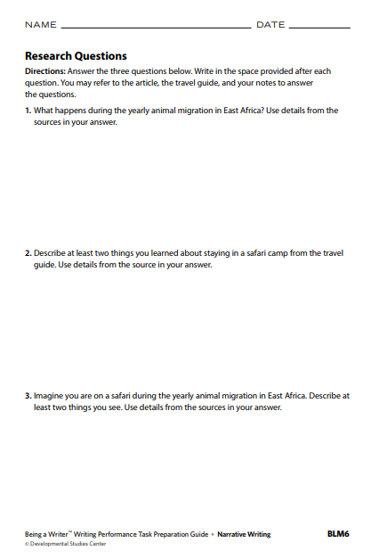
Research Questions
11:05 – 11:45

Slide 21

You have 35 Minutes! ☺

Slide 22
Share Time!
Research Questions
11:45 – 11:50

Slide 23
Math Focus Lesson!
11:50 – 12:35

Slide 24

Kicking it Quiz!

Slide 25
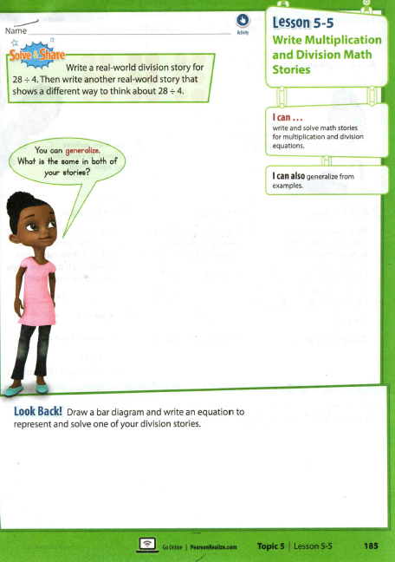

Slide 26
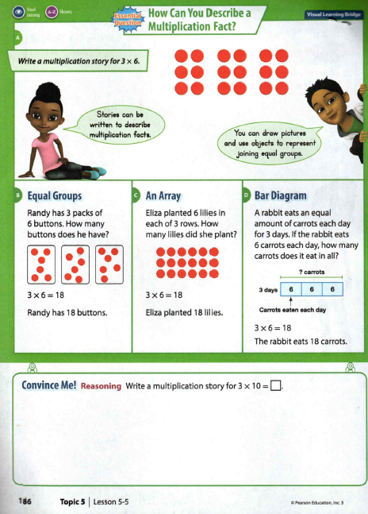
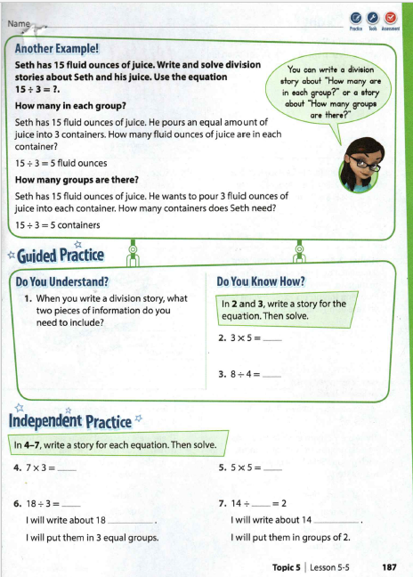

Slide 27
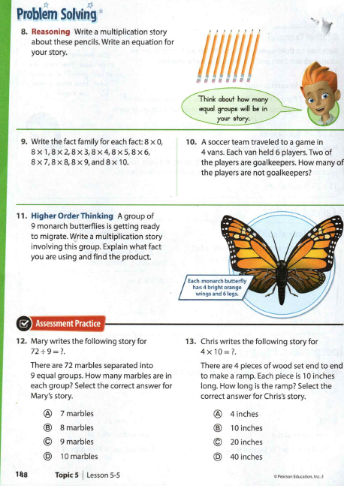

Slide 28

Out of Classroom!
Lunch 12:35 – 1:05

Slide 29
Restroom Break
1:05 – 1:10

Slide 30

Out of Classroom!
Activity 1:10 – 1:55

Slide 31

Computers – Classworks:
  M - Landon - 1
  M – Macon -2
  R – Alexis - 3
  R – Elin - 4
  R - Noah - 5
  R - Cayli - 6
  R – Jaiden - 7
  R - Paisleigh - 8
  R - Caydance – 9
  R – Kaylee - TC
Independent Daily Reading & Teacher Conferences
  Mrs. Roby:
  IDR check in
  Aiden
  Alexis
  Cayli
  Khamani
  Mrs. Thompson:
  LLI
  Amiyah
  Jaylie
  Jearon
  Cohen
Everyone else – Independent Novel
1:55 – 2:25

Slide 32

Reading Time
2:25 – 3:10
Objective: SL.3.1c
I can ask questions to check understanding of information presented, stay on topic, and link my comments to the remarks of others.

Slide 33
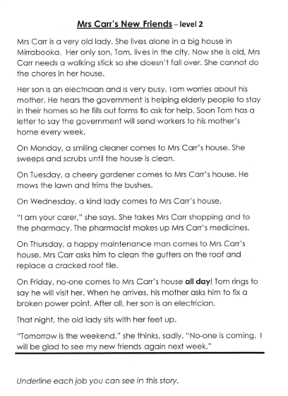

Slide 34
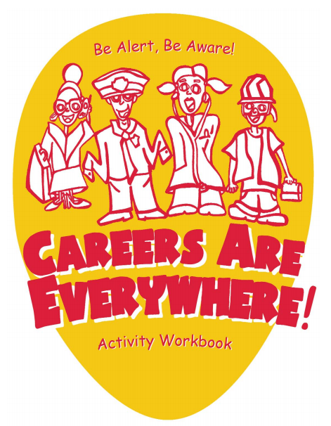

Slide 35
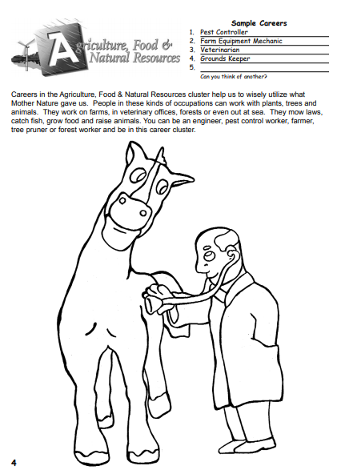

Slide 36
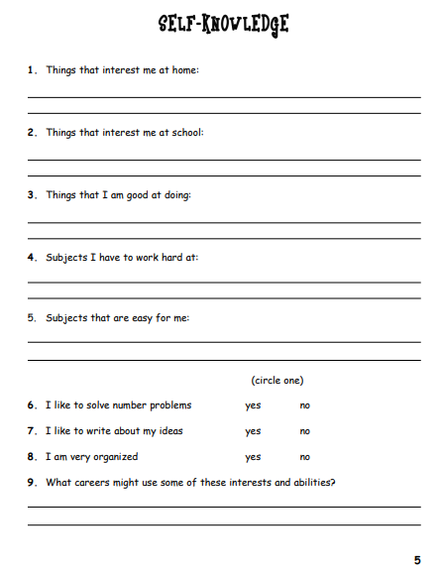

Slide 37
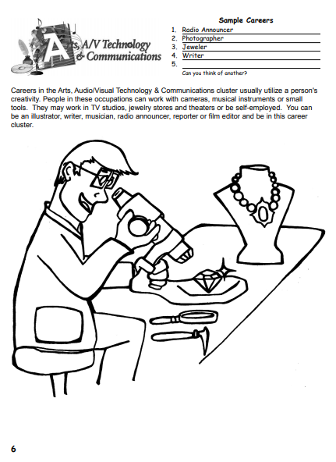

Slide 38
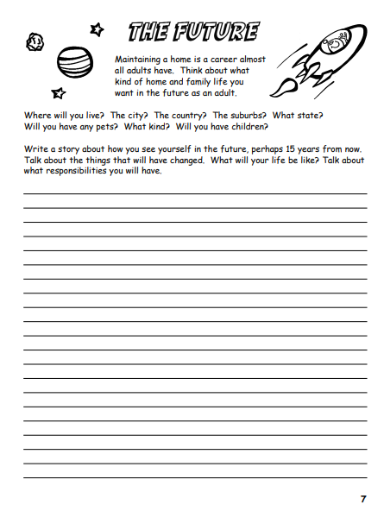

Slide 39
Restroom Break
3:10 – 3:15

Slide 40




3:10 – 3:15 Wrap Up!
Pair-Up back to back and share one thing you learned in class today with your partner
Pack-Up
Office will announce:
Car Riders – Leave around 3:20
Bus Riders – (listen to intercom for dismissal)
2:30 – 3:20
How much time has elapsed?

