Slide 1
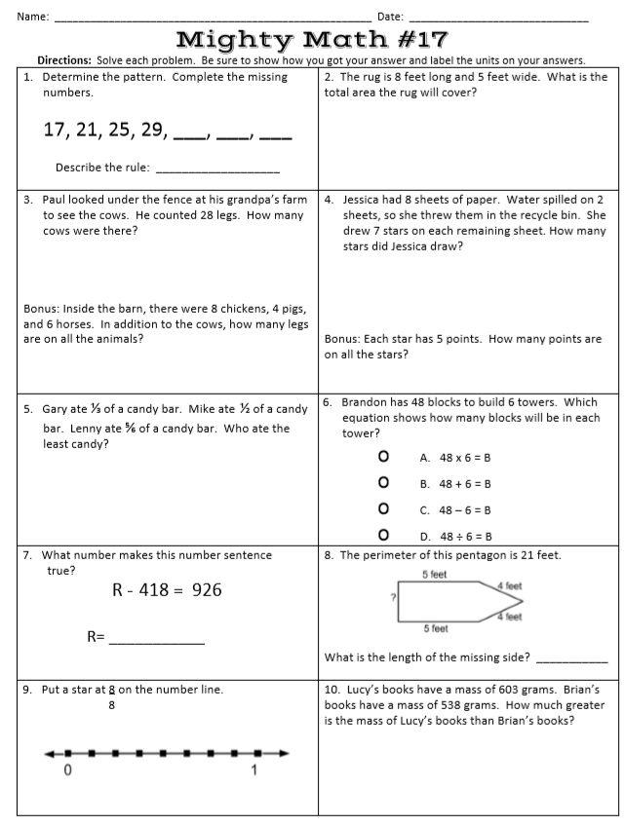
Tuesday, February 11, 2020
Superkids | Classworks – Math | Mrs. Thompson - LLI
1 - Amiyah | 2- Landon 3 - Cohen 4 – Erin 5 - Kaylee 6 - Brena 7 – Addisen 8 – Emma 9 - Jearon | Landon Macon Paisleigh Jaiden
GREEN BUTTONS FIRST – Addisen, Paisleigh
REMINDER: Bring in Tri-fold board
7:55 – 8:30

Slide 2
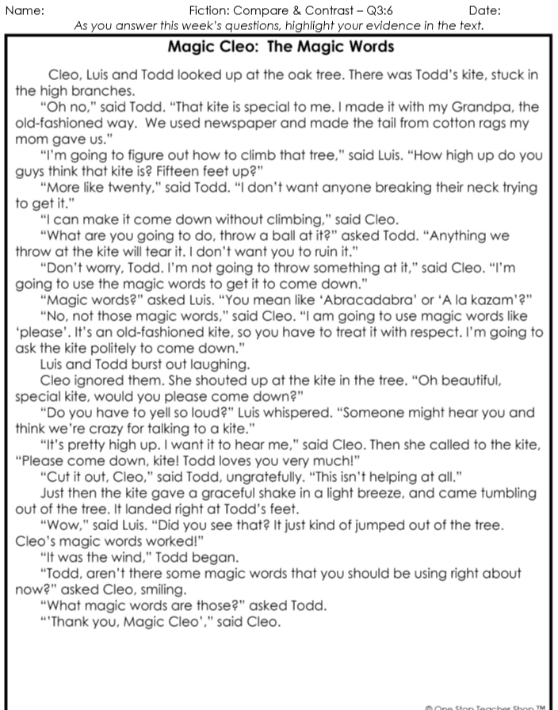
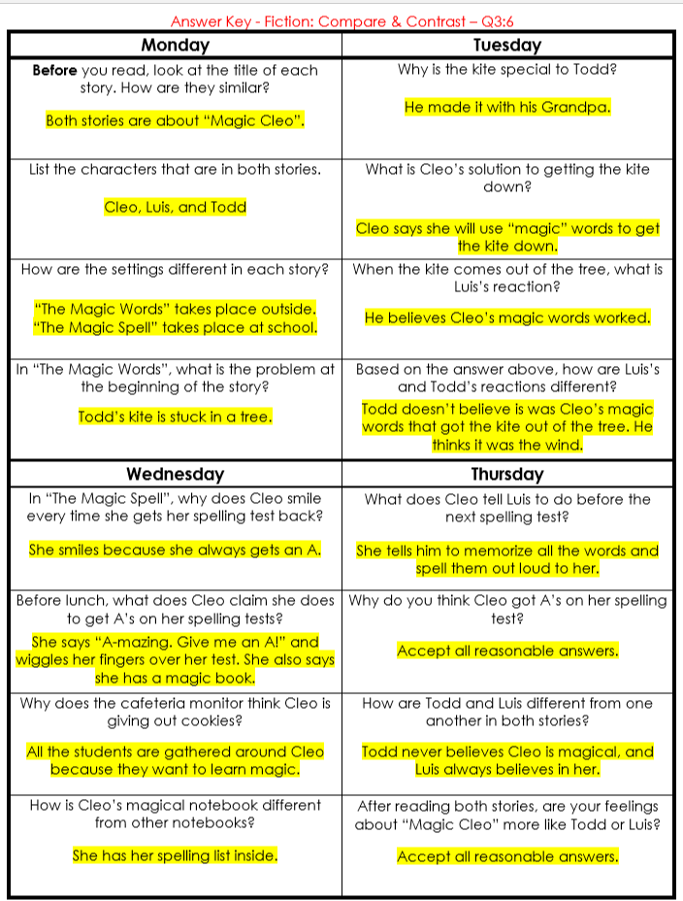
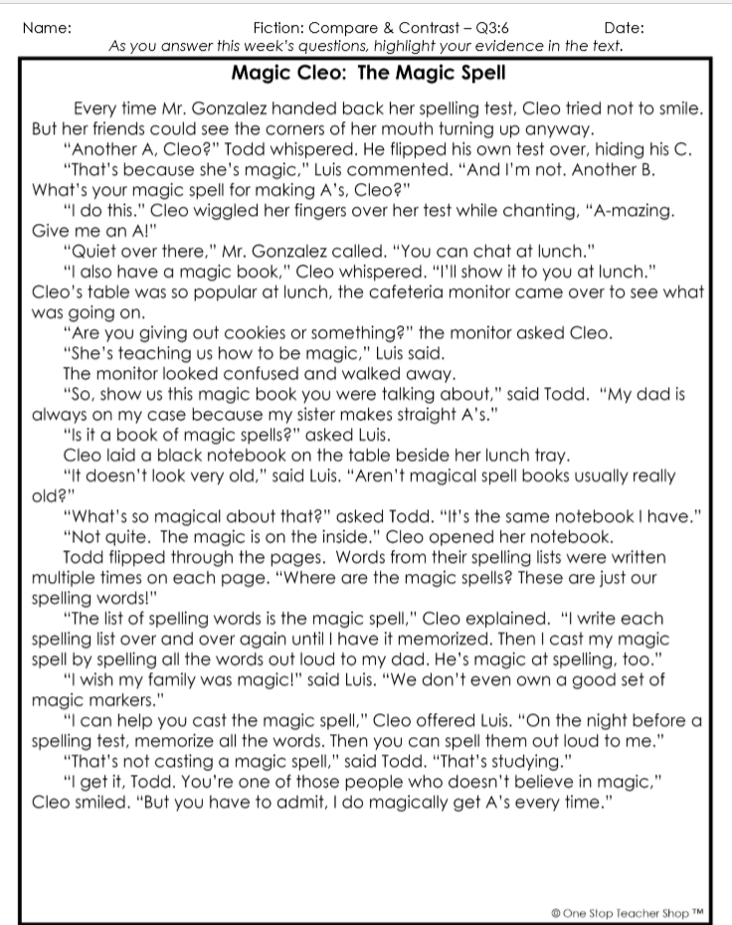
Reading Homework

Slide 3
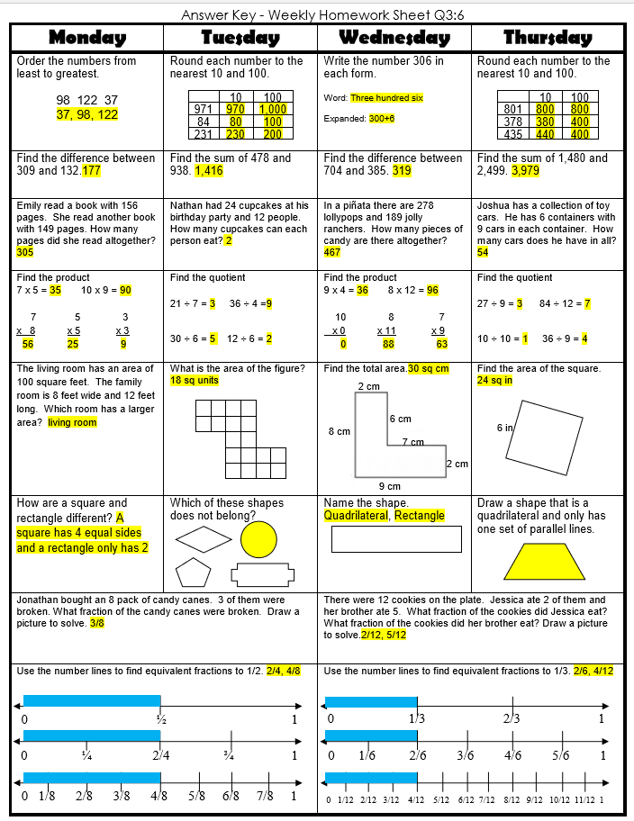
Math Homework

Slide 4

CHOMP TIME
F.A.S.T. Groups
Focused Academic Support Time

Slide 5
F.A.S.T. Designations
Superkids: 1 – Paisleigh -LA Hearbuilder: 2 - Amiyah | Epic: 4 - Katelynn | Classworks: 3 – Caydance - M 5 – Jaylie – M 6 - Lexi – M 7 - Aiden - R 8 - Erin – M 9 – Jaiden - M | Mrs. R: LLI: Jearon Brena Carleen Kaylah | Mrs. T: LLI Testing | Peer Tutoring: Cohen & Khamani Kaylee & Elin
Landon – Phonics 1st with Mrs. Page
Macon – SIPPS with Mrs. Bess
8:50 – 9:10

Slide 6

Reading Time
9:10 – 9:45
RI.3.1 I can ask and answer questions to demonstrate understanding of a text, referring explicitly to the text as the basis for the answers.
RI.3.2 I can determine the main idea of a text; recount the key details and explain how they support the main idea.
RI.3.4 I can determine the meaning of general academic and domain-specific words and phrases in a text relevant to a grade 3 topic or subject area.
SL.3.1c I can ask questions to check understanding of information presented, stay on topic, and link my comments to the remarks of others.

Slide 7
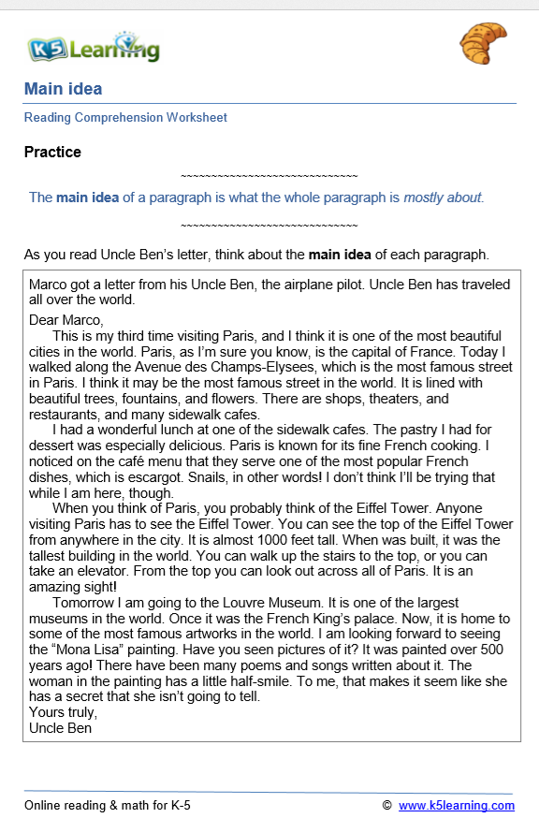
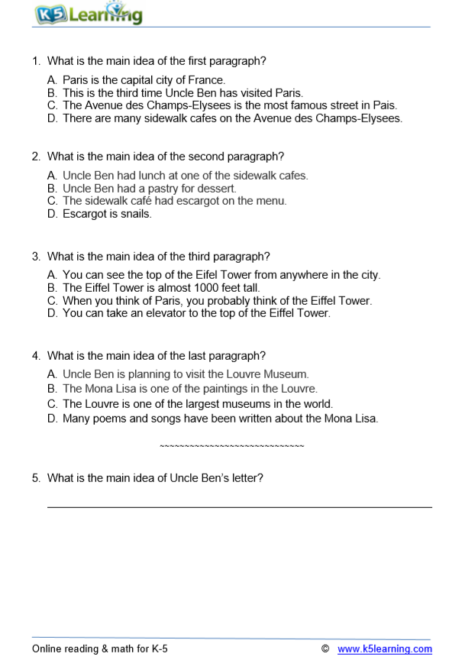

Slide 8
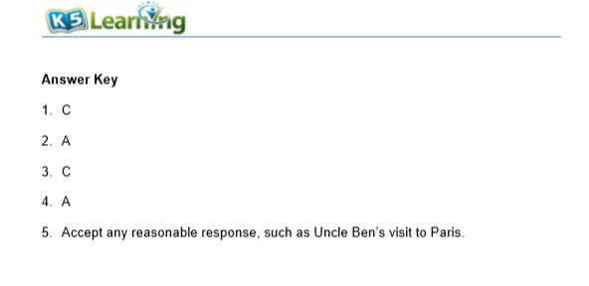

Slide 9

Restroom Break
9:45 – 9:55

Slide 10

Independent Daily Reading & Teacher Conferences
Hearbuilder: 3 – Macon | Epic: 1 – Khamani 2 – McKenzie 5 – Elin 8 - Erin | Classworks: 4 – Jearon – M 6 – Carleen – M 7 - Brena - R | Mrs. R LLI: Emma Adalyn Jaiden Addisen | Mrs. T SIPPS: Amiyah Jaylie Caydance Landon Kaylee Cohen Paisleigh
  All others – Independent Novel
9:55 – 10:25

Slide 11



Morning Work Review & Snack
10:25 – 10:40

Slide 13
Out of Classroom!
Recess 10:40 – 11:05

Slide 14
Math Fluency & Focus Lesson!
11:05 – 12:35
Math 3.NF.1 I can understand that a fraction 1/b as the quantity formed by one part when a whole is partitioned into b equal parts. I can understand that a fraction a/b as the quantity formed by a parts of size 1/b.
Math 3.NF.2 I can represent a fraction 1/b on a number line diagram by defining the interval from 0 to 1 as the whole and partitioning it into b equal parts.
.

Slide 15

Kicking it Quiz!

Slide 16
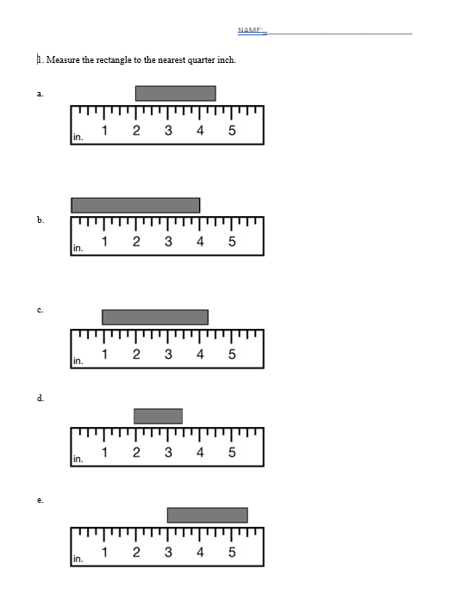

Slide 17
Station Time!
11:05 – 12:25
Math 3.NF.1 I can understand that a fraction 1/b as the quantity formed by one part when a whole is partitioned into b equal parts. I can understand that a fraction a/b as the quantity formed by a parts of size 1/b.
Math 3.NF.2 I can represent a fraction 1/b on a number line diagram by defining the interval from 0 to 1 as the whole and partitioning it into b equal parts.
.

Slide 18
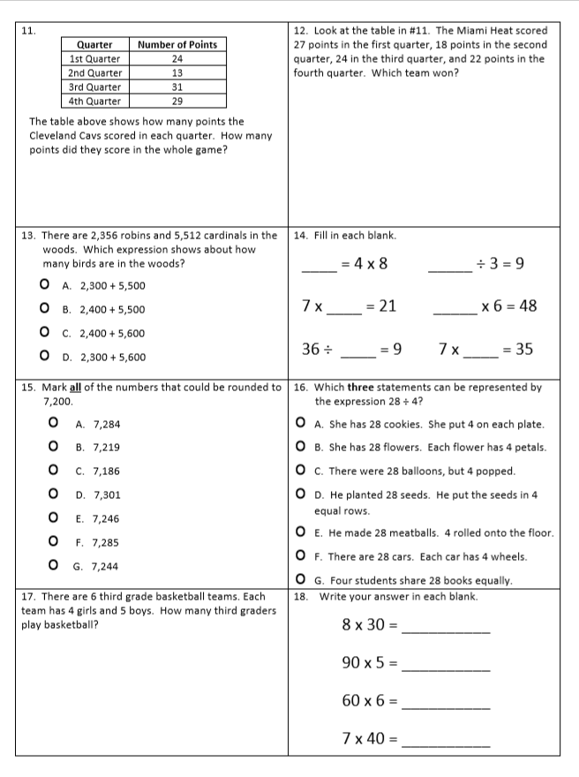
Math Rotation - separate tables

Slide 19
Rotation 1
11:15 – 11:30
Group 1 – Computers 1-5: Classworks Reading
Group 2 – Mrs. Roby –
Group 3 – Computers 6-TC: Classworks Math
Group 4 – Mrs. Thompson –
Group 5 – Rotating Subjects
  (Monday: Math, Tuesday: Science,
  Wednesday: Reading, Thursday: Writing,
  Friday: Social Studies)

Slide 20
Rotation 2
11:30 – 11:45
Group 5 – Computers 1-5: Classworks Reading
Group 1 – Mrs. Roby –
Group 2 – Computers 6-TC: Classworks Math
Group 3 – Mrs. Thompson –
Group 4 – Rotating Subjects
  (Monday: Math, Tuesday: Science,
  Wednesday: Reading, Thursday: Writing,
  Friday: Social Studies)

Slide 21
Rotation 3
11:45 – 12:00
Group 4 – Computers 1-5: Classworks Reading
Group 5 – Mrs. Roby –
Group 1 – Computers 6-TC: Classworks Math
Group 2 – Mrs. Thompson –
Group 3 – Rotating Subjects
  (Monday: Math, Tuesday: Science,
  Wednesday: Reading, Thursday: Writing,
  Friday: Social Studies)

Slide 22
Rotation 4
12:00 – 12:15
Group 3 – Computers 1-5: Classworks Reading
Group 4 – Mrs. Roby –
Group 5 – Computers 6-TC: Classworks Math
Group 1 – Mrs. Thompson –
Group 2 – Rotating Subjects
  (Monday: Math, Tuesday: Science,
  Wednesday: Reading, Thursday: Writing,
  Friday: Social Studies)

Slide 23
Rotation 5
12:15 – 12:30
Group 2 – Computers 1-5: Classworks Reading
Group 3 – Mrs. Roby –
Group 4 – Computers 6-TC: Classworks Math
Group 5 – Mrs. Thompson –
Group 1 – Rotating Subjects
  (Monday: Math, Tuesday: Science,
  Wednesday: Reading, Thursday: Writing,
  Friday: Social Studies)

Slide 24

Out of Classroom!
Lunch 12:35 – 1:05

Slide 25
Restroom Break
1:05 – 1:10

Slide 26

Out of Classroom!
Activity 1:10 – 1:55

Slide 27
Math Time!
Equivalent Fractions Check Progress Work/Review
1:55 – 2:30

Slide 28
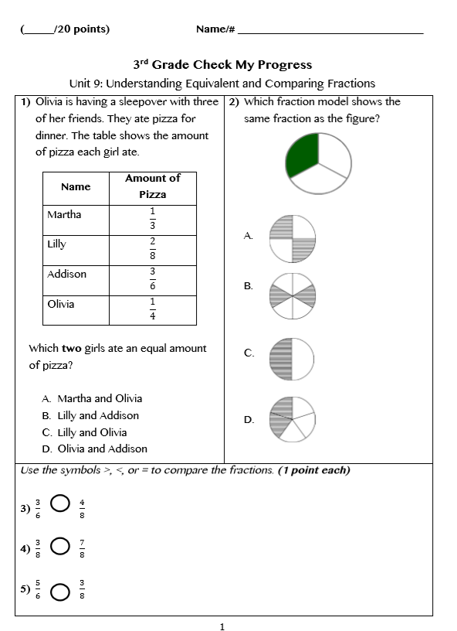
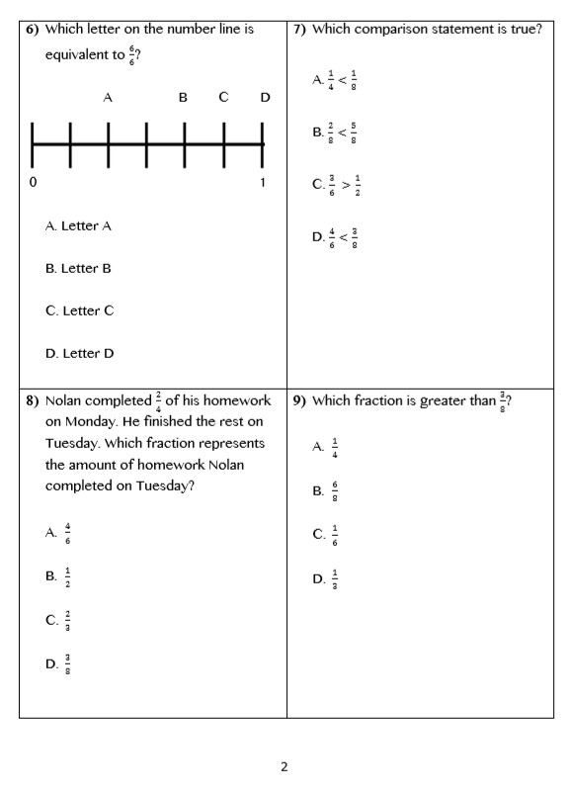

Slide 29
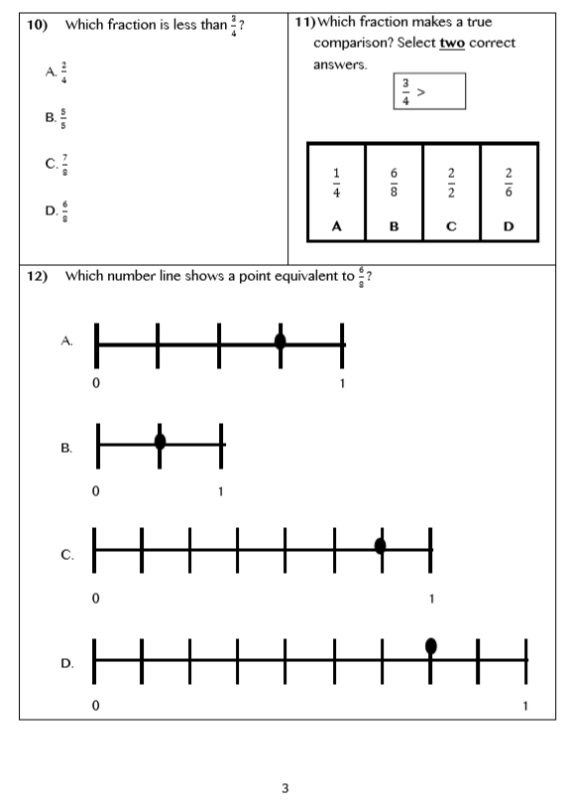
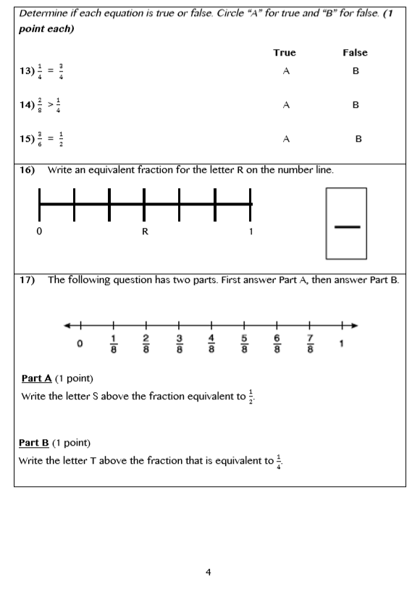

Slide 30
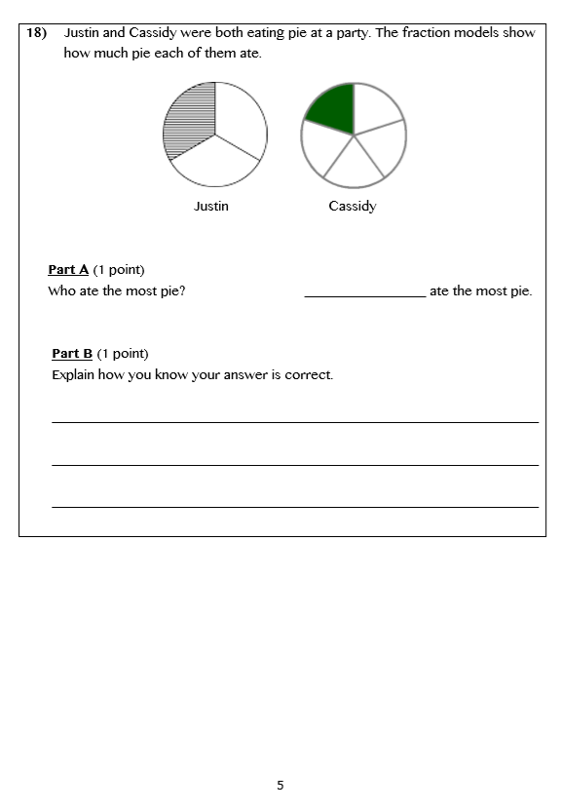

Slide 31
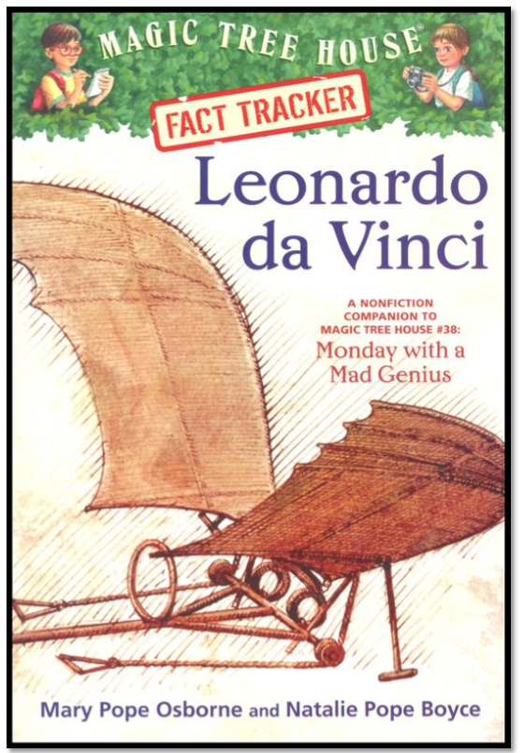
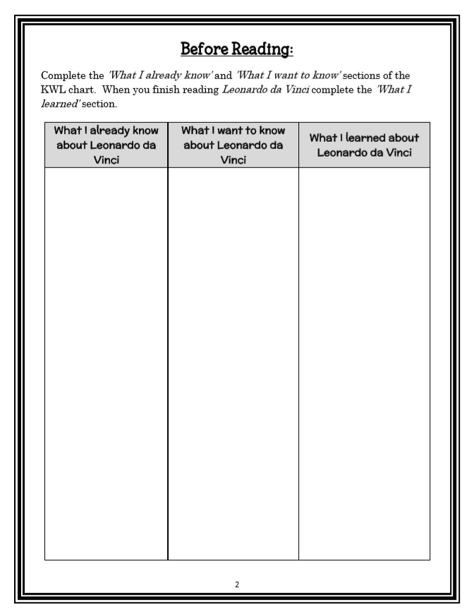
Book Study
Read Aloud Chapter 1
Paired Partners Workbook
2:30 – 3:00

Slide 32
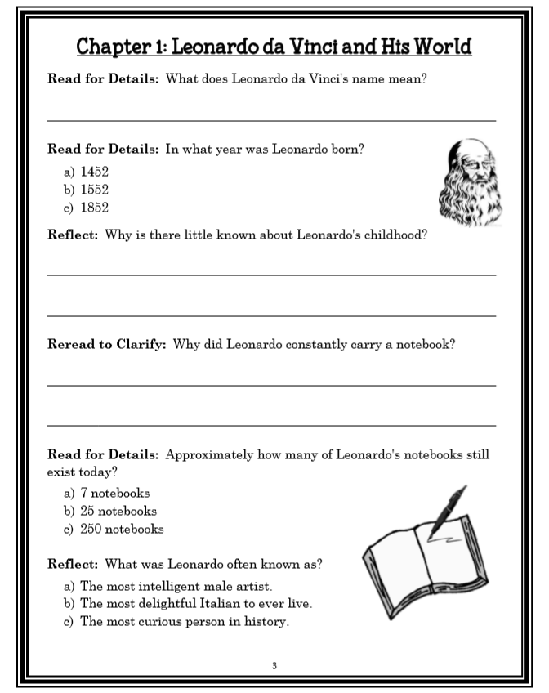
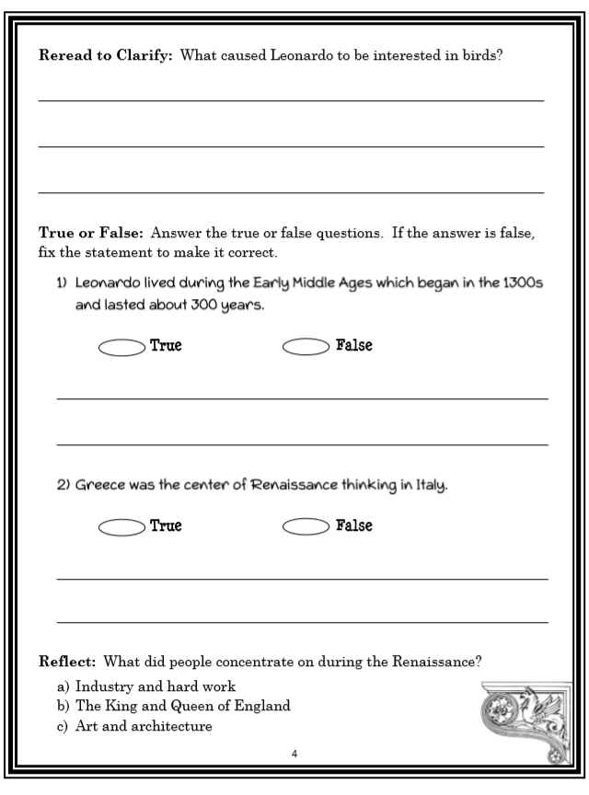

Slide 33
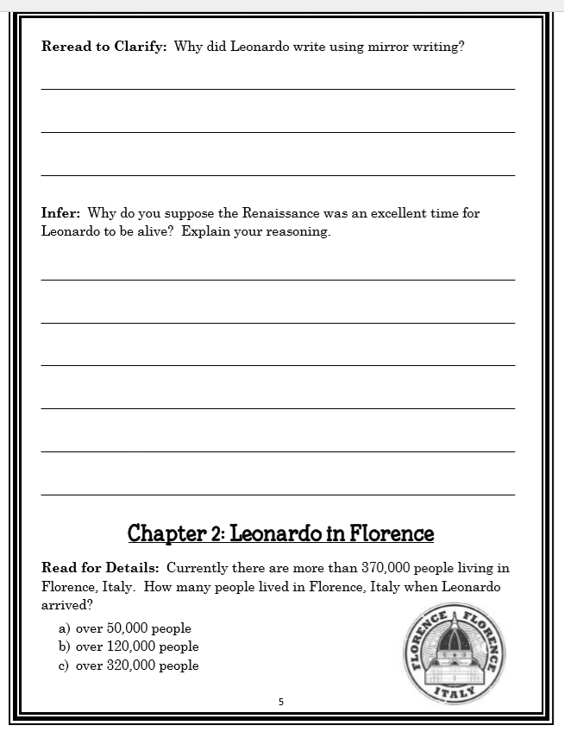

Slide 34
Restroom Break
3:10 – 3:15

Slide 35




3:20 – 3:25 Wrap Up!
Pair-Up back to back and share one thing you learned in class today with your partner
Pack-Up
Office will announce:
Car Riders – Leave around 3:25
Bus Riders – (listen to intercom for dismissal)
2:30 – 3:20
How much time has elapsed?

