Slide 1
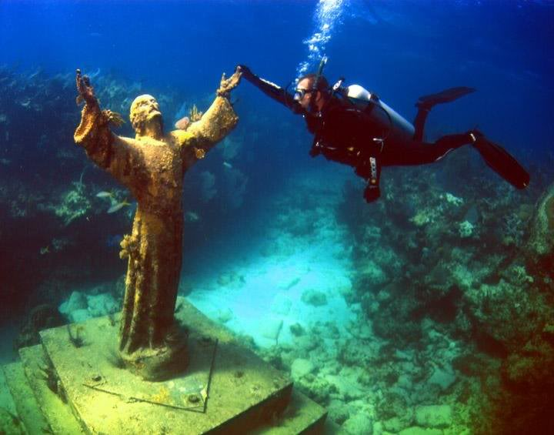
Lesson 6.NS.9 (ALT 2)
Rules for Adding & Subtracting Integers

Slide 2
What are Integers?
Integers are the whole numbers and their opposites.
…-3, -2, -1, 0, 1, 2, 3…

Slide 3
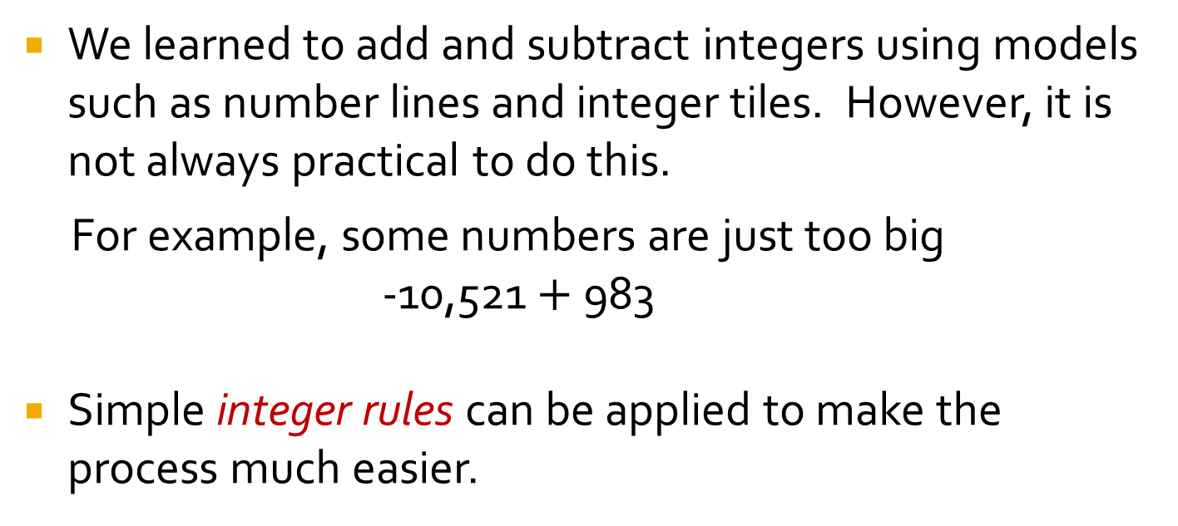
Yesterday…
We learned to add and subtract integers using models such as number lines and integer tiles. However, it is not always practical to do this.
For example, some numbers are just too big
-10,521 $+$983
Simple integer rules can be applied to make the process much easier.

Slide 4

Today…
Section 1: Introduction and read-world connection.
Section 2: Apply the rules for adding and subtracting integers.
Section 3: Board Activity.

Slide 5
Section 1:
Introduction and Real-World Connection
Adding & Subtracting Integers

Slide 6
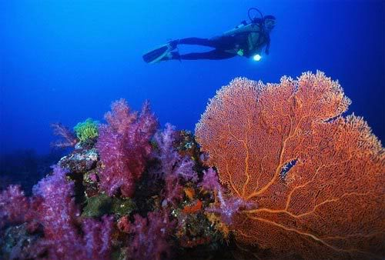
Why learn this skill?
Measurements and distances often involve working with both positive (+) and negative (-) numbers.
Let’s look at a real-world example…

Slide 7
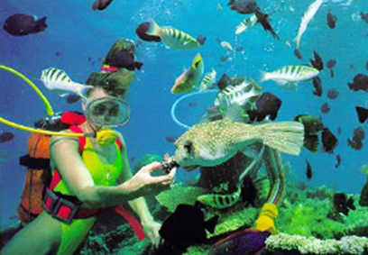
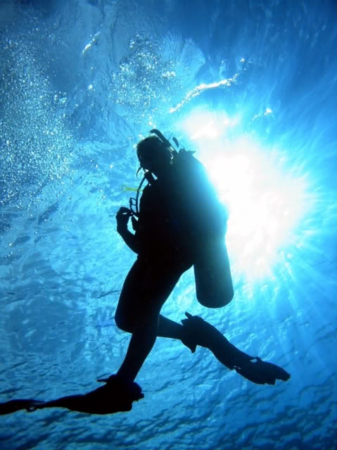
Let me ask you a question...
Has anyone ever gone scuba diving?
If you had the chance to go scuba diving, would you go?

Slide 8
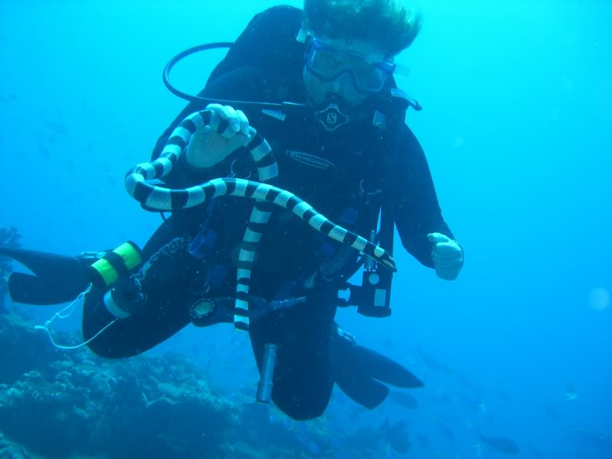
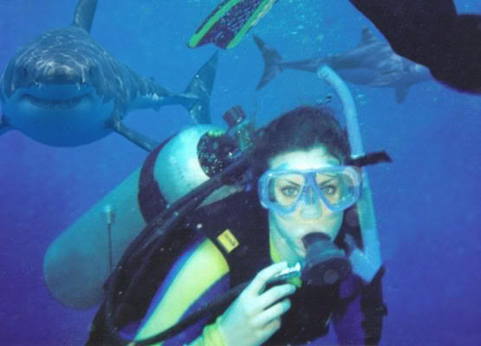
Sharks, Sea Snakes!
Yikes!
I probably would not…
I’m too much of a chicken!

Slide 9
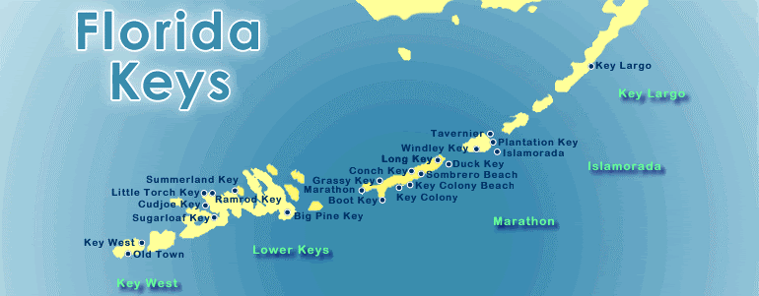
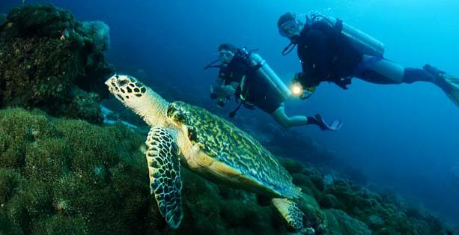
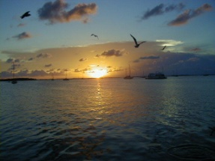
If you ever get to go scuba diving,
I have just the spot for you…
Key Largo -
Part of the Florida Keys
Notes:
Show students on the map where the tip of Florida is.
Then point to Key Largo and tell them that Key Largo is part of the Florida Keys.

Slide 10
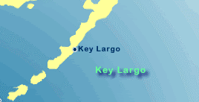
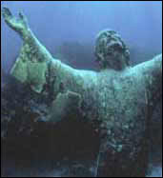
Why scuba-dive in Key Largo?
Christ of the Abyss
The 4000 lb bronze statue shown is called…
“Christ of the Abyss”.
It’s located in the Florida Keys, about 6 miles from Key Largo.
The statue was donated by an Italian dive manufacturer in 1962.
After sitting several years in storage at O’Hare airport in Chicago the decision was finally made to sink the statue in 22 feet of water on the seaward side of the reef (see map).
The statue presents an awesome sight with its hands raised towards the surface.
The statue itself is nearly 9 feet tall and with its religious overtones, it’s always one of the busiest sites for scuba diver lovers!
Christ of the Abyss

Slide 11
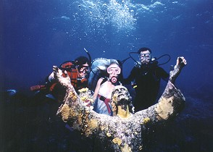
Christ of the Abyss
With hundreds of weddings performed each year in front of the statue of Christ, it is one of the most photographed areas in Key Largo.
On the other hand… funerals are held at the site as well.
Many people ask that their ashes be laid to rest there.
Notes:
Point out that the lady is wearing her wedding dress.

Slide 12
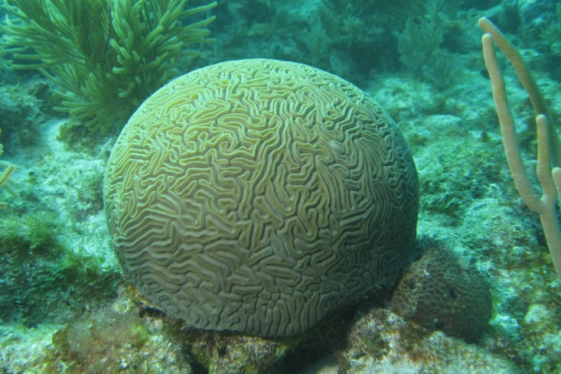
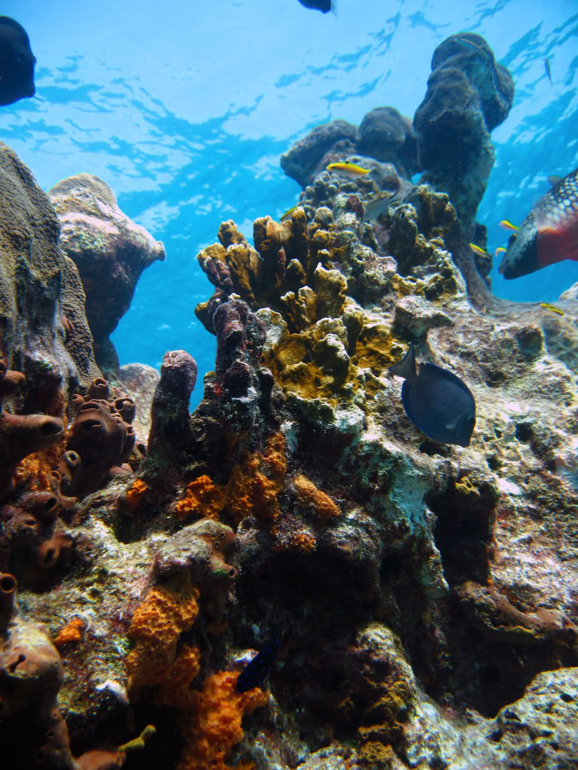
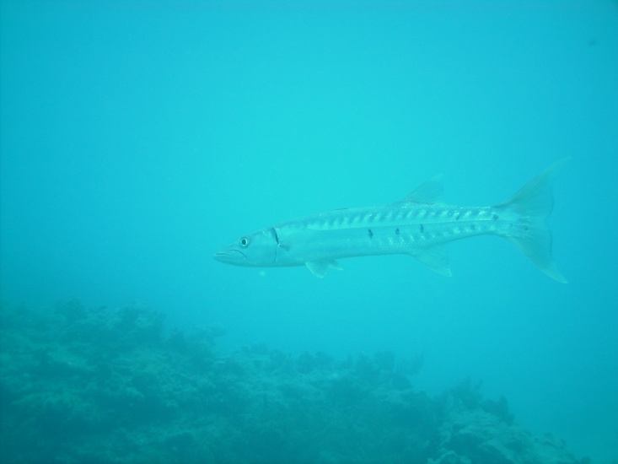
Other Interesting Sites…
The area has some interesting
brain coral and structures.
Smoky the barracuda has cruised the area for about as long as anyone can remember.
He’s totally domesticated.

Slide 13
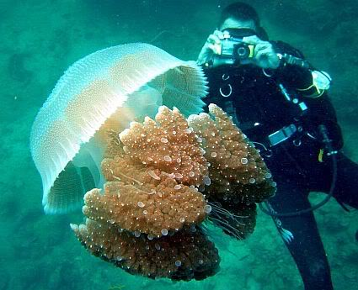
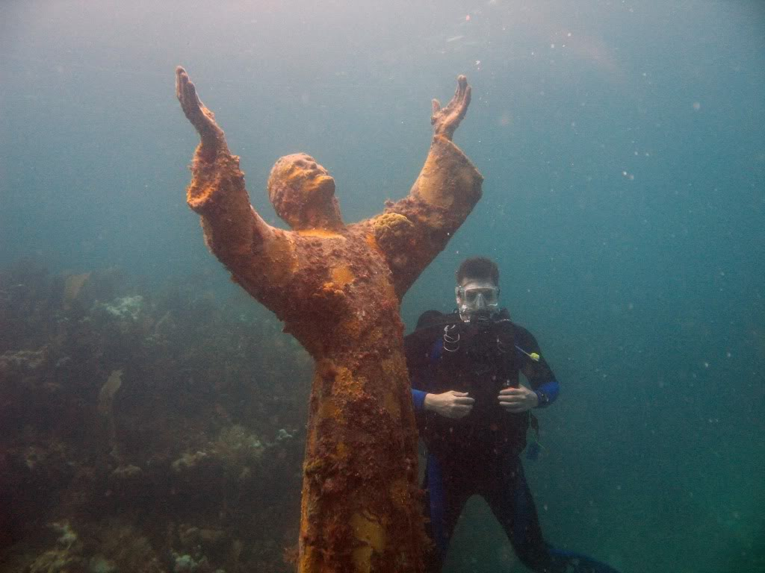
Real-World Connection
Scuba Diving Reading Problem.
0
-1
-2
-3
-4
-5
-6
-7
-8
-9
-10
-11
-12
-13
-14
-15
-16
-17
-18
-19
-20
-21
-22
A scuba diver descends 15 feet from the surface of the ocean, stops to photograph a huge jelly fish, then descends another 7 feet to photograph the “Christ of the Abyss”.
How many feet below the surface of the ocean is the diver now located?
Write an expression for the situation described and then solve using the vertical
number line on the right:
Notes:
- Ask the students if they know what the word descends means. Listen to some responses. Then clarify to the students that the word indicates that the diver is going down. The diver descends 15 feet (or goes down 15 feet) and then descends (or goes down) another 7 feet.
- Help students set up the expression: -15 – 7 =
Then, with the use of the number line, determine how many feet below the surface of the ocean the diver is now: Answer 22 feet

Slide 14
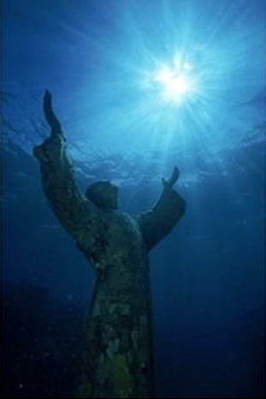
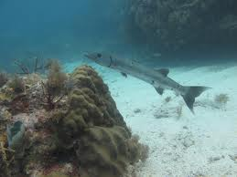
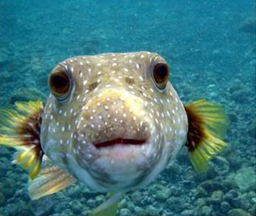
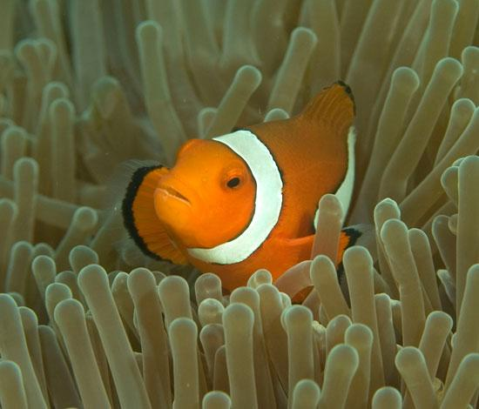
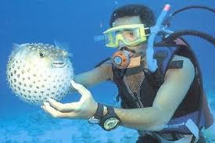
I might want to try scuba diving after all!
Smoky

Slide 15
Moving on…
Section 1: Introduction and read-world connection.
Section 2: Apply the rules for adding and subtracting integers.
Section 3: Board Activity.

Slide 16
Section 2:
Apply the Rules for Adding and Subtracting Integers

Slide 17
(Example 1)
Solve: ̶ 2 ̶ 4
Same Signs…
ADD the numbers.
KEEP the sign.
Stack-up the numbers and Circle the signs.
Different Signs…
SUBTRACT the numbers.
Give sign of the bigger digit.
̶ 2
̶ 4
Same Signs
ADD the numbers.
̶ 6
KEEP the sign.
SAME SIGNS = SAME DIRECTION
Notes:
Example: Same Signs

Slide 18
(Example 2)
Solve: ̶ 7 + 11
Same Signs…
ADD the numbers.
KEEP the sign.
Stack-up the numbers and Circle the signs.
Different Signs…
SUBTRACT the numbers.
Give sign of the bigger digit.
̶ 7
+ 11
Different Signs
4
SUBTRACT the numbers.
(An 11 is bigger than a 7.
The 11 is positive, so my
answer will be positive.)
Give sign of the bigger digit.
DIFFERENT SIGNS = DIFFERENT DIRECTIONS
Notes:
Example: Different Signs

Slide 19

Let’s Try These Together!
Same Signs
Add the digits and
Keep the sign.
Different Signs
Subtract the digits and
give sign of the bigger digit.
98 + 28 ̶ 51 ̶ 19 ̶ 20 + 24 18 ̶ 30
Notes:
1) 126 2) -70 3) 4 4) -12

Slide 20
You Try!
Same Signs
Add the digits and
Keep the sign.
Different Signs
Subtract the digits and
give sign of the bigger digit.
̶ 63 ̶ 20 78 + 41 12 ̶ 105 ̶ 10 + 15
Notes:
1) -83 2) 119 3) -93 4) 5

Slide 21

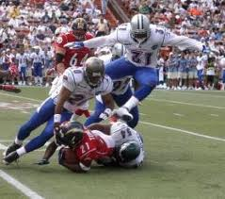
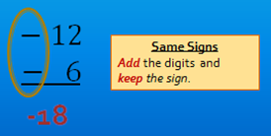
Challenge
A football team loses 12 yards on a play. They then lose another 6 yards on the next play. What is the net gain or loss on the two plays.
Write an expression using integers for the situation described. Then solve.

Slide 22

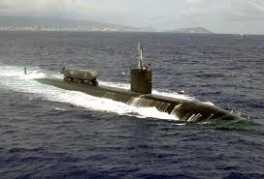
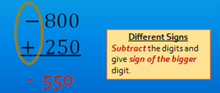
Challenge
From the surface of the ocean, a submarine dives 800 feet. If the submarine then rises 250 feet, at what position is the submarine now?
Write an expression using integers for the situation described. Then solve.

Slide 23
Last section…
Section 1: Introduction and read-world connection.
Section 2: Apply the rules for adding integers.
Section 3: Board Activity.

Slide 24

Board Activity
‒15 + 12 = ______
‒15 ‒ 12 = ______
Notes:
Get two student volunteers to work these out on the board at the same time.
Have them explain their work.
-15 + 12 = -3
-15 – 12 = -27

Slide 25
Board Activity
42 ‒ 32 = ______
‒ 32 ‒ 42 = ______
Notes:
42 - 32 = 10
-32 - 42 = -74

Slide 26

Board Activity
‒21 ‒ 5 = ______
21 + 5 = ______
Notes:
-21 - 5 = -26
21 + 5 = 26

Slide 27

Board Activity
-18 + 6 = ______
-18 + 25 = ______
Notes:
-18 + 6 = -12
-18 + 25 = 7

Slide 28

Board Activity
7 ‒ 24 = ______
8 ‒ 8 ‒ 3 = ______
Notes:
7 -24 = -17
8 - 8 - 3 = -3

Slide 29

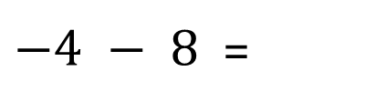
Same Signs
Add the digits and
Keep the sign.
Different Signs
Subtract the digits and
give sign of the bigger digit.
Apply rule
$−4 − 8$=
Justify
Notes:
-4 - 8 = 12

Slide 30


Same Signs
Add the digits and
Keep the sign.
Different Signs
Subtract the digits and
give sign of the bigger digit.
Apply rule
$$6 − 8 =$$
Justify
Notes:
6 - 8 = -2

Slide 31
Same Signs
Add the digits and
Keep the sign.
Different Signs
Subtract the digits and
give sign of the bigger digit.
Apply rule
-7 + 12 =
Justify
Notes:
-7 + 12 = 5

Slide 32
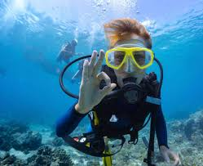
Closure
  Without actually working out the problem, identify if the solution will be a positive number or negative number. Use your knowledge of the integer rules you learned today to help. Be prepared to justify your answer.
  -53 - 21
  -2 + 1
  15 - 12
  36 + 44
Great Job Guys!
Notes:
-53 -21 Negative because same sign, keep the sign
-2 + 1 Negative because different signs, give sign to the bigger digit
15 - 12 Positive because different signs, give sign to bigger digit
36 + 44 Positive because same sign, keep sign

Slide 33
End of PowerPoint

