Slide 1
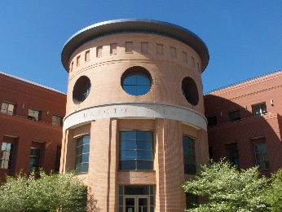
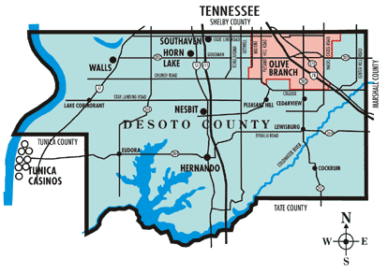
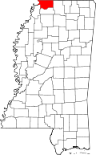
County Government
Population 1840 – 7,002
2010 – 161,252
Formed February 9, 1836
Land 478 sq mi (1,238 km²)

Slide 2
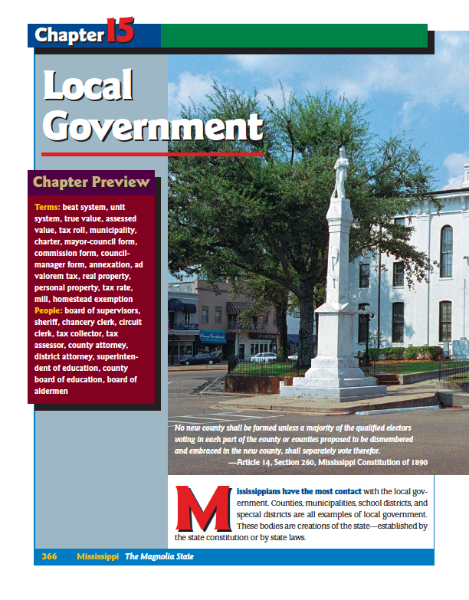
Chapter 15
Page 366

Slide 3
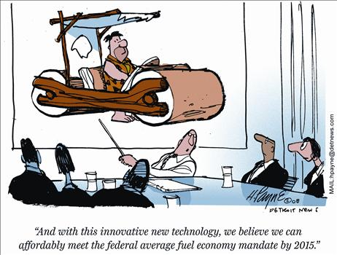

Slide 4
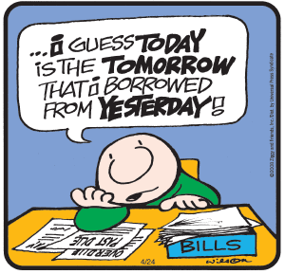

Slide 5
Objectives
MS4 Demonstrate the ability to use social studies tools (e.g., timelines, maps, globes, resources, graphs, a compass, technology, etc.).
MS5 Explain how civic responsibilities are important to Mississippians as citizens of the United States and residents of a global setting.

Slide 6
Objectives
MS5a Explain the necessity of politics and government.
MS5b Describe the roles of citizens in the state and nation.
MS5d Identify the major responsibilities of state and local government.

Slide 7
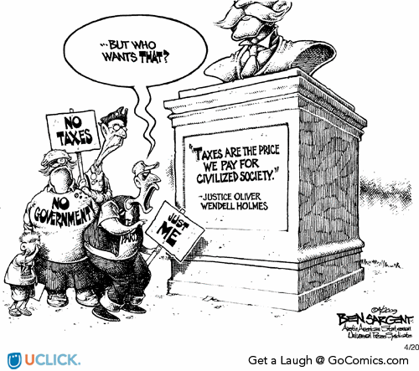

Slide 8
Overview
Counties
Board of Supervisors
Types of County Government
Law Enforcement
County Superintendent and the Board of Education

Slide 9
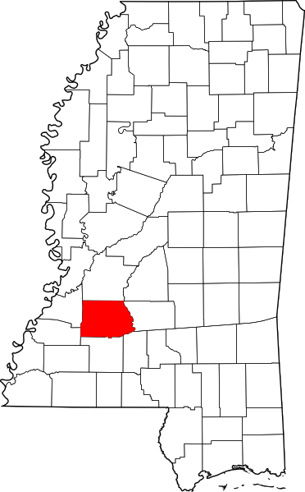
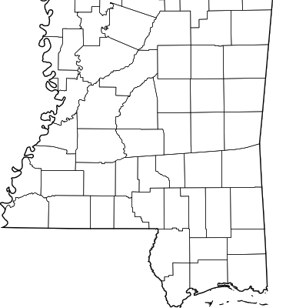
How is a new county created?
No new county shall be formed unless a majority of the qualified electors
voting in each part of the county or counties proposed to be dismembered
and embraced in the new county, shall separately vote therefore.
—Article 14, Section 260, Mississippi Constitution of 1890
Page 366 in the picture.

Slide 10
How many counties in ?
82

Slide 11
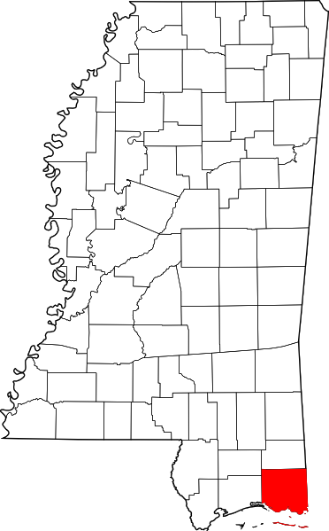
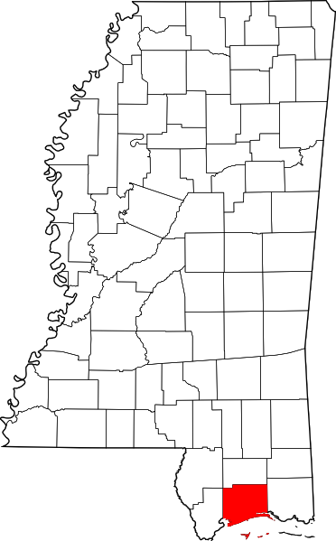
If you where going to create a new county which county would you split up?
Look at Harrison and Jackson County, anything odd about those counties?

Slide 12
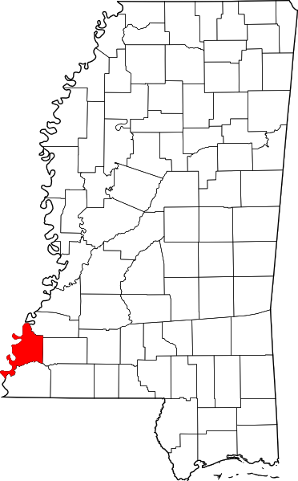
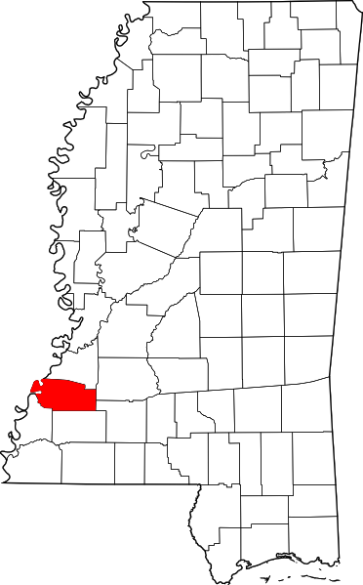
What are the first 2 counties in Mississippi?
Adams County
Jefferson County
(Pickering)

Slide 13
How many counties by statehood?
How many counties by
1841?
How many counties by
1890?
1817
1841
1890
14
56
75

Slide 14
How many counties since the 1890 Constitution was written?
Lamar County – 1904
Forrest County – 1906
Jefferson Davis County – 1906
George County – 1910
Walthall County – 1912
Stone County – 1916
Humphreys County – 1918
7

Slide 15
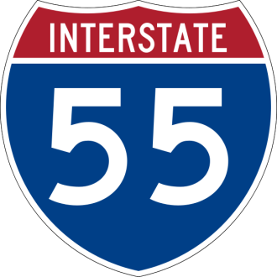
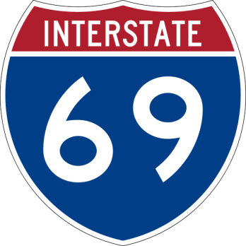
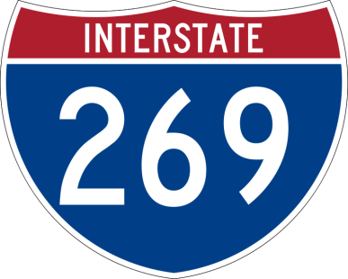
What are some county services?
Law Enforcement
Road Maintenance
Recreation
Fire Protection
SCENIC
ROUTE

Slide 16
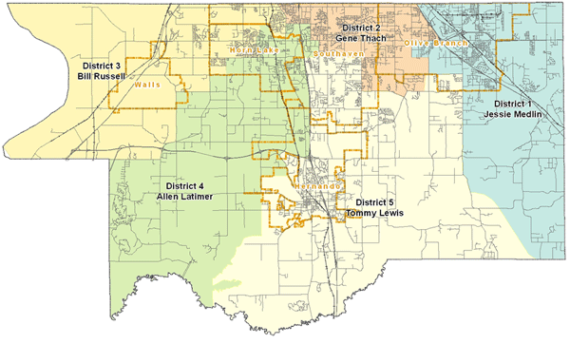
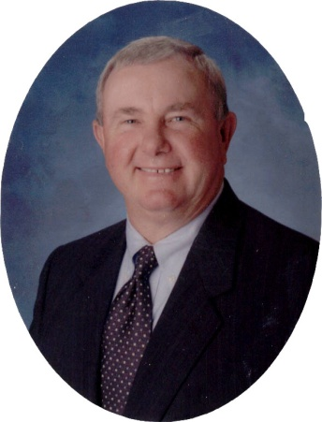
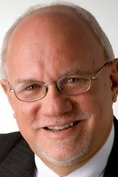
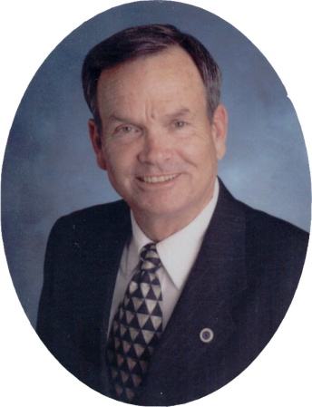
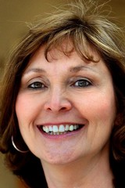
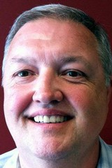
Board of Supervisors
Governing body of the county.
Every county in Mississippi is divided into 5 equal BEATS.
One supervisor is elected for 4 years from each beat.
Jessie Medlin
District 1 (OB)
Mark Gardner
District 2
Bill Russell
District 3
Lee Caldwell
District 4
Harvey Wayne Lee
District 5

Slide 17
Board of Supervisors Meetings
The minimum the Board of Supervisors must meet is once a month.
Can meet more than that if necessary.

Slide 18
Board’s Responsibilities
Levy taxes
Appropriate money
Prepare the budget
Issue bonds (borrow money)
Maintain roads, bridges and ferries
Repair the courthouse and jail
Monitor county health programs
Regulate fireworks
Call witnesses in matters under its jurisdiction
Appoint a county fire coordinator
Sick leave policy for the county
Maintain public libraries
Purchase supplies and equipment

Slide 19
2 Types of County Government
The Beat System
Complete control over the roads in his/her district.
Gives orders directly to the road crews.
Has an equipment barn for the district’s road crews.
Drafts a budget without the assistance of a county administrator.
Spend up to $100 for emergency repairs and equipment.
The Unit System (started in 1988)
Set policies.
Hires county employees.
Hires a county administrator.
County road manager monitors road crews.
Central Barn.
All purchases handled by purchasing, receiving, and inventory clerks.
DeSoto County

Slide 20
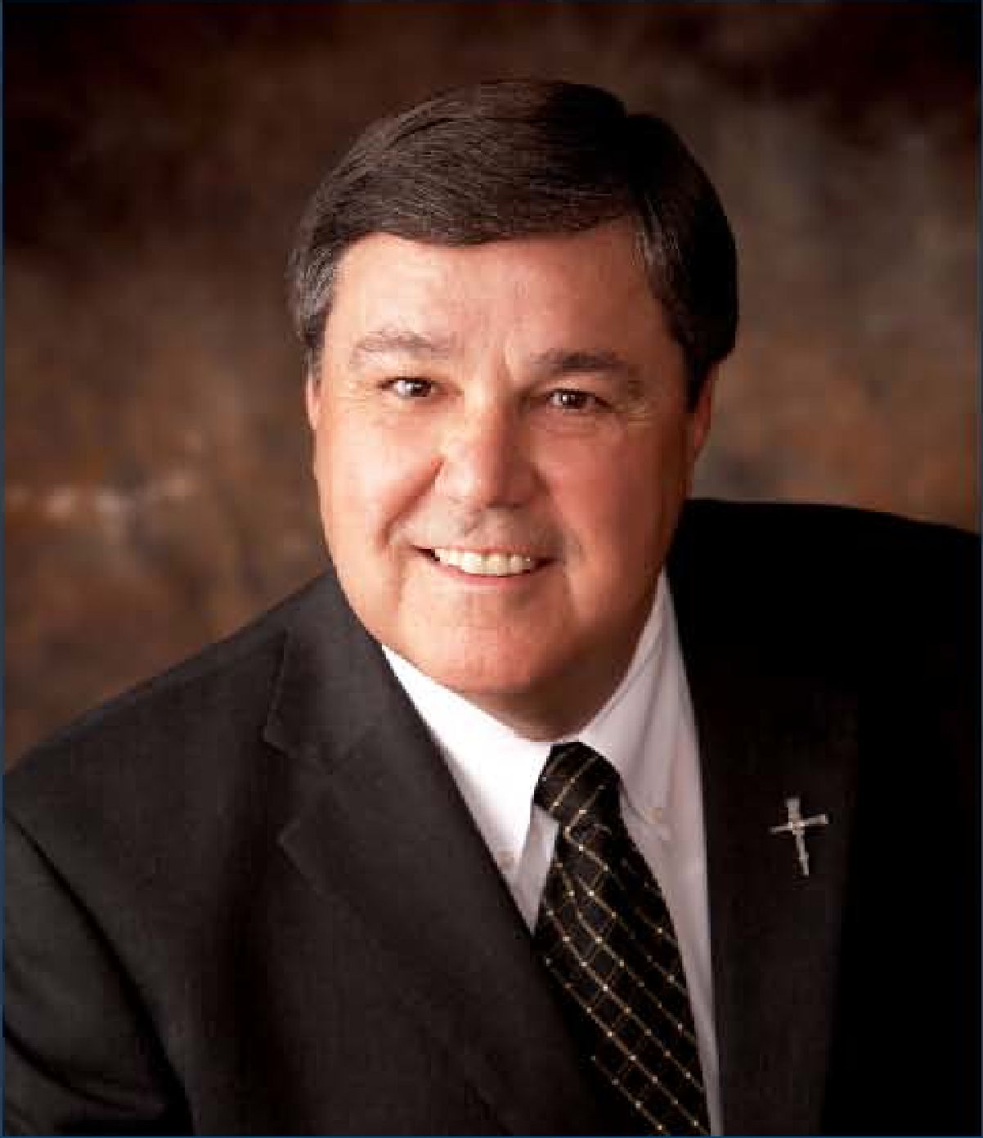
Oldest Office in the County
Sheriff
Bill Rasco

Slide 21
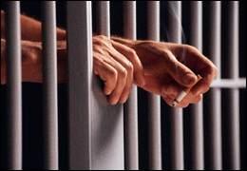
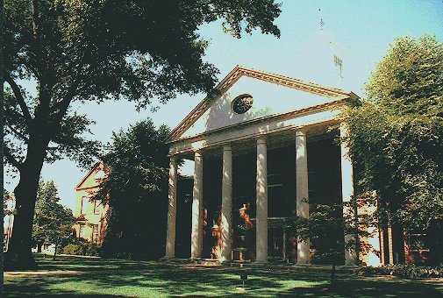
The Sheriff is in charge of:
County Jail
Prisoners
The Courthouse

Slide 22
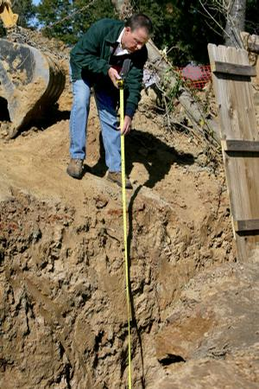
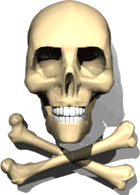
Coroner
Josh Pounders
DeSoto County
Conducts investigations
Violent deaths
Sudden deaths
Suspicious deaths

Slide 23
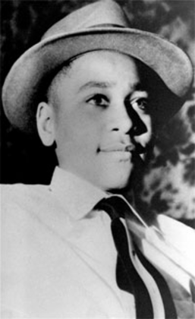
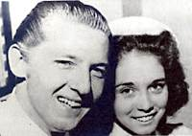
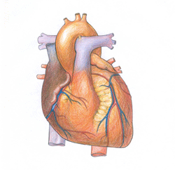
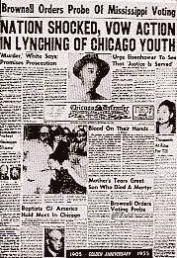
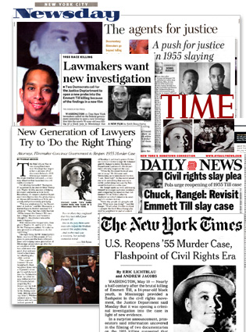
What is a Suspicious
Deaths?
What is a Sudden
Deaths?
What is a Violent
Death?
After Lewis himself nearly died from a stomach ailment in 1981, his fourth wife, Jaren Gunn, then estranged from him and seeking divorce, was found drowned in a swimming pool in June, 1982.
Who is the most famous person in DeSoto County?
Jerry Lee Lewis
In June, 1983, Lewis married Shawn Stephens; approximately two and a half months later she was found dead in their home of a drug overdose.
On December 12, 1957 he got married, Jerry Lee married Myra Gale Brown his 13 year old distant, but very obviously, kissin' cousin (first cousin once removed).

Slide 24
If a vacancy occurs in the sheriff position, who takes that place?
Coroner

Slide 25
What is the office of the Constable?
DeSoto County Constables 2012-2015
District One | Liz Medlin
District Two | Chris Plumlee
District Three | Brandon Hylander
District Four | Bobby Holloway
District Five | Lee Hodge
Elected as law enforcement officers for the justice court judge(s) and serves papers for this court.

Slide 26
Chancery Clerk
Misty Heffner is DeSoto County's Chancery Clerk.
The Chancery Clerk serves as the Clerk of the Board of Supervisors, the Clerk of the Chancery Court, and is responsible for processing all Land Records in DeSoto County.

Slide 27
Chancery Clerk
Keeps a complete record of the board of supervisor’s proceedings and orders.
Receives and records legal papers, such as deeds and warranty deeds related to land transactions.
Responsible for the papers and records of the chancery court.
Treasurer and auditor for the county.

Slide 28
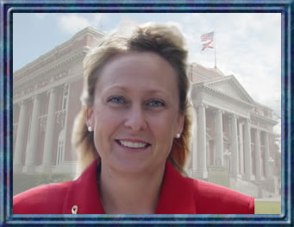
Circuit Clerk
Mitzie McGavic is the
Circuit Clerk in DeSoto County.
The Circuit Clerk serves as Clerk of the County and Circuit Courts.
Issues marriage licenses and keeps records of marriages.
Records medical and other professional licenses.
Registers citizens to vote and has other duties in handling elections.

Slide 29
Tax Collector and Tax Assessor
The offices of tax collector and tax assessor are combined in most counties.
Are the 2 offices combined in DeSoto County?
No

Slide 30
Tax Collector
The Tax Collector is responsible for the collection of taxes on Real Property, Personal Property, Mobile Homes, Automobiles, Motorcycles, Motor Homes, Trailers and Airplanes.

Slide 31
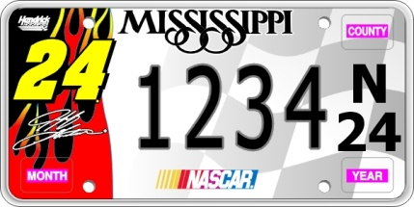
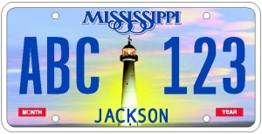
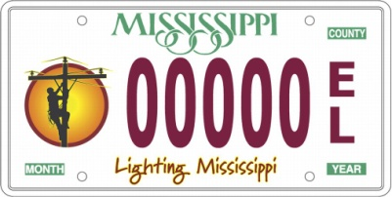
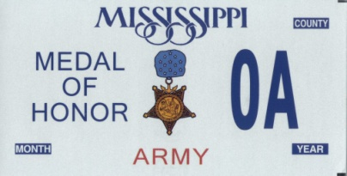
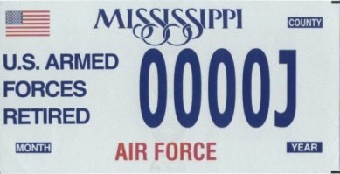
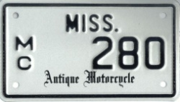
Tax Collector Office
The DeSoto County Tax Collector has three offices for your convenience: Hernando, Southaven and Olive Branch.
Where is the office in Olive Branch?
Olive Branch Tax Collector Office
6597 BJ Chain Dr
Next door to the new Senior Building

Slide 32
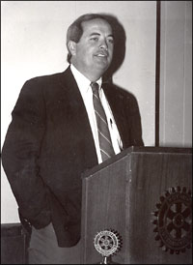
Tax Collector
Joey Treadway

Slide 33
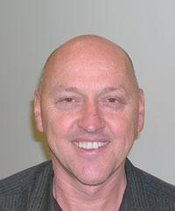
Parker Pickle
Tax Assessor

Slide 34
Tax Assessor Office
Determines the true value of each piece of property in the county.
Then establishes the taxable value of the property every year.
Determines the property’s assessed value, which is a percentage of the property’s true value.
Then compiles a list of the properties (called the tax roll) and presents it to the board of supervisors, which levies the taxes.

Slide 35
County Attorney
Craig Treadway
Prosecutes cases for the state in justice courts and county courts.
Assists the district attorney in cases before circuit courts.

Slide 36
District Attorney
John Champion
Represents more than one county, prosecutes criminals who commit felony crimes, gives legal advice to law enforcement agencies, handles bad check cases, carries out criminal investigations and provides assistance to victims of crime.

Slide 37
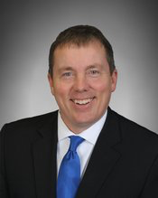
County Superintendent of Education
Cory Uselton, Superintendent

Slide 38
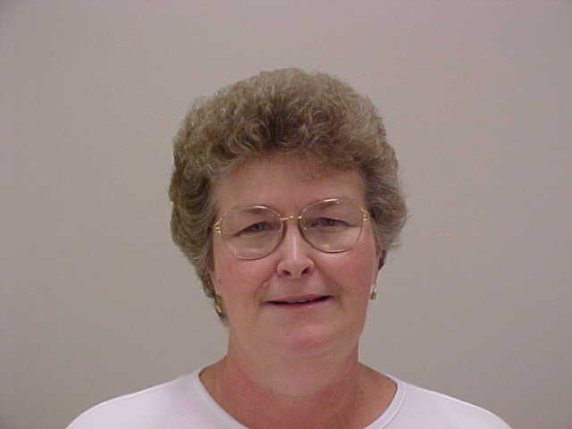
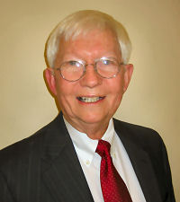
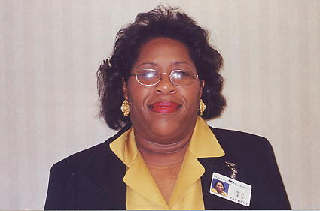
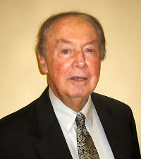
DeSoto County School Board
Ann Jolley, Board President
Milton Nichols
Patricia Hurt
Stephen Dodd
Theron Long
Five members elected from supervisory districts for staggered six-year terms.

Slide 39
DeSoto County School Board
Manages the financial affairs of the school system.
Determines employment policies.
Oversees the construction.
Maintenance of school facilities.
Operates a school transportation system.
Handles severe discipline problems.

Slide 40
Review
Counties
Board of Supervisors
Types of County Government
Law Enforcement
County Superintendent and the Board of Education

Slide 41
Homework
Read pages 374 to 379.

