Slide 1
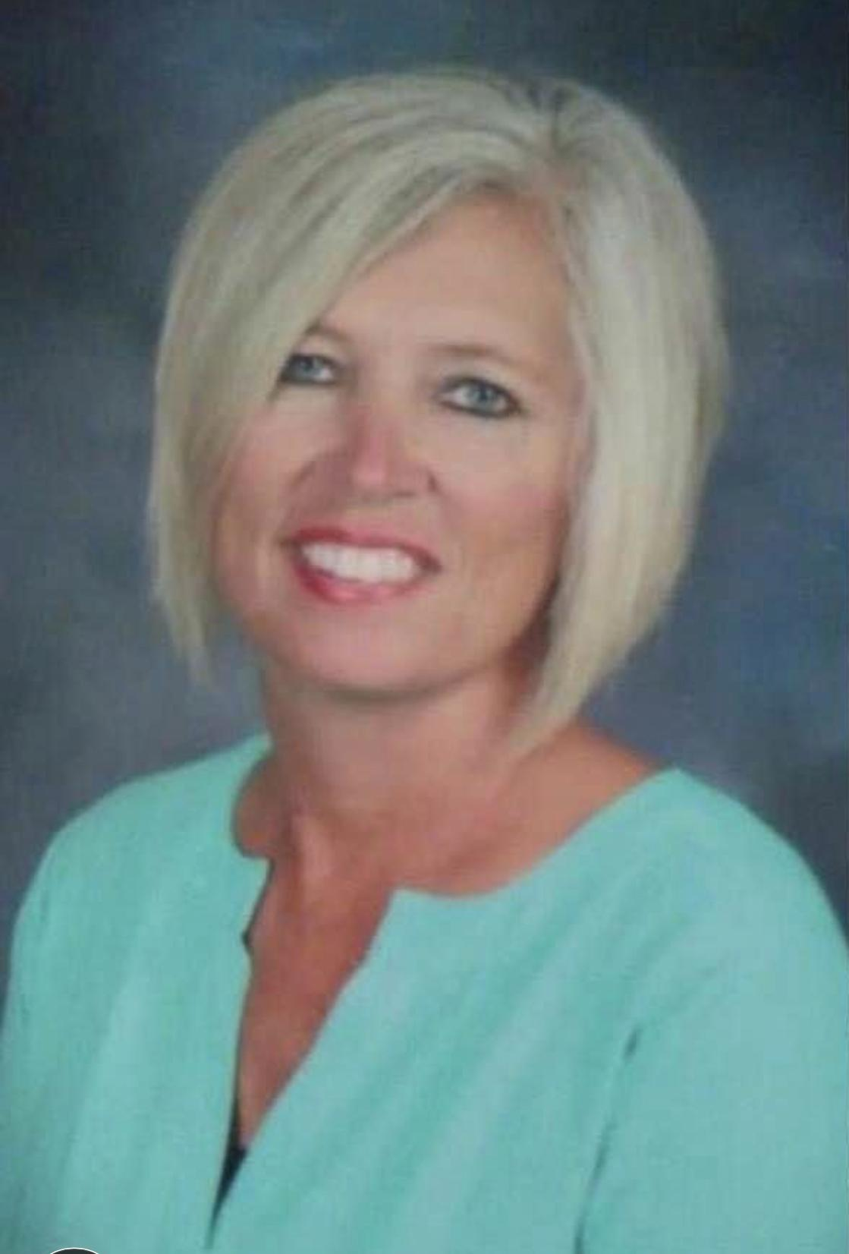

Slide 3
This is my 29th year in education.
I have taught in Georgia, Louisiana, and Alabama.
I received my undergraduate degree in Early Childhood from Auburn University.
I received my Master’s from LSU.
I have taught Kindergarten, 2nd, 3rd, 4th, and 5th. I have also been a technology teacher, elementary and high school guidance counselor.
.

Slide 4
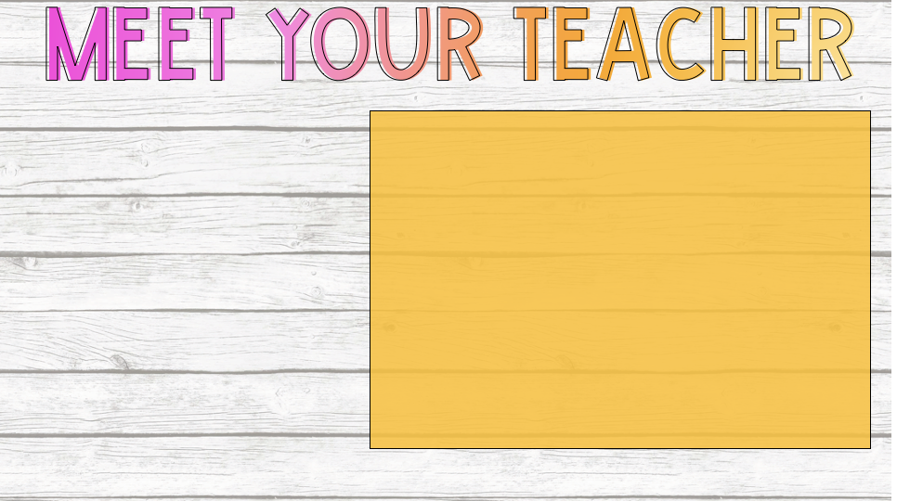
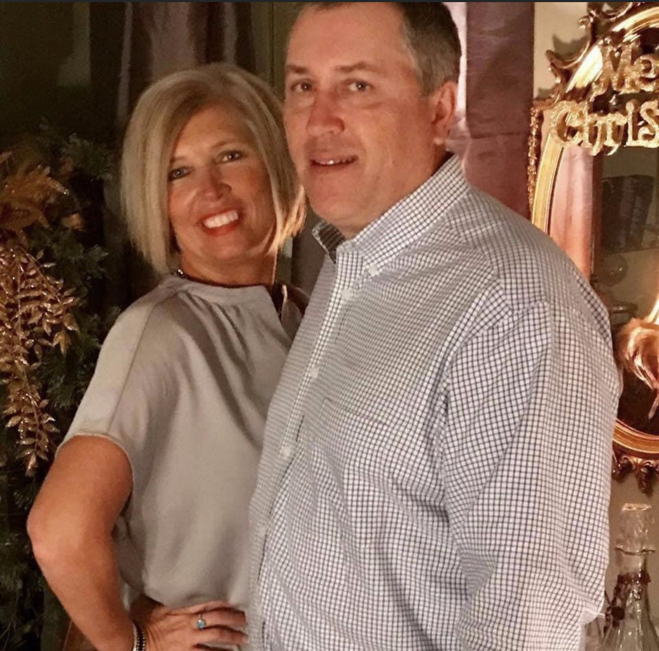
Welcome to SWHS for the 2020-2021 school year. I am excited about our year together!
If you have any questions or concerns about your child, please do not hesitate to contact me.

Slide 5
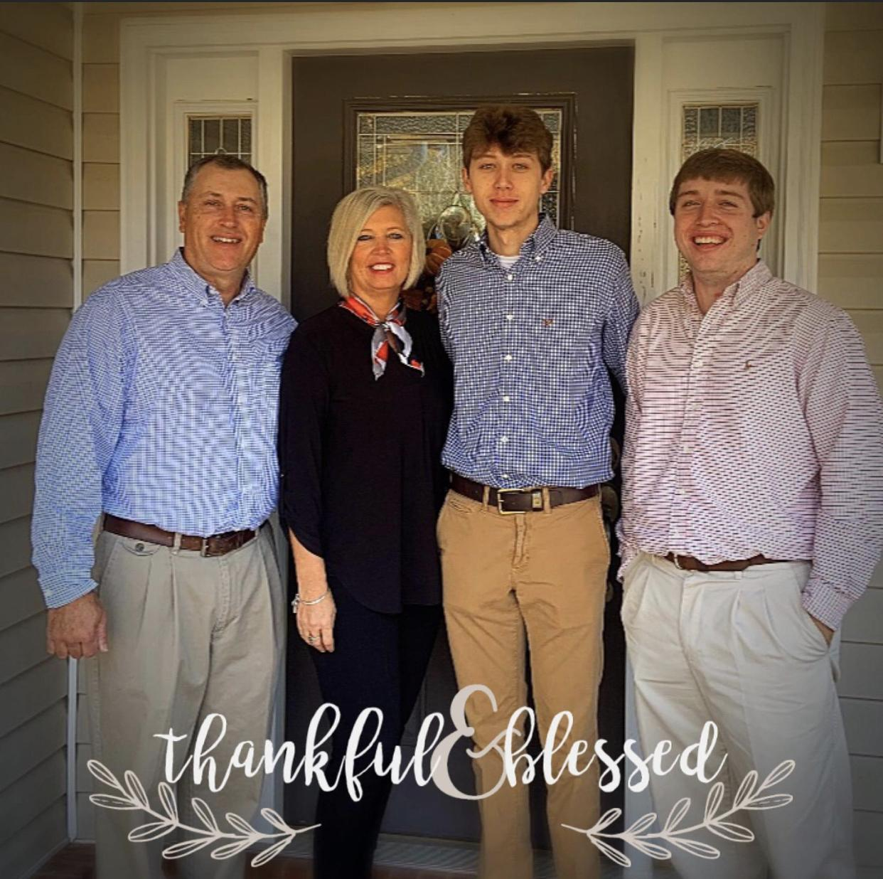
I love books!
I love fishing and boating!
I love Alabama football!

Slide 6
I love reading!!!

Slide 8
wjoiner@marengo.k12.al.us
@WendyJoiner711
334-994-4263

