Slide 1
The United States Flag –
Colors of Pride

Slide 2
This lesson explains the rules for properly displaying the U.S. Flag.

Slide 3
Lesson Objectives
Explain the rules for properly displaying the United States flag.
Display the proper procedure for folding the U.S. flag.
Identify the holidays when the flag should be especially displayed.
Notes:
Example:

Slide 4
Warm Up Questions
CPS Lesson Questions (1-2)
Notes:
Example:

Slide 5
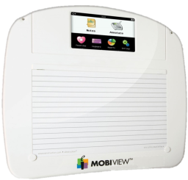
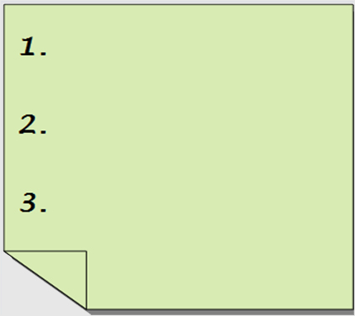

Opening Question
List 2-3 things that you already know about the proper procedure for folding or displaying the U.S. flag.
(Use CPS “Pick a Student” for this question.)

Slide 6
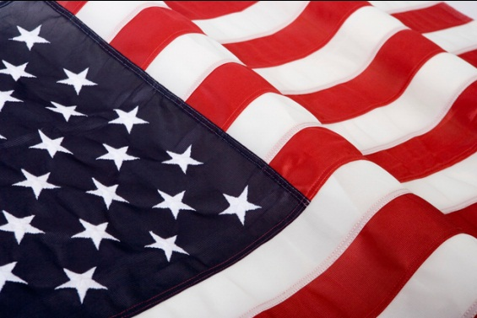
Introduction
Always show the flag the utmost respect, whether you are in uniform or in civilian attire.
Even after the flag becomes old and worn, you should not use it for banners or in any disrespectful way.
If you do not preserve it, you should destroy it as a whole, privately, respectfully, and traditionally by _______.
burning
Notes:
Example:

Slide 7
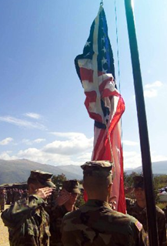
Rules for Displaying the U.S. Flag
When displaying the flag, you should always raise it ______ and lower it ____________.
briskly
ceremoniously
On Memorial Day, we display the flag at half-staff until noon and then raise it to the top of the staff.
When flying the flag at half-staff, first raise it to its peak, and then lower it to the half-staff position.
Notes:
Example:

Slide 8
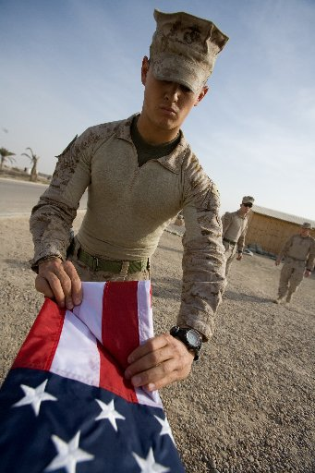
Folding the Flag Correctly
Notes:
Example:

Slide 9

Folding the Flag Correctly
Step 1: Bring the lower striped section of the flag up over the blue field.
Notes:
Example:

Slide 10

Folding the Flag Correctly
Step 2: Fold the “folded edge” over to meet the “open edge.”
Notes:
Example:

Slide 11

Folding the Flag Correctly
Step 3: Start a triangular fold by bringing the lower striped corner to the “open edge.”
Notes:
Example:

Slide 12

Folding the Flag Correctly
Step 4: Fold the outer point inward and parallel with the “open edge” to form a second triangle.
Notes:
Example:

Slide 13

Folding the Flag Correctly
Step 5: Continue to fold the flag in triangles until the entire length of the flag is folded with only the blue field and the margin showing.
Notes:
Example:

Slide 14

Folding the Flag Correctly
Step 6: Tuck the margin into the pocket formed by the folds at the blue field edge of the flag.
Notes:
Example:

Slide 15

Folding the Flag Correctly
Step 7: When you have completely folded the flag, only the blue field should be visible, and it should have the triangular shape of a cocked hat.
Notes:
Example:

Slide 16
Lesson Question
CPS Lesson Question (3-4)
Notes:
Example:

Slide 17
Display of the U.S. Flag Alone
When displaying the flag flat against a wall, either horizontally or vertically, the union should be upper most and to the observer’s left.
Notes:
Example:

Slide 18
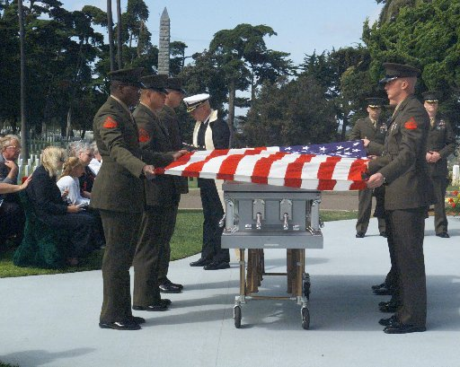
Display of the U.S. Flag Alone
When using the flag over a casket, place it so the union is at the head and over the left shoulder.
Notes:
Example:

Slide 19
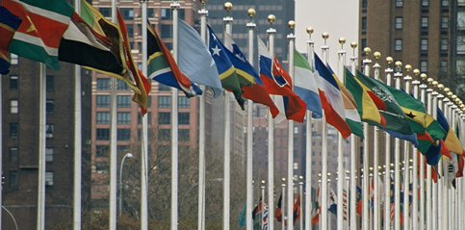
Group Display
When displaying the flags of two or more nations or states, fly them from separate flag staffs of the same height. The flags should be of similar size.
Notes:
Example:

Slide 20
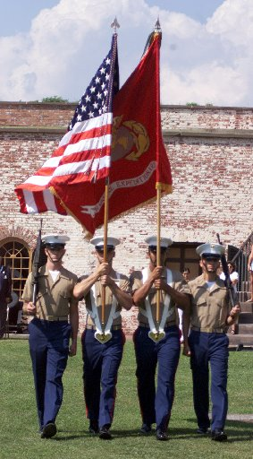
Group Display
When carried in a procession with other flags, carry the national flag on the right of the row of marching persons.
Notes:
Example:

Slide 21

Marine Corps Colors and Standards
The commandant issues to every major Marine unit a distinguishing flag that is carried beside the National Color.
These unit flags are called Marine Corps Colors (or Standards).
Notes:
Example:

Slide 22

Marine Corps Colors and Standards
The Guidon is a small rectangular scarlet flag measuring 22 by 28 inches with the Corps badge in silhouette in the center in yellow.
Guidons are carried on all occasions of ceremony when a company or equivalent unit is represented by two or more platoons.
Notes:
Example:

Slide 23

Marine Corps Colors and Standards
The Commandant of the Marine Corps has the only personal flag among the chiefs of the five armed forces that is not divided diagonally into two colors.
Notes:
Example:

Slide 24
Lesson Question
CPS Lesson Question (5-6)
Notes:
Example:

Slide 25
Closing Question
What did you learn about folding and displaying the U.S. flag that you did not already know?
(Use CPS “Pick a Student” for this question.)

Slide 26
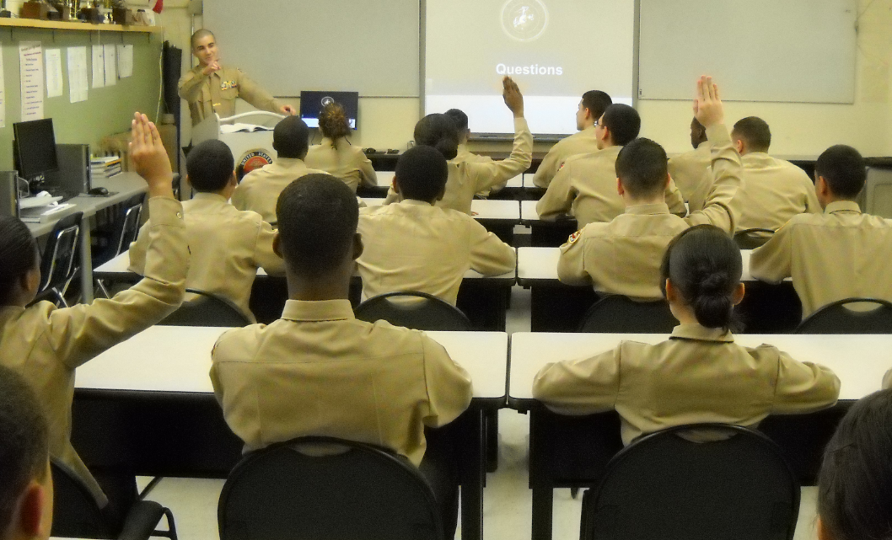
Questions

Slide 27
Copyright Information
Images in this lesson were taken from:
    Microsoft© Clip Art Gallery
    Marine Corps Combat Camera
    MCJROTC Student Text

