Slide 1
Google Meet: Spotlight
HSSD Tech Department

Slide 2
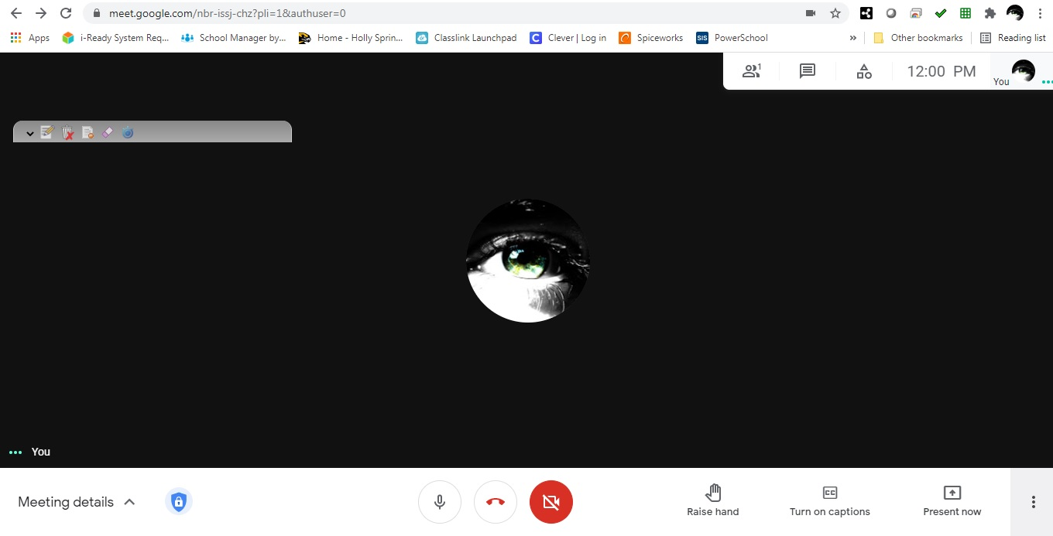

Slide 3
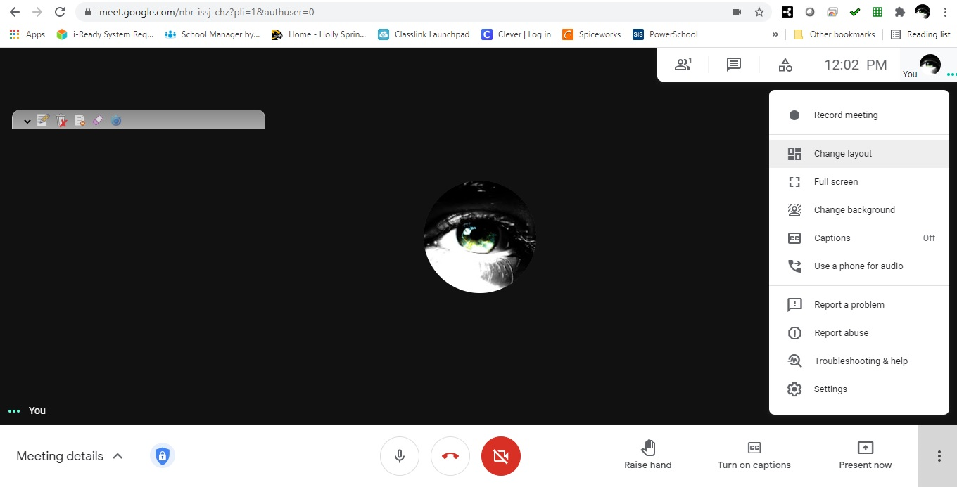

Slide 4
