Slide 1
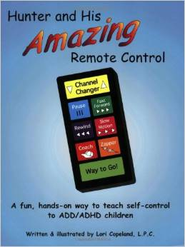
Hunter and His Amazing
Remote Control
Notes:
I bought this book thinking it would be good for small group lessons on self control for students with attention and focusing issues (ADHD). However, as I read it, I realized that the strategies were great for ALL students. The book includes a story about Hunter who has difficulty with self-control. In the story, Hunter uses an imaginary remote control, not to control his television, but to control his thoughts and behavior. Each week for 6 weeks, I am covering a lesson on a different button from Hunter’s remote control. The buttons each represent a particular strategy in self-control, self-esteem, and staying focused. By the end of this six week unit, my goal is for students to understand that no one else has a “remote control” to make them think, act, or feel a certain way. They are the only one who can make their remote control work!

Slide 2
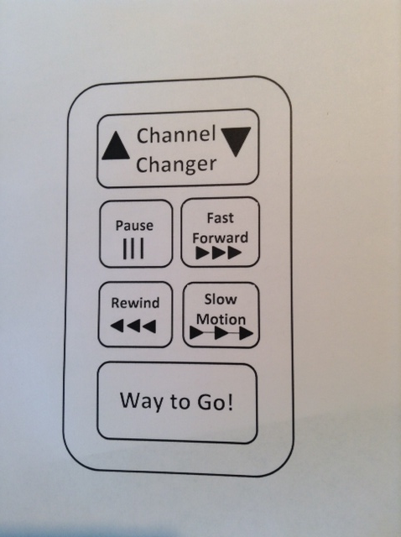
Hunter and His Amazing
Remote Control
Notes:
I am covering the following 6 buttons in class. I would like to go over each of the buttons with you so you can get an idea of how we’re using this at school and how you can use it at home to reinforce.

Slide 3
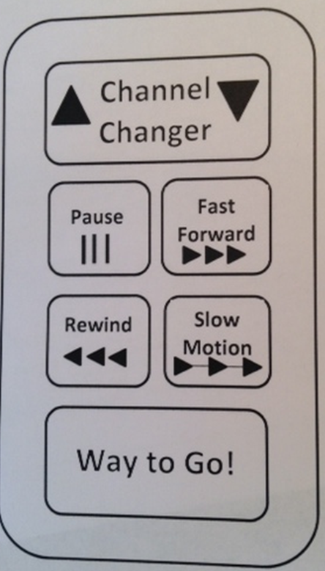
How can the channel changer on your remote control help you stay focused?
You need to be AWARE when you’ve “changed channels.”
As soon as you are aware that you changed
channels, press the channel changer button
to get back to the correct channel.
Notes:
The Channel Changer button teaches children to filter out distractions by helping them recognize when they have “changed channels.” If the teacher is teaching about fractions in math class and his/her mind drifts off to the "What I'm Doing After School Channel" then he/she needs to press the Channel Changer button to get back on the Fractions Channel. (Terminology: “What Channel are you on?” or “Put your channel on me.”)

Slide 4

Learning about Continents

Slide 5

What should I do after school?

Slide 6
Learning about Continents

Slide 7
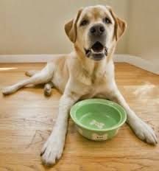
Please feed Ginger

Slide 8
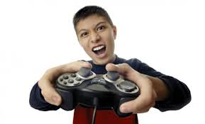
Minecraft is so Awesome!

Slide 9
Please feed Ginger

Slide 10
The PAUSE button helps us remember to stop action so we can slow down, think, relax, and make good choices.
Notes:
How helpful would it be if we could occasionally just pause – freeze time like they do in the movies for a few moments and consider the consequences of the actions we are about to take? Would you snap at your mom or dad so sharply? Would you shout at your brother or sister when they’re winding you up? Would you think twice about bullying on the playground? Sometimes we all need some more thinking time so we can consider all the possibilities of what could happen before we make a choice.

Slide 11


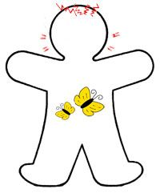
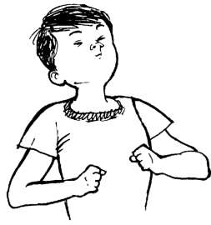
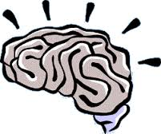

Notice what’s going on with your body.
Slow down your breathing.
Think about what could happen.
Act in a way that makes
you feel proud of yourself.
Notes:
How does the Pause button work? First, stop and notice what’s going on with your body. Do you have a lot of energy? Are you getting hot? Do you feel a sick feeling in your belly? Do you feel like you want to explode? WHEN THIS HAPPENS YOU KNOW YOU NEED TO PAUSE!!! This is not the time to react. Stop. Take a deep breath and slow down your breathing. (If you need to take a lot of deep breaths). And think before you do anything! The Pause button reminds kids to stop action in order to think, relax, slow down, wait, identify feelings, and create a plan. (Terminology: Say “pause,” when your child is doing something you would like him/her to stop doing.)

Slide 12
The FAST FORWARD button helps us look into the future to imagine what could happen before we act.
Notes:
The Fast Forward button reminds them to stop and think about what could happen before they act. Used with the pause button, the concept of looking into the future and imagining what might happen teaches kids the advantages of evaluating consequences before acting. (Terminology: Can be used to prevent unwanted behavior you may anticipate for a given task. For example, after having your child pause, say “Let’s fast forward and think about what may happen if you do not finish your chores before going to bed.”)

Slide 13
You laugh at the story and encourage Lewis by saying, “She is so weird.”
Sandy overhears you as she comes back to the lunch table. She is hurt by your words and will not talk to you.
Lewis stops gossiping about Sandy and realizes that you’re right. He learns that you have your friends’ back, which makes him glad to be your friend. Sandy never overhears the gossip.
You say to Lewis, “Sandy’s our friend. Let’s not spread gossip about her.”

Slide 14
The REWIND button helps us learn from our mistakes. Everyone makes mistakes!
Notes:
The Rewind button reminds kids that we all make mistakes but we can learn from them so we do better next time. The focus is on problem solving-how can you make it right? (Terminology: “Would you like to rewind and try a do-over?” or “Rewind and say it kindly.” This gives children an opportunity to rehearse appropriate behavior immediately after being corrected.)

Slide 15
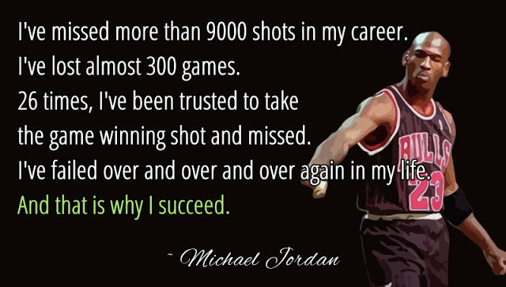
Notes:
What do you think he means by “And that is why I succeed”? I think he means that he learns from his mistakes. The rewind button is not about repeating the same mistakes, but by learning from mistakes.

Slide 16
What Can I Say to Myself?
Instead of…
I should have done better on that Math test.
I never should have showed off to impress my friends.
I should not have gotten so mad at my friend.
I should have more friends.
I should pay attention better in class.
Try thinking…
Next time I will be more prepared for that Math test.
Next time I will remember that I don’t have to show off to true friends.
Next time I’ll try to understand my friends point of view.
Next time I will introduce myself to someone nice.
Next time I’ll notice when I’ve changed channels. I’ll use my remote control to change back!
Notes:
We want to try to get rid of “the shoulds” right? So instead of saying “should,” I want you to think of a “next time” sentence that you can say to yourself a next time statement.

Slide 17
When our body starts to react to feeling stressed, we use our SLOW MOTION button to calm down and relax.
Notes:
The Slow Motion button involves more than just slowing down and being more careful. It reminds kids to use stress management skills to do their best. (Use anytime you want your child to calm down and relax. “Let’s use our slow motion button, so we don’t act out in a way we may regret later.”)
We talk about how everybody gets stressed from time to time. Different people feel stress in different ways. Some ways of dealing with stress — like screaming, hitting someone, or punching a wall — don't solve much. But other ways, like talking to someone you trust, can start you on the road to solving your problem or at least feeling better

Slide 18

CHILL Cube
Play w/ my kids
 | Listen to music
Go for a run
Yoga
In the three squares across the top and the center squares going down write your top six strategies to slowing down when you are stressed. Then cut along the dotted lines and fold along the solid lines. Fold in the shape of a cube and tape together. When you begin to feel stressed, roll your “ice” cube for an idea to help you “Chill!”
Call my mom
Walk in nature

Slide 19
The WAY TO GO button reminds us to use positive self-talk and to give ourselves credit for effort, improvement, and achievement of goals.
Notes:
The Way to Go button reminds kids to use positive self-talk. The goal is for children to identify and focus on their strengths, and credit themselves for effort, positive attitude, improvement, and achievement of goals. (Terminology: Use with any positive reinforcement, “Way to go improving your math score. That took a lot of effort. Are you proud of yourself?”)

Slide 20
