Slide 1
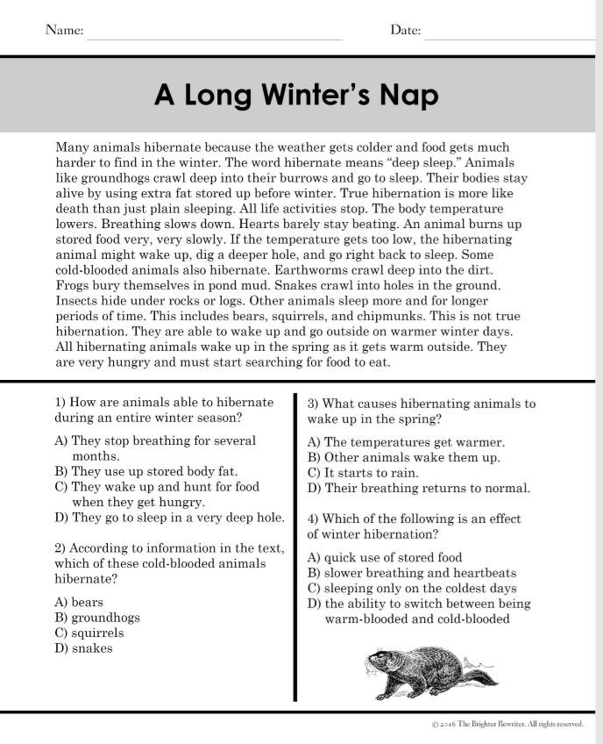
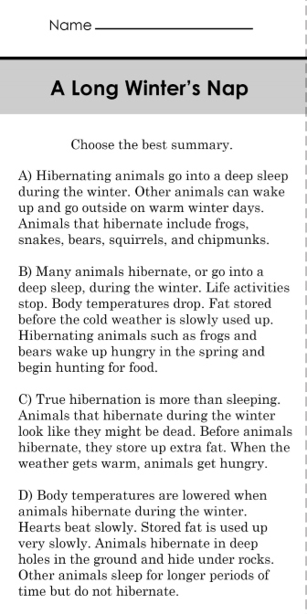
Monday, February 3, 2020
Superkids | Classworks – Math | Mrs. Thompson - SIPPS
2 - Cohen | 1 - Erin 3 - Jaiden 4 - Amiyah 5 - Landon 6 - Macon 7 - Carleen 8 - Caydance 9 - Jearon | Paisleigh Jaylie Kaylee
7:55 – 8:30

Slide 2
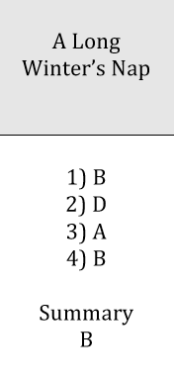

Slide 3
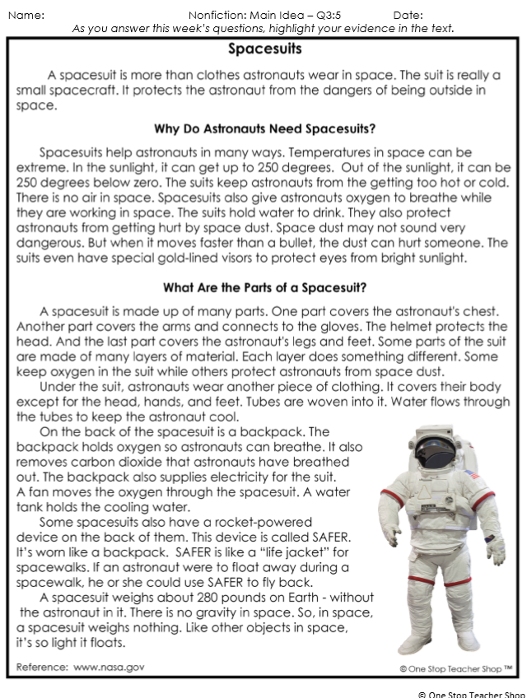
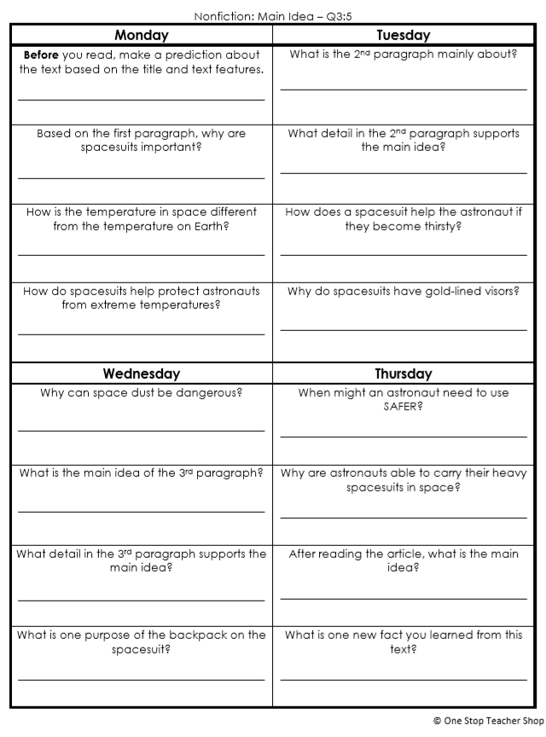
Reading Homework

Slide 4
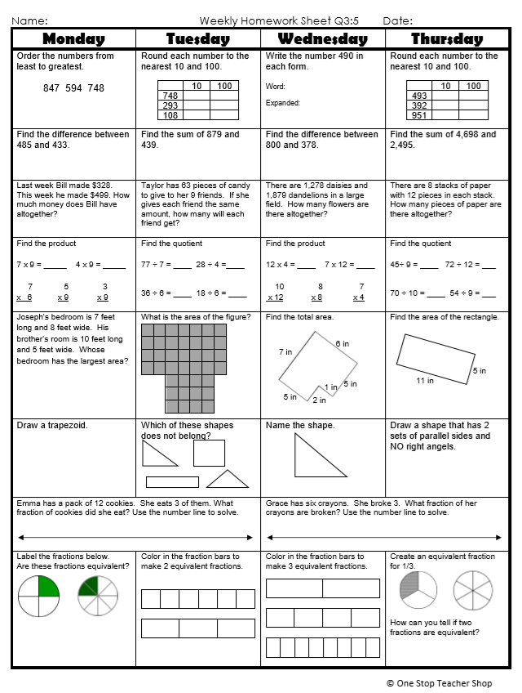
Math Homework

Slide 5

CHOMP TIME
F.A.S.T. Groups
Focused Academic Support Time

Slide 6
F.A.S.T. Designations
Superkids: 1 – Amiyah 2 - Kaylee 9 – Paisleigh | Epic: 7 – Erin 8 - Katelynn | Classworks: 3 - Addisen - Math 4 - Emma - Math 5 - Lazerrick - Math 6 – Jaylie – Math | Mrs. T LLI: Jearon Brena Carleen Kaylah | Peer Tutoring: Jaiden & Noah
  All others – Independent Novel
Landon – Phonics 1st with Mrs. Page
Macon – SIPPS with Mrs. Bess
8:40 – 9:10

Slide 7

Reading Time
9:10 – 9:45
RI.3.1 I can ask and answer questions to demonstrate understanding of a text, referring explicitly to the text as the basis for the answers.
RI.3.2 I can determine the main idea of a text; recount the key details and explain how they support the main idea.
RI.3.4 I can determine the meaning of general academic and domain-specific words and phrases in a text relevant to a grade 3 topic or subject area.
RI.3.5 I can use information gained from illustrations, other visual elements, and the words in a text to demonstrate understanding of the text.
SL.3.1c I can ask questions to check understanding of information presented, stay on topic, and link my comments to the remarks of others.

Slide 8
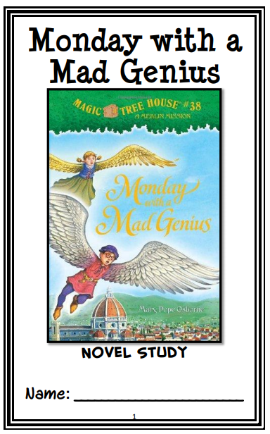
Novel Study
Continue reading the book through Chapter 8 and then complete pages 18 - 19

Slide 9
Novel Focus
Read aloud, workbook check & discussion

Slide 10
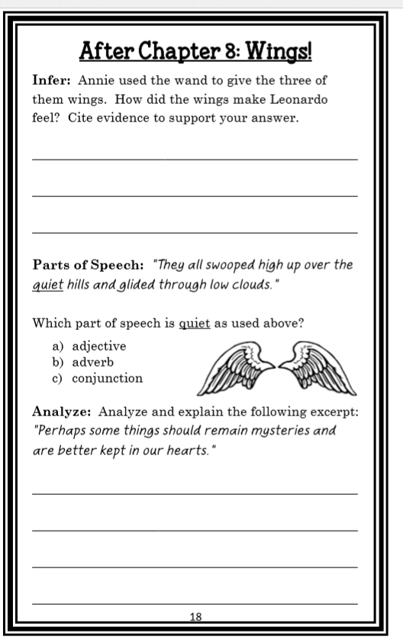
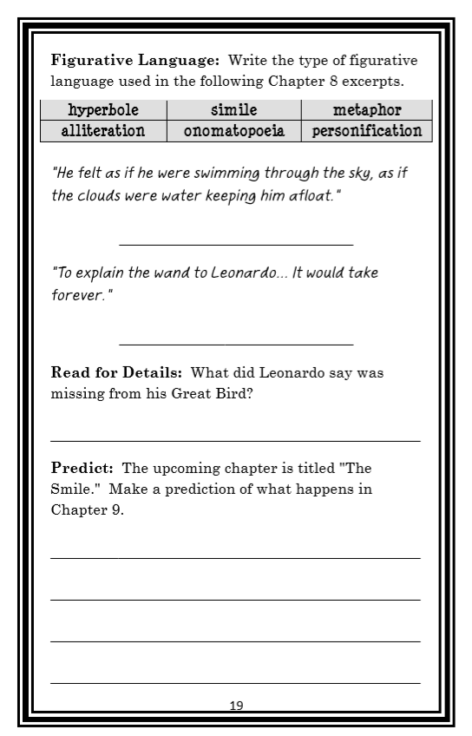

Slide 11
Math Review

Slide 12
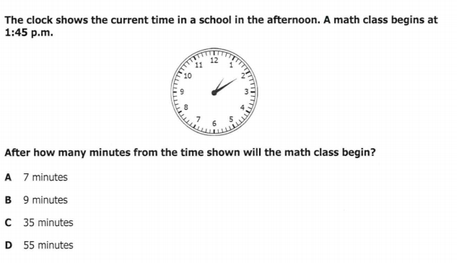

Slide 13
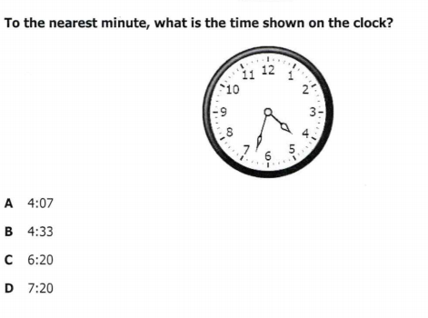

Slide 14
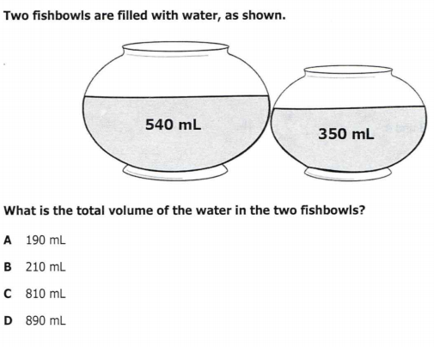

Slide 15
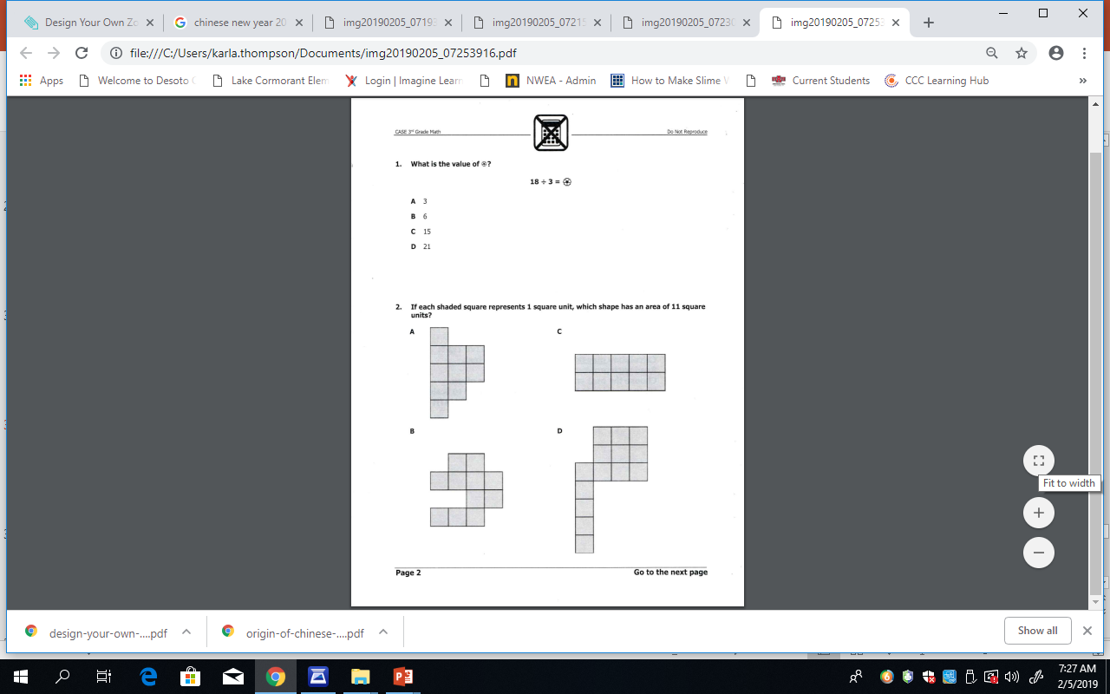

Slide 17
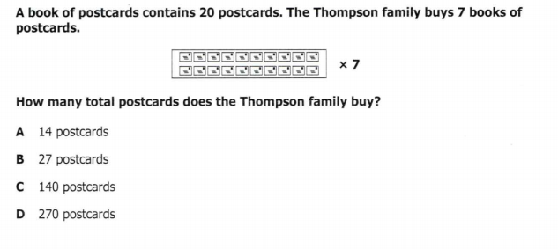

Slide 18

Restroom Break
9:45 – 9:55

Slide 19

Independent Daily Reading & Teacher Conferences
Superkids: 2 – Landon 3 - Macon | Epic: 1 – Aiden 6 – Khamani 7 – McKenzie 8 - Cayli | Classworks: 4 – Brena - Math 5 – Jearon – Reading 9 - Paisleigh – Math | Mrs. T LLI: Jaylie Caydance Amiyah Cohen Kaylee Lazerrick
Everyone else – Independent Novel! ☺
9:55 – 10:25

Slide 20
Out of Classroom!
Recess 10:45 – 11:05

Slide 21
Math Fluency & Focus Lesson!
11:05 – 11:15
Math 3.NF.1 I can understand that a fraction 1/b as the quantity formed by one part when a whole is partitioned into b equal parts. I can understand that a fraction a/b as the quantity formed by a parts of size 1/b.
Math 3.NF.2 I can represent a fraction 1/b on a number line diagram by defining the interval from 0 to 1 as the whole and partitioning it into b equal parts.
.

Slide 22
Write Equal Fractions
0 is how many fifths?
1 is how many fifths?
2 is how many fifths?
___
___
___
___
___
0
1
2
3
4
3 is how many fifths?
4 is how many fifths?

Slide 23
Application Problem
Lexi drinks 1 eighth gallon of milk every morning.
  How many days will it take Lexi to drink 1 gallon of milk? Use a number line and words to explain your answer.
  How many days will it take Lexi to drink 2 gallons? Extend your number line to show 2 gallons, and use words to explain your answer.

Slide 24
Concept Development
TE p290
Each rectangle represents 1 whole. Partition the first rectangle into thirds. Write the whole as a fraction below it.

Slide 25
Mrs. Roby’s Station
Unit Review Packet – one page (show all work)

Slide 26
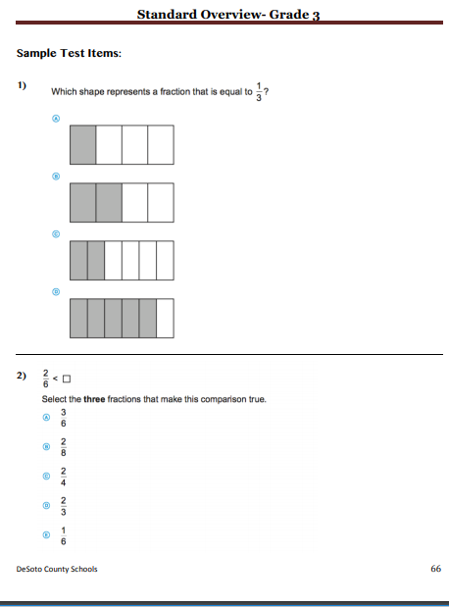
NF.3 Packet
Subject Rotation – separate tables

Slide 27
Station Time!
11:15 – 12:35
Math 3.NF.1 I can understand that a fraction 1/b as the quantity formed by one part when a whole is partitioned into b equal parts. I can understand that a fraction a/b as the quantity formed by a parts of size 1/b.
Math 3.NF.2 I can represent a fraction 1/b on a number line diagram by defining the interval from 0 to 1 as the whole and partitioning it into b equal parts.
.

Slide 28
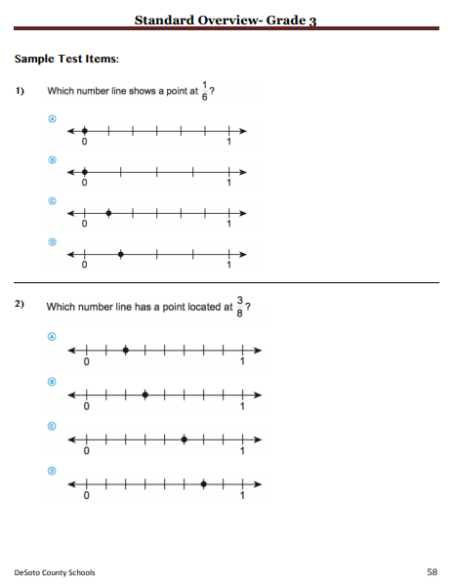
Math Rotation - separate tables

Slide 29
Rotation 1
11:15 – 11:30
Group 1 – Computers 1-5: Classworks Reading
Group 2 – Mrs. Roby – Review
Group 3 – Computers 6-TC: Classworks Math
Group 4 – Mrs. Thompson – Review
Group 5 – Rotating Subjects
  (Monday: Math, Tuesday: Science,
  Wednesday: Reading, Thursday: Writing,
  Friday: Social Studies)

Slide 30
Rotation 2
11:30 – 11:45
Group 5 – Computers 1-5: Classworks Reading
Group 1 – Mrs. Roby – Review
Group 2 – Computers 6-TC: Classworks Math
Group 3 – Mrs. Thompson – Review
Group 4 – Rotating Subjects
  (Monday: Math, Tuesday: Science,
  Wednesday: Reading, Thursday: Writing,
  Friday: Social Studies)

Slide 31
Rotation 3
11:45 – 12:00
Group 4 – Computers 1-5: Classworks Reading
Group 5 – Mrs. Roby – Review
Group 1 – Computers 6-TC: Classworks Math
Group 2 – Mrs. Thompson – Review
Group 3 – Rotating Subjects
  (Monday: Math, Tuesday: Science,
  Wednesday: Reading, Thursday: Writing,
  Friday: Social Studies)

Slide 32
Rotation 4
12:00 – 12:15
Group 3 – Computers 1-5: Classworks Reading
Group 4 – Mrs. Roby – Review
Group 5 – Computers 6-TC: Classworks Math
Group 1 – Mrs. Thompson – Review
Group 2 – Rotating Subjects
  (Monday: Math, Tuesday: Science,
  Wednesday: Reading, Thursday: Writing,
  Friday: Social Studies)

Slide 33
Rotation 5
12:15 – 12:30
Group 2 – Computers 1-5: Classworks Reading
Group 3 – Mrs. Roby – Review
Group 4 – Computers 6-TC: Classworks Math
Group 5 – Mrs. Thompson – Review
Group 1 – Rotating Subjects
  (Monday: Math, Tuesday: Science,
  Wednesday: Reading, Thursday: Writing,
  Friday: Social Studies)

Slide 34

Out of Classroom!
Lunch 12:35 – 1:05

Slide 35
Restroom Break
1:05 – 1:10

Slide 36

Out of Classroom!
Activity 1:10 – 1:55

Slide 37
Reading Time
11:05 – 11:25

Slide 38
Novel Study
Continue reading the book through Chapter 9 and then complete pages 20-22

Slide 39
Novel Focus
Read aloud, workbook check & discussion

Slide 40
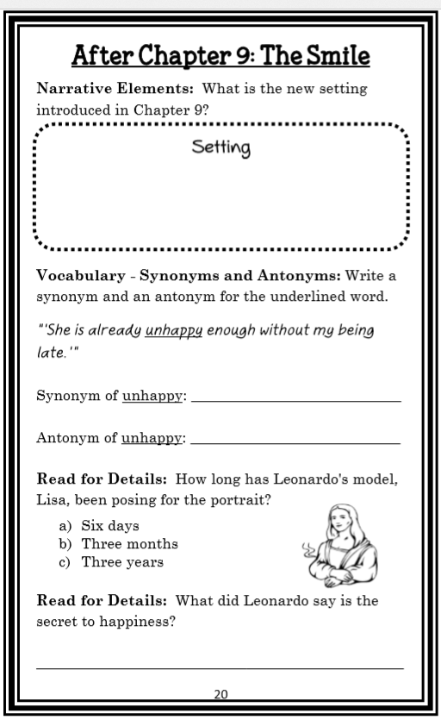
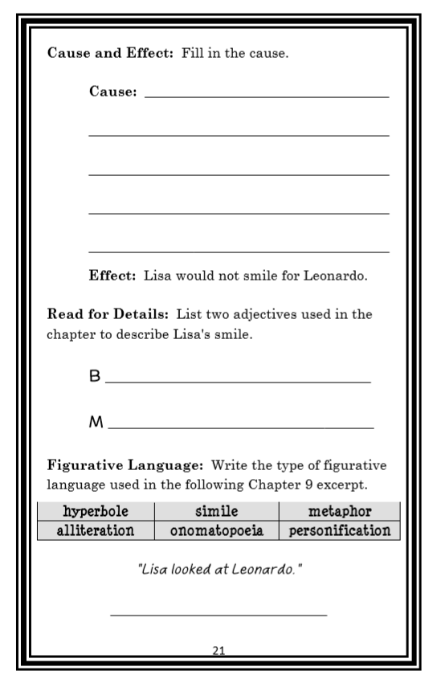

Slide 41
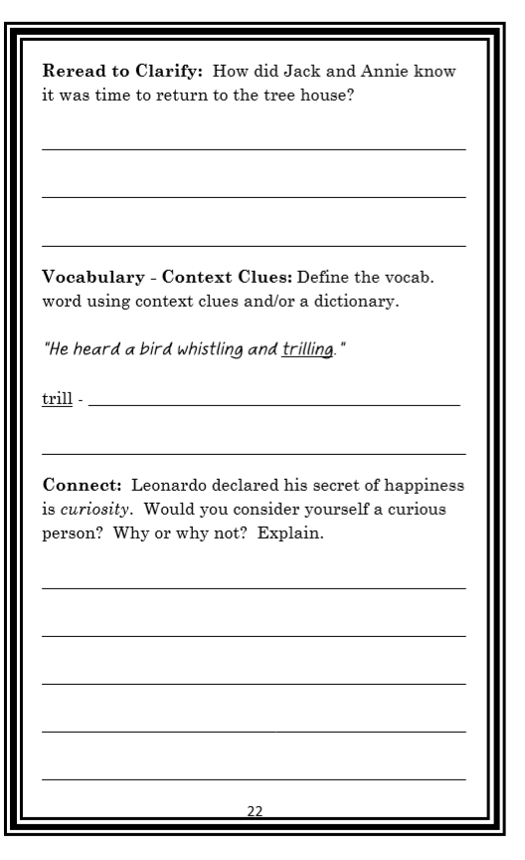

Slide 42
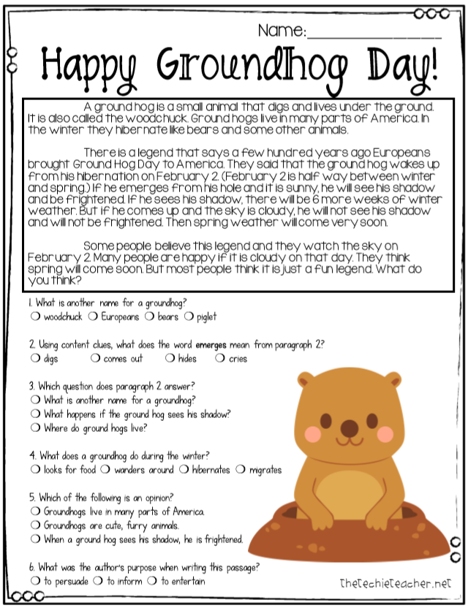

Slide 43
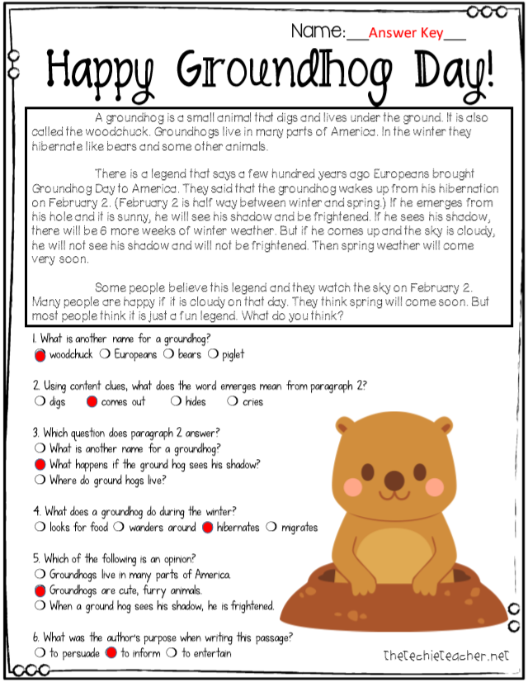

Slide 44
Restroom Break
3:10 – 3:15

Slide 45




3:20 – 3:25 Wrap Up!
Pair-Up back to back and share one thing you learned in class today with your partner
Pack-Up
Office will announce:
Car Riders – Leave around 3:25
Bus Riders – (listen to intercom for dismissal)
2:30 – 3:20
How much time has elapsed?

