Slide 1
Whole Numbers and Fractions
Lesson 10-7

Slide 2
Objective
I can use fraction strips and number lines to find fraction names for whole numbers.

Slide 3
Set the Purpose
You have learned that equivalent fractions name the same point on the number line. Today, you will learn that whole numbers have many equivalent fraction names.

Slide 4
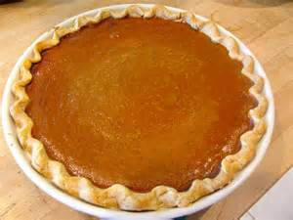
Pose the Problem
Jacy ate six pieces of pie during the week. Each piece was 1/6 of the pie. How much pie is left.
Draw a picture to solve the problem.

Slide 5
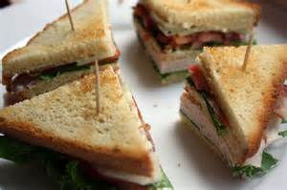
Four friends buy a large sandwich to share. They cut it into 4 equal pieces. How much does each person get? If they all eat each piece, how much of the sandwich has been eaten?

Slide 6
If Judy earns half (1/2) of a sticker every day in class. How long will it take for her to earn 3 whole stars?

Slide 7
Let’s count by halves…

Slide 8
Lets look at fourths on our fraction number lines in a different way

