Slide 1
WIDA Can Do Descriptors

Slide 3
POP QUIZ

Slide 5
Why?

Slide 6
What are “Can Dos”?
Detailed descriptions of what students at each level “can do” in terms of four language domains: reading, writing, speaking and listening
Use them to plan and modify lessons
Use them to monitor progress
Use them to understand the process of language development

Slide 7
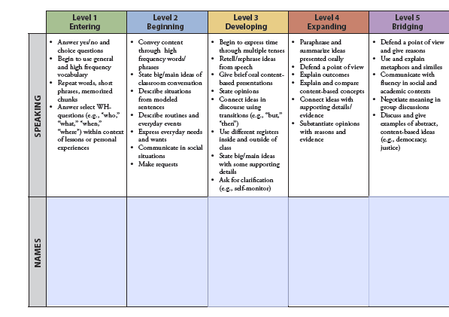
How are they organized?

Slide 8
How can I use them?
Determine your students’ proficiency levels for listening, speaking, reading and writing
Determine content and language objectives for your lesson
Use keywords from the can do descriptors to differentiate the lesson
The objectives are the same for everyone – how they get there is differentiated.

Slide 9
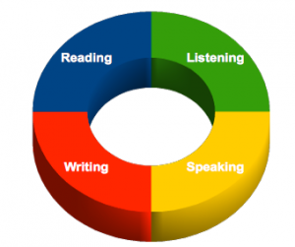
A note about language objectives

Slide 10
Example 1
Content Objective: Analyze the stages in the life cycle of a frog
Language Objective: Engage classmates effectively in a collaborative discussion about the frog life cycle

Slide 11
Example 2
Content Objective: Students will demonstrate essential knowledge of the Dust Bowl, including major causes and effects of the event.
Language Objective: Students will engage in a meaningful conversation in a way that builds and improves a shared understanding of the Dust Bowl.

Slide 12
Example 2 continued

Slide 13
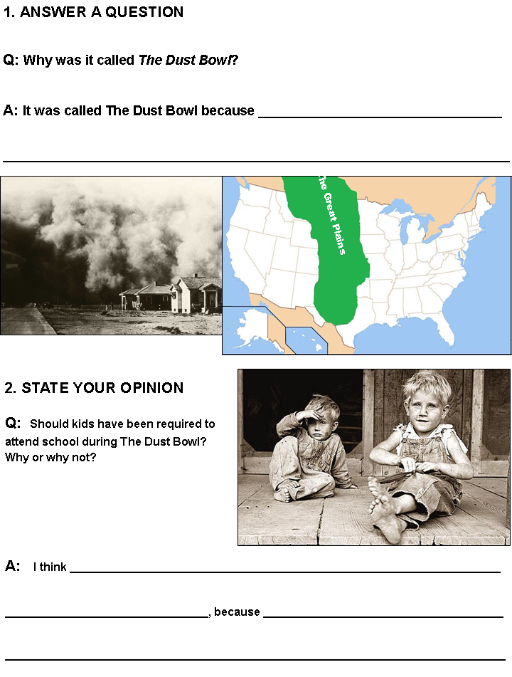
Level 3
Retell/rephrase ideas
State opinions

Slide 14
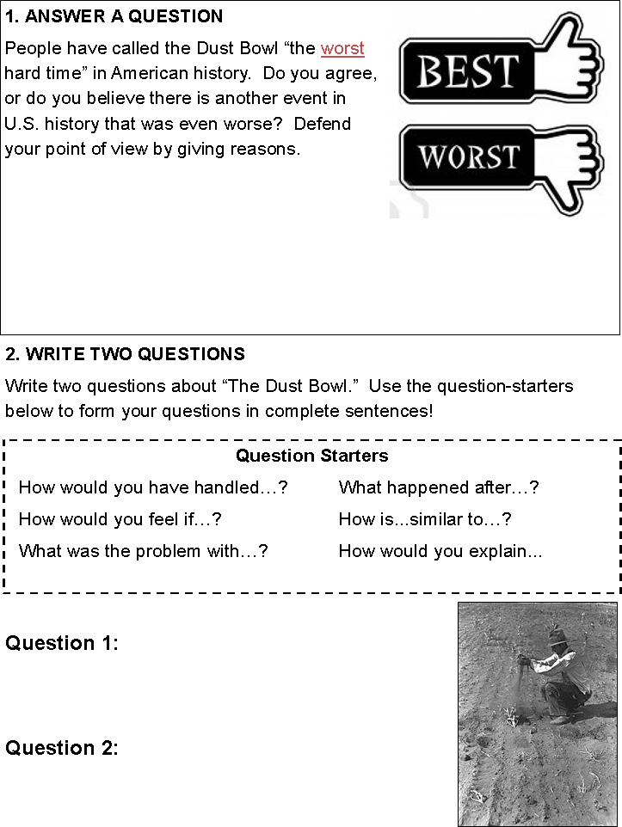
Level 5
Defend a point of view and give reasons
Communicate with fluency in academic contexts

Slide 15
Something for Everyone
Group Discussion sentence starters:
I agree with ________, and I would like to clarify by adding.
I agree with ________, and I would like to show how I did it a different way.
_________, I would like you to say it again louder.
_________, can you clarify that for me?
Instead of what ______ said, I was thinking the answer was…

Slide 16
On the Charts! Activity

Slide 17
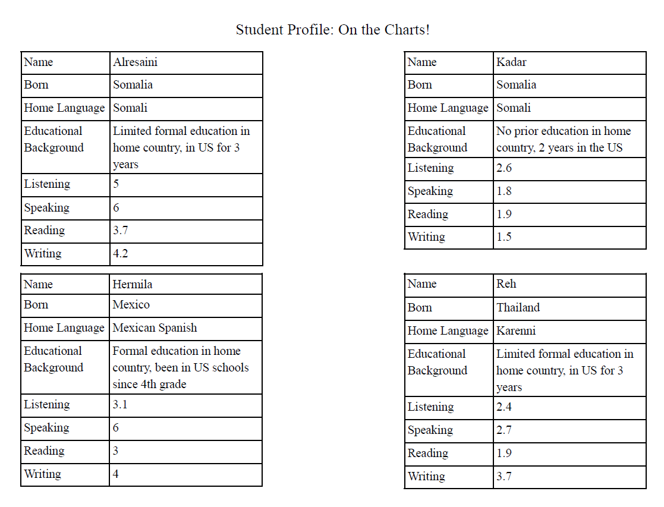

Slide 18
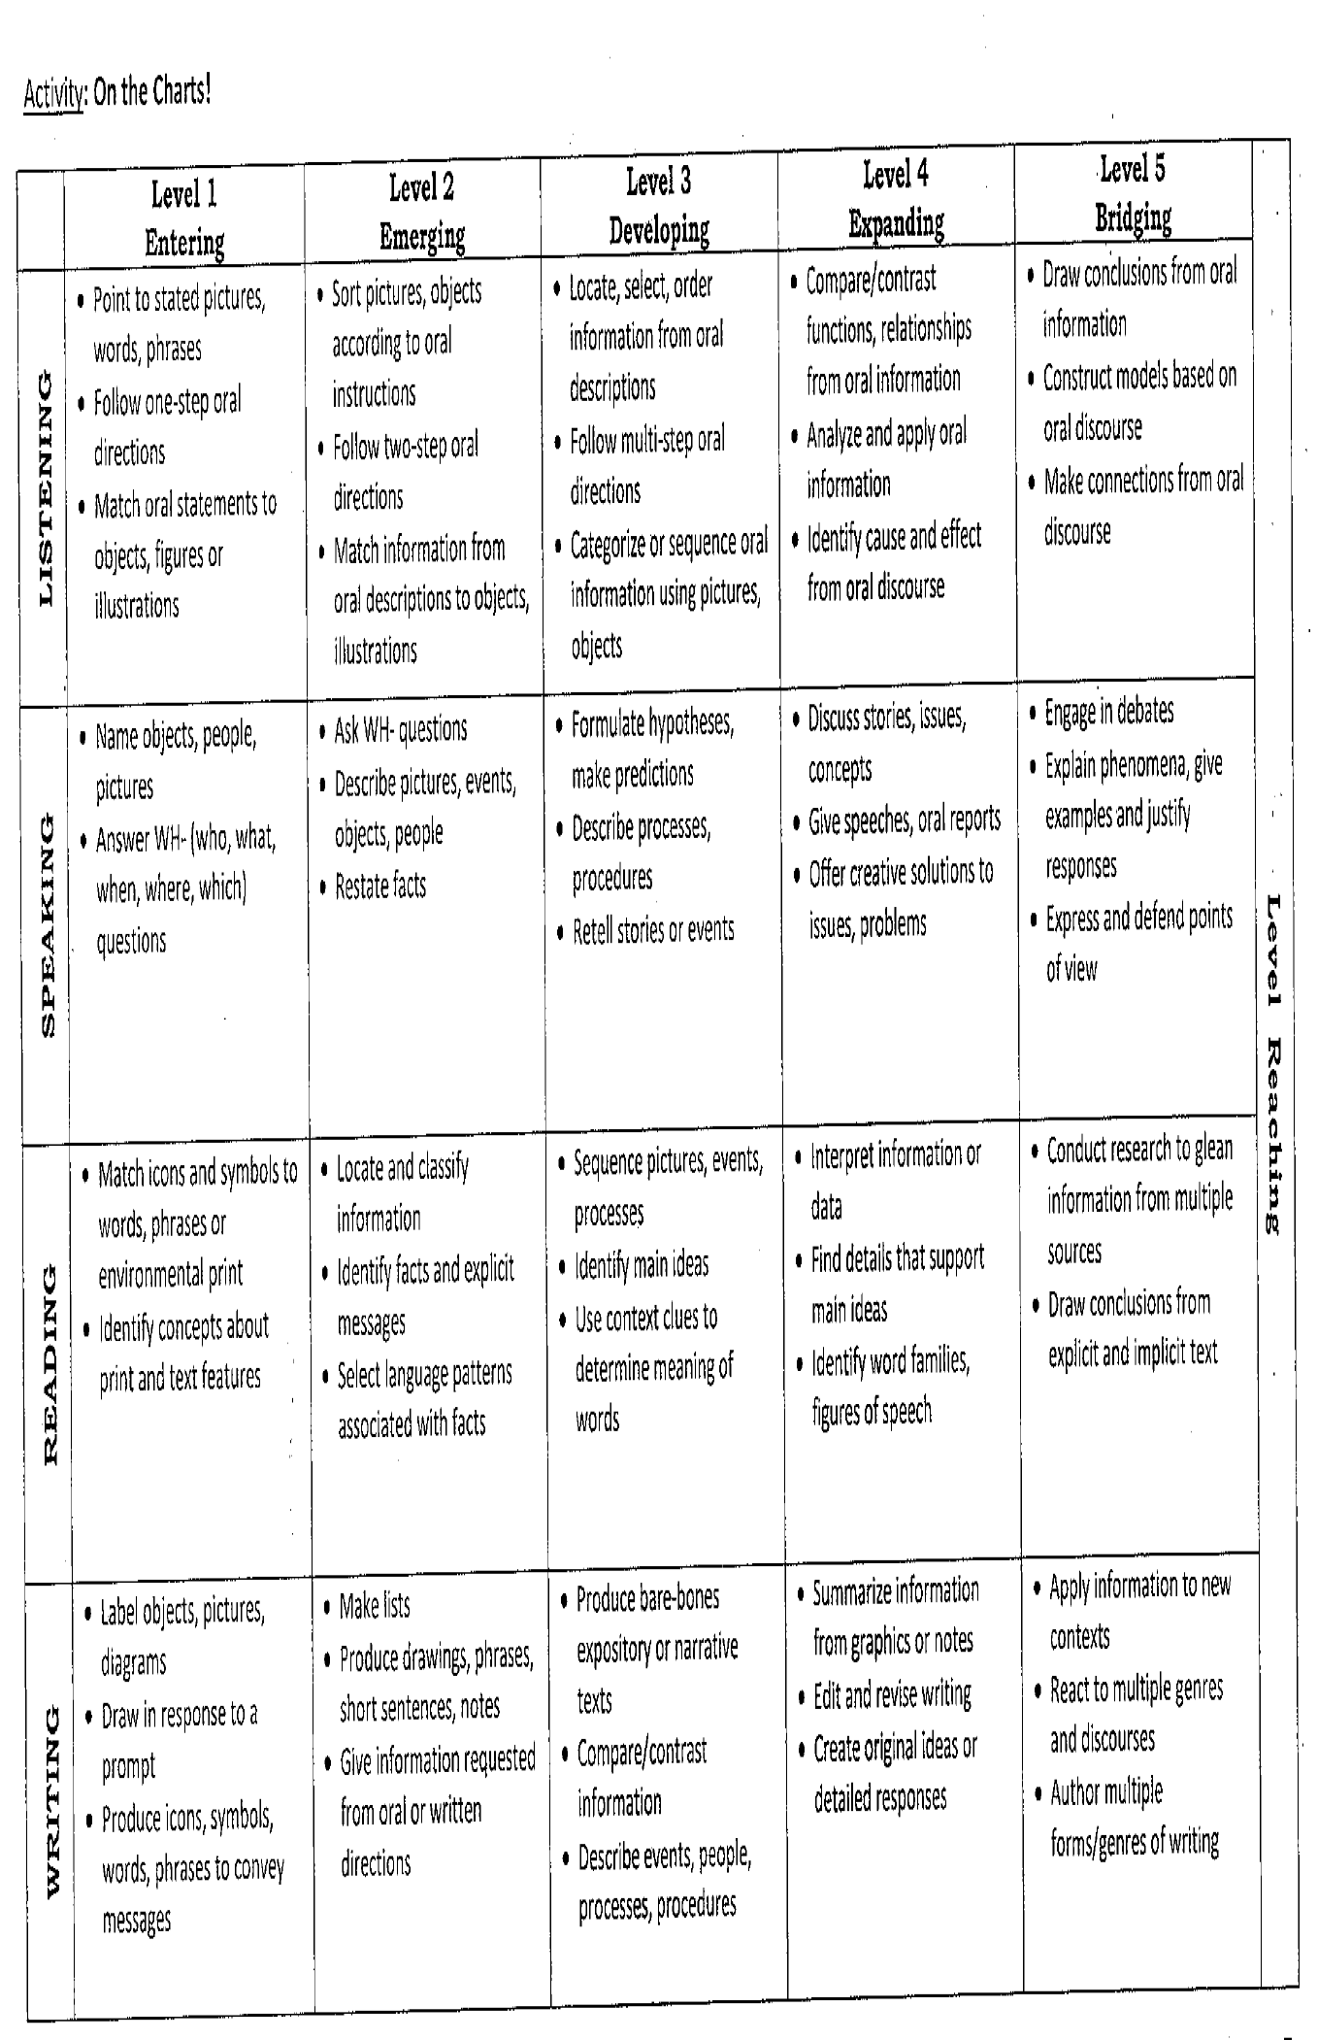

Slide 19
Reflections and Questions
On an index card—
Rate your comfort level with differentiation
1—not comfortable
2—somewhat comfortable
3—very comfortable
Suggestions for future ELD PD?

Slide 20
Next Steps…
August 26th Early release
Follow-up with Can do descriptors in grade level teams
ELD team will attend bi-weekly team meetings
This afternoon—work time to identify ELD students

