Slide 1
New Title IX Regulations
Important changes You need to know

Slide 2
Main Changes:
Definitions, including the conduct that constitutes sexual harassment
When and How District must respond to allegations of sexual harassment; including offer of supportive measures and grievance process
Which employees can bind the District based on knowledge of sexual harassment
Complications as to discipline procedures

Slide 3
What does Title IX Actually Say?
No person in the United States shall, on the basis of sex, be excluded from participation in, be denied the benefits of, or be subjected to discrimination under any education program or activity receiving Federal financial assistance

Slide 4
The United States Supreme Court on Title IX
Cannon v University of Chicago (1979), private right of action exists under Title IX
Franklin v. Gwinnett County Pub. Sch. (1992), recognizing an implied cause of action for monetary damages under Title IX against education institutions receiving federal funds
Gebser v. Lago Vista Indep. Sch. Dist. (1998), the plaintiff must establish that an official with authority to institute corrective measures (a) had actual notice of the teacher’s misconduct and (b) was deliberately indifferent in responding to it.
Davis v. Monroe County Board of Education (1999), the conduct of the perpetrator must be so severe, pervasive and objectively offensive that it denies the victim equal access to educational opportunities or benefits

Slide 5
Office of Civil Rights: Guidance and Dear Colleague Letters
2001 Guidance
10/2001 Dear Colleague Letter
4/2011 Dear Colleague Letter
4/2014 Dear Colleague Letter
4/2015 Dear Colleague Letter
5/2016 Dear Colleague Letter
9/2017 Dear Colleague Letter

Slide 6
10/2001 Dear Colleague Letter
4/2011 Dear Colleague Letter
4/2014 Dear Colleague Letter
4/2015 Dear Colleague Letter
5/2016 Dear Colleague Letter
9/2017 Dear Colleague Letter

Slide 7
May 6, 2020 New Title IX Regulations
Effective August 14, 2020

Slide 8
Important Terms
Actual Knowledge
Notice of sexual harassment or allegations of sexual harassment to a school’s Title IX Coordinator or any official of the school who has authority to institute corrective measures, or to any employee of an elementary and secondary school.

Slide 9
Sexual Harassment
Quid Pro Quo
An employee of the recipient conditioning the provision of aid, benefit, or service of the recipient on an individual’s participation in unwelcome sexual conduct
Hostile Environment
Unwelcome conduct determined by a reasonable person to be so severe,
pervasive, and objectionably offensive that it effectively denies a person equal
access to the recipient’s educational program or activity
Clery Act/Violence Against Women Act
sexual assault – example: seduction, incest, indecent exposure

Slide 10
Domestic Violence
Committed by:
Current/former spouse
Current/former intimate partner
Current/former cohabitation person
Person similarly situated as a spouse
Any other person

Slide 11
Dating Violence
Committed by a person:
Is or was in social relationship of romantic/intimate nature AND
Existence of relationship determined by various factors (length, type, frequency)

Slide 12
Stalking
Conduct directed at a person that would cause a reasonable person to:
Fear for own safety or others safety OR
Suffer substantial emotional distress

Slide 13
Complainant
Means an individual who is alleged to be the victim of conduct that could constitute sexual harassment
In K-12 also means parent or guardian of student
Any person can report sexual harassment and trigger recipient’s obligation to respond
Victim, bystander, witness, friend, or any other person

Slide 14
Respondent
Means an individual who has been reported to be the perpetrator of conduct that could constitute sexual harassment

Slide 15
The Obligation to Respond
A school is obligated to respond when:
The school has actual knowledge of sexual harassment;
The act occurred within the school’s own “education program or activity”;
Against a “person in the United States.”
A school must respond meaningfully to every report of sexual harassment.

Slide 16
Program or Activity
“all of the operators” of elementary and secondary school
Includes locations, events or circumstances over which the recipient exercised substantial control over both the respondent and context in which the harassment occurs
What about online?

Slide 17
Who Has to have Actual Knowledge?
Title IX Coordinator or
Any employee of the school

Slide 18
How are Districts Supposed to Respond?
Actual Knowledge
Formal Complaint

Slide 19
Regardless, District MUST respond:
Promptly
Offer supportive measures to complainant and respondent
In addition, Title IX Coordinator must contact complainant to:
discuss supportive measures
wishes
with or without formal complaint
explain process of filing formal complaint

Slide 20
What are Supportive Measures?
Non-disciplinary, non-punitive individual services designed to restore or preserve equal access to educational program or activity without unreasonably burdening the other party
Without fee or charge
i.e. counseling, deadline extensions, modification of class/work schedules, restricting contact between parties, revised seating or assignments, increased monitoring, emergency removals

Slide 21
Focus on the Process
Treat both complainant and respondent equal
Evaluate all relevant evidence objectively
Title IX Coordinator, Investigator, and decision-maker are to be free from conflict of interest and trained to be impartial
Presume innocence of respondent
Prompt time frames for process
Range of remedies and sanctions which may be imposed
Standard of proof –preponderance of evidence
Appeal procedures
Privileged (with waiver)

Slide 22
Focus On Due Process
A presumption of innocence throughout the grievance process;
Written notice of allegations against the accused;
An equal opportunity for both parties to present and review all the evidence;
Opportunity to submit written questions to challenge credibility of both parties

Slide 23
Formal Complaint
Upon receipt, recipient must provide written notice to the known parties that includes:
Notice of grievance process and informal resolution
Notice of allegations in sufficient detail and time to allow preparation of response prior to initial interview
Identities of known parties, alleged conduct, date and location of conduct, if known
Statement that respondent is not responsible for alleged conduct; determination made at conclusion of process
Notice that parties may inspect and review evidence
Notice of any provision in student code of conduct regarding making false statement

Slide 24
Investigation
Decision-maker must be someone other than Title IX Coordinator or Investigator
Burden of gathering evidence and determination of responsibility is on recipient
Certain evidence is protected unless waiver signed
Give all parties same opportunity to present witnesses and evidence
Can’t restrict parties’ obligation to discuss allegations or gather and present relevant evidence
Provide parties with written notice of day, time, location, participants and purpose of each investigation interview with sufficient time for party to prepare
Provide complainant and respondent with at least 10 days to review evidence prior to investigative written report, and opportunity to respond

Slide 25
Determination of Responsibility
Decision maker can’t be Title IX Coordinator or investigator
Must issue written determination that includes:
Allegations
Description of procedural steps taken, making notification to and interview of parties and witnesses
Finding of facts
Application of code of conduct
Statement of and rationale for result as to each allegation
Must Include
Determination of responsibility
Discipline sanctions, whether remedies to restore/preserve, equal access to educational program/activity will be provided by recipient to complainant

Slide 26
Appeals
Must offer to both parties for:
Determination of responsibility
Dismissal
As to the following bases:
Procedural irregularity that affects the outcome
New evidence not reasonably available at time of determination
Conflict of interest on part of Title IX Coordinator, Investigator or decision-maker

Slide 27
Putting All This Together…

Slide 28
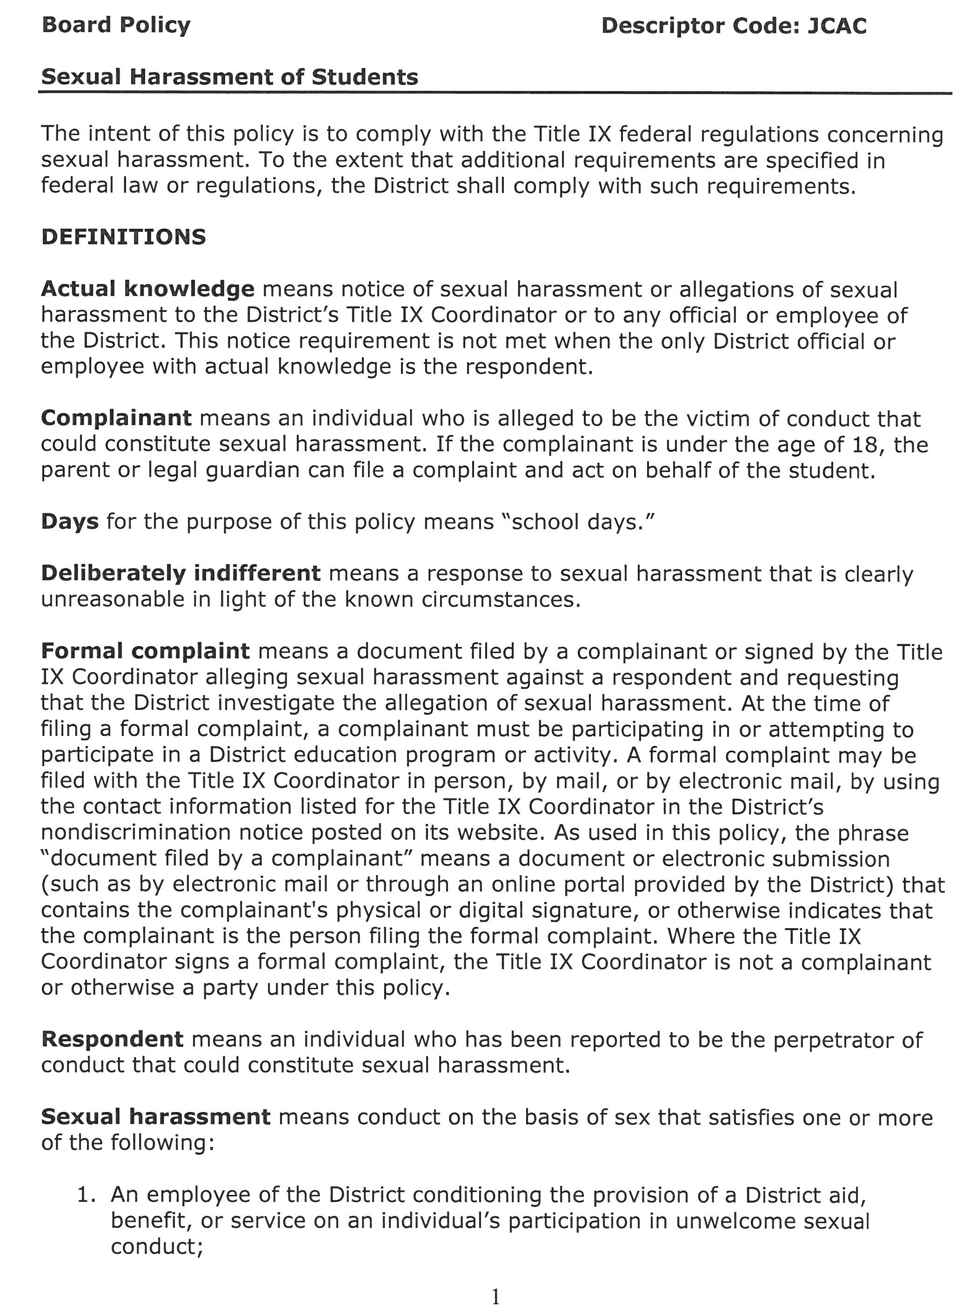

Slide 29
Actual knowledge means notice of sexual harassment or allegations of sexual harassment to the District’s Title IX Coordinator or to any official or employee of the District. This notice requirement is not met when the only District official or employee with actual knowledge is the respondent.
Complainant means an individual who is alleged to be the victim of conduct that could constitute sexual harassment. If the complainant is under the age of 18, the parent or legal guardian can file a complaint and act on behalf of the student.
Days for the purpose of this policy means “school days.”
Deliberately indifferent means a response to sexual harassment that is clearly unreasonable in light of the known circumstances.

Slide 30
Formal complaint means a document filed by a complainant or signed by the Title IX Coordinator alleging sexual harassment against a respondent and requesting that the District investigate the allegation of sexual harassment. At the time of filing a formal complaint, a complainant must be participating in or attempting to participate in a District education program or activity. A formal complaint may be filed with the Title IX Coordinator in person, by mail, or by electronic mail, by using the contact information listed for the Title IX Coordinator in the District’s nondiscrimination notice posted on its website. As used in this policy, the phrase “document filed by a complainant” means a document or electronic submission (such as by electronic mail or through an online portal provided by the District) that contains the complainant's physical or digital signature, or otherwise indicates that the complainant is the person filing the formal complaint. Where the Title IX Coordinator signs a formal complaint, the Title IX Coordinator is not a complainant or otherwise a party under this policy.
Respondent means an individual who has been reported to be the perpetrator of conduct that could constitute sexual harassment.

Slide 31
Sexual harassment means conduct on the basis of sex that satisfies one or more of the following:
An employee of the District conditioning the provision of a District aid, benefit, or service on an individual’s participation in unwelcome sexual conduct;
Unwelcome conduct determined by a reasonable person to be so severe, pervasive, and objectively offensive that it effectively denies a person equal access to the District’s education program or activity; or
“Sexual assault”- an offense classified as a forcible or nonforcible sex offense under the uniform crime reporting system of the Federal Bureau of Investigation; or
“Dating Violence”- sex-based violence committed by a person-
(A) who is or has been in a social relationship of a romantic or intimate nature with the victim; and
(B) where the existence of such a relationship shall be determined based on a consideration of the following factors:
(i) The length of the relationship.
(ii) The type of relationship.
(iii) The frequency of interaction between the persons involved in the relationship; or

Slide 32
“Domestic Violence”- sex-based violence which includes felony or misdemeanor crimes of violence committed by a current or former spouse or intimate partner of the victim, by a person with whom the victim shares a child in common, by a person who is cohabitating with or has cohabitated with the victim as a spouse or intimate partner, by a person similarly situated to a spouse of the victim under the domestic or family violence laws of the jurisdiction receiving grant monies, or by any other person against an adult or youth victim who is protected from that person's acts under the domestic or family violence laws of the jurisdiction; or
“Sex-based Stalking” - engaging in a course of conduct directed at a specific person that would cause a reasonable person to-
(A) fear for his or her safety or the safety of others; or
(B) suffer substantial emotional distress.

Slide 33
Supportive measures means non-disciplinary, non-punitive individualized services offered as appropriate, as reasonably available, and without fee or charge to the complainant or the respondent before or after the filing of a formal complaint or where no formal complaint has been filed. Such measures are designed to restore or preserve equal access to the recipient's education program or activity without unreasonably burdening the other party, including measures designed to protect the safety of all parties or the District's educational environment, or deter sexual harassment. The District shall presume that the respondent is not responsible for the alleged conduct until a determination regarding responsibility is made at the conclusion of the grievance process. The grievance process will be followed before the imposition of any disciplinary sanctions or other actions that are not supportive measures against a respondent. Supportive measures may include counseling, extensions of deadlines or other course-related adjustments, modifications of work or class schedules, campus escort services, mutual restrictions on contact between the parties, changes in work locations, leaves of absence, increased security and monitoring of certain areas of the campus, and other similar measures. The District shall maintain as confidential any supportive measures provided to the complainant or respondent, to the extent that maintaining such confidentiality would not impair the ability of the District to provide the supportive measures. The Title IX Coordinator is responsible for coordinating the effective implementation of supportive measures.

Slide 34
Title ix sexual harassment timeline
Formal Complaint Received
10 days to provide written notice to Complainant/Respondent of Grievance Process/Allegations
15 days to investigate and send evidence to both parties
10 days for evidence review and response ***
5 days to finalize Investigative Report and send to parties
10 days to review investigative report and submit written questions ***
10 days to make responsibility decision and send to parties
10 days after decision to appeal
10 days for determination of appeal
*** = number of days in regs

Slide 35
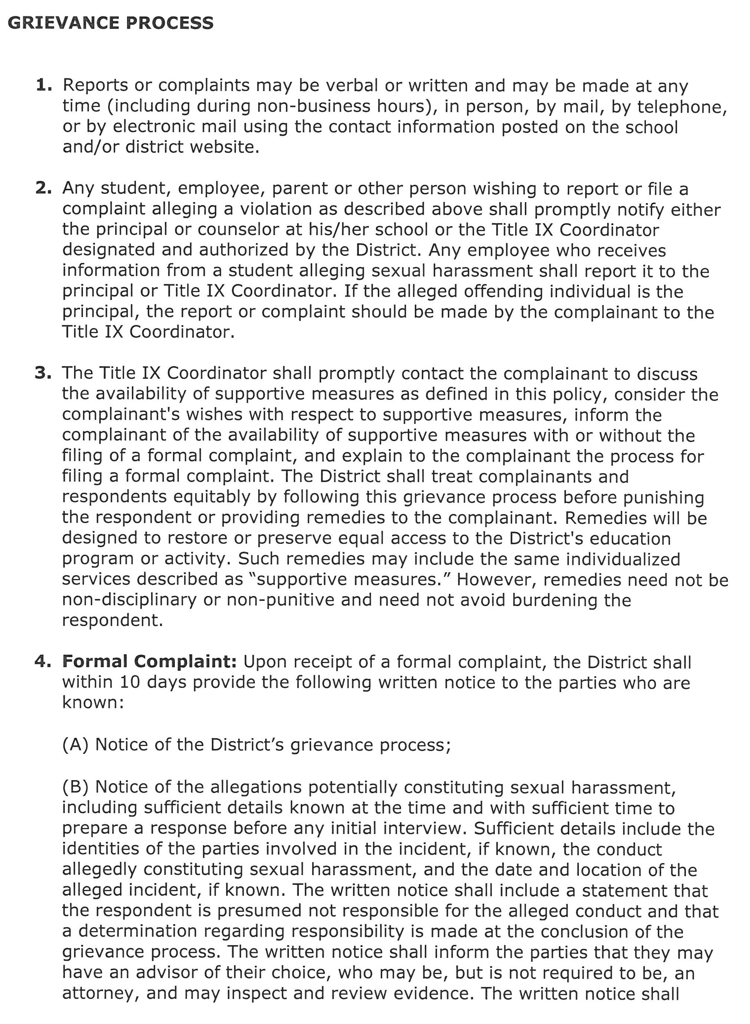

Slide 36
Formal Complaint: Upon receipt of a formal complaint, the District shall within 10 days provide the following written notice to the parties who are known:
(A) Notice of the District’s grievance process;
(B) Notice of the allegations potentially constituting sexual harassment, including sufficient details known at the time and with sufficient time to prepare a response before any initial interview. Sufficient details include the identities of the parties involved in the incident, if known, the conduct allegedly constituting sexual harassment, and the date and location of the alleged incident, if known. The written notice shall include a statement that the respondent is presumed not responsible for the alleged conduct and that a determination regarding responsibility is made at the conclusion of the grievance process. The written notice shall inform the parties that they may have an advisor of their choice, who may be, but is not required to be, an attorney, and may inspect and review evidence. The written notice shall inform the parties of any provision in the code of conduct that prohibits knowingly making false statements or knowingly submitting false information during the grievance process. The notice shall describe the range of or list the possible disciplinary sanctions and remedies that the District may implement following any determination of responsibility.
C) If, in the course of an investigation, the District decides to investigate allegations about the complainant or respondent that are not included in the notice provided pursuant to paragraph (4)(B), the District shall provide notice of the additional allegations to the parties whose identities are known.

Slide 37
5. Dismissal of a formal complaint— The District shall investigate the allegations in a formal complaint. If the conduct alleged in the formal complaint would not constitute sexual harassment as defined herein even if proved or did not occur in the District's education program or activity, or in the United States, then the District shall dismiss the formal complaint with regard to that conduct for purposes of sexual harassment under Title IX; such a dismissal does not preclude action under another provision of the District’s code of conduct.
(A) The District may dismiss the formal complaint or any allegations therein, if at any time during the investigation: A complainant notifies the Title IX Coordinator in writing that the complainant would like to withdraw the formal complaint or any allegations therein; the respondent is no longer enrolled or employed by the District; or specific circumstances prevent the District from gathering evidence sufficient to reach a determination as to the formal complaint or allegations therein.
(B) Upon a dismissal required or permitted pursuant to paragraph (5), the District shall promptly send written notice of and reason(s) for the dismissal simultaneously to the parties.

Slide 38
6. Consolidation of formal complaints. The District may consolidate formal complaints as to allegations of sexual harassment against more than one respondent, or by more than one complainant against one or more respondents, or by one party against the other party, where the allegations of sexual harassment arise out of the same facts or circumstances. Where a grievance process involves more than one complainant or more than one respondent, references to the singular “party,” “complainant,” or “respondent” include the plural, as applicable.
7. Investigation of a formal complaint. After providing written notice to the parties of the receipt of a formal complaint, the District shall have 15 days to investigate. When investigating a formal complaint and throughout the grievance process, the District shall—
Assume the burden of proof and the burden of gathering evidence sufficient to reach a determination regarding responsibility and not place such burdens on the parties provided that the District cannot access, consider, disclose, or otherwise use a party's records that are made or maintained by a physician, psychiatrist, psychologist, or other recognized professional or paraprofessional acting in the professional's or paraprofessional's capacity, or assisting in that capacity, and which are made and maintained in connection with the provision of treatment to the party, unless the District obtains that party's voluntary, written consent to do so;
(B) Provide an equal opportunity for the parties to present witnesses, including fact and expert witnesses, and other inculpatory and exculpatory evidence;

Slide 39
(C) Not restrict the ability of either party to discuss the allegations under investigation or to gather and present relevant evidence;
(D) Provide the parties with the same opportunities to have others present during any grievance proceeding, including the opportunity to be accompanied to any related meeting or proceeding by the advisor of their choice, who may be, but is not required to be, an attorney, and not limit the choice or presence of advisor for either the complainant or respondent in any meeting or grievance proceeding; however, the District may establish restrictions regarding the extent to which the advisor may participate in the proceedings, as long as the restrictions apply equally to both parties;
(E) Provide, to a party whose participation is invited or expected, written notice of the date, time, location, participants, and purpose of all investigative interviews or other meetings, with sufficient time for the party to prepare to participate;
(F) Provide both parties an equal opportunity to inspect and review any non-privileged evidence obtained as part of the investigation that is directly related to the allegations raised in a formal complaint, including the evidence upon which the District does not intend to rely in reaching a determination regarding responsibility and inculpatory or exculpatory evidence whether obtained from a party or other source, so that each party can meaningfully respond to the evidence prior to conclusion of the investigation. Prior to completion of the investigative report, the District shall send to each party and the party's advisor, if any, the evidence subject to inspection and review in an electronic format or a hard copy, and the parties shall have at least 10 days to submit a written response, which the investigator will consider prior to completion of the investigative report. The District shall make all such evidence subject to the parties' inspection and review available at any meeting to give each party equal opportunity to refer to such evidence during the meeting, including for purposes of cross-examination; and

Slide 40
(G) Create within 5 days an investigative report that fairly summarizes relevant evidence, and at least 10 days prior to the determination regarding responsibility, send to each party and the party's advisor, if any, the investigative report in an electronic format or a hard copy, for their review and written response.
(H) If at any point in the investigation of reported sexual harassment of a student, the investigator determines that the reported harassment should more properly be termed abuse, the reported incident or situation shall be referred pursuant to the established protocol for child abuse investigation. Reported sexual harassment determined not to be sexual harassment as defined under Title IX may be investigated in accordance with Policy JAA.

Slide 41
8. Questions. After the District has sent the investigative report to the parties and before reaching a determination regarding responsibility, the decision-maker(s) shall afford a 10 day period for each party to have the opportunity to submit written, relevant questions that a party wants asked of any party or witness, provide each party with the answers, and allow for additional, limited follow-up questions from each party. Questions and evidence about the complainant's sexual predisposition or prior sexual behavior are not relevant, unless such questions and evidence about the complainant's prior sexual behavior are offered to prove that someone other than the respondent committed the conduct alleged by the complainant, or if the questions and evidence concern specific incidents of the complainant's prior sexual behavior with respect to the respondent and are offered to prove consent. The District shall not require, allow, rely upon, or otherwise use questions or evidence that constitute, or seek disclosure of, information protected under a legally recognized privilege, unless the person holding such privilege has waived the privilege. The decision-maker(s) shall explain to the party proposing the questions any decision to exclude a question as not relevant.

Slide 42
Determination regarding responsibility. The decision-maker(s), who cannot be the same person(s) as the Title IX Coordinator or the investigator(s), shall, within 10 days of the conclusion of the question and answer period, issue a written determination regarding responsibility. To reach this determination, the District shall apply the preponderance of the evidence standard of evidence to formal complaints against students, to formal complaints against employees and to all complaints of sexual harassment.
The written determination shall include—
(A) Identification of the allegations potentially constituting sexual harassment as defined in this policy;
(B) A description of the procedural steps taken from the receipt of the formal complaint through the determination, including any notifications to the parties, interviews with parties and witnesses, site visits, and methods used to gather other evidence;
(C) Findings of fact supporting the determination;
(D) Conclusions regarding the application of the District’s code of conduct to the facts;

Slide 43
(E) A statement of, and rationale for, the result as to each allegation, including a determination regarding responsibility, any disciplinary sanctions the District imposes on the respondent, and whether remedies designed to restore or preserve equal access to the District's education program or activity will be provided by the District to the complainant; and
(F) The District's procedures and permissible bases for the complainant and respondent to appeal.
(G) The District shall provide the written determination to the parties simultaneously. The determination regarding responsibility becomes final either on the date that the District provides the parties with the written determination of the result of the appeal, if an appeal is filed, or if an appeal is not filed, the date on which an appeal would no longer be considered timely.
(H) The Title IX Coordinator is responsible for effective implementation of any remedies.

