Slide 1
Problem Solving: Solving a Simpler Problem
11-8

Slide 2
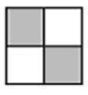
How many squares are in this design?

Slide 3
Solve a Simpler Problem
Taryn made this design. You can find large squares made up of small squares in her design. How many total squares can you find in her design?

Slide 4
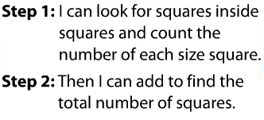

Slide 7
