Slide 1
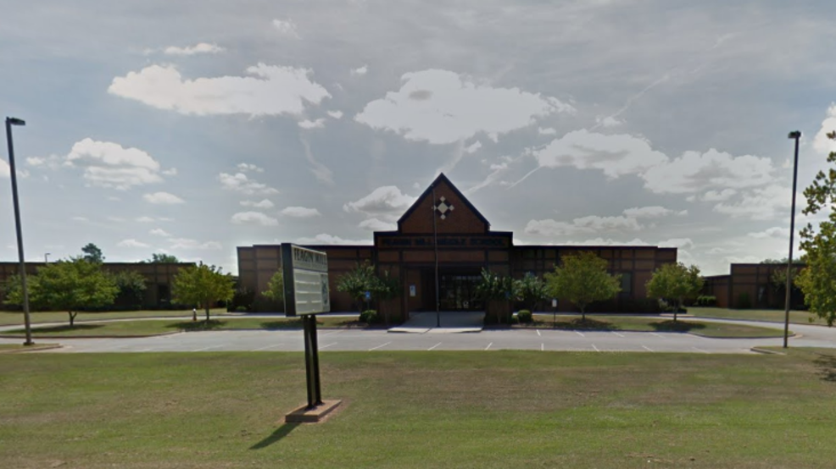
Welcome to Feagin Mill Middle School!

Slide 2
Welcome Back!!
Remember me???
It’s been a long time since we were together at school! But I’m SOO ready for us to be at school!
Ms. Genia, Ms. Jen, and Ms. Abby are ready to see you, too!!

Slide 3
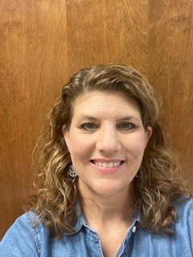
Ms. Denise with and without her mask on

Slide 4
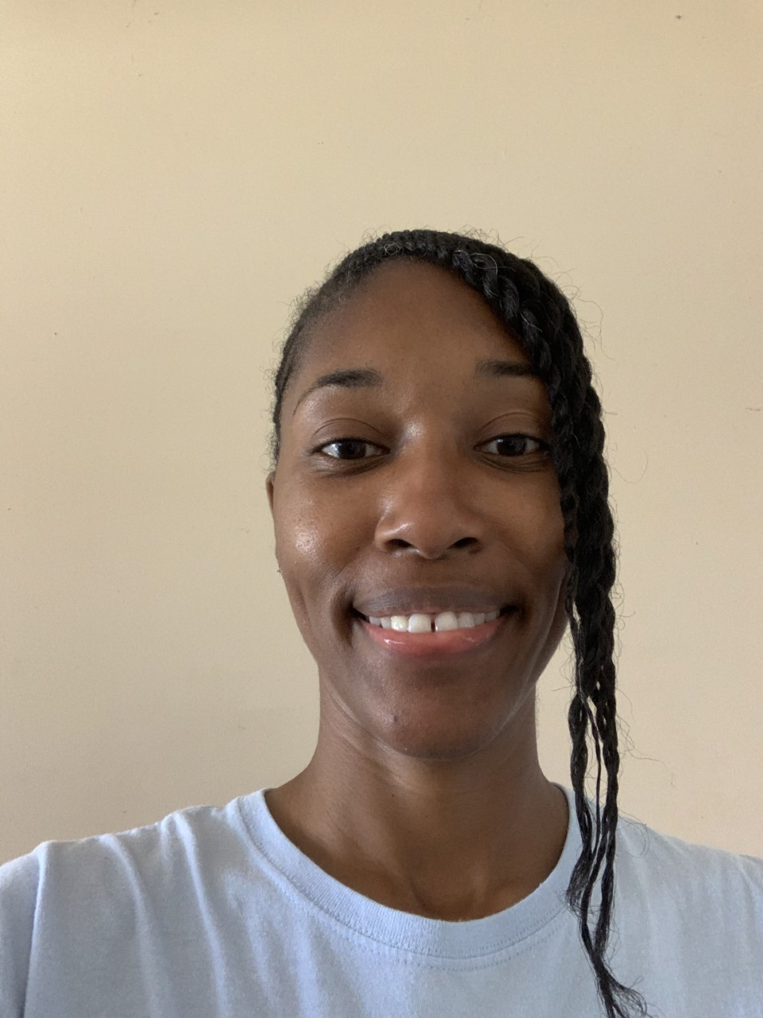
Ms. Genia with and without her mask on

Slide 5
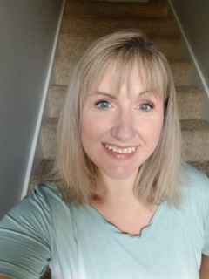
Ms. Jen with and without her mask on

Slide 6
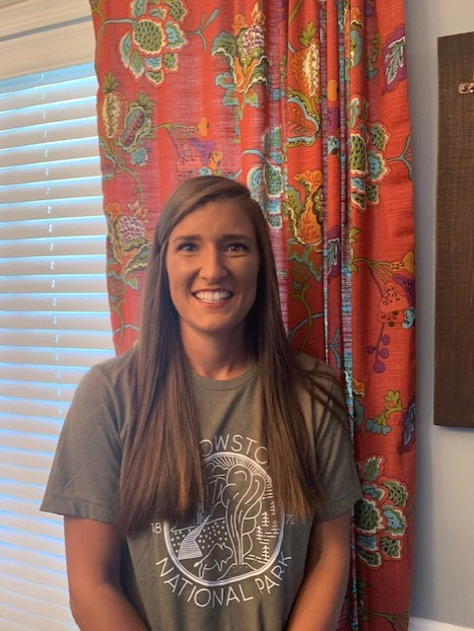
Ms. Abby with and without her mask on

Slide 7
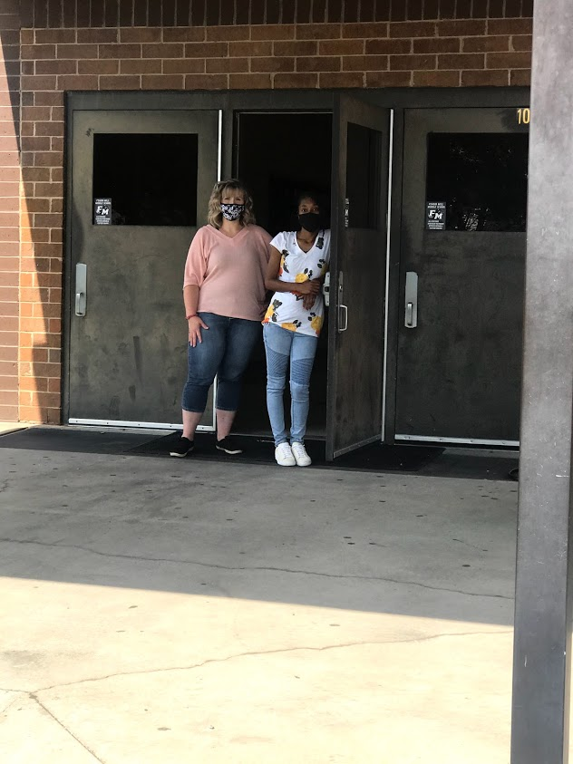
When you arrive…
you will be dropped off on the bus ramp!

Slide 8
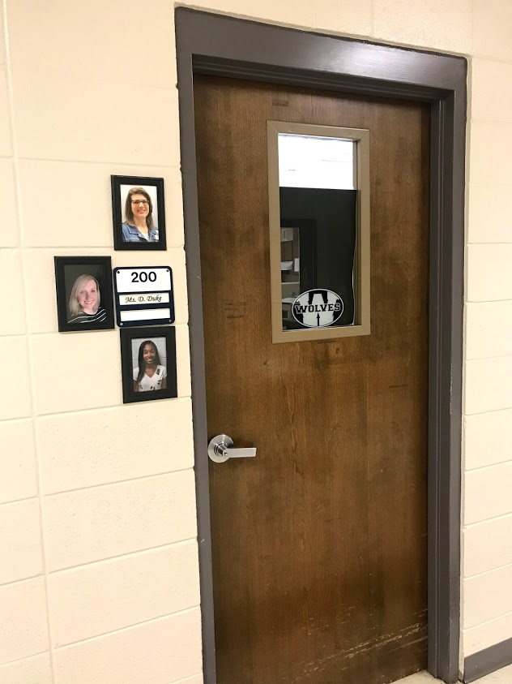
After you arrive…
We will walk to our classroom.
This is room 200!

Slide 9
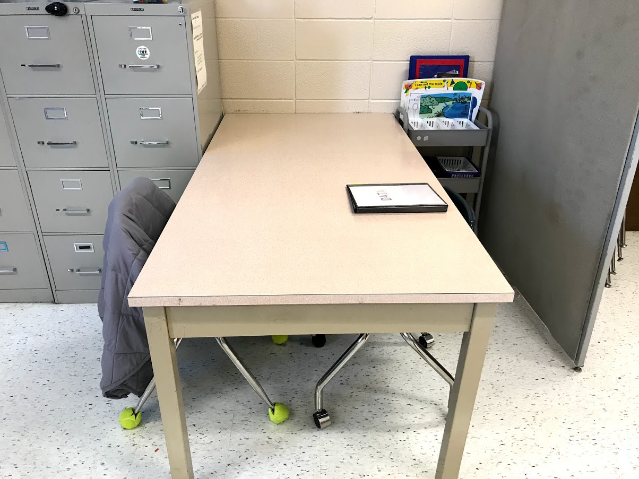
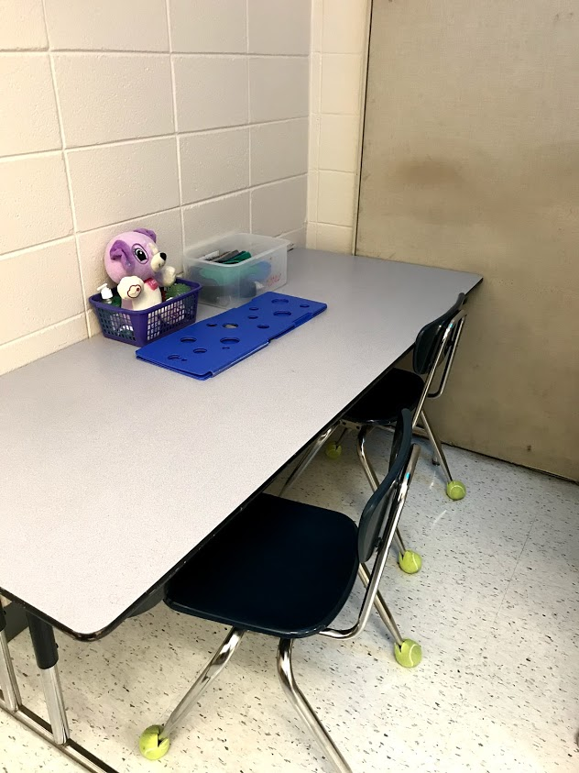
Inside the classroom…
We have our workstations

Slide 10
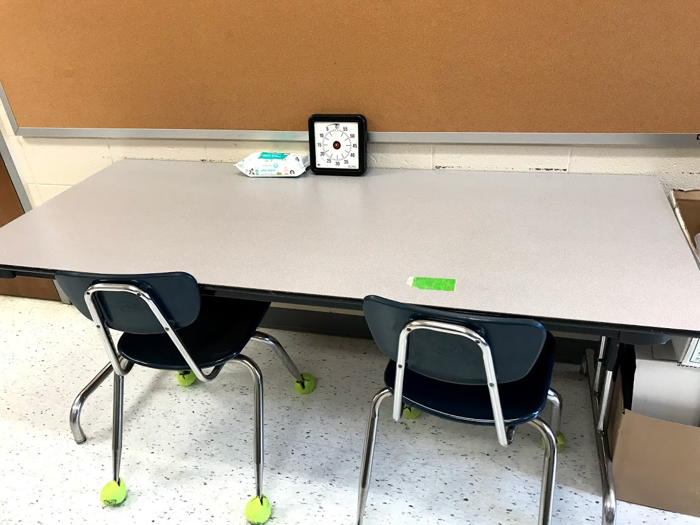
Inside the classroom…
The lunch table

Slide 11
Let’s take a tour outside the classroom…

Slide 12
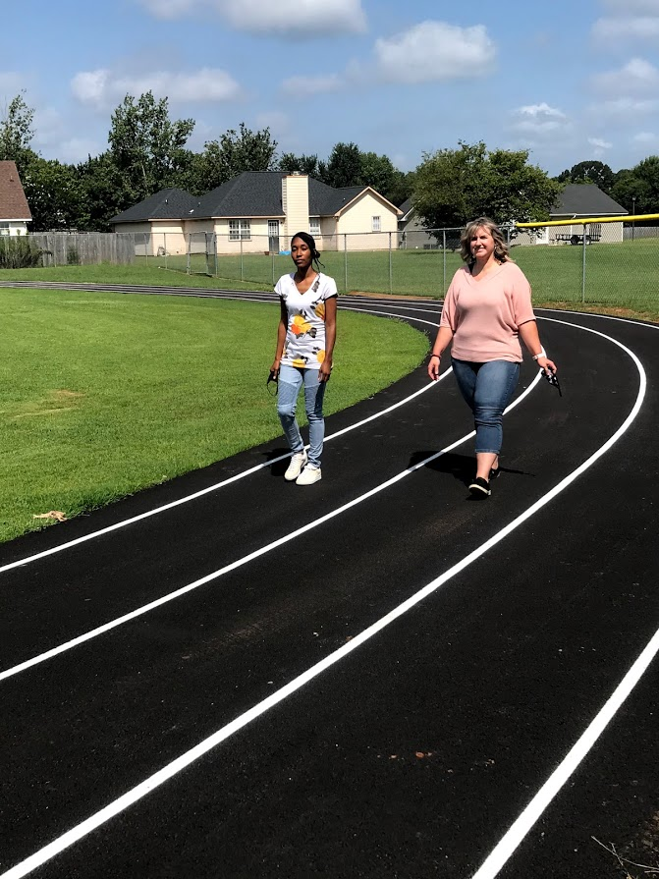
The Gym and the Track

Slide 13
Now, let’s explore the office area and who we might find there…

Slide 14
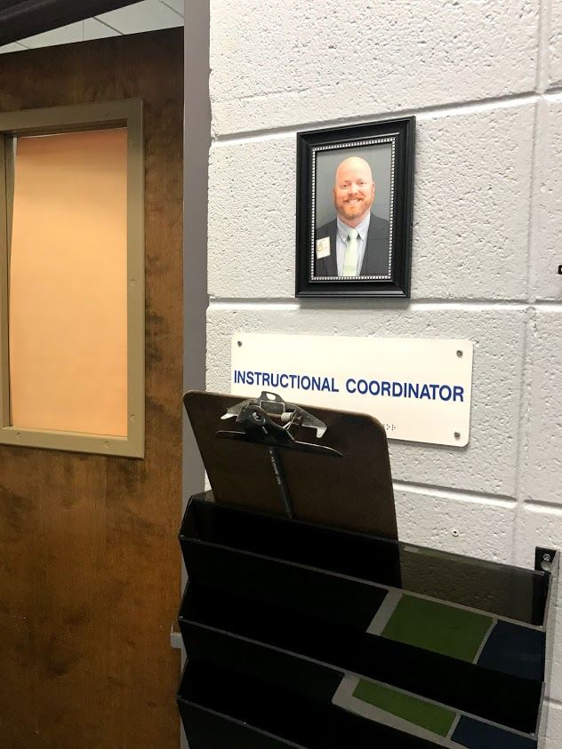
Assistant Principle: Mr. Hinson
Mr. Hinson’s Office

Slide 15
Assistant Principle: Mrs. Thomas

Slide 16
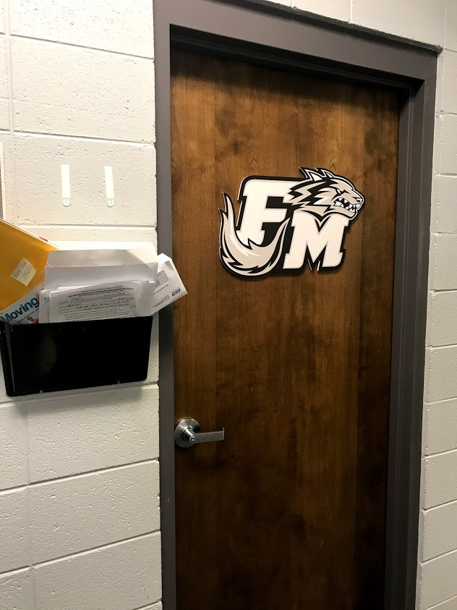
Principle: Mr. Sams
Mr. Sams

Slide 17
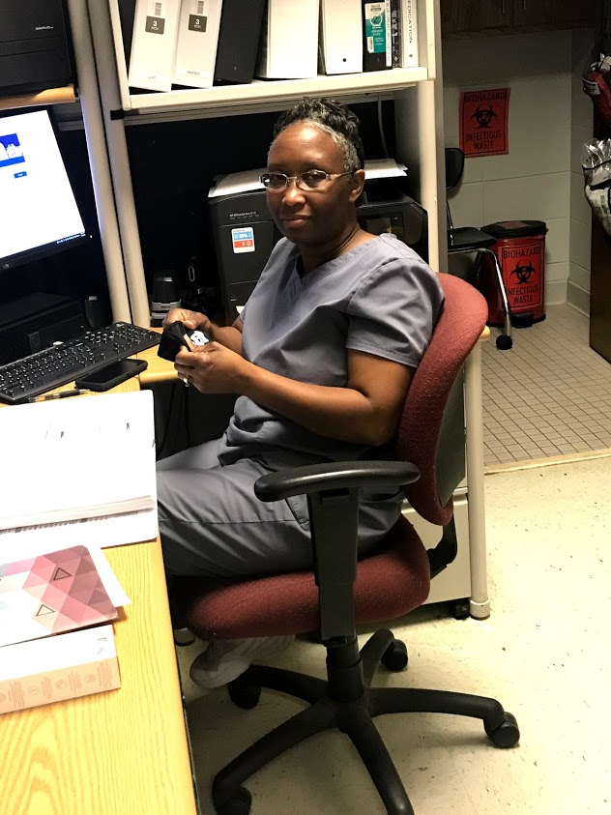
Nurse: Mrs. Mobley
This is where you would take your medicine, go if you do not feel well, or if you are hurt

Slide 18
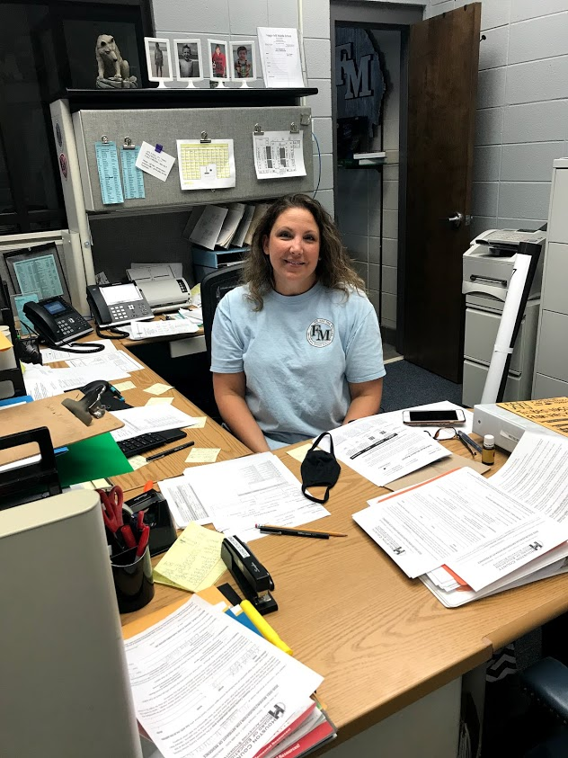
Front Desk: Mrs. Austin

Slide 19
School Resource Officer: Officer Ondike
Officer Ondike keeps our school safe!

Slide 20
A few things to remember:
Remember to bring your mask and water bottle to school everyday.
Wash your hands often.
Have fun.
Stay safe.
School starts August 6th.
Check out my teacher page on the Feagin Mill website.
Go to “Faculty and Staff Directory”.
Look in the “D” section for “Duke, Denise”.
Click and learn more about me!
7. Be great and back the pack!

Slide 21
I can’t wait to see you!!!

