Slide 1
FOUNDATIONS OF LAW

Slide 2
United States Constitution
Signed September 17, 1787
Established America’s national government and fundamental laws.
Guaranteed certain basic right for it’s citizens.
Established out 3 Branch System
Executive
Legislative
Judicial

Slide 3
Preamble of the Constitution
We the People of the United States, in Order to form a more perfect Union, establish Justice, insure domestic Tranquility , provide for the common defense, promote the general Welfare, and secure the Blessings of Liberty to ourselves and our Posterity, do ordain and establish this Constitution for the United States of America.
Barney Fife Preamble
Notes:
Break down the preamble by phrases. Ask the kids to analyze what each phrase means.

Slide 4
Bill of Rights
Also known as the 10 Amendments
Guaranteed individual basic freedoms such as speech and religion.
To date, there are 27 constitutional amendments.
Notes:
Amendment Activity – Pass out a list of amendments (1 to each student). Have them analyze and present why they believe that amendment is important to our country.

Slide 5
Executive Branch
Consists of the President, Vice-President, and 15 cabinet-level executive departments.
President:
Commander-in-chief of our armed forces
Leader of our country
Recommends legislation to congress
Appoints ambassadors to other nations
Appoints supreme court justices

Slide 6
Executive Branch (Cont’d)
Vice President
Replaces president in the event that the president is unable perform his duties
Presides over the senate
Is the “tie-breaking” vote in the case of a tie

Slide 7
Legislative Branch
Known as the “Law-making” branch
Made up of Congress (Senate and House of representatives)
Write, debate, and pass bills to send to the president for approval or veto.
Can override presidential veto with a 2/3 vote in both the senate and the house of representatives
Has authority to declare war

Slide 8
Judicial Branch
Decides if legislation is constitutional.
Made up of our Court System
United States Supreme Court
United States Court of Appeals
District Courts

Slide 9
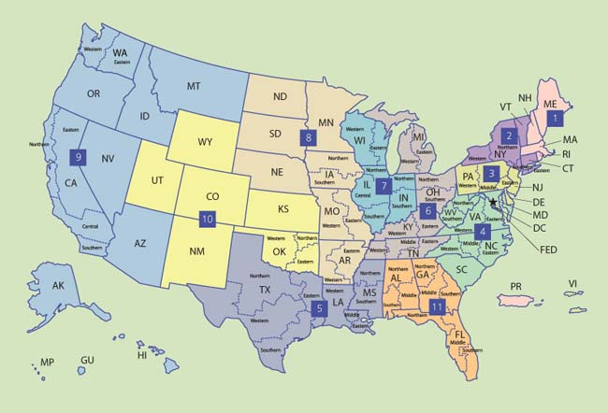
U.S. Federal Court Districts
http://www.oblon.com/sites/all/themes/oblon/resources/img/usmap.jpg

Slide 10
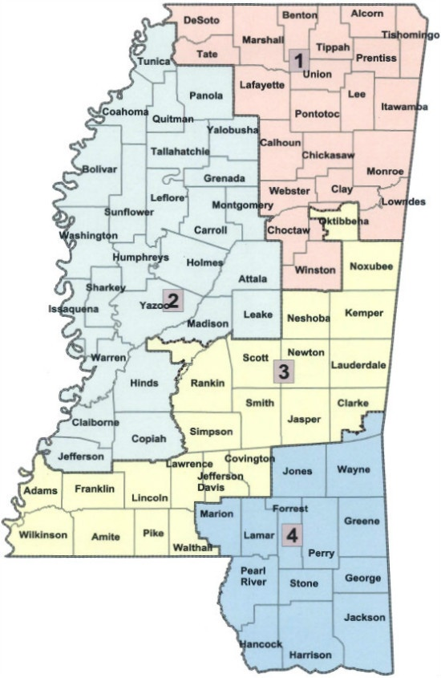
Mississippi Court Districts

Slide 11
How are laws passed?
Laws begin as ideas. First, a representative sponsors a bill. The bill is then assigned to a committee for study. If released by the committee, the bill is put on a calendar to be voted on, debated or amended. If the bill passes by simple majority (218 of 435), the bill moves to the Senate. In the Senate, the bill is assigned to another committee and, if released, debated and voted on. Again, a simple majority (51 of 100) passes the bill. Finally, a conference committee made of House and Senate members works out any differences between the House and Senate versions of the bill. The resulting bill returns to the House and Senate for final approval. The Government Printing Office prints the revised bill in a process called enrolling. The President has 10 days to sign or veto the enrolled bill.
school house rock - bill

Slide 12
Different Types of Law
Criminal Law
Family Law
Consumer Law/Contracts
Individual Rights
Torts
Employment/Housing Law
Intellectual Property Law
ETC…

