Slide 1
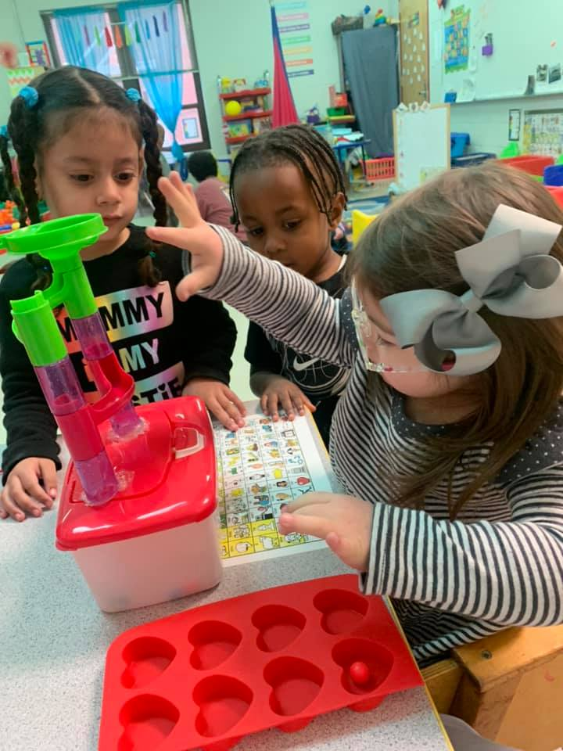
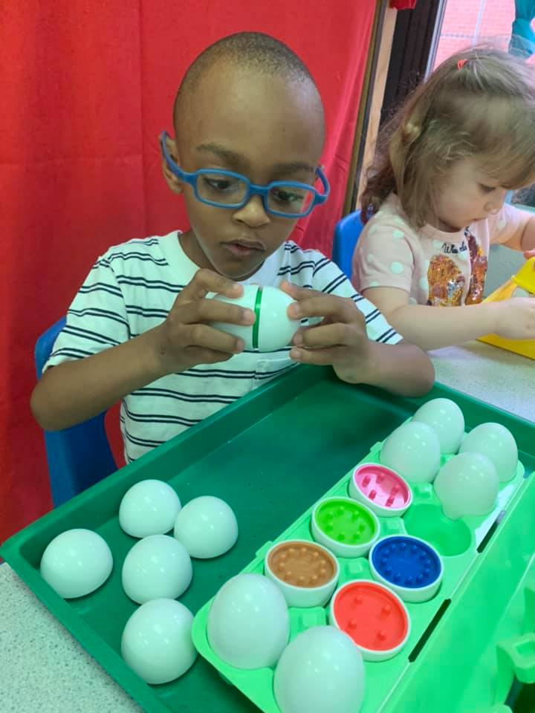
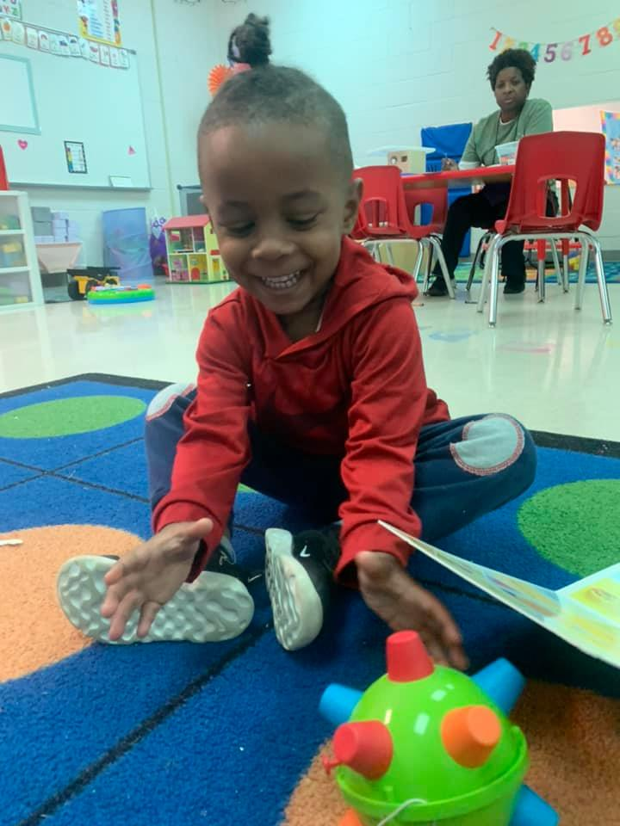
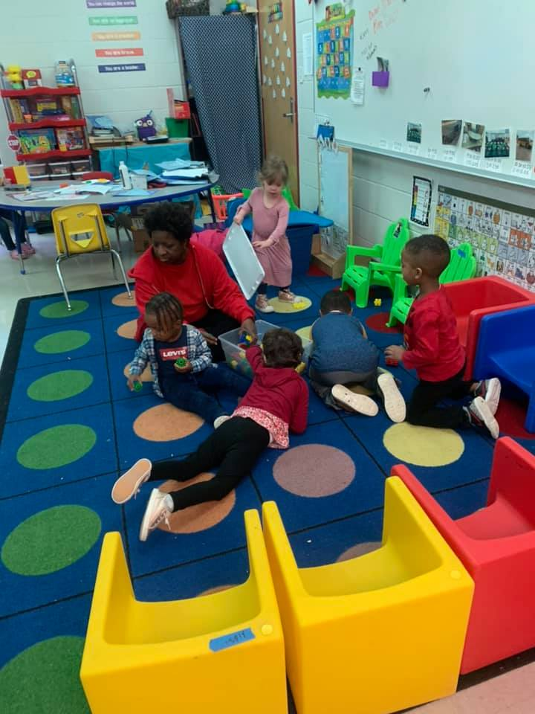
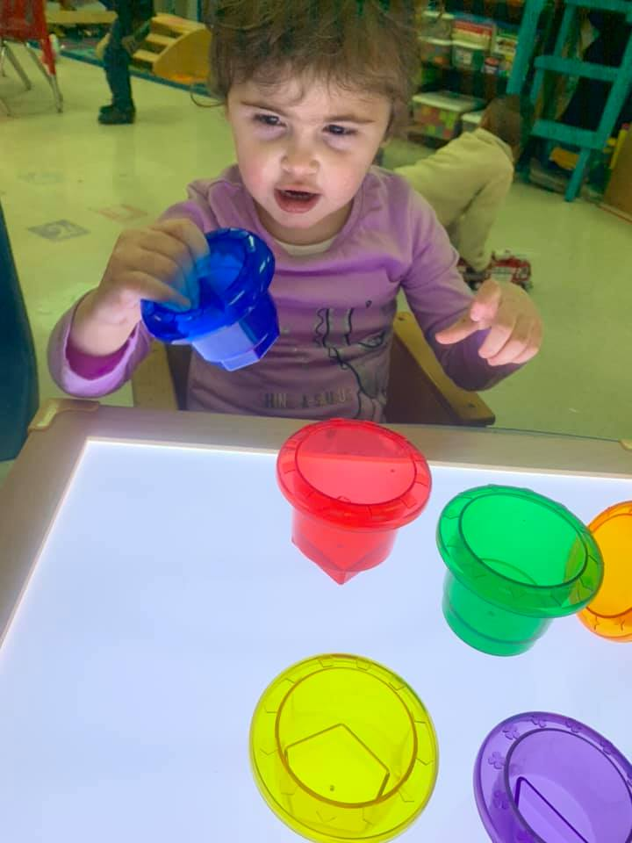
Week 1
Distance Learning AM Class
March 25-31

Slide 2
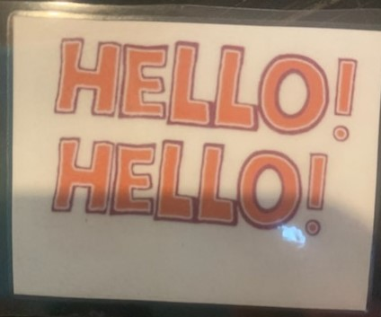
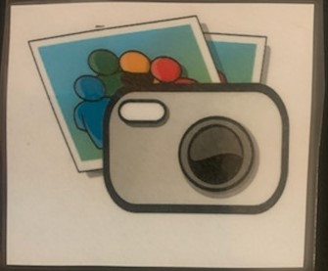
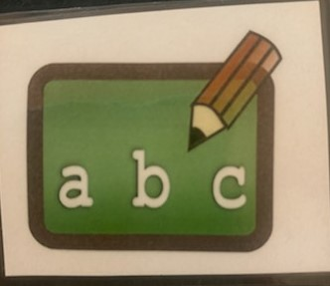
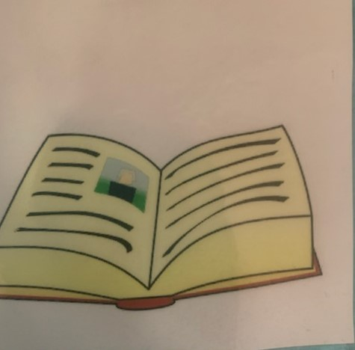
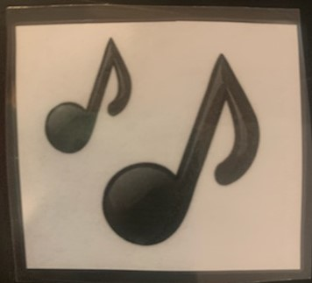
Circle Time!
Hello! Hello! Song
___ is here today
ABC’s
Monthly Song
Book

Slide 3
Questions of the week
Ask one question a day. Let your child answer either verbally or by touching their response. Try talking about it.
Here is a link to the questions. You can print them off or just use your electronic device to show them the pictures to choose from.

Slide 4
Letter Aa
Letter Aa Song
Create the letter Aa using Play-Doh or anything you can find to use around the house.
Pick one, two, or all worksheets to do together!
Worksheets

Slide 5
Number 1
Complete this scavenger hunt
Find 1 coffee cup
Find 1 toy with wheels
Find 1 roll of toilet paper
Find 1 stuffed animal
Find 1 person and give them a BIG HUG
Worksheets (Pick one, two or all to do)

Slide 6
Storytime!
Little Blue Truck’s Springtime <- Click Link
Questions:
What color is the truck?
Name an animal that you see.

Slide 7
Social Skill: Washing your hands
file:///C:/Users/Wolf/Downloads/SS-HandWashing%20(1).pdf
This is a social story about washing our hands. Print it off.
Go over this skill with your child. Practice washing your hands!
Wash your dolls hands, or dinosaurs. It is so important to know how to keep your hands clean to stay safe from germs.

Slide 8
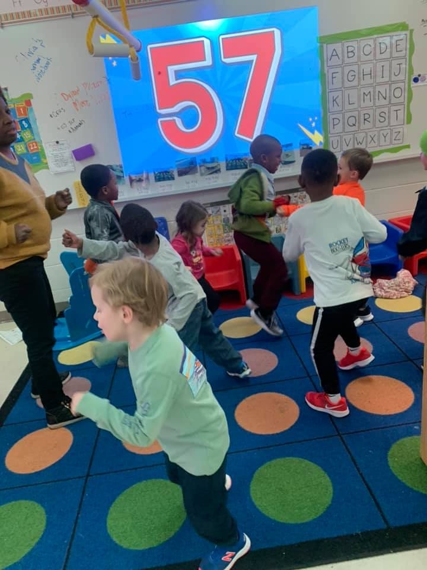
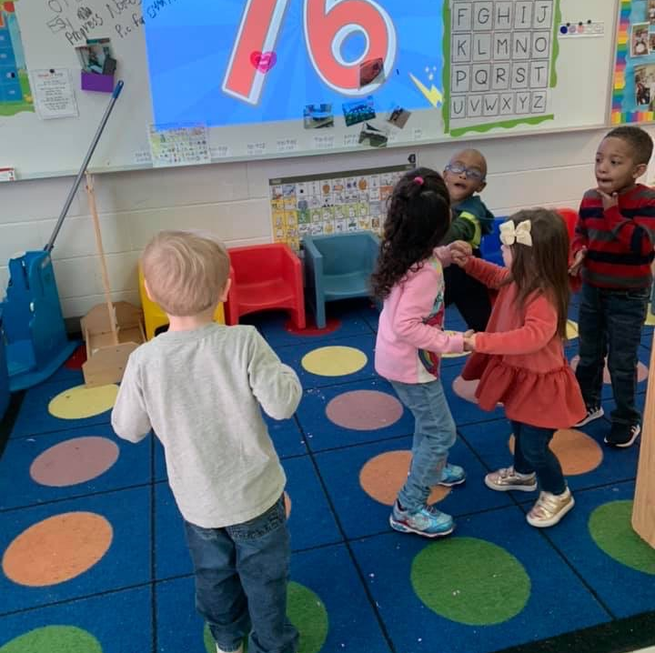
Movement Break!!!
https://www.youtube.com/watch?v=NwT5oX_mqS0
https://www.youtube.com/watch?v=0TgLtF3PMOc

