Slide 1
Graphic Sources
By Ms. Martin

Slide 2
What type of graphic source is it?
Name it!

Slide 3
The cat plays in the sink.
Picture with a caption!

Slide 4
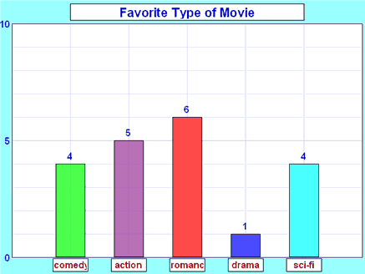
Image credit: http://www.mathsisfun.com/data/bar-graphs.html
Bar Graph!

Slide 5
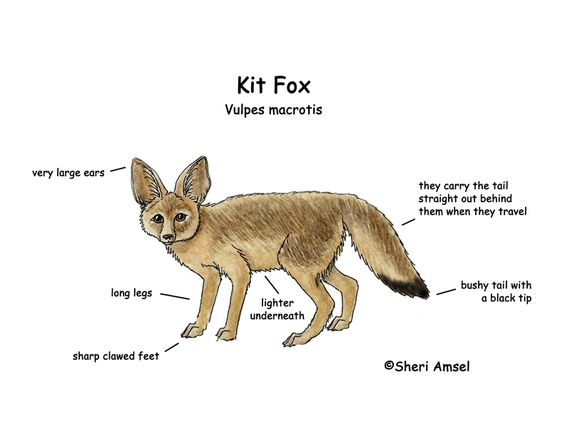
Image credit: http://www.exploringnature.org/db/detail.php?dbID=36&detID=685
Diagram!

Slide 6
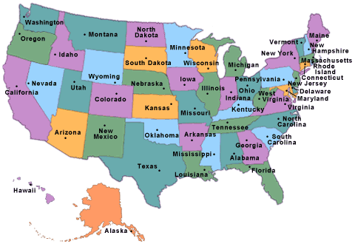
Image Credit: http://www.infoplease.com/states.html
Map!

Slide 7
Image Credit: http://www.bromfields.net/ljb/organzrs.htm
Graphic Organizer!

Slide 8
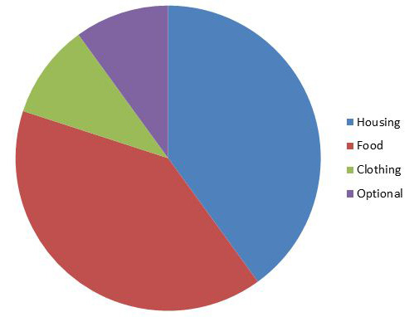
Image Credit: http://www.investopedia.com/university/teaching-financial-literacy-kids/teaching-financial-literacy-kids-needs-and-wants.asp
Pie Chart!

Slide 9
So…
What is a graphic source?
A graphic source is a visual representation of information. Graphic sources help us understand what we have read, or give us more information on the topic.

