Slide 1
Evolution
By Zayne Stanford, Aydan Ward, Almo Nasser

Slide 2
What is evolution?
Evolution is the process by which different kinds of living organisms developed and diversified from earlier forms during the history of the earth.

Slide 3
Scientist of Evolution
Charles Darwin- He stated that all species of organisms develop through natural selection of inherited variation that increase an individual’s ability to compete, survive, and reproduce.
Alfred Wallace- He is known for helping Darwin with the Theory of Natural Selection.
Thomas Malthus- He is known for his contribution of carrying capacity and population growth.
Jean-Baptiste Lamarck- He is known for his theory of acquired characteristics.

Slide 4
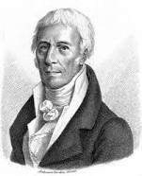
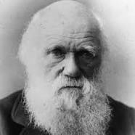
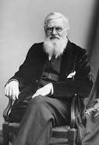
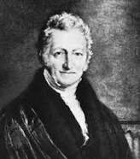

Slide 5
Types of Evolution
Mass Extinction
Adaptive Radiation
Convergent Evolution
Punctuated Equilibrium
Developmental Gene Changes

Slide 6
Cladogram
Cladogram- a branching diagram showing a number of species

Slide 7
Example for Natural Selection
Before the industrial revolution in the mid-1700s, the peppered moth was most commonly a pale whitish color with black spots.
This coloring enabled them to hide from potential predators on trees with pale-colored bark, such as birch trees.
The rarer dark-colored peppered moths were easily seen against the pale bark of trees and therefore more easily seen by predators.

Slide 8
Facts
Darwin was inspired to write The Origin of Species after a trip to the Galapagos islands in the H.M.S Beagle.
It took him 20 years to write and publish The Origin of Species.
Evolution relies on there being genetic variation in a population which affects the physical characteristics (phenotype) of an organism.
Some of these characteristics may give the individual an advantage over other individuals which they can then pass on to their offspring.

Slide 9
The end

