Slide 1
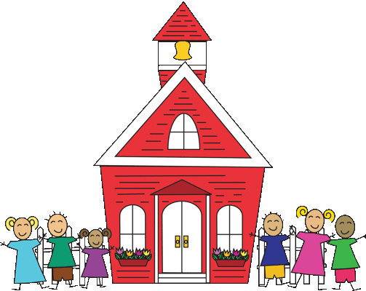
GES Kindergarten
Week 3-(April 6-April 10)

Slide 2
Standards
Reading:
R.L.K.1: Ask and answer questions when reading.
R.L.K.3: Name characters, setting, and events in the story.
Writing:
W.K.1: Use a combination of drawing, dictating, and writing when composing opinion, narratives, and informative texts.
L.K.2: Use g appropriate capitalization, punctuation, and spelling when writing.
Phonics:
R.F.K.2: Demonstrate understanding of sounds (middle sounds, short vowels).
Sight Words:
R.F.K.3: Read common high frequency sight words.
Math:
K.C.C.7: Compare 2 numbers between 1-20 presented with written numerals.

Slide 3
Phonemic Awareness
Intro to Heggerty: https://www.youtube.com/watch?v=lroKByqjBd0
Heggerty Week 27 Day 1 https://www.youtube.com/watch?v=lvag1cXOrkE
Heggerty Week 27 Day 2 https://www.youtube.com/watch?v=9ioGaO7JqQk
Heggerty Week 27 Day 3 https://www.youtube.com/watch?v=Bfko_px-raU
Heggerty Week 27 Day 4 https://www.youtube.com/watch?v=Qv0rTyyda7U&t=80s
Heggerty Week 27 Day 5 https://www.youtube.com/watch?v=CNOt0Uv1o9c

Slide 4
Reading
Essential Questions:
How can we describe a rabbit?
I Can:
I can describe the characteristics of a rabbit.

Slide 5
Reading
Activity: Read the books to a sibling, parent, pet, or toys.
Nonfiction: Any book about rabbits
Fiction:
The Easter Bunny’s Assistant By Jan Thomas
https://www.youtube.com/watch?v=oVUP2ydxhG4

Slide 6
Day 1
Read for fun!
Make a list of things you know about rabbits
Capture This and That Activity:
Illustrate your favorite part of the Easter Bunny’s Assistant.

Slide 7
Day 2
Reread the text. Review and discuss the essential questions.
Listen and Draw Activity:
Illustrate a rabbit with floppy ears.

Slide 8
Vocabulary
Pellets- small, rounded mass of food
Floppy- hanging in a loose way
Kit- a baby rabbit
Active- busy doing many things
Burrow- a hole dug by certain animals for use as a hiding place or home
Nibble- to eat small bites

Slide 9
Day 3
Read any books about Easter or rabbits
Label It Activity:
Label the parts of a rabbit

Slide 10
Day 4
Review vocabulary words.
Connect It!
Directions: If you could choose a new pet to have, what would it be and how will you take care of it?

Slide 11
Day 5
Wrap up:
How can you describe a rabbit?
Theme craft: Draw a picture of a rabbit at an Easter Egg Hunt.

Slide 12
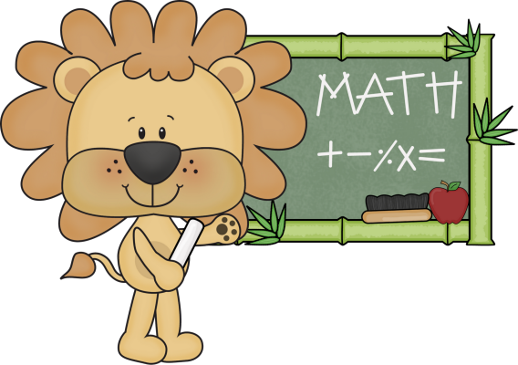
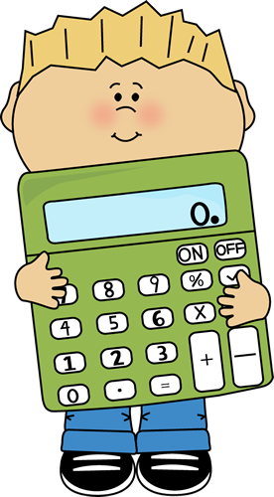
MATH:
Grab a deck of cards and a partner. Each player draws a card,whoever has the “greater/bigger” number gets both cards. If you both draw the same number draw again and compare. Play until there are no cards left to draw. Whoever has the most cards wins OR Get a partner, paper and pencil. Each of you write a number between 1-20, whoever writes the “greater/bigger” number gets a point. Count up your points, whoever has the most wins.

Slide 13
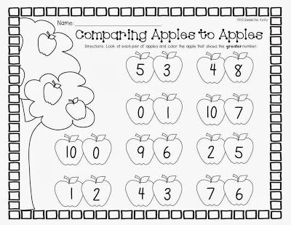
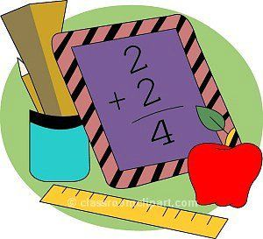

Slide 14
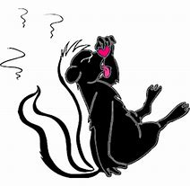
Science
L.K.1B.1 Develop and use models to exemplify how animals use their body parts to (a) obtain food and other resources, (b) protect themselves, and (c) move from place to place.
Question:
When does a skunk uses its spray?
Write a sentence and/or draw a picture of when a skunk would use its spray.
I
Continued on next 2 pages...

Slide 15
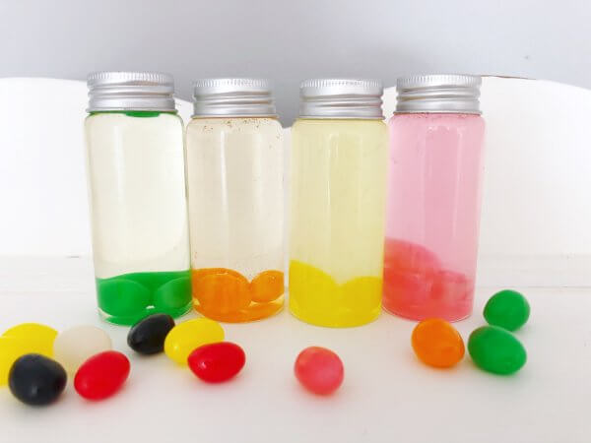
Science
Activity:
Dissolving Jelly Beans
Materials:
4 clear cups or jars
Warm Water
Cooking oil
White vineger
Rubbing Alcohol
Jelly Beans
Continued on next slide

Slide 16
Science
Activity:
Dissolving Jelly Beans
Procedures:
Place a few jelly beans in each jar or cup.
Pour a different liquid in each jar or cup.
Making a note of which jar/cup has which liquid.
Observe what happens to the jelly beans in each jar. Write a sentence about or draw a picture of what is happening to the jelly beans in each jar.
Continued on next slide

Slide 17
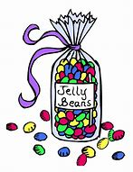
Science
Activity:
Dissolving Jelly Beans
Questions to ask/answer:
Which liquid or liquids dissolved the jelly beans?
How long did it take to dissolve the jelly beans?
Tell your parent, sibling, or TEACHER the answers to these questions.

Slide 18
Writing
Activity:
Choose 1:
Write three sentences about your favorite candy.(opinion)
see science slide (informative)
Write three sentences about what you would do if you were the Easter bunny. See next slide. (narrative)

Slide 19
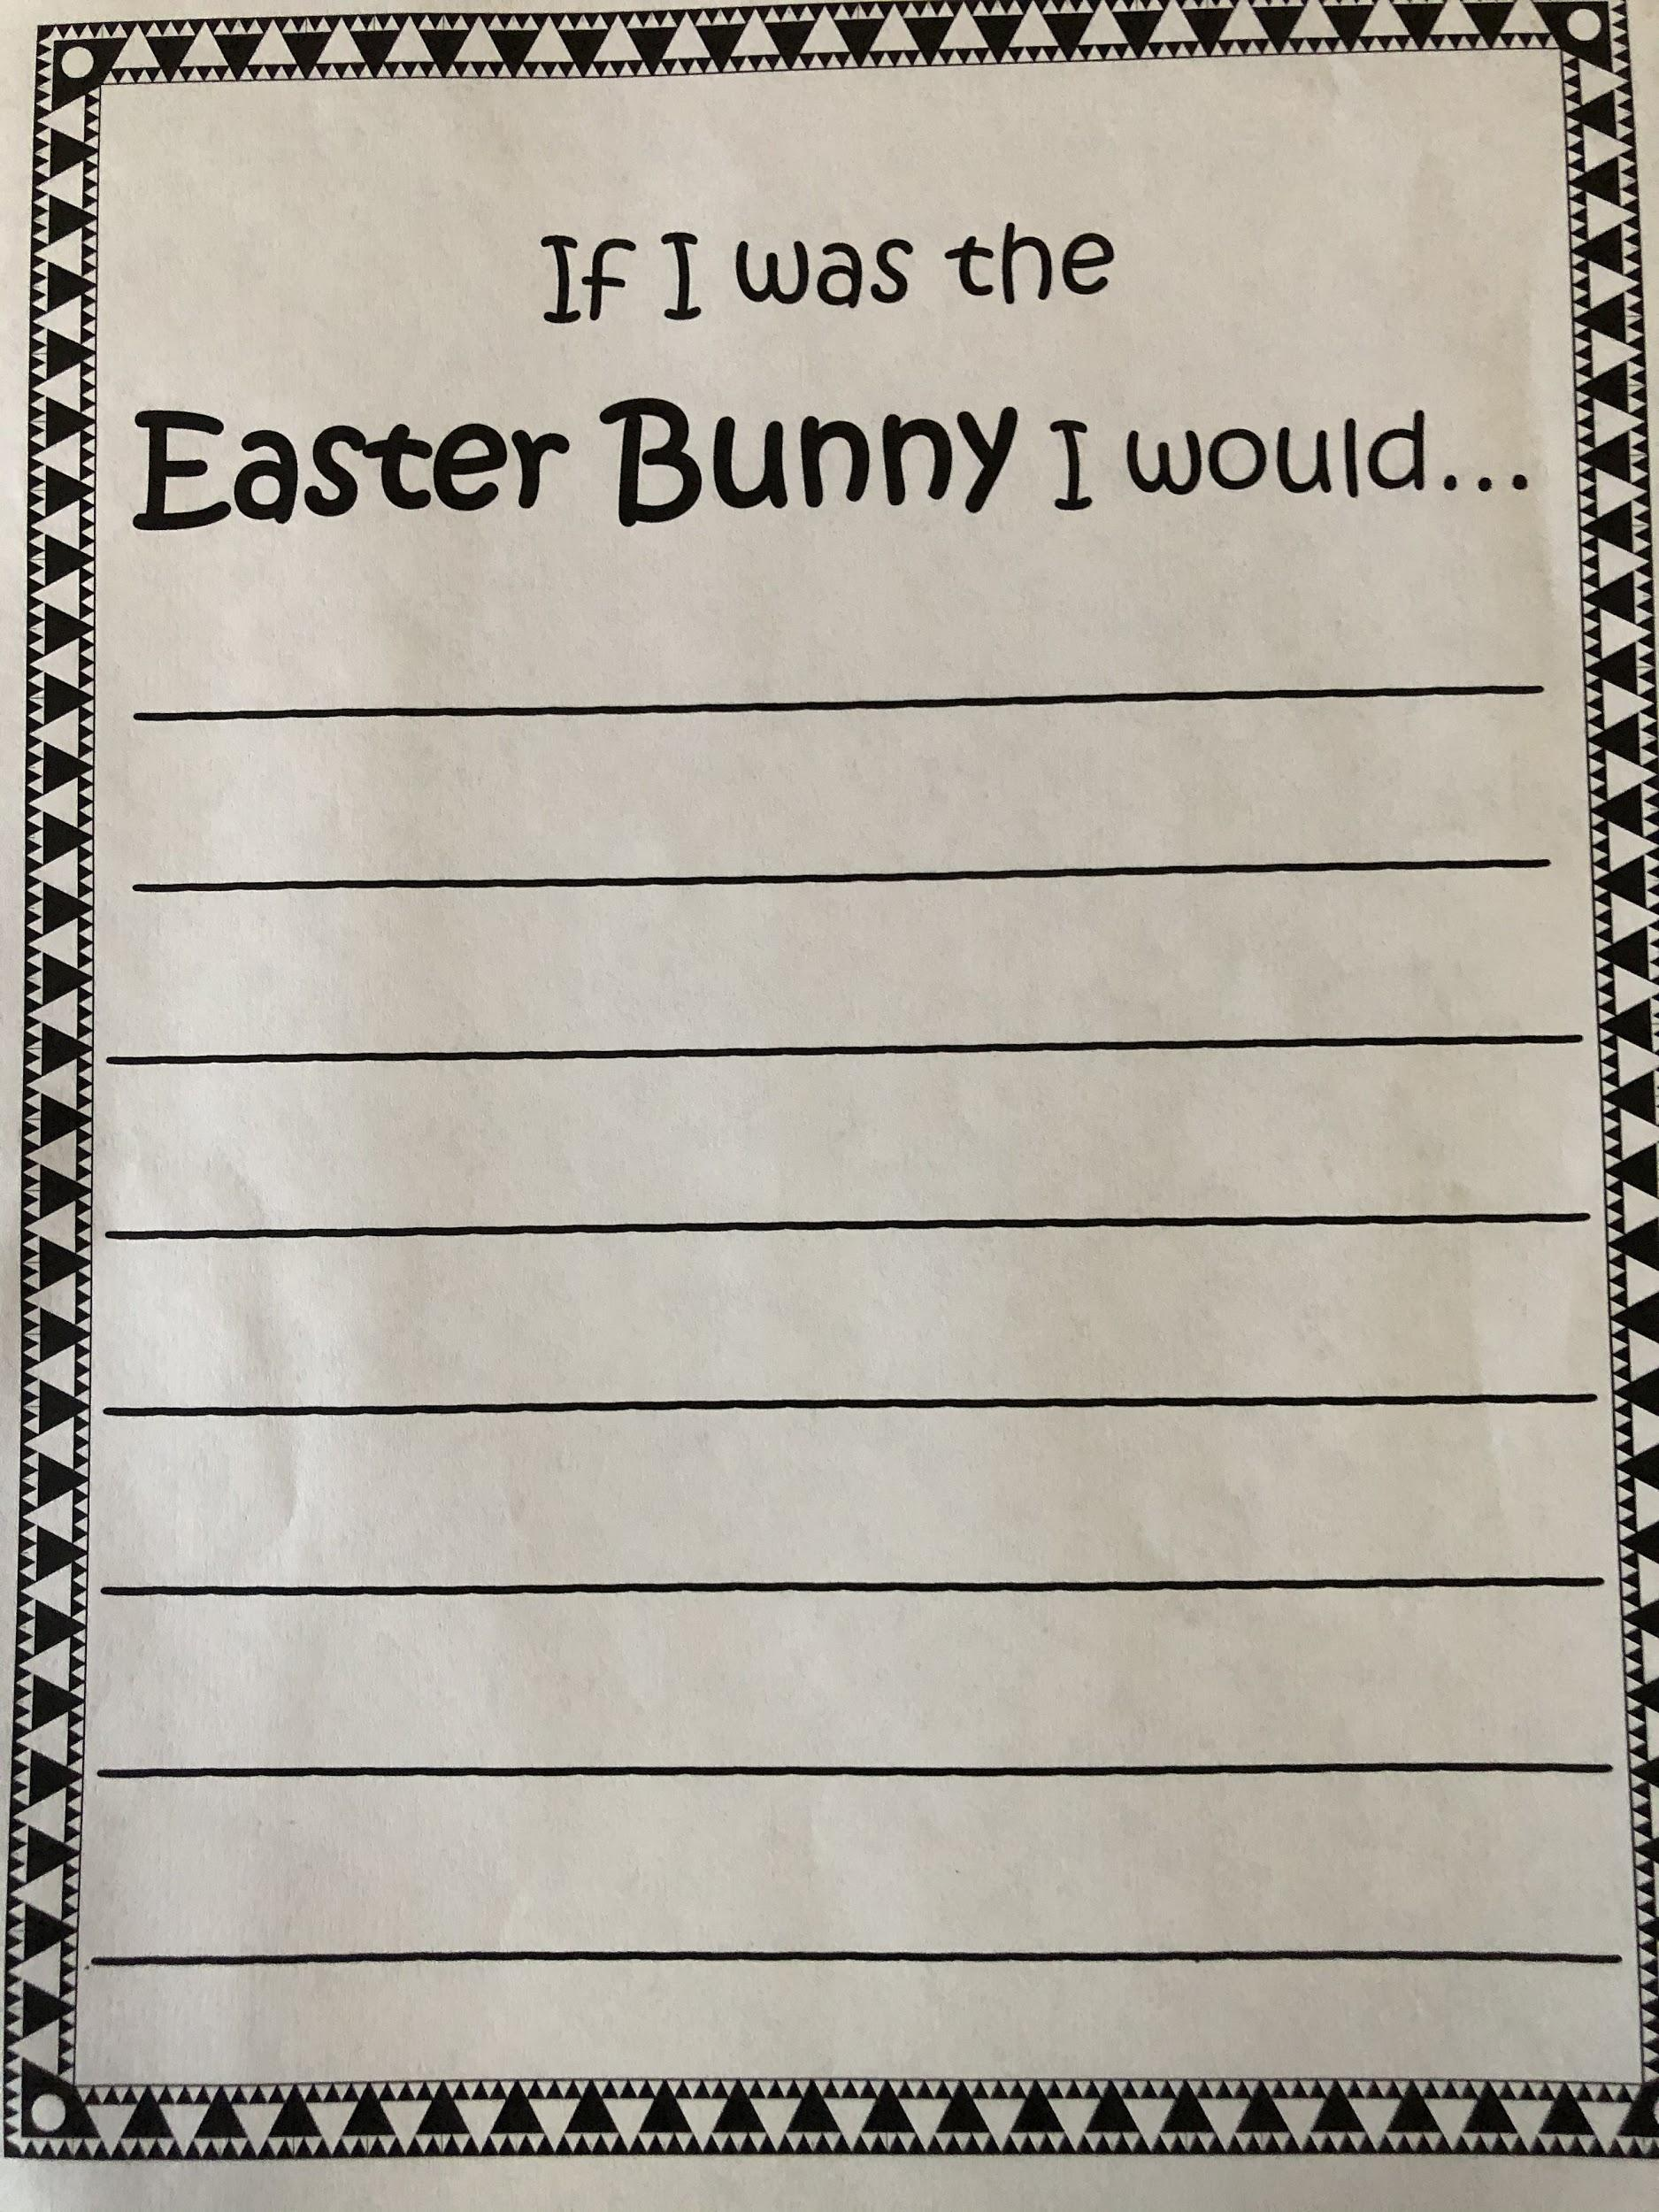

Slide 20
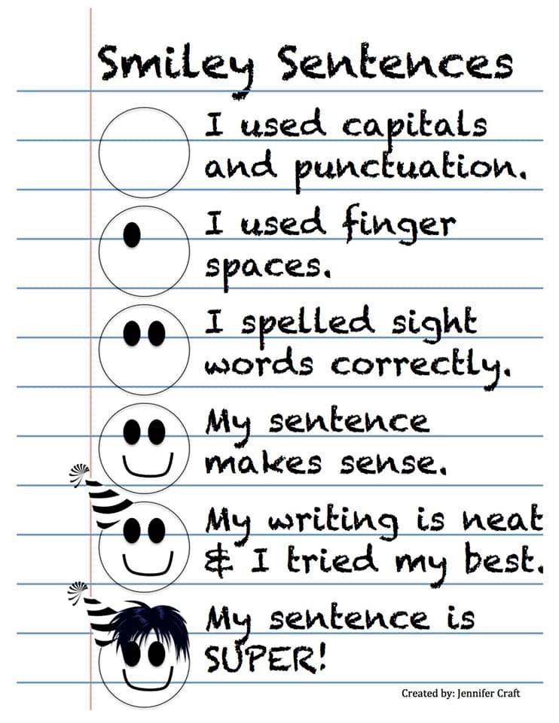

Slide 21
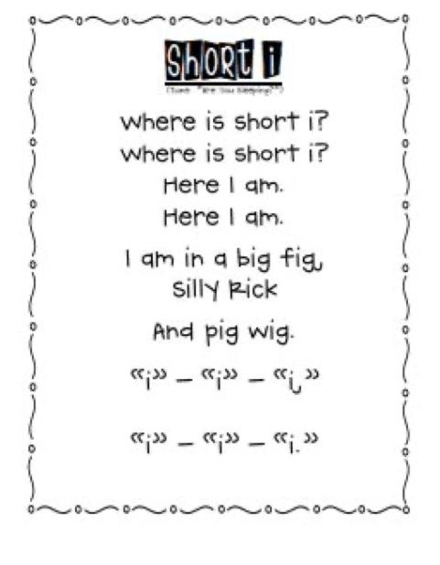
Phonics
The following word list includes words that use our short vowel addressed on the phonics worksheet given. You may practice these words all week by sounding them out and reading them, writing them with different fun materials, coming up with words that rhyme with these words, and even using them in sentences. At the end of the week a spelling test can be given to see if the words have been mastered.
Win Hit
Zip Sip
Big Kid
Bit Pin
Wig Hid
Bonus word: stick

Slide 22
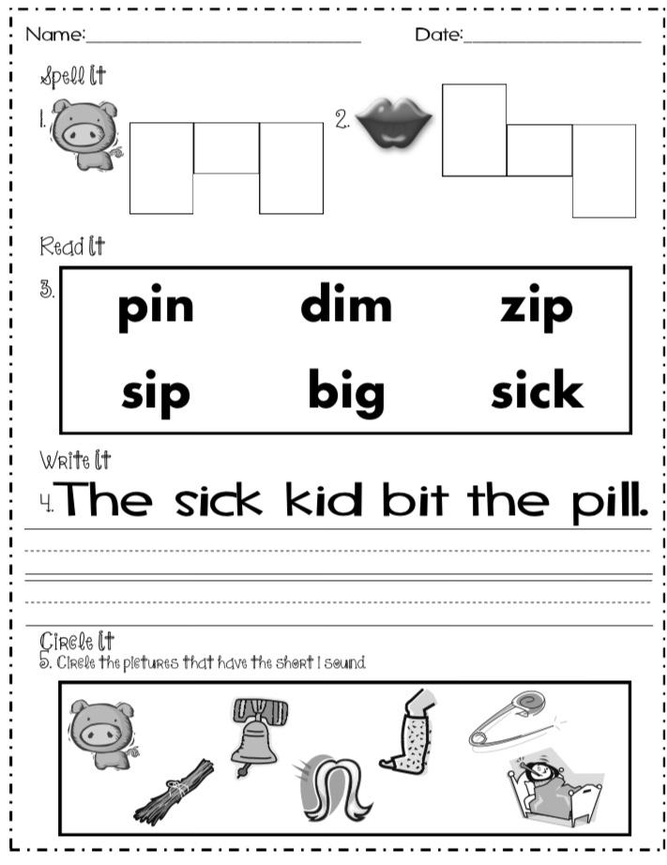

Slide 23
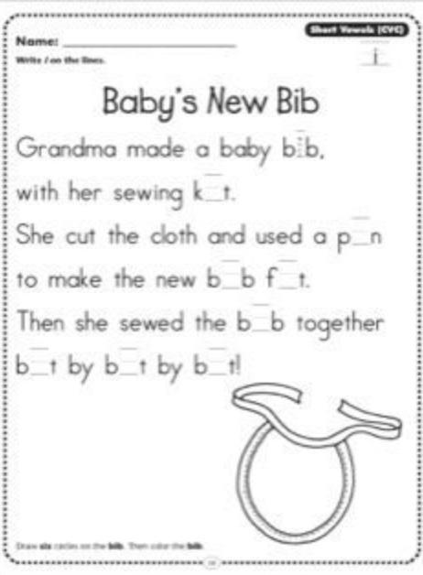

Slide 24
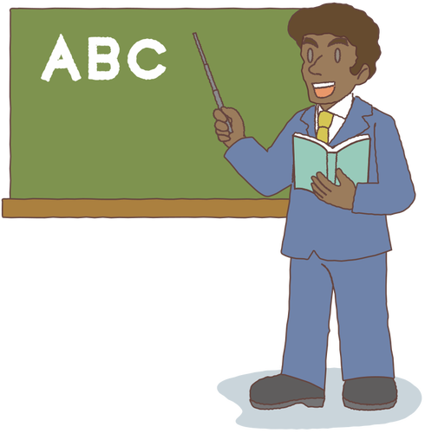
Sight Words
Sight words: over, did, down, only
Activity: Be the teacher. Teach someone/something (sibling, parent, pet, toys) how to spell
your sight words. Make sure to use your
teacher voice. :)

Slide 25
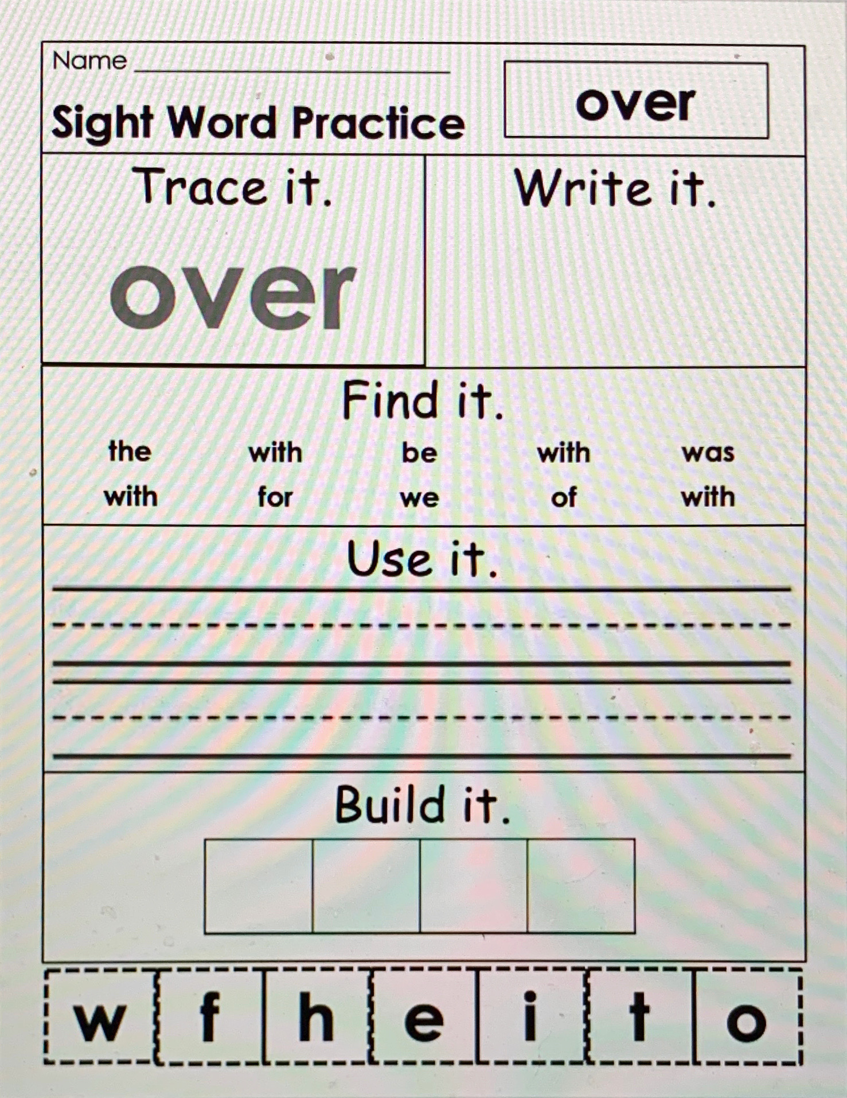

Slide 26
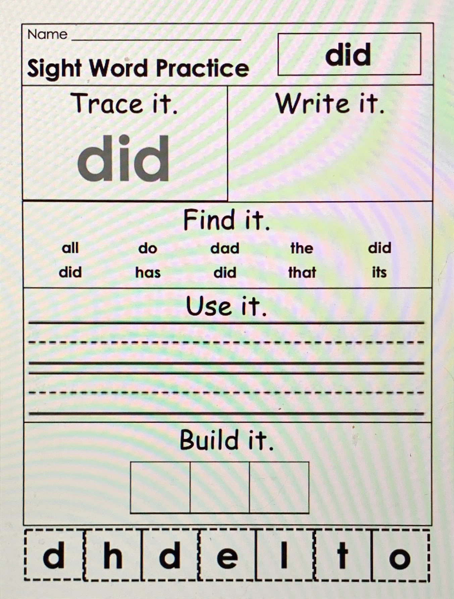

Slide 27
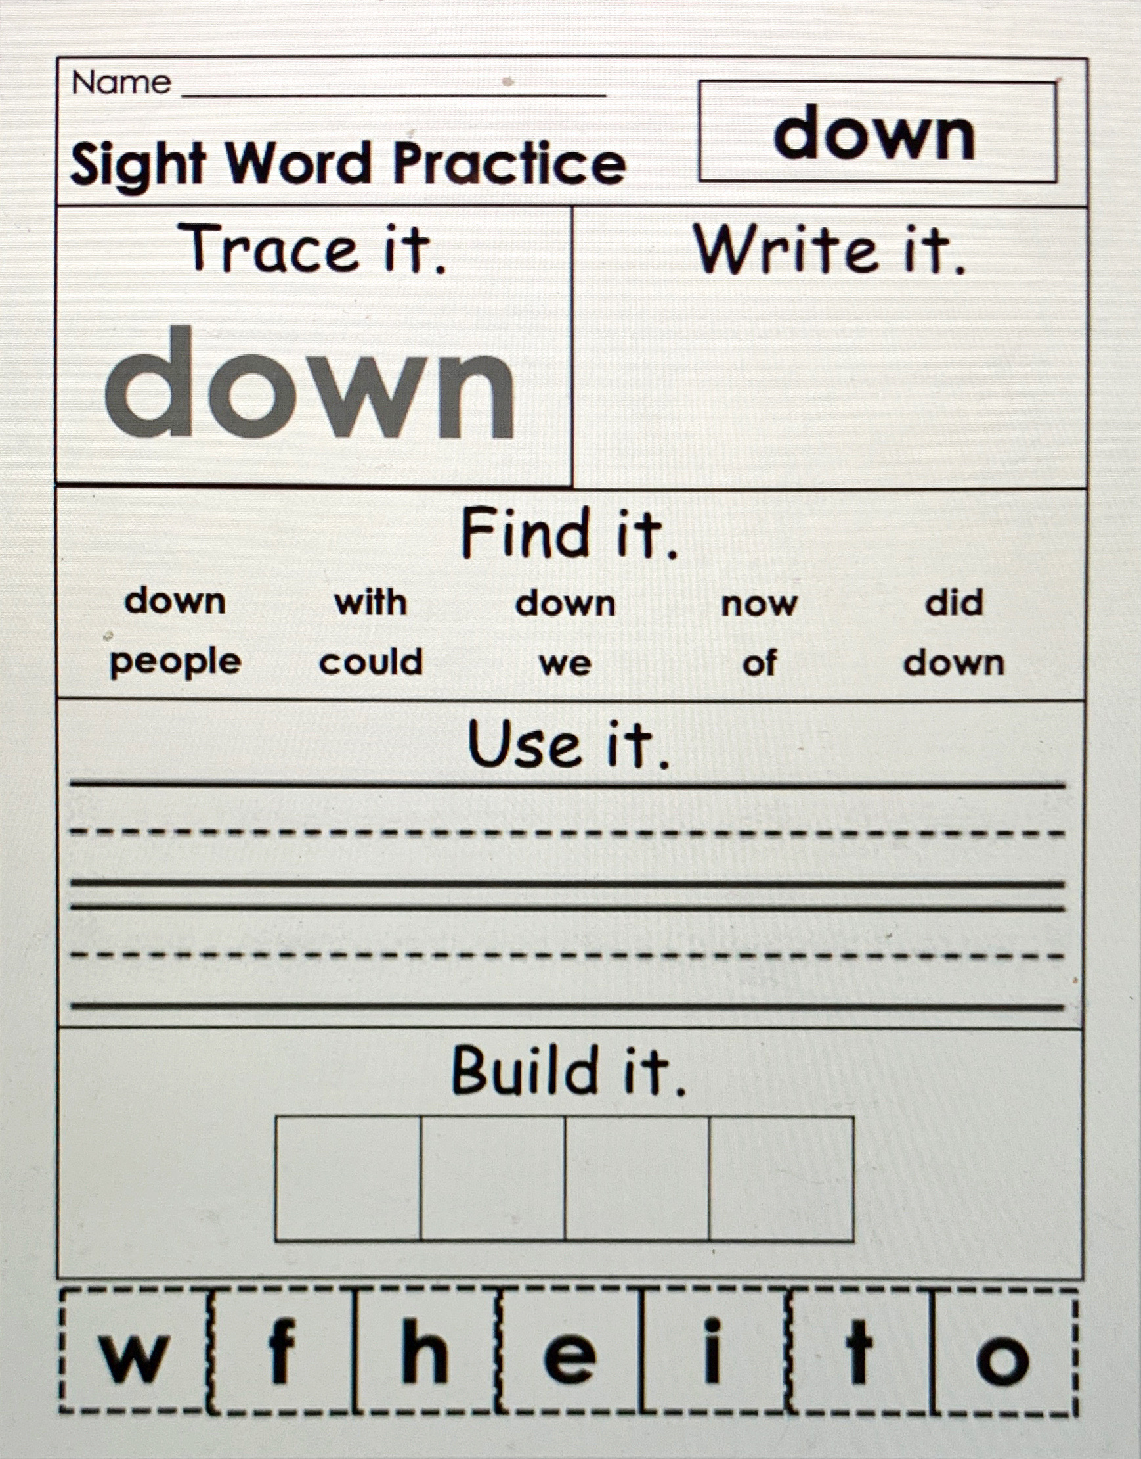

Slide 28
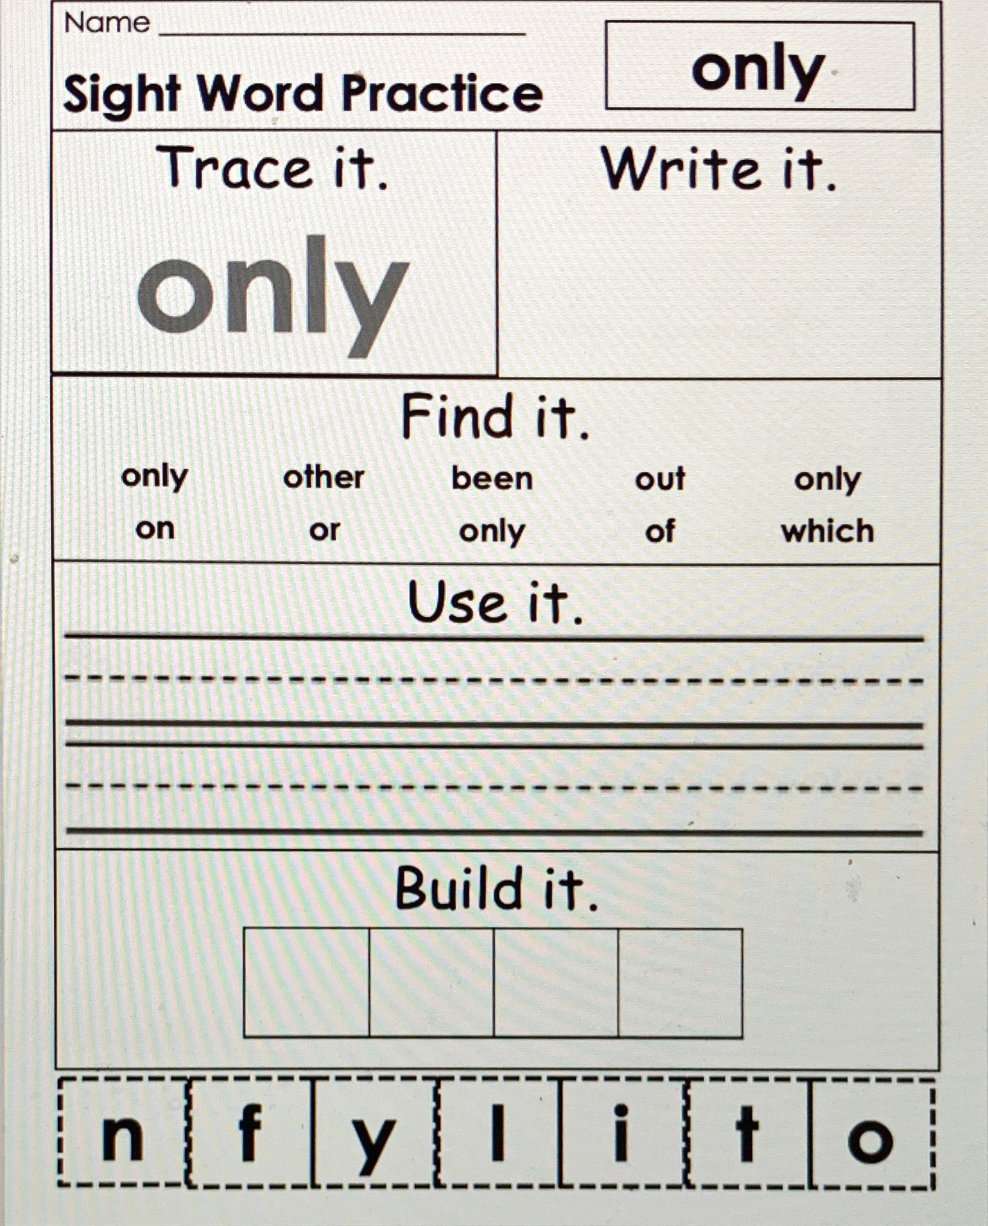

Slide 29
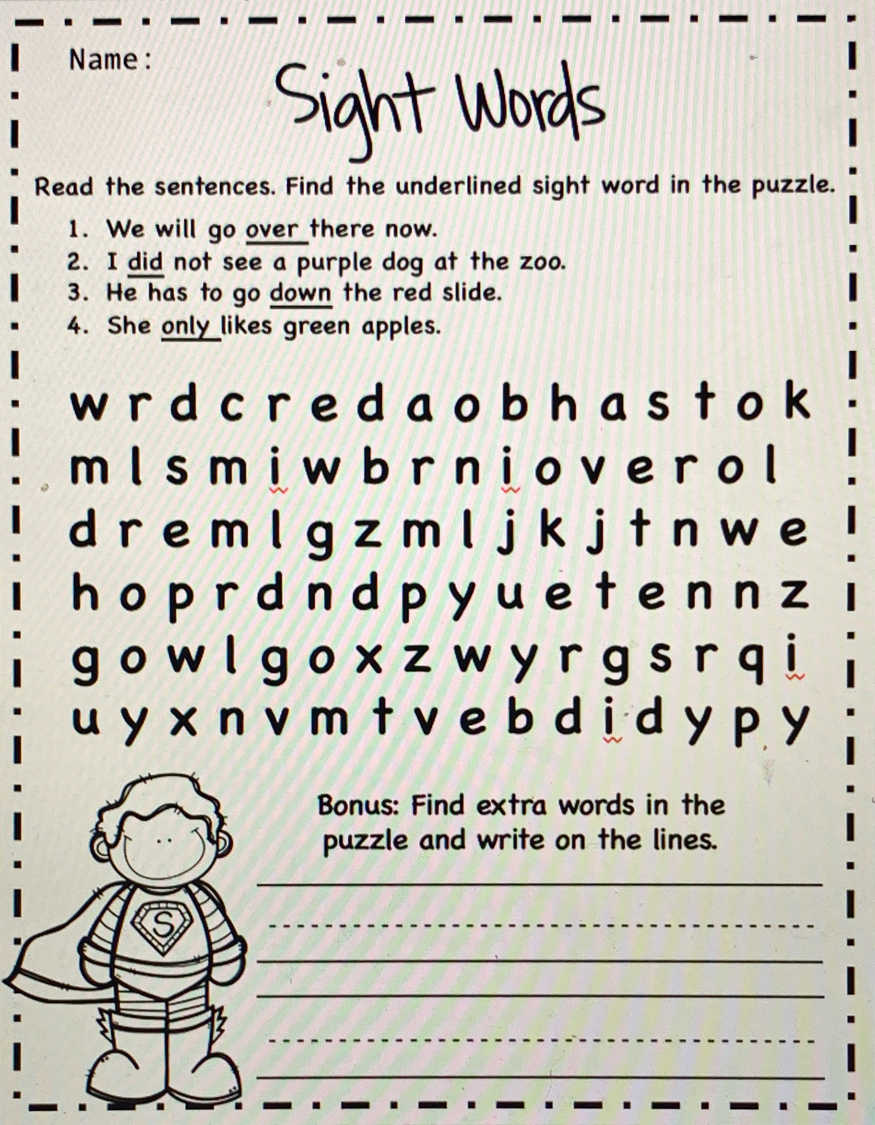

Slide 30
Optional Activity:
Lt. Gov. Hosemann would like to hear from students. He will be sharing some of these writings/drawings on social media and with senators. To submit to his office, email child's writing along with permission slip to Ltgov@senate.ms.gov. Students k-3 May submit this writing.

Slide 31
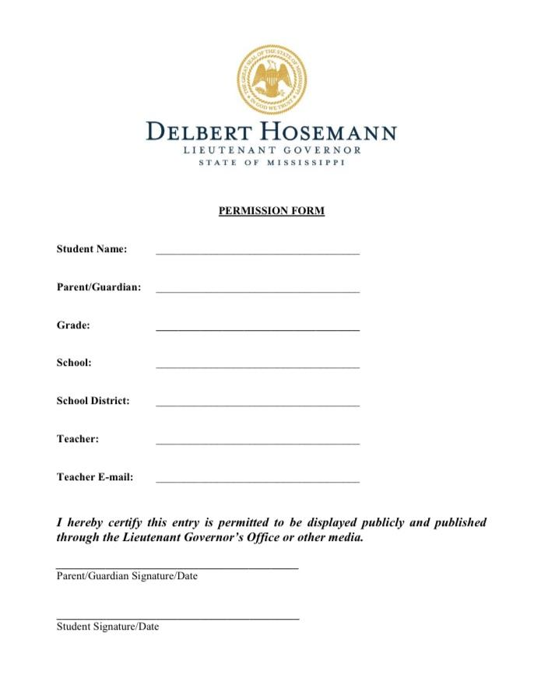

Slide 32
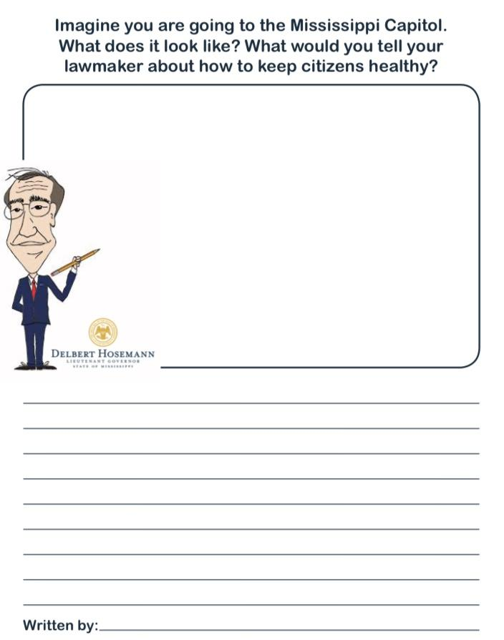
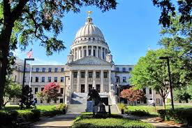

Slide 33
Online Resources Section
These are not links. On this page you will have to type the website name in the web browser, but these are great YouTube alternatives during this time of distance learning and all throughout the year!

Slide 34
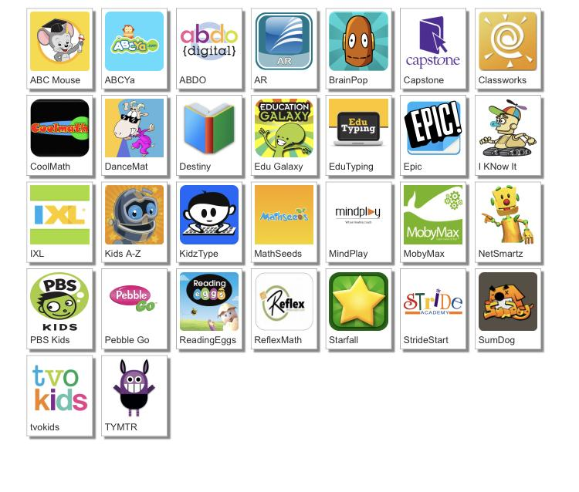
http://www.dcsdms.org/ll/

Slide 35
Message from the Teachers
We miss you guys. We are so proud of all of the hard work you guys have done. Listen to your parents. They are your teachers right now. We may do things differently, but we are all working together to do all that we can for you guys. We would love to see a picture of you working hard. You can send these to us via Remind. Keep working hard, and we hope to see you soon! :)

Slide 36
Note to the parents, thank you for investing in your child’s education!

