Slide 1
by William Shakespeare
fair is foul and foul is fair

Slide 2
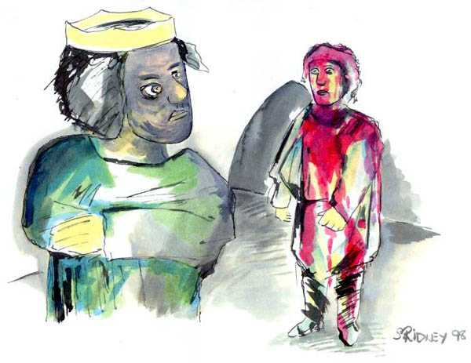
Written in 1605 – 1606
Set in 11th century Scotland = 1000 –1100

Slide 3
The essential questions:
What is a tragedy?
Motifs and imagery in Macbeth?
Thematic ideas in Macbeth?
How does Shakespeare use motifs and imagery to develop theme?

Slide 4
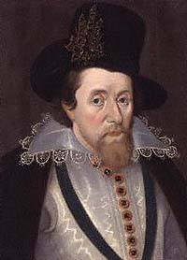
King James (r 1603 – 1625)
from Scotland
patron of Shakespeare
disliked long plays
wrote on divine right of kings
interested in witchcraft and demonology
claimed to be a direct descendant of Banquo, a character in Macbeth

Slide 5
Therefore:
Macbeth was written for James, takes place in Scotland, is Shakespeare’s shortest tragedy, involves the ascension of kings, features witches, and has the character of Banquo (the ancestor of James).

Slide 6
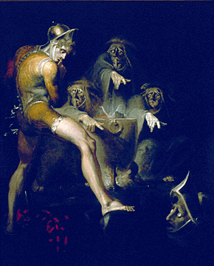
ELIZABETHAN AND JACOBEAN VIEWS ON WITCHES
firmly believed in the existence of witches
embodiment of evil
in league with Satan
supernatural powers
“tempters” to be avoided

Slide 7
The Cursed Play

Slide 8
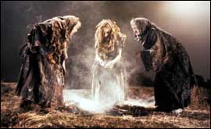
Legend says that Shakespeare included actual incantations from a book of black magic in the witches’ lines resulting in a curse on the play
For example -
1st performance – 1607 – boy playing Lady Macbeth fell ill and died. Shakespeare had to play the role.
1672 – a real dagger was used in Duncan’s murder and the actor playing Duncan died

Slide 9
More examples …
1721 – altercation between actors and a nobleman resulted in burning the theater down
•1775 – Sarah Siddons, playing Lady M, attacked by the audience
•1849 – riot broke out during performance resulting in 23 deaths
•1926 – actress Sybil Thorndyke
nearly strangled onstage by actor
•1928 – set fell, seriously
injuring several cast members

Slide 10
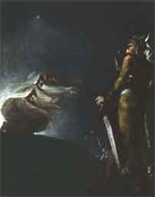
And more …
1930 – Lillian Boyliss, playing Lady M, died during the final dress rehearsal
•1947 – actor stabbed onstage during
swordfight and died
•1953 – Charlton Heston caught on fire
•1960s – actor playing Macbeth died onstage

Slide 11
Do not say the name “Macbeth” INSIDE a theater – refer to it as “the Scottish play”
To reverse the curse –cleanse the air with a quotation from Hamlet:
"Angels and Ministers of Grace, defend us!

Slide 12
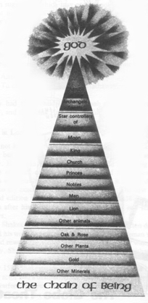
Elizabethan Order of the Universe
Elizabethans believed the universe followed a divine order, a hierarchy ordained by God. This divine order was called the “Great Chain of Being”

Slide 13
Elizabethan Order of the Universe
God
Angels
King
Church
Nobles
knights
gentlemen
peasants
Animals
Plants
Minerals
Within each category, further subdivisions can be made (i.e., the lion is the highest animal, gold the chief metal). Within Macbeth, trace violations of this order and examples of disorder.
MaNkind/
Humans

Slide 14
Elizabethan Order of the Universe
Elizabethans believed any disruption in this order (i.e., a rabbit kills a lion or a peasant kills a nobleman) would result in chaos on earth.
The king was God’s representative on earth and in the highest position of any mortal.
What would the Elizabethan audience expect if a nobleman assassinated a king?

Slide 15
Motifs –
blood
false appearances
hands
animals
sleep

Slide 16
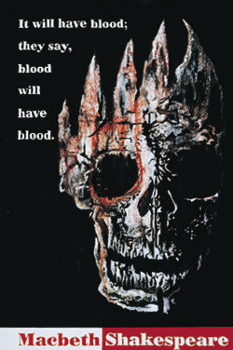
More motifs–
darkness/sight
manhood
nature/unnatural
birds
clothing

Slide 17
Thematic Ideas–
lust for power
effects of guilt
appearance vs. reality
good/evil
natural order

Slide 18
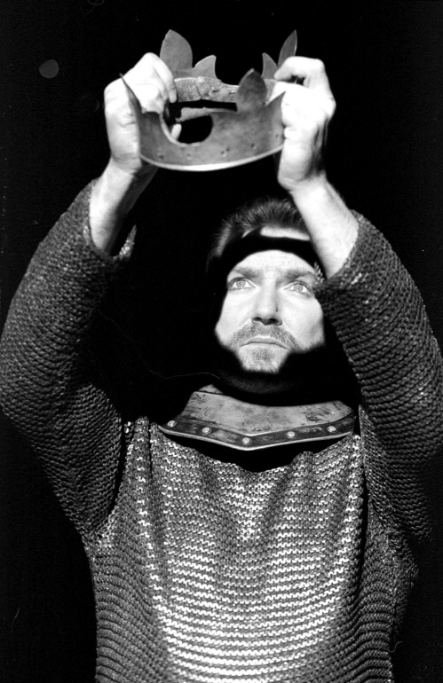
A literary work depicting serious events in which the main character, often high-ranking and dignified, comes to an unhappy end.
TRAGEDY

Slide 19
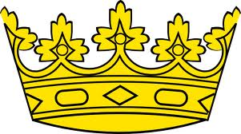
Characteristics of a Tragic Hero
Must be of noble blood. The idea of “that could happen to me!” produces a sense of fear in the audience.
Modern tragedy may show the tragic hero as “everyman,” not necessarily nobility.

Slide 20
Characteristics of a Tragic Hero
The tragic hero meets his fate because of a "tragic flaw" (HARMATIA). The tragic flaw is not a defect in character, but an error in judgment of the kind we all make. Since we all make mistakes, this generates "fear" in that we recognize our own potential for tragedy by committing the same errors. It also generates "pity" because we do not blame the hero for his tragic fate.
We quickly find out what Macbeth’s tragic flaw is, and how the witches use it to their advantage!

Slide 21
Tragic Heroes are
Born into nobility
Morally like the “average person” – neither better nor worse
Responsible for their own fate (in Shakespeare)
Endowed with a “tragic flaw” (harmatia) that makes them susceptible to fall from their position
Doomed to make a serious error in judgment

Slide 22
Eventually tragic heroes
· Fall from positions of respect or esteem
· Realize they have made an irreversible mistake
· Meet a tragic death and accept that death with honor

Slide 23
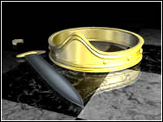
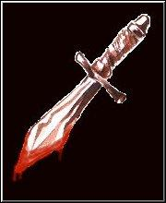
The Language of Macbeth
Almost all of Macbeth is in blank verse, unrhymed iambic pentameter.
Macbeth and Lady Macbeth use blank verse.
The witches use rhymed iambic tetrameter.
Notice who uses prose (anything not in poetry)

Slide 24
Fair is foul and foul is fair,
Hover through fog and filthy air.
By the pricking of my thumbs,
Something wicked this way comes.

Slide 25
PowerPoint presentation created by Jenny Burdette, Dacula High School
Edited by Crystal Russell, Houston County High

