Slide 1
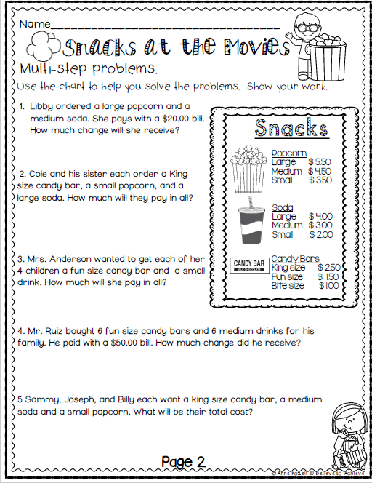
Friday, November 8, 2019
Friday: Classworks
M - Caydance - 1
M – Landon - 2
Free Time – Paisleigh – 3
Free Time – Brena - 4
M – Jaylie – 5
M – Macon – 6
M – Kaylee - 7
M – Elin - 8
Free Choice – Cayli – 9
7:55 – 8:30

Slide 2
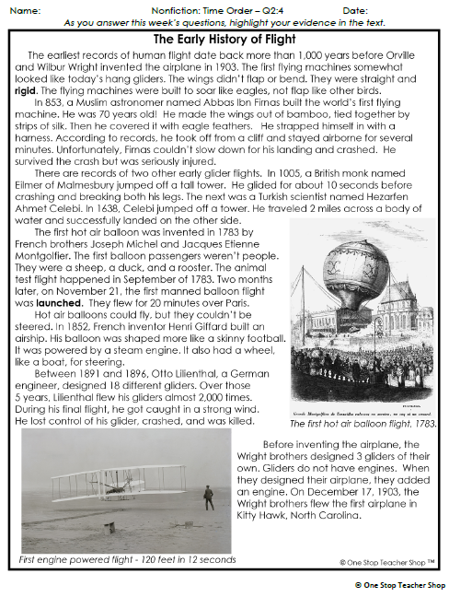
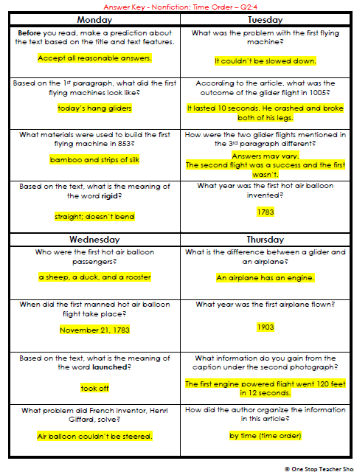
Reading Homework

Slide 3
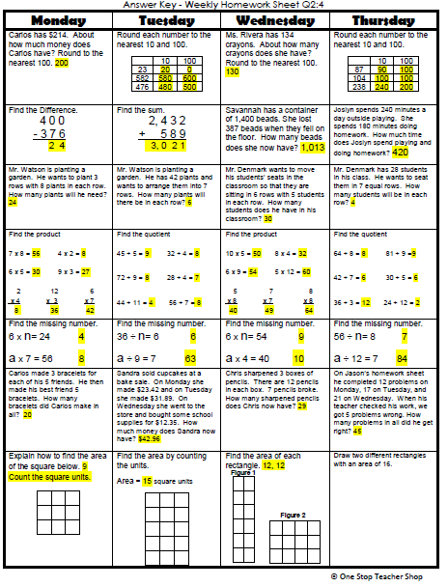
Math Homework

Slide 4
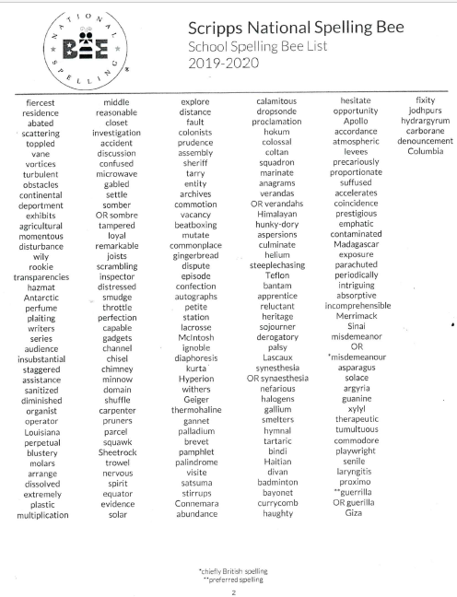

Reminder:
Classroom Spelling Bee
November 12th

Slide 5
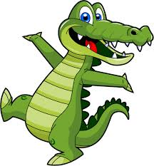
CHOMP TIME
F.A.S.T. Groups
Focused Academic Support Time

Slide 6
F.A.S.T. Designations
Computers – EPIC: - Katelynn - 1 - Caydance - 2 - Kaylah - 3 - Emma - 4 – McKenzie – 5 – Jaylie - 6 - Macon - 7 - Khamani - 8 Classworks M - Adalyn – 9 Classworks M – Kaylee - TC | Mrs. Roby: LLI Jaiden Paisleigh | Mrs. Thompson: Check In McKenzie Erin Noah Elin Katelynn | Free Book Choice: Everyone else
Landon – Phonics 1st with Mrs. Page
Macon – SIPPS with Mrs. Bess
8:40 – 9:10

Slide 7

Restroom Break
9:10 – 9:20

Slide 8
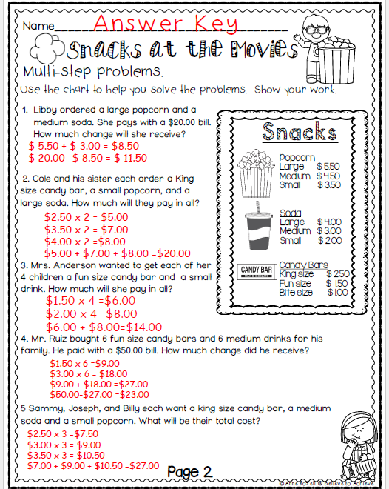
9:20 – 9:50

Slide 9
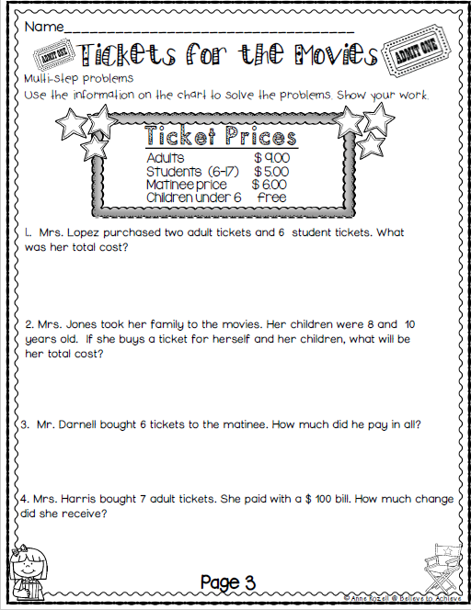
Independent Practice

Slide 10
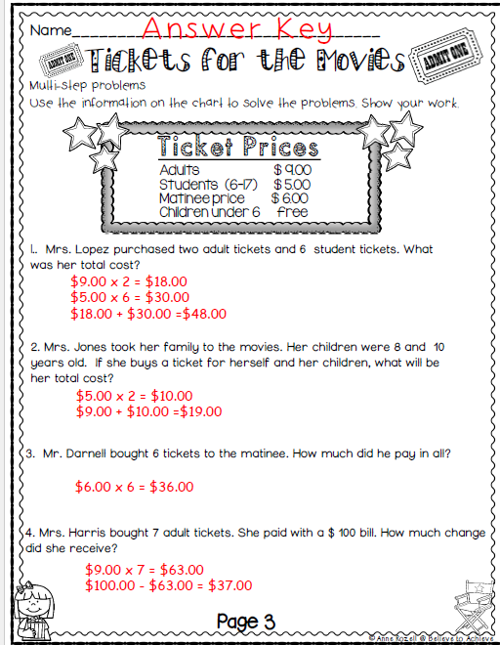

Slide 11

Veterans Day Program
9:50 – 11:20

Slide 12
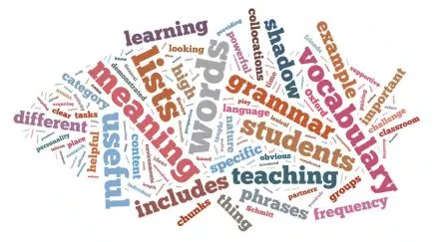


Vocabulary & Grammar Time
11:20 – 11:35

Slide 13

motion – tell someone something through a movement of the hand, head, or other part of the body
P10-11 (first two paragraphs)
Ben decides to hire Francisco and his grandfather.
In addition to using words to tell Francisco and his grandfather to jump into the truck, he also motions to them.
Watch as I motion for one of you to stand up.

Slide 14

motion
What did you see me do when I motioned for a volunteer to stand up? – Turn to your Partner
  When _________ motioned for ___________ to stand up, (he/she)…

Slide 15
motion
How might you motion for someone to sit down? – Turn to your Partner
  To motion for someone to sit down, I might…

Slide 16
motion
How might you motion for someone to be quiet? – Turn to your Partner
  To motion for someone to sit down, I might…

Slide 17
motion
How might you motion for someone to follow them? – Turn to your Partner
  To motion for someone to sit down, I might…

Slide 18
What’s the new word we are learning that means “tell someone something through a movement of the hand, head, or other part of the body”?
motion

Slide 19
prowl – move quietly or secretly, trying not to be seen or heard
P18-19 (first 3 paragraphs)
Animals such as cats prowl, or move quietly, or secretly, when they are hunting other animals.
Watch closely as I act out how a person might prowl.
What did you notice me doing when I prowled? Turn to your partner When Mrs. ____ prowled, she…

Slide 20
prowl
Why might a person prowl? – Turn to your Partner
  A person might prowl because…

Slide 21
What’s the new word we are learning that means “move quietly or secretly, trying not to be seen or heard”?
prowl

Slide 22
Blow Your Top – get very angry
P22-23
Ben discovers that Francisco and Abuelo have dug up the plants and left the weeds.
Ben blows his top, or gets very angry, when he discovers Franciso and Abuelo’s mistake.
“Blow your top” is an idiom.
Remember, an idiom is an “expression or phrase” that means something different from what it appears to mean.

Slide 23
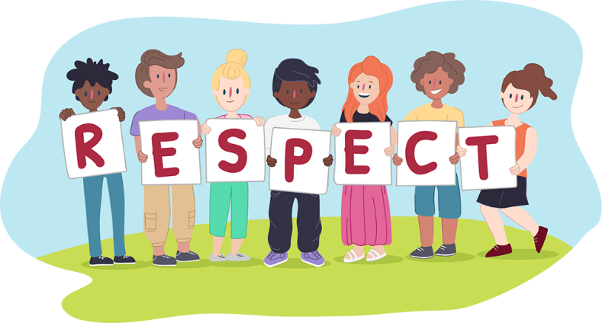
Blow your top…or not
I will describe a situation and your partner and you will discuss whether the situation would make you blow your top, and why.
Remember, you may not always agree with your partner, but you must be respectful and explain your thinking.

Slide 24
Blow your top…or not
Your best friend says she will go to a movie with you on Saturday. You’re excited because it’s a movie you really want to see. Then, on Saturday morning, your friend tells you she can’t go.
Would you blow your top if your friend said she couldn’t go to the movie? Why? – Turn to your Partner
  I would/would not blow my top because…

Slide 25
Blow your top…or not
You worked very hard to build a model volcano for a science project. You are carrying it to school and you trip. You drop the volcano, and it breaks into pieces.
Would you blow your top? Why? – Turn to your Partner
  I would/would not blow my top because…

Slide 26
Blow your top…or not
You are wearing a brand new jacket. You are walking across the playground and the sprinklers come on, soaking you from head to toe.
Would you blow your top? Why? – Turn to your Partner
  I would/would not blow my top because…

Slide 27
What’s the new phrase we are learning that means “get very angry”?
Blow your top

Slide 28

Independent Daily Reading & Teacher Conferences
  Mrs. Roby
  LLI:
  Kaylah
  Kaylee
  Emma
  Adalyn
  Mrs. Thompson:
  LLI
  Landon
  Paisleigh
  Jaiden
  Macon
  FREE CHOICE
  - Katelynn - 1
  - Caydance - 2
  - Noah - 3
  - Cohen - 4
  – McKenzie – 5
  – Jaylie - 6
  - Macon - 7
  Khamani - 8
  Elin – 9
Everyone else: Flashlight Friday!!
11:35 – 12:05

Slide 29
Indoor Recess
Recess 12:05 -12:35

Slide 30

Out of Classroom!
Lunch 12:35 – 1:05

Slide 31
Restroom Break
1:05 – 1:10

Slide 32

Out of Classroom!
No Activity 1:10 – 1:55
  First for FREE CHOICE
  - Landon - 1
  - Kaylah - 2
  - Emma - 3
  - Adalyn - 4
  – Kaylee – 5

Slide 33
Math Fluency & Focus Lesson!
1:55 – 3:10

Slide 34
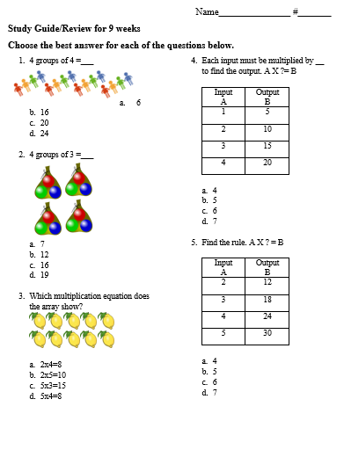
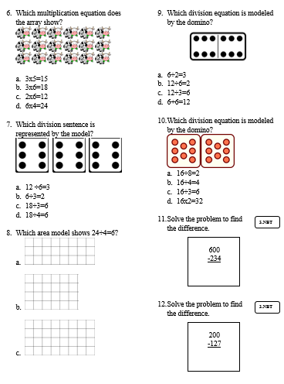
Paired Partners 10 minutes!
1:55 – 2:10 (review 2:10 – 2:15)

Slide 35
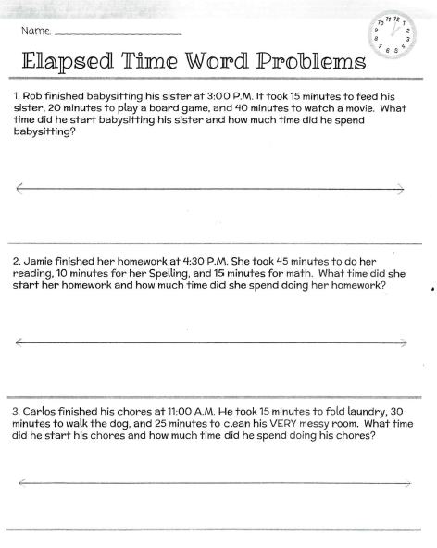
Extra practice and then more practice!

Slide 36
Restroom Break
3:10 – 3:15

Slide 37

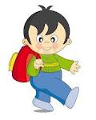


3:10 – 3:15 Wrap Up!
Pair-Up back to back and share one thing you learned in class today with your partner
Pack-Up
Office will announce:
Car Riders – Leave around 3:20
Bus Riders – (listen to intercom for dismissal)
2:30 – 3:20
How much time has elapsed?

