Slide 1
Myers’ Psychology for AP*
David G. Myers
PowerPoint Presentation Slides
by Kent Korek
Germantown High School
Worth Publishers, © 2010
*AP is a trademark registered and/or owned by the College Board, which was not involved in the production of, and does not endorse, this product.

Slide 2
Unit 6: Learning

Slide 3
Unit Overview
How Do We Learn?
Classical Conditioning
Operant Conditioning
Learning by Observation
Click on the any of the above hyperlinks to go to that section in the presentation.

Slide 4
How Do We Learn?

Slide 5
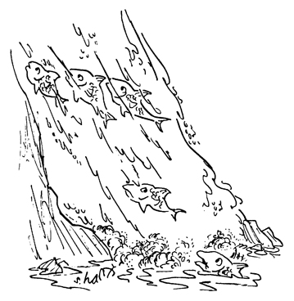
Introduction
Learning
Habituation
Associative learning
Classical conditioning
Operant conditioning
Observational learning

Slide 6
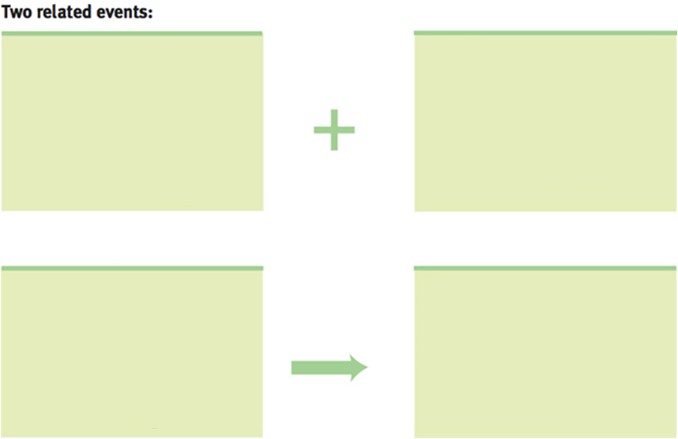
Classical Conditioning

Slide 7
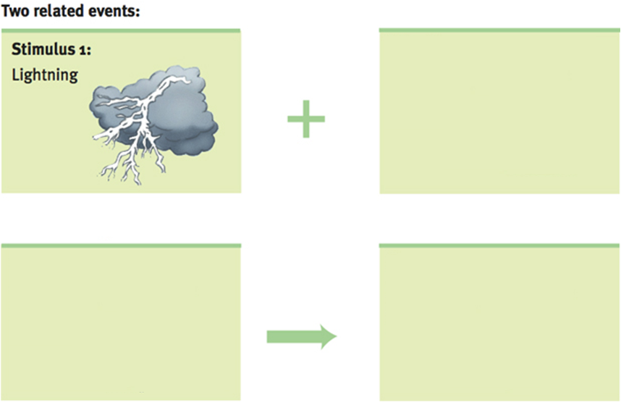
Classical Conditioning

Slide 8
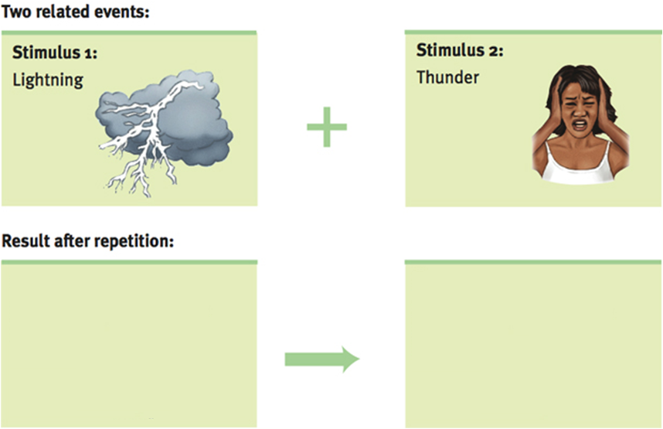
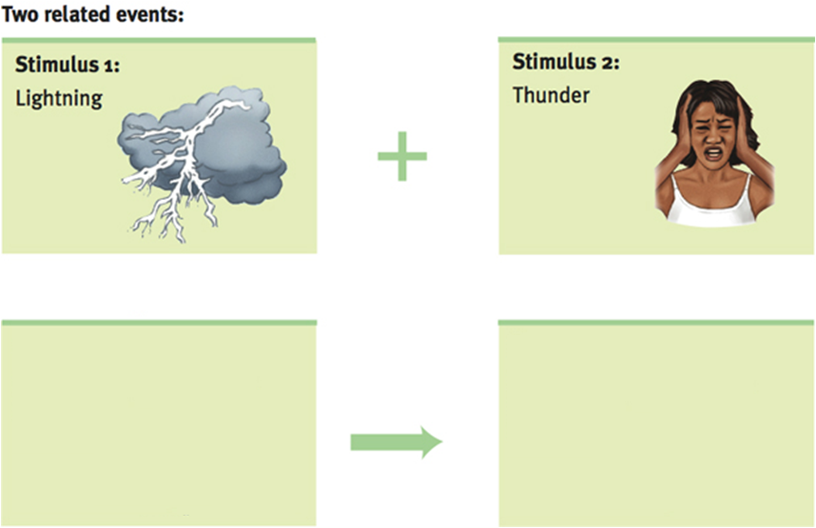
Classical Conditioning

Slide 9
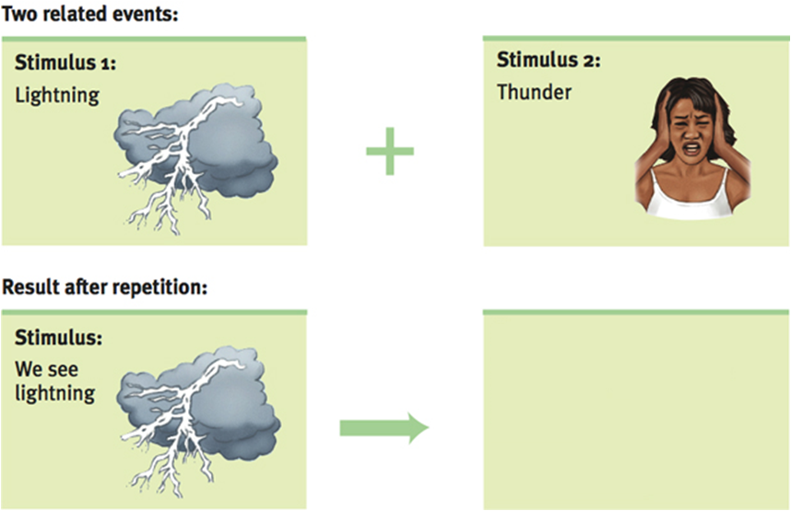
Classical Conditioning

Slide 10
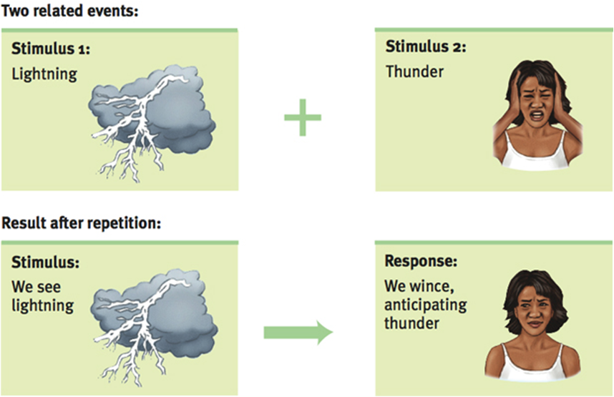
Classical Conditioning

Slide 11
Operant Conditioning

Slide 12
Operant Conditioning

Slide 13
Operant Conditioning

Slide 14
Classical Conditioning

Slide 15
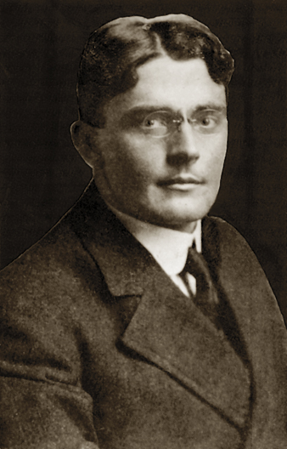
Introduction
Classical conditioning
Ivan Pavlov
John B. Watson
Behaviorism

Slide 16
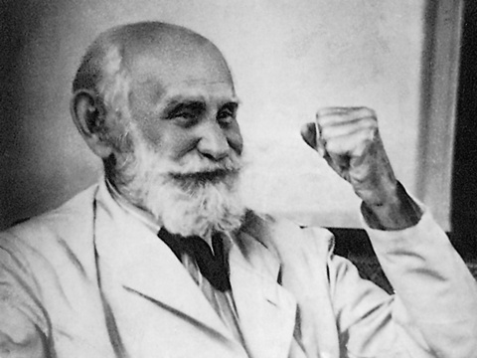
Pavlov’s Experiments
Ivan Pavlov
Background
Experimental procedure

Slide 17
Pavlov’s Experiments
Parts of Classical Conditioning
Unconditioned stimulus (US)
Unconditioned response (UR)
Conditioned stimulus (CS)
Conditioned response (CR)

Slide 18
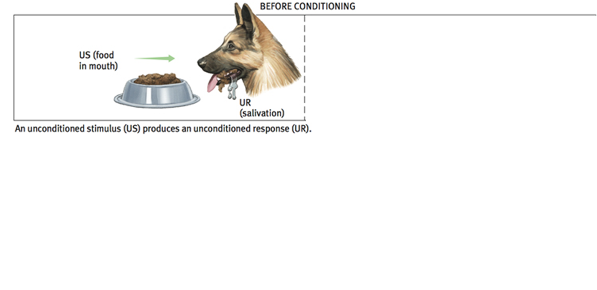
Pavlov’s Experiments

Slide 19
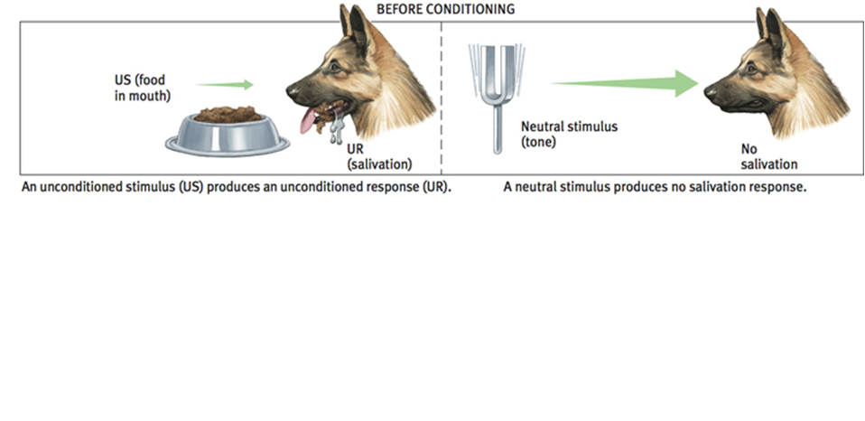
Pavlov’s Experiments

Slide 20
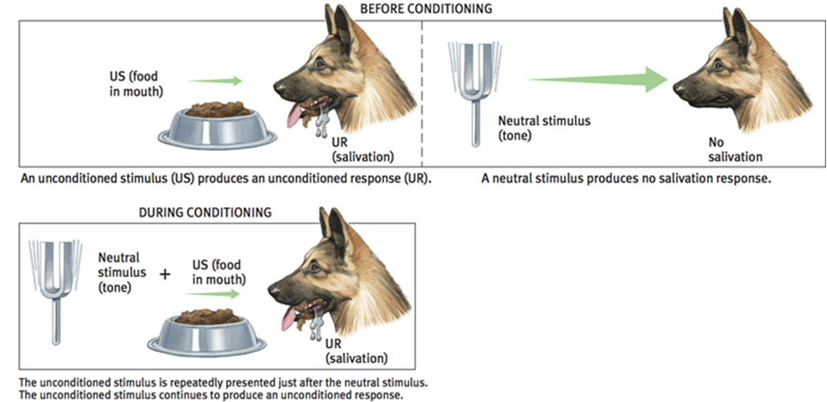
Pavlov’s Experiments

Slide 21
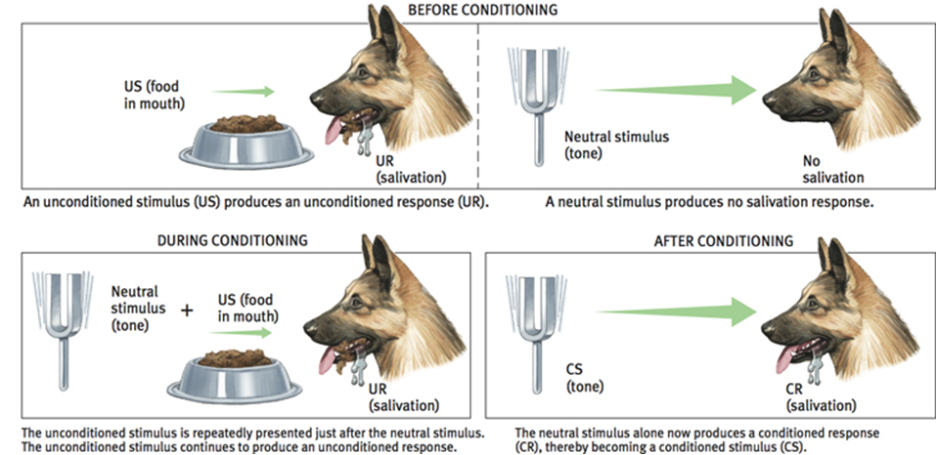
Pavlov’s Experiments

Slide 22
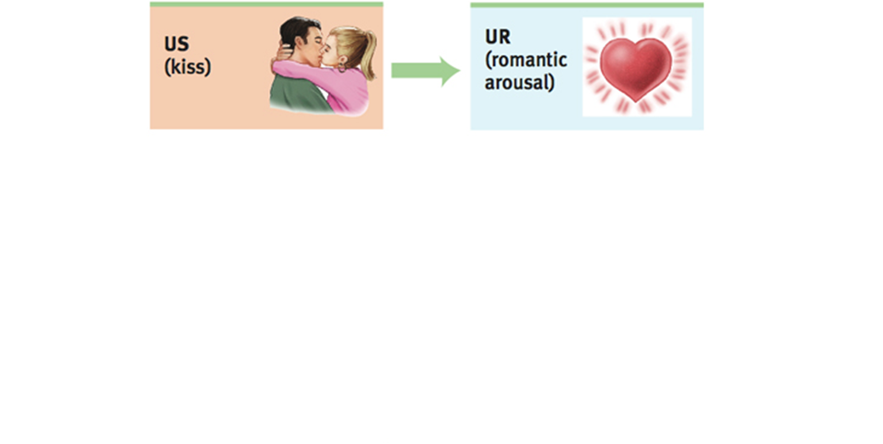
Classical Conditioning

Slide 23
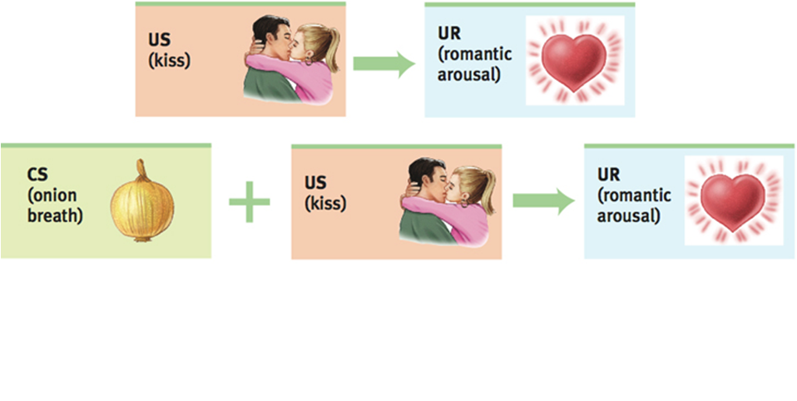
Classical Conditioning

Slide 24
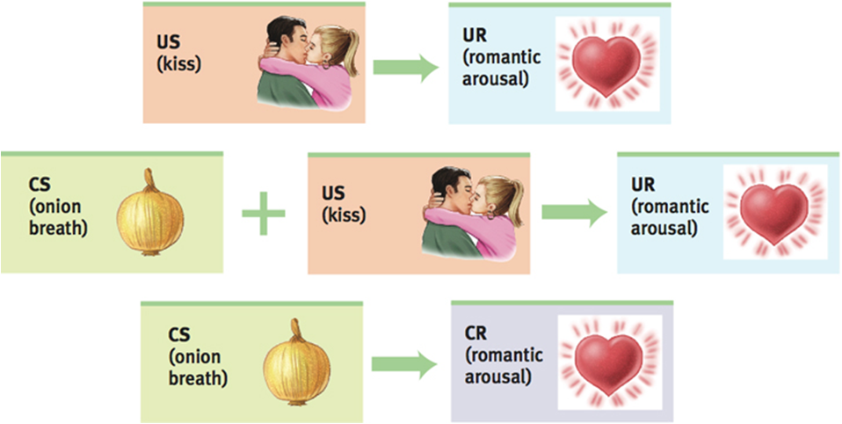
Classical Conditioning

Slide 25
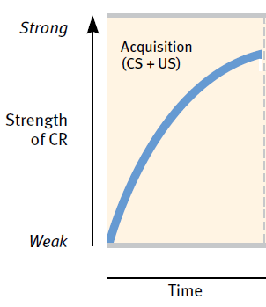
Pavlov’s Experiments Acquisition
Acquisition
Higher-order conditioning

Slide 26
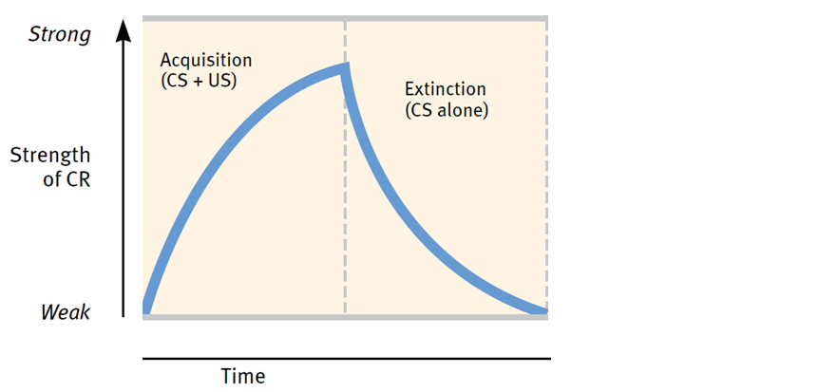
Pavlov’s Experiments Extinction and Spontaneous Recovery
Extinction

Slide 27
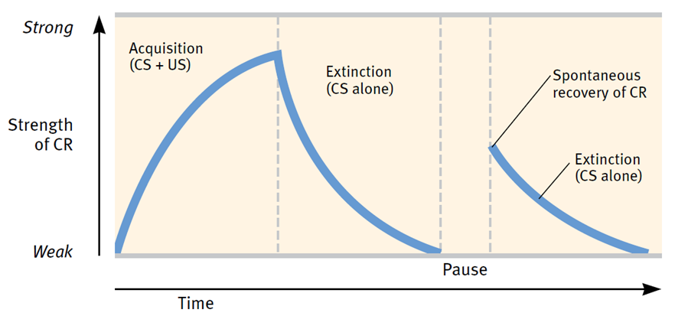
Pavlov’s Experiments Extinction and Spontaneous Recovery
Extinction
Spontaneous recovery

Slide 28
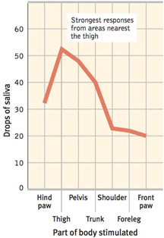
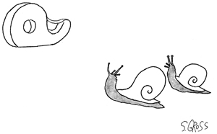
Pavlov’s Experiments Generalization
Generalization

Slide 29
Pavlov’s Experiments Discrimination
Discrimination

Slide 30
Extending Pavlov’s Understanding
Cognitive Processes
Learned helplessness
Biological Predispositions
Conditioned taste aversion

Slide 31
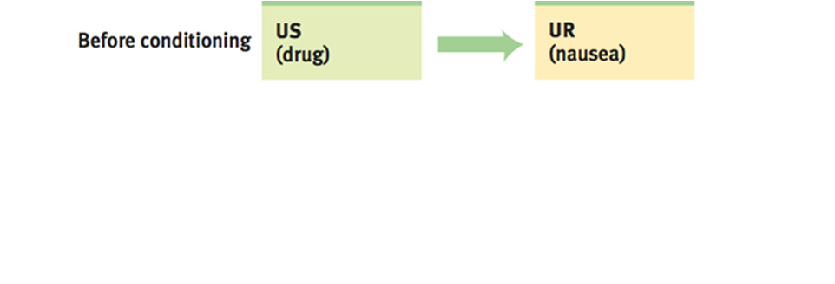
Extending Pavlov’s Understanding

Slide 32
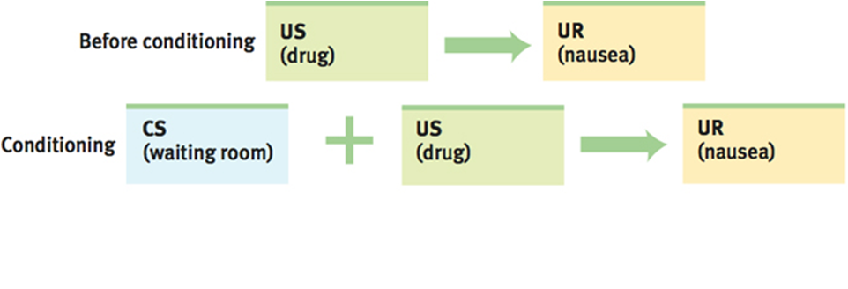
Extending Pavlov’s Understanding

Slide 33
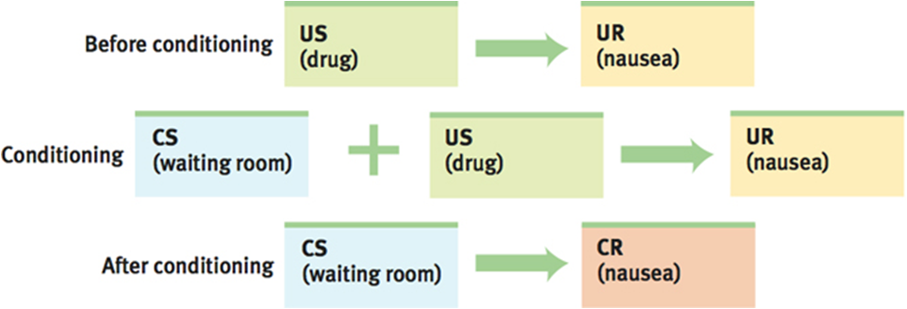
Extending Pavlov’s Understanding

Slide 34
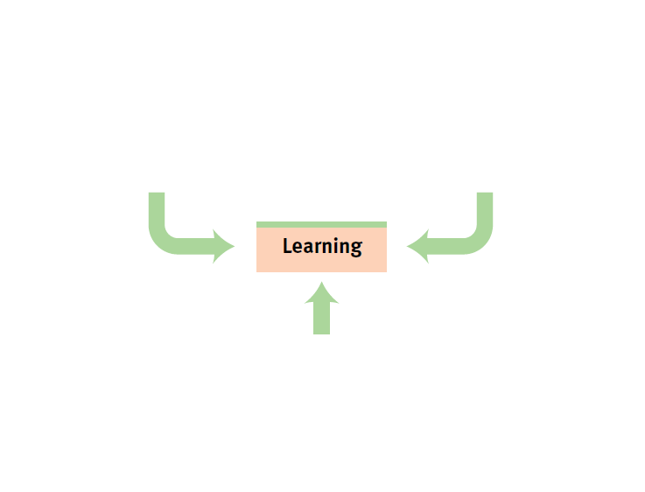
Biopsychosocial Influences on Learning

Slide 35
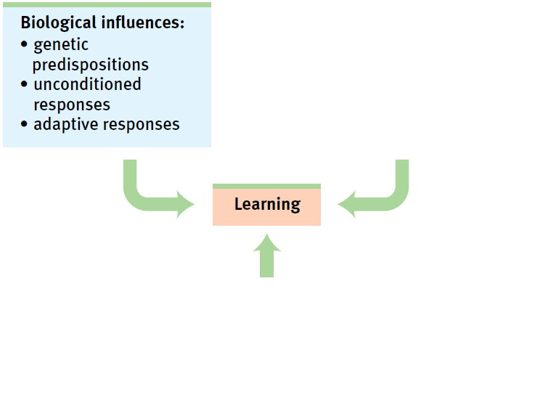
Biopsychosocial Influences on Learning

Slide 36
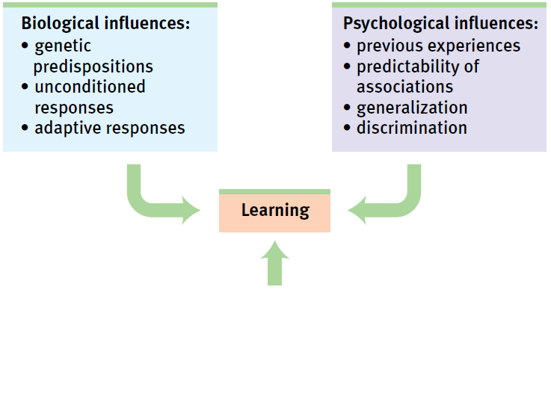
Biopsychosocial Influences on Learning

Slide 37
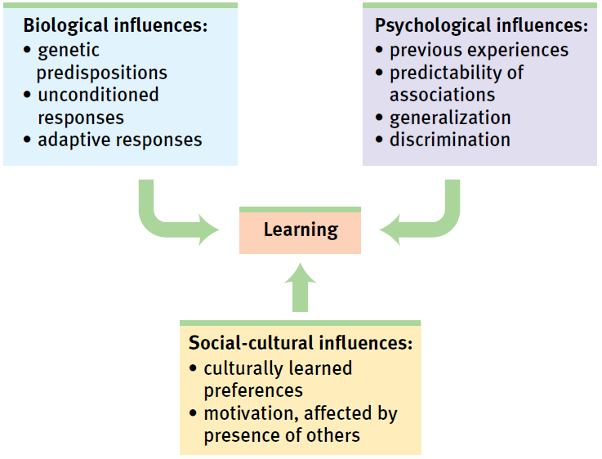
Biopsychosocial Influences on Learning

Slide 38
Pavlov’s Legacy
Classical conditioning applies to other organisms
Showed how to study a topic scientifically

Slide 39
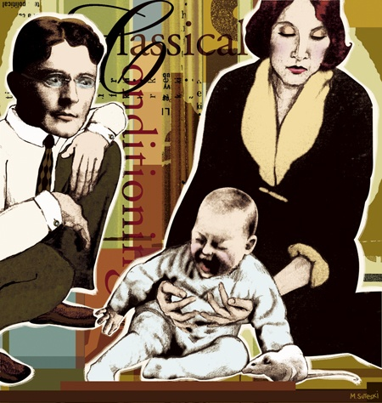
Pavlov’s Legacy Applications of Classical Conditioning
John Watson and Baby Albert

Slide 40
Operant Conditioning

Slide 41
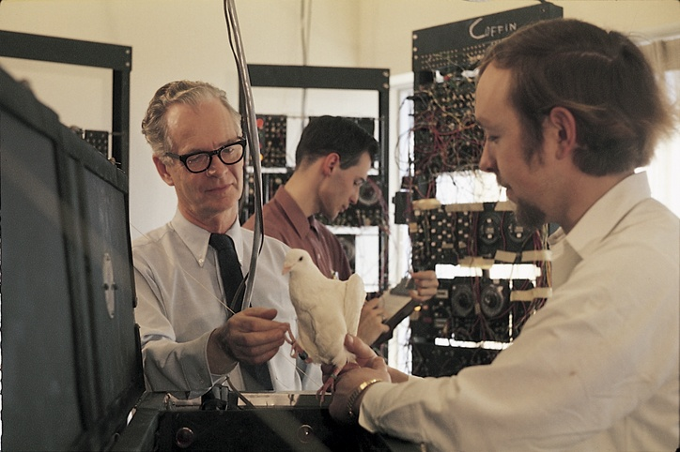
Introduction
Respondent behavior
Operant conditioning
Operant behavior

Slide 42
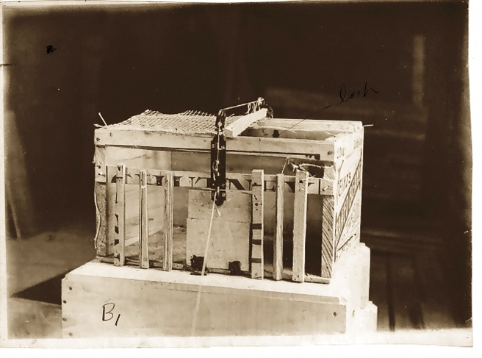
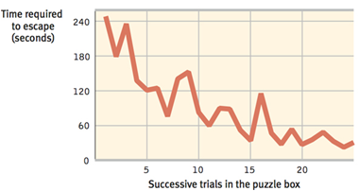
Skinner’s Experiments
Edward Thorndike’s Law of Effect
B.F. Skinner
Behavioral technology
Behavior control

Slide 43
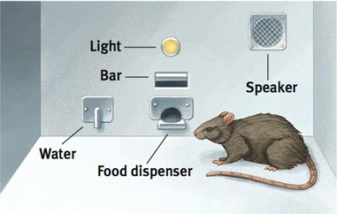
Skinner’s Experiments
Operant Chamber (Skinner Box)

Slide 44
Skinner’s Experiments Shaping Behavior
Shaping
Successive approximations
Discriminative stimulus

Slide 45
Skinner’s Experiments Types of Reinforcers
Reinforcer
Positive reinforcement
Negative reinforcement

Slide 46
Skinner’s Experiments Types of Reinforcers
Reinforcer
Positive reinforcement
Negative reinforcement

Slide 47
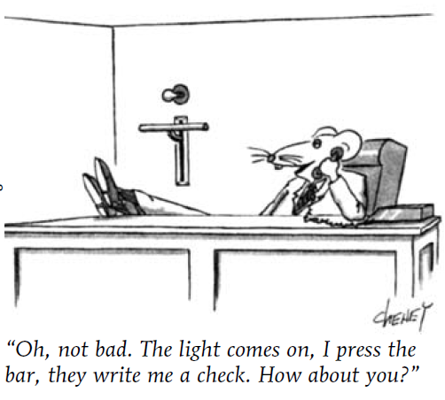
Skinner’s Experiments Types of Reinforcers
Primary reinforcer
Conditioned reinforcer
Secondary reinforcer
Immediate vs delayed reinforcers

Slide 48
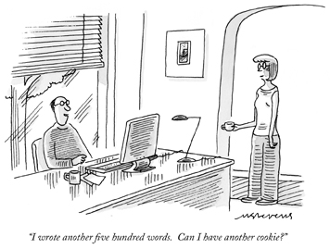
Skinner’s Experiments Reinforcement Schedules
Continuous reinforcement
Partial (intermittent) reinforcement
Schedules
Fixed-ratio schedule
Variable-ratio schedule
Fixed-interval schedule
Variable-interval schedule

Slide 49
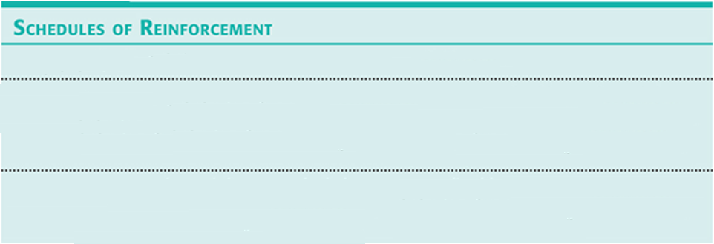
Skinner’s Experiments Reinforcement Schedules

Slide 50
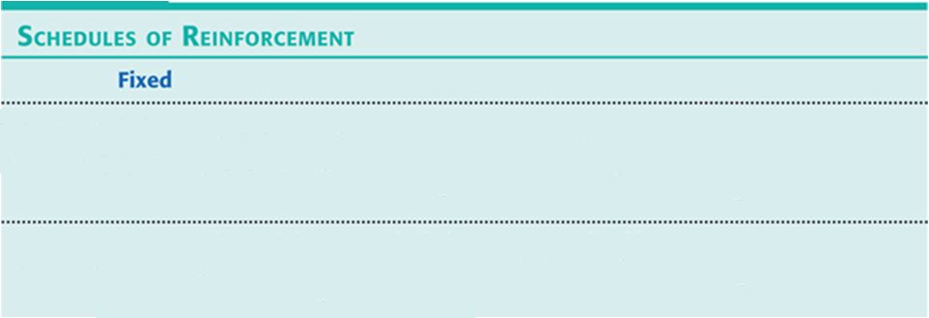
Skinner’s Experiments Reinforcement Schedules

Slide 51
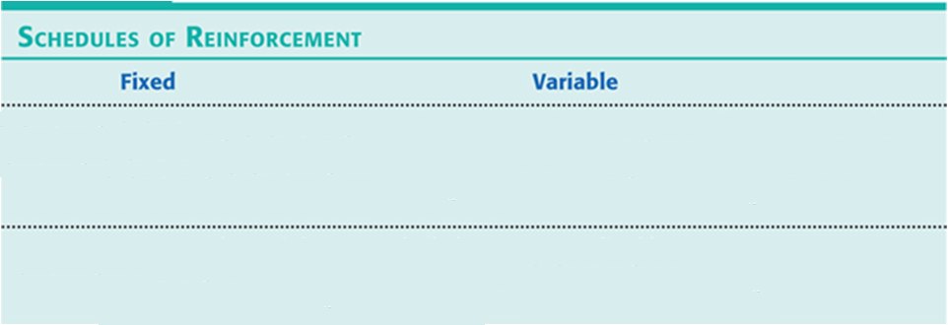
Skinner’s Experiments Reinforcement Schedules

Slide 52
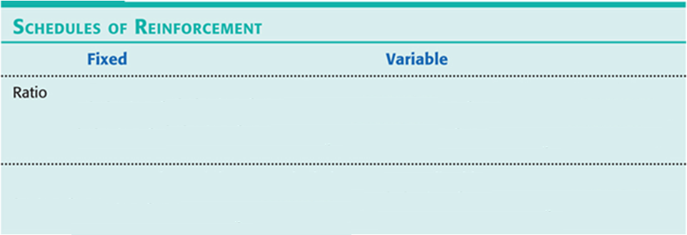
Skinner’s Experiments Reinforcement Schedules

Slide 53
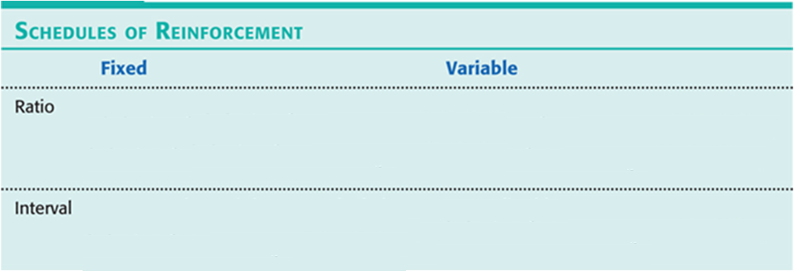
Skinner’s Experiments Reinforcement Schedules

Slide 54
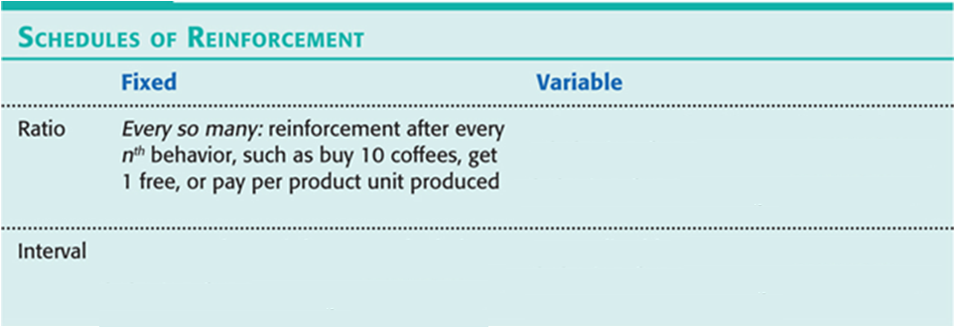
Skinner’s Experiments Reinforcement Schedules

Slide 55
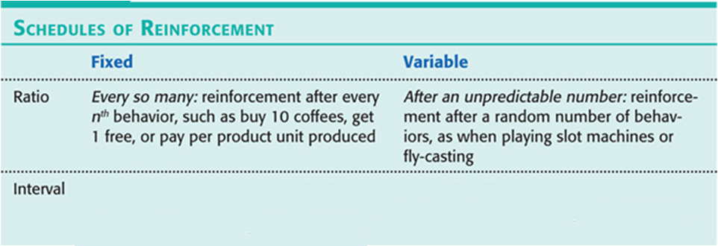
Skinner’s Experiments Reinforcement Schedules

Slide 56
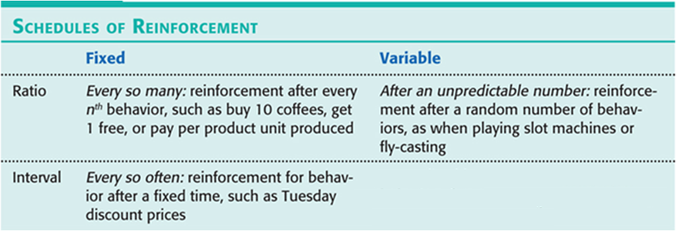
Skinner’s Experiments Reinforcement Schedules

Slide 57
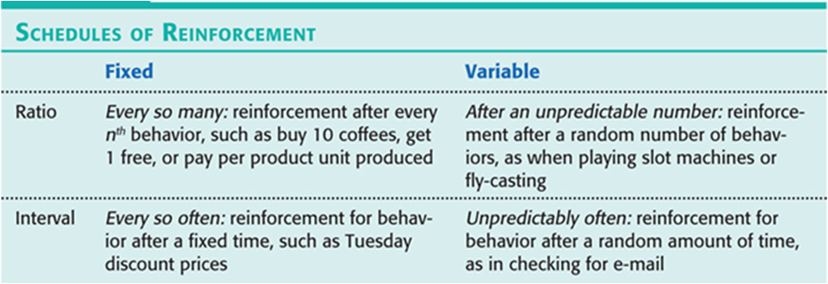
Skinner’s Experiments Reinforcement Schedules

Slide 58
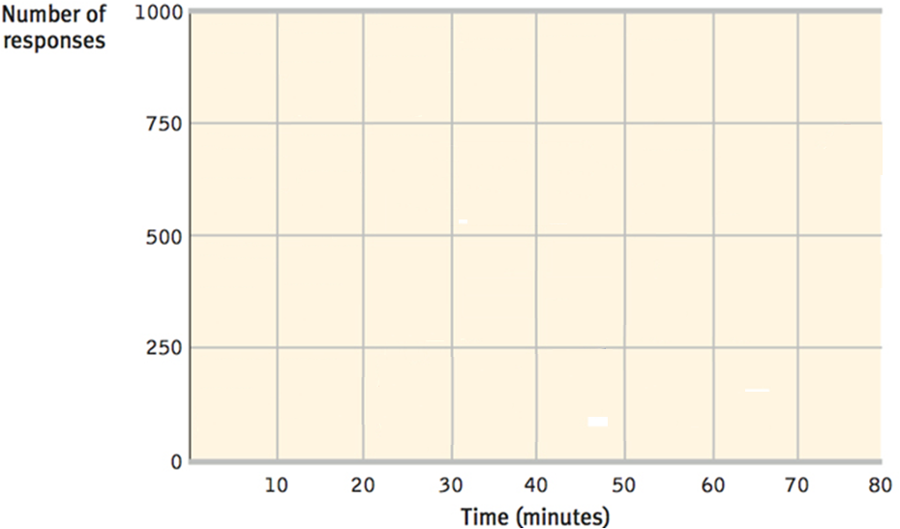
Skinner’s Experiments Reinforcement Schedules

Slide 59
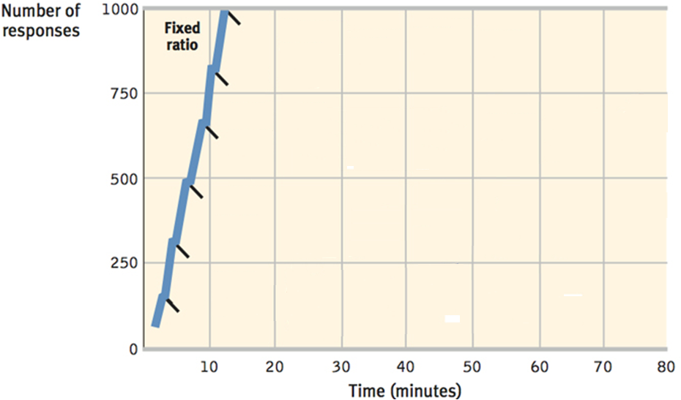
Skinner’s Experiments Reinforcement Schedules

Slide 60
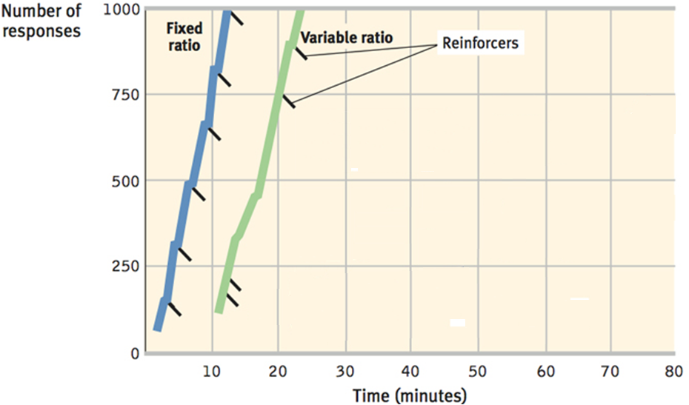
Skinner’s Experiments Reinforcement Schedules

Slide 61
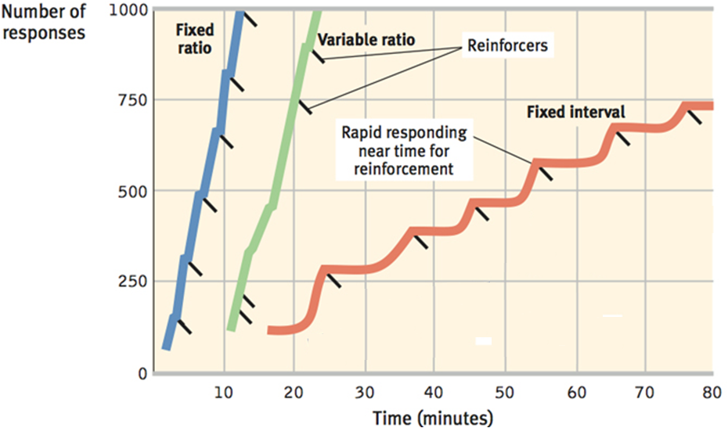
Skinner’s Experiments Reinforcement Schedules

Slide 62
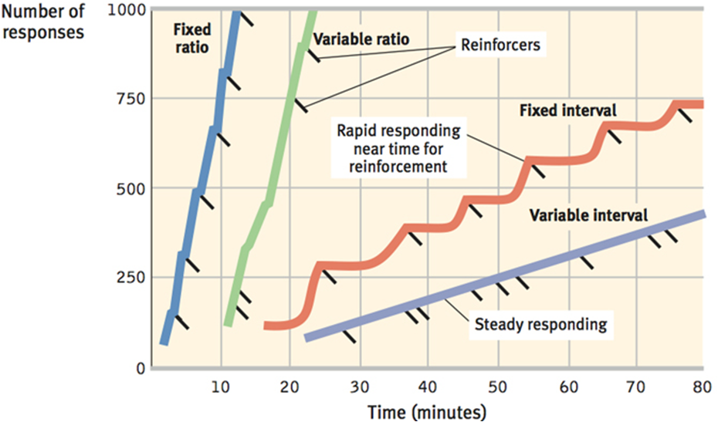
Skinner’s Experiments Reinforcement Schedules

Slide 63
Skinner’s Experiments Punishment
Punishment
Positive punishment
Negative punishment

Slide 64
Skinner’s Experiments Punishment

Slide 65
Skinner’s Experiments Punishment

Slide 66
Skinner’s Experiments Punishment

Slide 67
Skinner’s Experiments Punishment

Slide 68
Skinner’s Experiments Punishment

Slide 69
Skinner’s Experiments Punishment
Negatives of using punishment
Punished behavior is suppressed not forgotten
Punishment teaches discrimination
Punishment can teach fear
Physical punishment may increase aggression

Slide 70
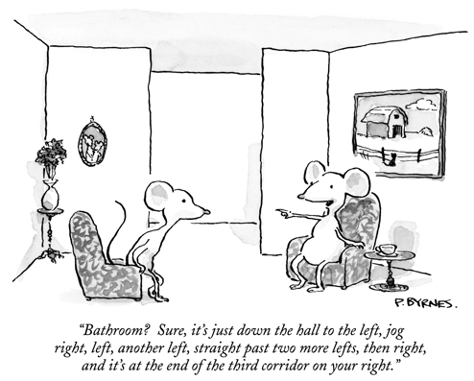
Extending Skinner’s Understanding Cognition and Operant Conditioning
Latent learning
Cognitive map
Insight learning
Intrinsic motivation
Extrinsic motivation

Slide 71
Extending Skinner’s Understanding Biological Predispositions
Biological constraints predispose organisms to learn associations that are naturally adaptive

Slide 72
Skinner’s Legacy Applications of Operant Conditioning
At school
In sports
At home
For self- improvement

Slide 73
Contrasting Classical and Operant Conditioning
Similarities between classical and operant conditioning
Differences between classical and operant conditioning

Slide 74
Contrasting Classical and Operant Conditioning

Slide 75
Contrasting Classical and Operant Conditioning

Slide 76
Contrasting Classical and Operant Conditioning

Slide 77
Contrasting Classical and Operant Conditioning

Slide 78
Contrasting Classical and Operant Conditioning

Slide 79
Contrasting Classical and Operant Conditioning

Slide 80
Contrasting Classical and Operant Conditioning

Slide 81
Contrasting Classical and Operant Conditioning

Slide 82
Contrasting Classical and Operant Conditioning

Slide 83
Contrasting Classical and Operant Conditioning

Slide 84
Contrasting Classical and Operant Conditioning

Slide 85
Contrasting Classical and Operant Conditioning

Slide 86
Contrasting Classical and Operant Conditioning

Slide 87
Contrasting Classical and Operant Conditioning

Slide 88
Contrasting Classical and Operant Conditioning

Slide 89
Contrasting Classical and Operant Conditioning

Slide 90
Contrasting Classical and Operant Conditioning

Slide 91
Contrasting Classical and Operant Conditioning

Slide 92
Contrasting Classical and Operant Conditioning

Slide 93
Contrasting Classical and Operant Conditioning

Slide 94
Contrasting Classical and Operant Conditioning

Slide 95
Contrasting Classical and Operant Conditioning

Slide 96
Contrasting Classical and Operant Conditioning

Slide 97
Contrasting Classical and Operant Conditioning

Slide 98
Contrasting Classical and Operant Conditioning

Slide 99
Contrasting Classical and Operant Conditioning

Slide 100
Contrasting Classical and Operant Conditioning

Slide 101
Contrasting Classical and Operant Conditioning

Slide 102
Learning by Observation

Slide 103
Introduction
Observational learning
Social learning
Modeling

Slide 104
Mirrors in the Brain
Mirror neurons
Theory of mind

Slide 105
Bandura’s Experiments
Bandura’s bobo doll experiment

Slide 106
Bandura’s Experiments

Slide 107
Bandura’s Experiments

Slide 108
Applications of Observational Learning Prosocial vs Antisocial Effects
Prosocial effects
Antisocial effects

Slide 109
The End

Slide 110
Teacher Information
Types of Files
This presentation has been saved as a “basic” Powerpoint file. While this file format placed a few limitations on the presentation, it insured the file would be compatible with the many versions of Powerpoint teachers use. To add functionality to the presentation, teachers may want to save the file for their specific version of Powerpoint.
Animation
Once again, to insure compatibility with all versions of Powerpoint, none of the slides are animated. To increase student interest, it is suggested teachers animate the slides wherever possible.
Adding slides to this presentation
Teachers are encouraged to adapt this presentation to their personal teaching style. To help keep a sense of continuity, blank slides which can be copied and pasted to a specific location in the presentation follow this “Teacher Information” section.

Slide 111
Teacher Information
Hyperlink Slides - This presentation contain two types of hyperlinks. Hyperlinks can be identified by the text being underlined and a different color (usually purple).
Unit subsections hyperlinks: Immediately after the unit title slide, a page (slide #3) can be found listing all of the unit’s subsections. While in slide show mode, clicking on any of these hyperlinks will take the user directly to the beginning of that subsection. This allows teachers quick access to each subsection.
Bold print term hyperlinks: Every bold print term from the unit is included in this presentation as a hyperlink. While in slide show mode, clicking on any of the hyperlinks will take the user to a slide containing the formal definition of the term. Clicking on the “arrow” in the bottom left corner of the definition slide will take the user back to the original point in the presentation.
These hyperlinks were included for teachers who want students to see or copy down the exact definition as stated in the text. Most teachers prefer the definitions not be included to prevent students from only “copying down what is on the screen” and not actively listening to the presentation.
For teachers who continually use the Bold Print Term Hyperlinks option, please contact the author using the email address on the next slide to learn a technique to expedite the returning to the original point in the presentation.

Slide 112
Teacher Information
Continuity slides
Throughout this presentation there are slides, usually of graphics or tables, that build on one another. These are included for three purposes.
By presenting information in small chunks, students will find it easier to process and remember the concepts.
By continually changing slides, students will stay interested in the presentation.
To facilitate class discussion and critical thinking. Students should be encouraged to think about “what might come next” in the series of slides.
Please feel free to contact me at kkorek@germantown.k12.wi.us with any questions, concerns, suggestions, etc. regarding these presentations.
Kent Korek
Germantown High School
Germantown, WI 53022
262-253-3400
kkorek@germantown.k12.wi.us

Slide 113
Division title (green print) subdivision title (blue print)
xxx
xxx
xxx

Slide 114
Division title (green print) subdivision title (blue print)
Use this slide to add a table, chart, clip art, picture, diagram, or video clip. Delete this box when finished

Slide 115
Definition Slide
= add definition here

Slide 116
Definition Slides

Slide 117
Learning
= a relatively permanent change in an organism’s behavior due to experience.

Slide 118
Habituation
= an organism’s decreasing response to a stimulus with repeated exposure to it.

Slide 119
Associative Learning
= learning that certain events occur together. The events may be two stimuli (as in classical conditioning) or a response and its consequence (as in operant conditioning).

Slide 120
Classical Conditioning
= a type of learning in which one learns to link two or more stimuli and anticipate events.

Slide 121
Behaviorism
= the view that psychology (1) should be an objective science that (2) studies behavior without reference to mental processes. Most research psychologists today agree with (1) but not with (2).

Slide 122
Unconditioned Response (UR)
= in classical conditioning, the unlearned, naturally occurring response to the unconditioned stimulus (US), such as salivation when food is in the mouth.

Slide 123
Unconditioned Stimulus (US)
= in classical conditioning, a stimulus that unconditionally – naturally and automatically – triggers a response.

Slide 124
Conditioned Response (CR)
= in classical conditioning, the learned response to a previously neutral (but now conditioned) stimulus (CS).

Slide 125
Conditioned Stimulus (CS)
= in classical conditioning, an originally irrelevant stimulus that, after association with an unconditioned stimulus (CS), comes to trigger a conditioned response.

Slide 126
Acquisition
= in classical conditioning, the initial stage, when one links a neutral stimulus and an unconditioned stimulus so that the neutral stimulus begins triggering the conditioned response. In operant conditioning, the strengthening of a reinforced response.

Slide 127
Higher-order Conditioning
= a procedure in which the conditioned stimulus in one conditioning experience is paired with a new neutral stimulus, creating a second (often weaker) conditioned stimulus. For example, an animal that has learned that a tone predicts food might then learn that a light predicts the tone and begin responding to the light alone. (Also called second-order conditioning.)

Slide 128
Extinction
= the diminishing of a conditioned response; occurs in classical conditioning when an unconditioned stimulus (US) does not follow a conditioned stimulus (CS); occurs in operant conditioning when a response is no longer reinforced.

Slide 129
Spontaneous Recovery
= the reappearance, after a pause, of an extinguished conditioned response.

Slide 130
Generalization
= the tendency, once a response has been conditioned, for stimuli similar to the conditioned stimulus to elicit similar responses.

Slide 131
Discrimination
= in classical conditioning, the learned ability to distinguish between a conditioned stimulus and stimuli that do not signal an unconditioned stimulus.

Slide 132
Learned Helplessness
= the helplessness and passive resignation an animal or human learns when unable to avoid repeated aversive events.

Slide 133
Respondent Behavior
= behavior that occurs as an automatic response to some stimulus.

Slide 134
Operant Conditioning
= a type of learning in which behavior is strengthened if followed by a reinforcer or diminished if followed by a punisher.

Slide 135
Law of Effect
= Thorndike’s principle that behaviors followed by favorable consequences become more likely, and that behaviors followed by unfavorable consequences become less likely.

Slide 136
Operant Chamber
= in operant conditioning research, a chamber (also known as a Skinner Box) containing a bar or key that an animal can manipulate to obtain a food or water reinforcer; attached devices record the animal’s rate of bar pressing or key pecking.

Slide 137
Shaping
= an operant conditioning procedure in which reinforcers guide behavior toward closer and closer approximations of the desired behavior.

Slide 138
Discriminative Stimulus
= in operant conditioning, a stimulus that elicits a response after association with reinforcement (in contrast to related stimuli not associated with reinforcement).

Slide 139
Reinforcer
= in operant conditioning, any event that strengthens the behavior it follows.

Slide 140
Positive Reinforcement
= increasing behaviors by presenting positive stimuli, such as food. A positive reinforcer is any stimulus that, when presented after a response, strengthens the response.

Slide 141
Negative Reinforcement
= increases behaviors by stopping or reducing negative stimuli, such as shock. A negative reinforcer is any stimulus that, when removed after a response, strengthens the response (Note: negative reinforcement is NOT punishment).

Slide 142
Primary Reinforcer
= an innately reinforcer stimulus, such as one that satisfies a biological need.

Slide 143
Conditioned Reinforcer
= a stimulus that gains its reinforcing power through its association with a primary reinforcer; also known as a secondary reinforcer.

Slide 144
Continuous Reinforcement
= reinforcing the desired response every time it occurs.

Slide 145
Partial (intermittent) Reinforcement
= reinforcing a response only part of the time; results in slower acquisition of a response but much greater resistance to extinction than does continuous reinforcement.

Slide 146
Fixed-ratio Schedule
= in operant conditioning, a reinforcement schedule that reinforces a response only after a specific number of responses.

Slide 147
Variable-ratio Schedule
= in operant conditioning, a reinforcement schedule that reinforces a response after an unpredictable number of responses.

Slide 148
Fixed-interval Schedule
= in operant conditioning, a reinforcement schedule that reinforces a response only after a specific time has elapsed.

Slide 149
Variable-interval Schedule
= in operant conditioning, a reinforcement schedule that reinforces a response at unpredictable time intervals.

Slide 150
Punishment
= an event that decreases the behavior that it follows.

Slide 151
Cognitive Map
= a mental representation of the layout of one’s environment. For example, after exploring a maze, rats act as if they have learned a cognitive map of it.

Slide 152
Latent Learning
= learning that occurs but is not apparent until there is an incentive to demonstrate it.

Slide 153
Insight
= a sudden and often novel realization of the solution to a problem.

Slide 154
Intrinsic Motivation
= a desire to perform a behavior effectively for its own sake.

Slide 155
Extrinsic Motivation
= a desire to perform a behavior to receive promised rewards or avoid threatened punishment.

Slide 156
Observational Learning
= learning by observing others. Also called social learning.

Slide 157
Modeling
= the process of observing and imitating a specific behavior.

Slide 158
Mirror Neurons
= frontal lobe neurons that fire when performing certain actions or when observing another doing so. The brain’s mirroring of another’s action may enable imitation and empathy.

Slide 159
Prosocial Behavior
= positive, constructive, helpful behavior. The opposite of antisocial behavior.

