Slide 1
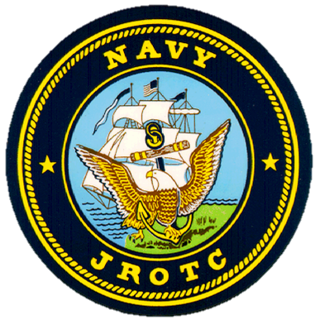
W.P. Davidson High School’s Navy Junior Reserve Officer Training Corps
Why you should consider joining the NJROTC program?

Slide 2
NJROTC benefits
Elective P.E. credit for all and P.E/ required Career Prep. credit for Freshmen.
Advanced pay/rank if you enlist in the military after high school (with 3 years credit in NJROTC).
Many opportunities to earn community service hours.
College scholarship opportunities
CO-OP opportunity for Seniors with City of Mobile Fire & Police Dept.

Slide 3
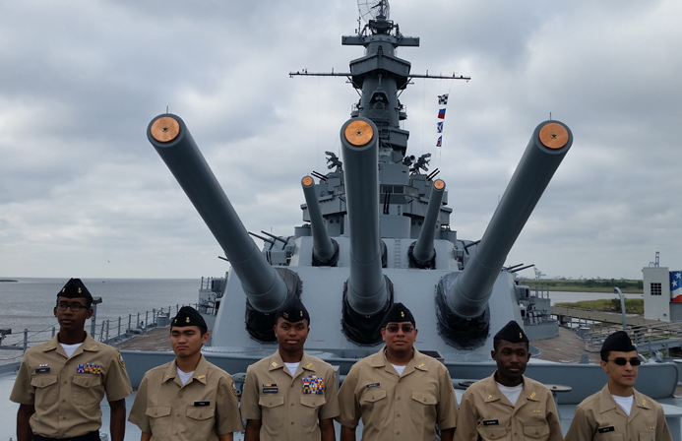
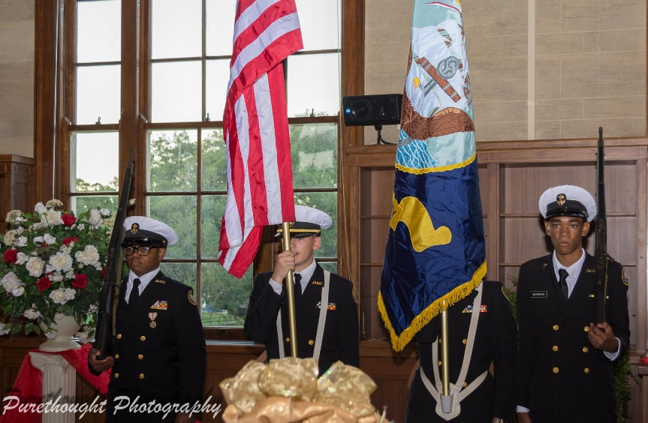
Njrotc Activities
Competitive team opportunities: Academics, Air Rifle, Color Guard, Drill Team, Exhibition Team, Honor Guard, and Physical Training.
Field Trips: Ship visits, Tulane University (Battle of New Orleans), Pensacola Gator Games, Community Service, Veterans day parade , STEM / Leadership summer camp .
Field Day: Sports activities and team building. Joint Army/Navy Military ball (9-12 )
Student leadership opportunities : Senior assistant teacher, Team commanders ,NJROTC rank opportunities (from Seaman Recruit to Master Chief Petty Officer and Ensign to Commander).

Slide 4
Frequently asked questions
Q: Do I have to join the military after I graduate?
A: NO, you are not obligated nor required to join any branch of service.
Q: When do I have to wear my NJROTC uniform?
A: On Thursdays, Field Trips, and Community Service.
Q: When do I wear my NJROTC T-Shirts?
A: On Fridays, and during Physical Training.
Q: What are the academic requirements?
A: Public Speaking, Naval Knowledge, and Current Events.
Q: Can I play sports and other extra curricular activities while enrolled in NJROTC?
A: YES, with the exception of football.

